Slide 1
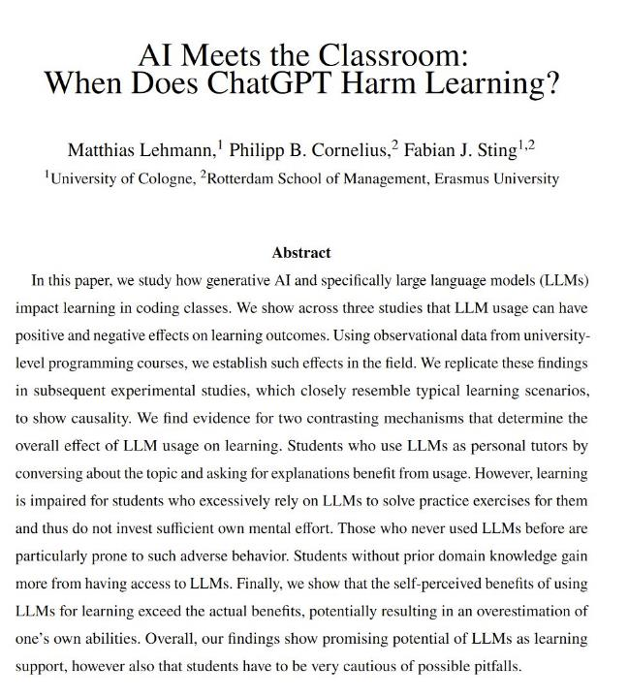
Notes:
https://x.com/emollick/status/1844789972462662049

Slide 2
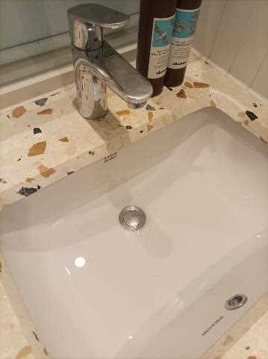
So, I’ve been exploring LLMs as much as possible and learn to use them
How do I open the thing that's closing the sink to allow the water to go down?

Slide 3
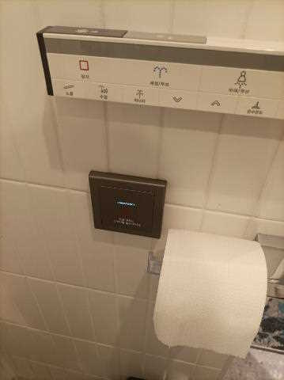
So, I’ve been exploring LLMs as much as possible and learn to use them
Translate everything I say into Korean.
“I accidentally pressed the emergency button in the bathroom. I just wanted to let you know that there is no emergency”

Slide 4
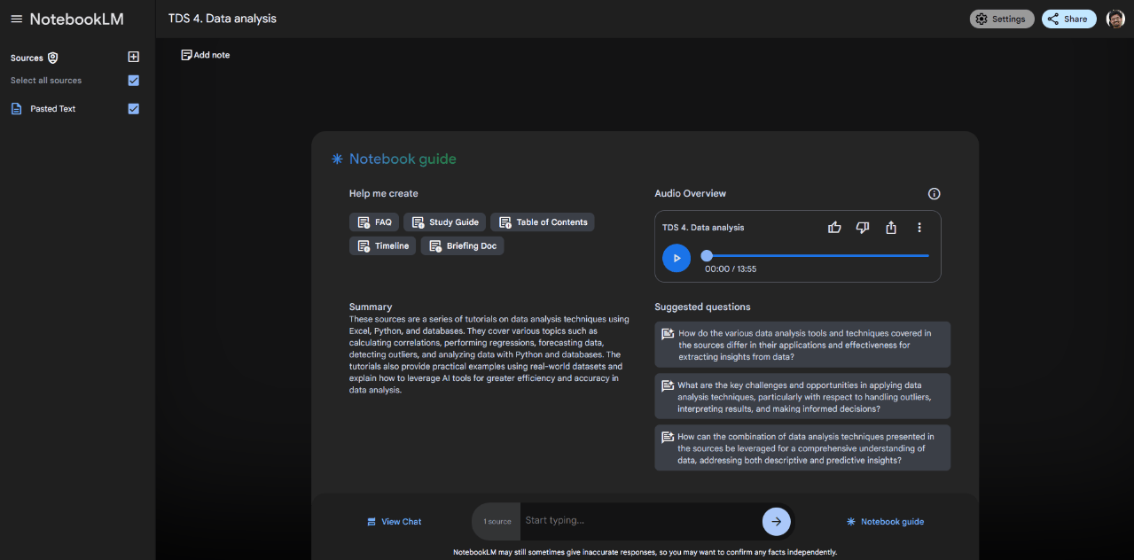
NotebookLM helps me listen to study material
Notes:
https://notebooklm.google.com/

Slide 5

LLMs help me create presentations

Slide 6
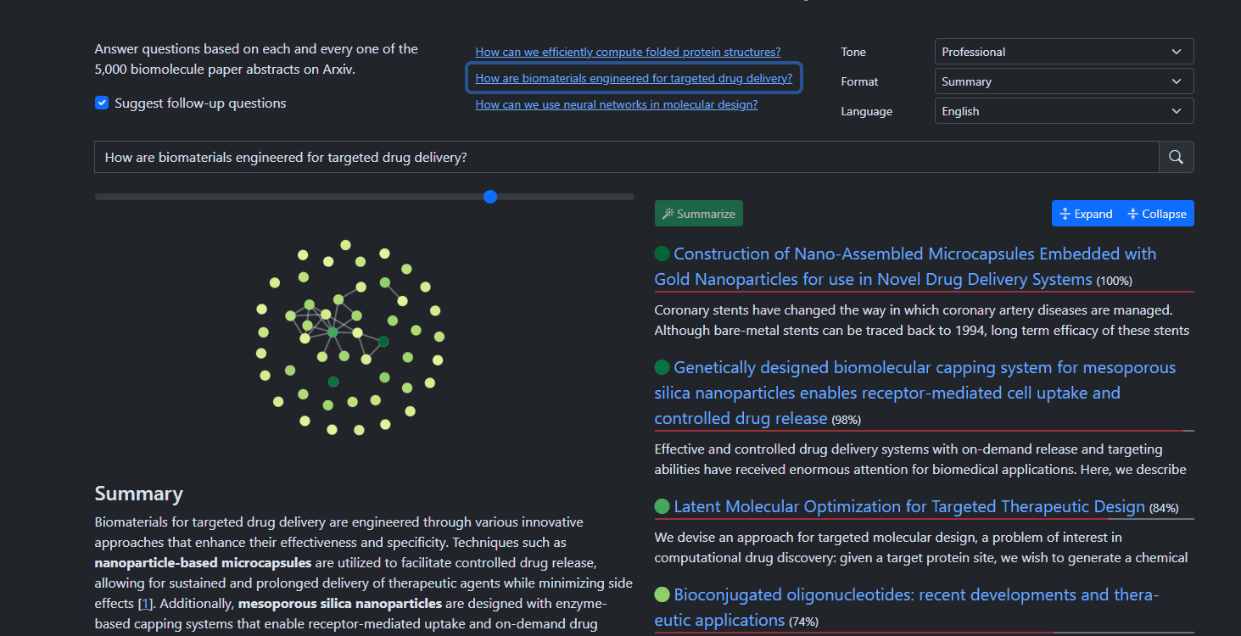
LLMs help me research by finding the most relevant questions

Slide 7
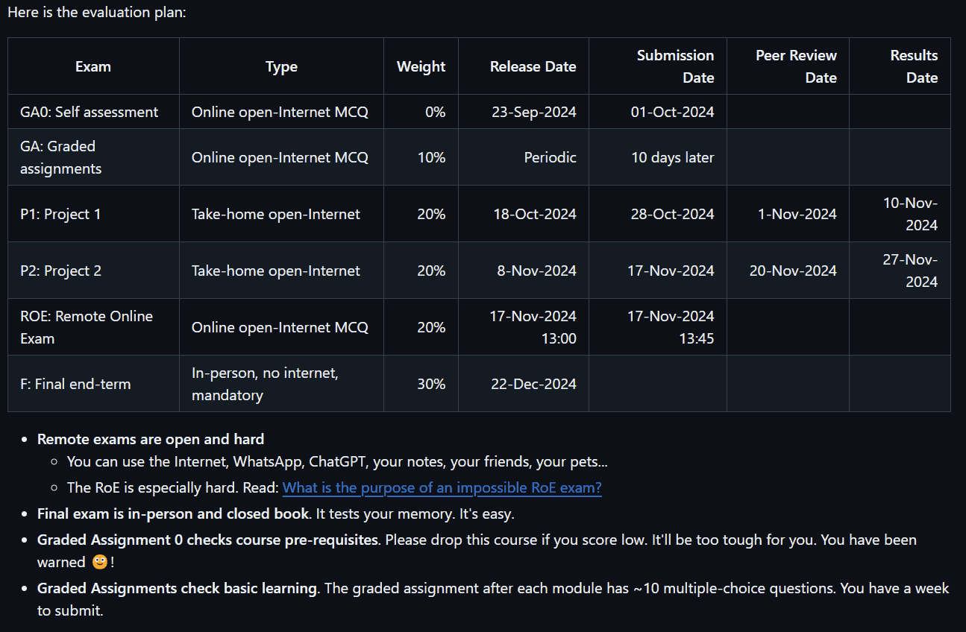
In my courses, I encourage students to use ChatGPT

Slide 8
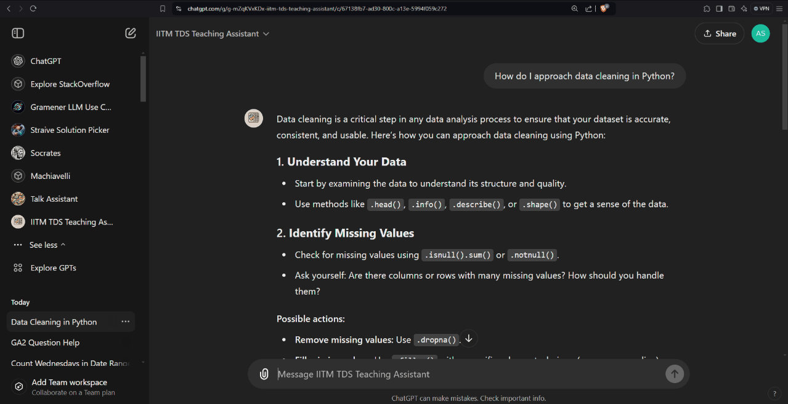
Custom GPTs reduces the load on my teaching assistants
Notes:
https://chatgpt.com/g/g-mZqKVxKDx-iitm-tds-teaching-assistant/c/67138fb7-ad30-800c-a13e-5994f059c272

Slide 9
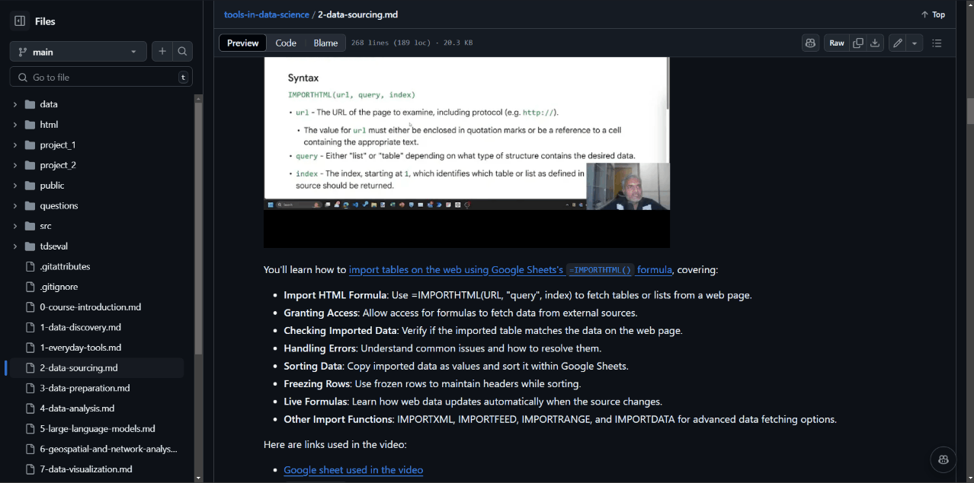
Whisper (and Gemini) created the summaries & subtitles for my videos
But not everything works smoothly all the time

Slide 10

Translating to Hindi and transcribing Hindi don’t work too well, though
Maintain an “Impossibility List” and revisit periodically

