Slide 1
Learning R
datameet.org
28 Jan 2011
www.s-anand.net

Slide 2
Why R?
A scripting language focused on statistics and visualisation.
Lots of packages, installable via a package manager.
Large and powerful community (Google, Amazon, Facebook)
Lots of documentation (but difficult to read)
How to learn?
R Videos: bit.ly/rvideos
Quick R: statmethods.net
Introduction to R: bit.ly/rintro

Slide 3
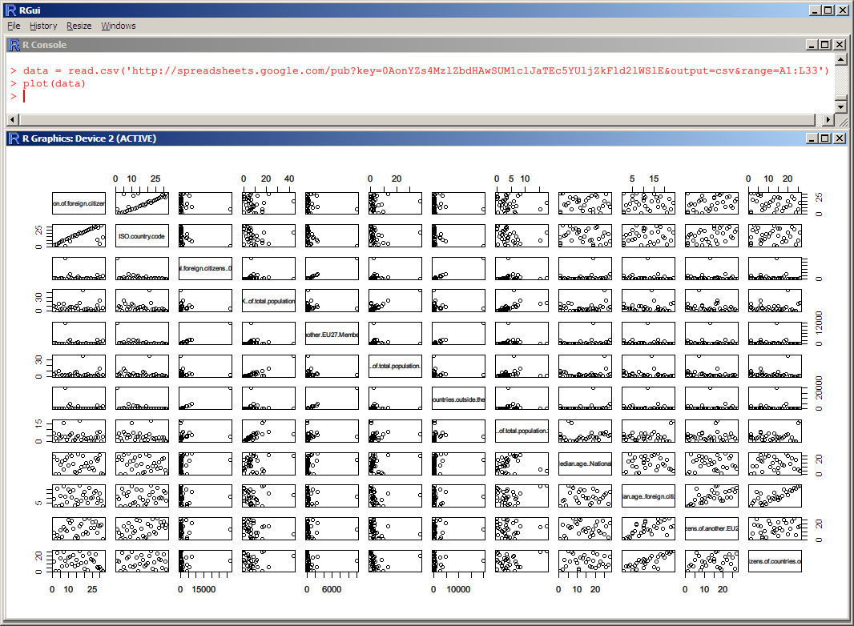
Show me R

