Slide 1
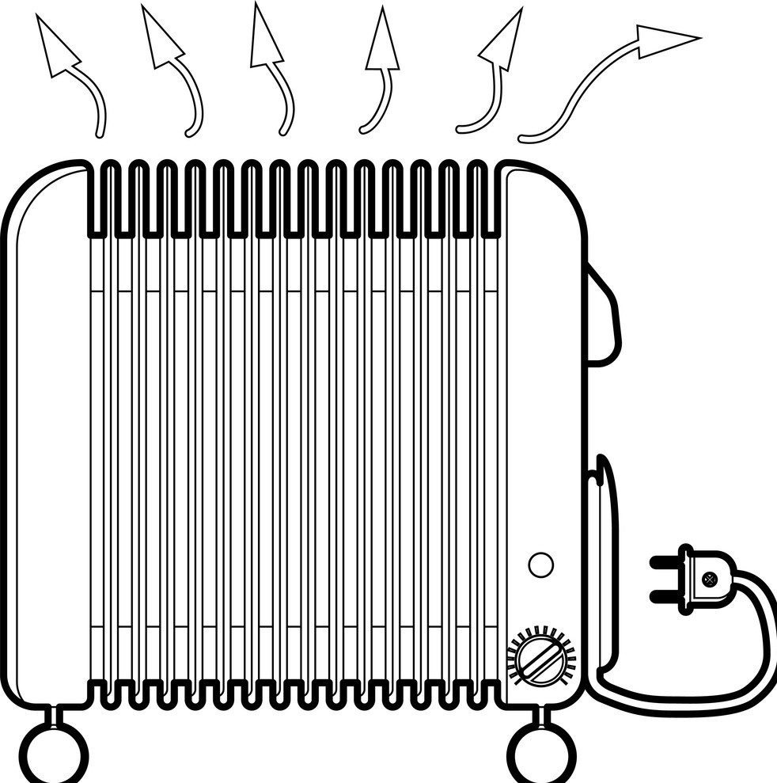
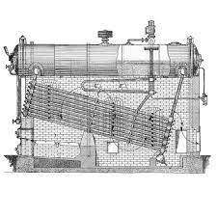





Fig.4: Solar thermal trough power plant with thermal storage
Reheater
Hot Tank
Superheater
Grid
Storage
Generator
Solar Collector field
Cold Tank
Turbine
Vaporizer
Cooling
Tower
Economizer
Condenser
HTF pump
Feedwater pump

