Slide 1


D2C-SKINCARE-BUSINESS-ANALYTICS
BY:SANA KHAN

Slide 2
Project Overview & Business Objectives
THE PROJECT : This project focuses on data analytics for a Direct-to-Consumer (D2C) Skincare brand.
Using SQL, we analyze the brand's database to find hidden patterns in sales, manage stock efficiently, and understand what customers love the most .
WHAT WE ARE ANALYZING
Customer Insights: Tracking new user registrations and buying habits.
Sales Performance: Finding top-selling product categories and total revenue by state.
Inventory Control: Monitoring stock levels to prevent products from going out of stock.

Slide 3
Database Architecture & Schema
ABOUT THE DATA
Our D2C Skincare database consists of 6 interconnected tables that track the complete customer and sales lifecycle.
CORE TABLES
customers: Stores customer profile details, locations, and registration dates.
products: Contains skincare inventory, prices, categories, and ratings.
orders: Tracks transaction dates, order status, and total billing amounts.
order _items: Records specific products and quantities bought inside each order.
❖reviews: Stores product feedback, star ratings, and text comments from users.
returns: Tracks product returns, reasons for return, and refund status.

Slide 4
Data Source & Project Methodology
DATA SOURCE : The dataset used in this project is real-time Direct-to-Consumer (D2C) skincare business data consisting of transactional and customer metrics.
ANALYTICAL APPROACH
Data Import: The data was imported directly from structured CSV source files into the SQL server.
Project Goal: Writing data-driven queries to extract actionable business intelligence without altering the core database structure.

Slide 5
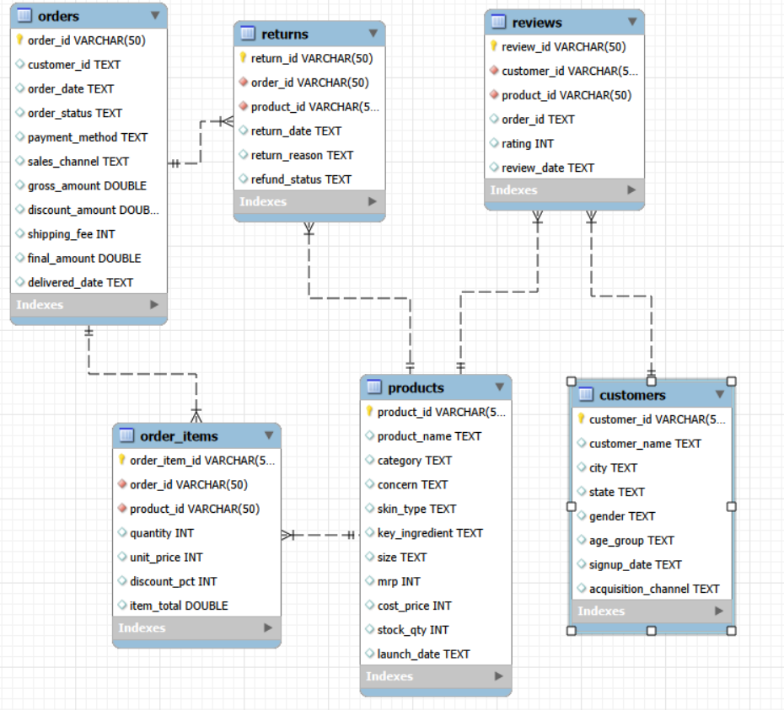
Database Schema

Slide 6
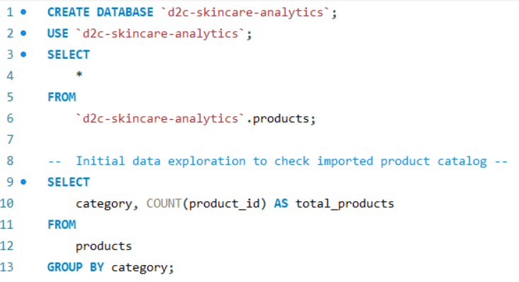
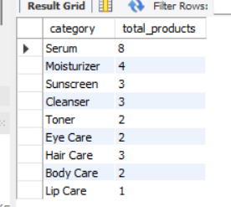
Initial Data Exploration :Product Catalog

Slide 7
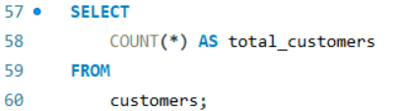
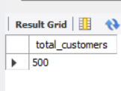
Question 1: count total numbers of customers.

Slide 8
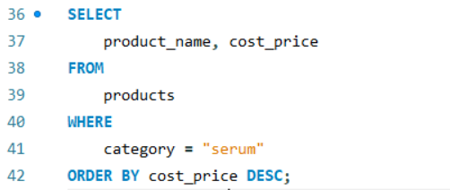
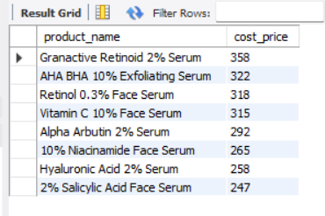
QUESTION 2: Display the Serums that have highest cost price.

Slide 9
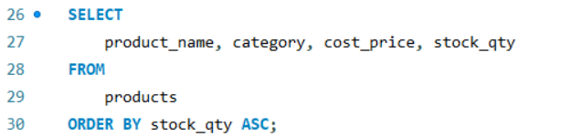
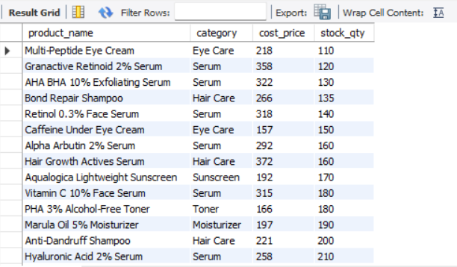
QUESTION 3: Display all products sorted by lowest stock at the top.

Slide 10
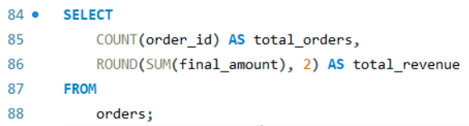

Question 4 :display total orders placed and their revenue.

Slide 11
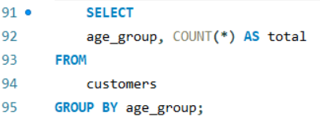
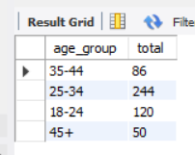
Question 5 : Count customers by age category.

Slide 12
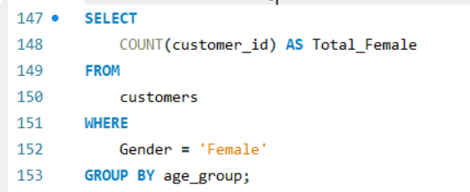
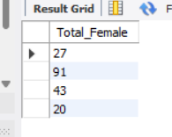
Question 6 : How many female are there.

Slide 13
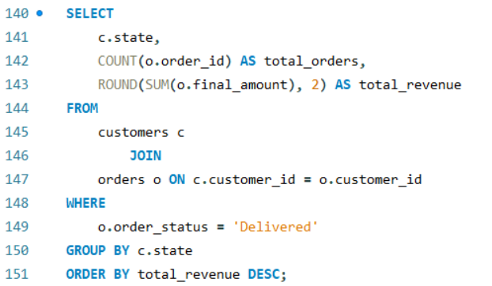
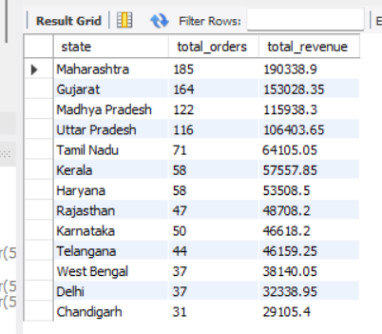
QUESTION 7 : Geographical sales breakdown (Total Orders and Revenue by State).

Slide 14
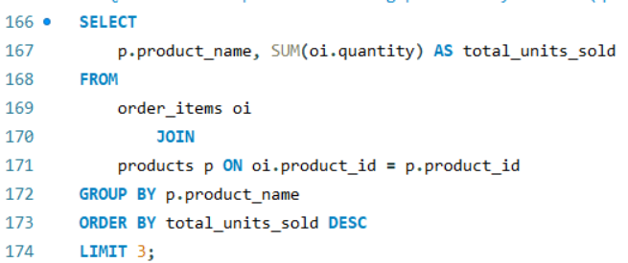
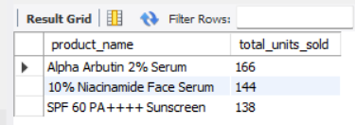
Question 8 :Top 3 best-selling products by volume (quantity sold).

Slide 15
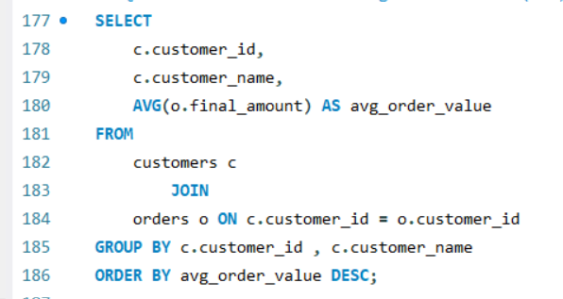
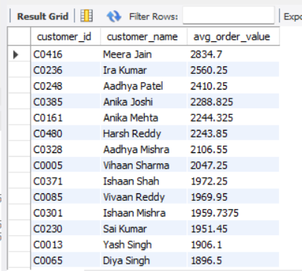
Question 9 : Calculate Average Order Value (AOV) per customer.

Slide 16
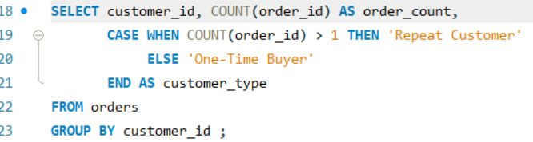
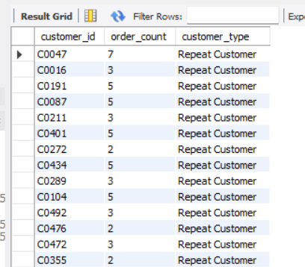
QUESTION 10 : Categorize users into Repeat Customers vs One-Time Buyers.

Slide 17
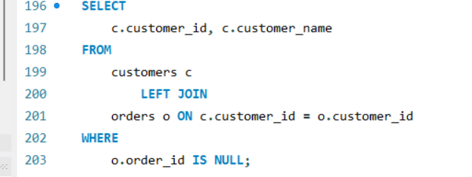
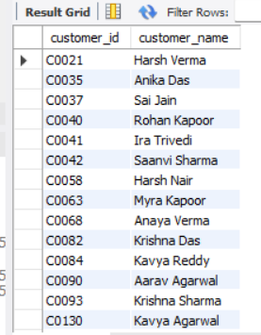
QUESTION 11 : Cart Abandonment Analysis (Inactive users with 0 purchases).

Slide 18
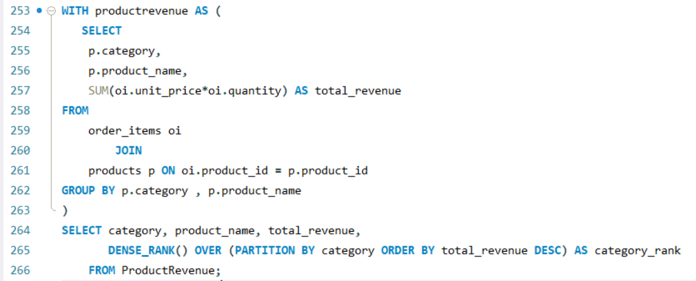
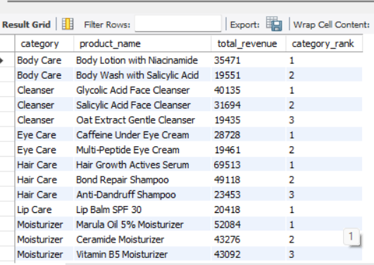
QUESTION 12: Rank products within each category by revenue generated.

Slide 19
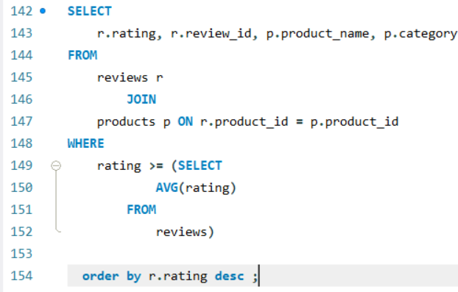
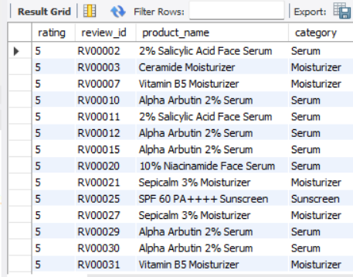
Question 13 :list all above-average rated product reviews.

Slide 20
Key Performance Indicator
Total Business Volume : 1250 Orders Placed | ₹11,22,034.65 Total Revenue Generated . This shows strong sales performance across all categories.
Customer Base: 500 Total Customers Registered . With 95% repeat customer rate, indicating high customer loyalty and retention.
Top Performing Category: Serum is the best-selling category . Alpha Arbutin 2% Serum sold 166 units and 10% Niacinamide Face Serum sold 144 units.
Core Demographics: 25-34 age group is the largest segment with 244 customers . This represents 49% of the total customer base, showing young adults are the primary buyers.
Geographical Reach: Maharashtra leads with 185 orders and ₹1,90,328 revenue . Followed by Gujarat with 164 orders, making West India the strongest market.
Inventory Health: Multi-Peptide Eye Cream has the lowest stock at 110 units. Granactive Retinoid 2% Serum is both highest cost at ₹358 and 2nd lowest stock at 120 units.

Slide 21
The core issues being addressed are :
To analyze customer demographics and purchasing behavior Focusing on the 25-34 age group and female customers to target marketing campaigns effectively.
To monitor inventory and product performance Identifying low-stock items and best-selling products like Serums to avoid stockouts and maximize revenue.
To evaluate regional sales performance Understanding why Maharashtra and Gujarat generate the highest revenue to replicate success in other states.
To assess product quality and customer satisfaction Tracking above-average rated reviews to ensure product quality and maintain high satisfaction scores.
To improve customer retention and reactivate inactive users With 15 inactive users identified, strategies are needed to convert them into active buyers. Thank you.

