Slide 1
House Price Predictions
By: Beatriz Ruiz, Gabriela Cortes, Sana Shaikh, Pavit Chawla, Abubakir Siedahmed

Slide 2
Introduction
The goal of our project is to predict Sale Prices for Houses in Iowa by applying our Data Science knowledge and using various techniques we have learned in the semester.
Our model will look at various features to predict the sale price such as:
Number of bedrooms in the house
The month and year the houses were sold
Lot area in square feet
Overall condition of the house

Slide 3
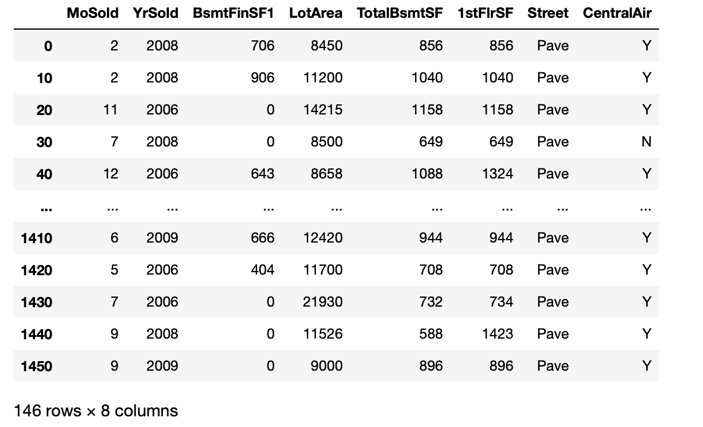
Data set
We are using the following data set from Kaggle:

Slide 4
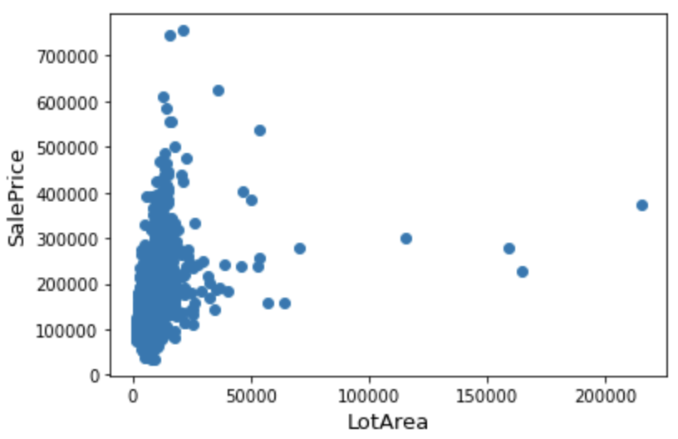
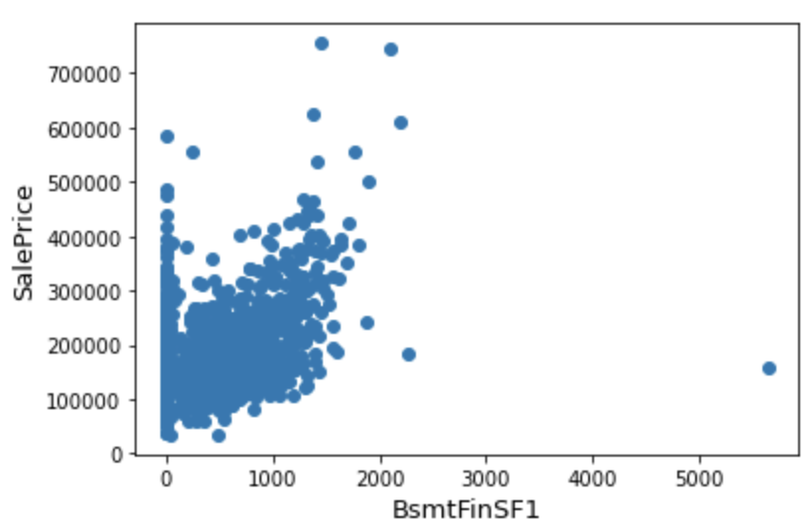
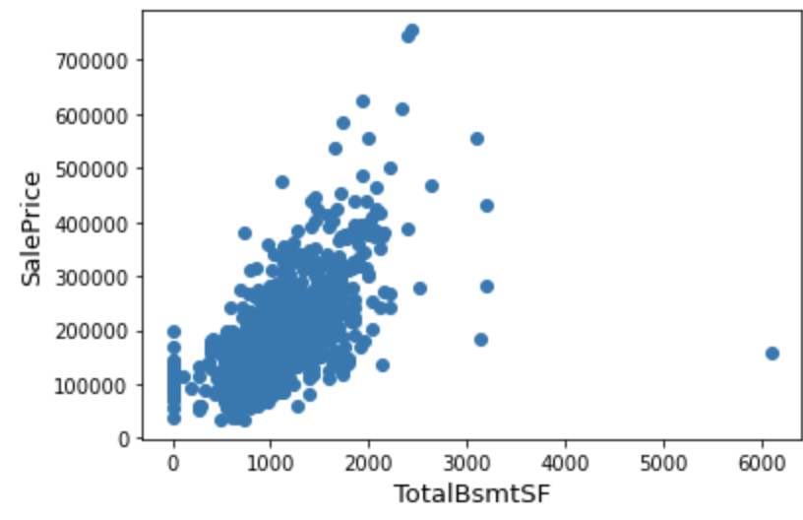
Numerical Features
LotArea, BsmtFinSF1, and TotalBsmtSF plotted against our label(SalePrice)

Slide 5
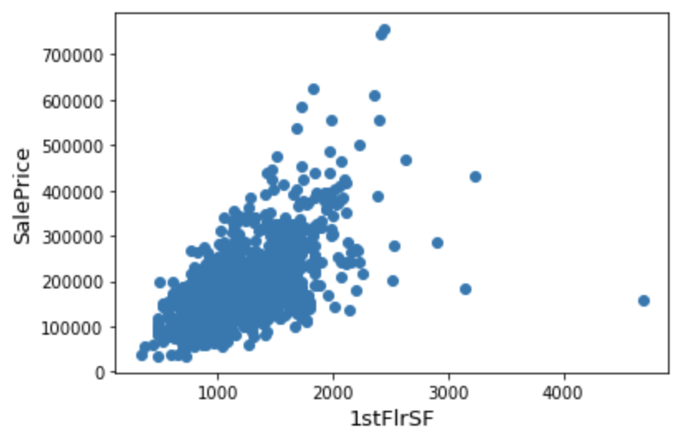
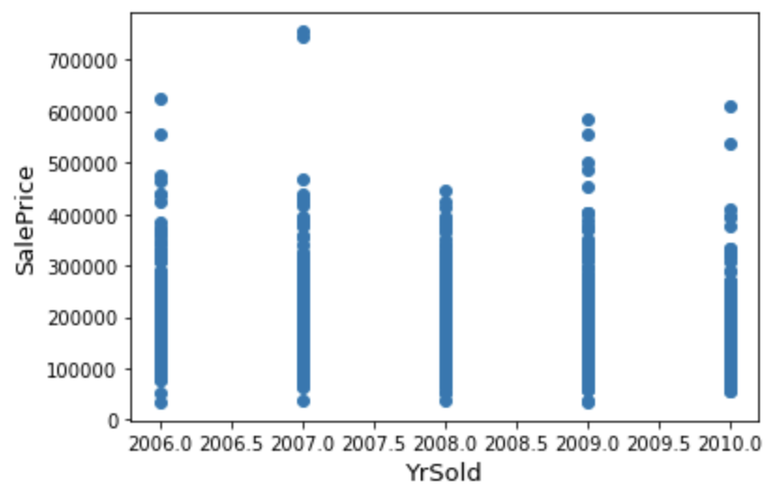
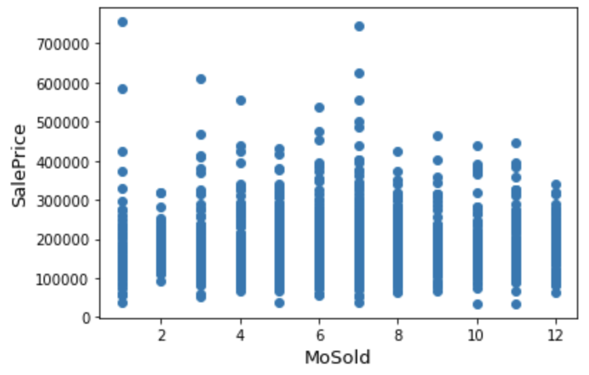
Numerical Features (continued)
1stFlrSF, YrSold, and MoSold plotted against our label (SalePrice)

Slide 6
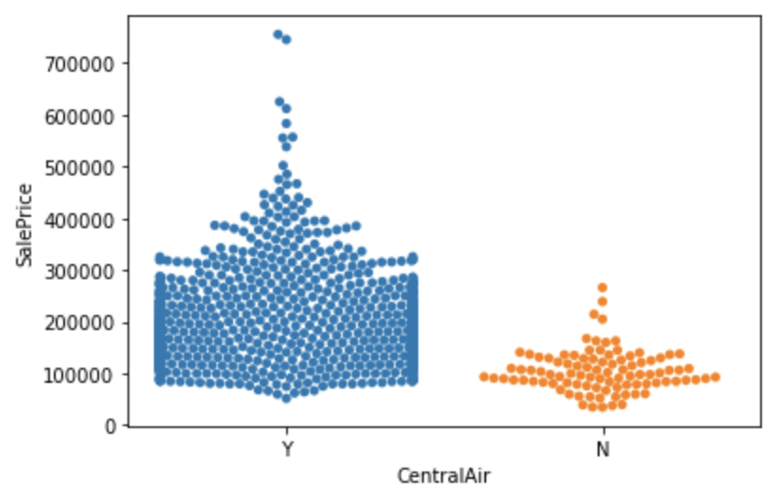
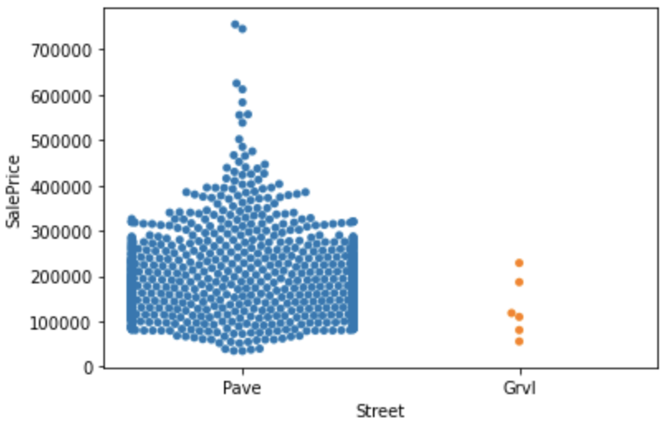
Categorical Features
‘CentralAir’ and ‘Street’ are two of our categorical features that we also plotted against our label (SalePrice)
These categorical features were chosen to bring additional value to our prediction results.

Slide 7
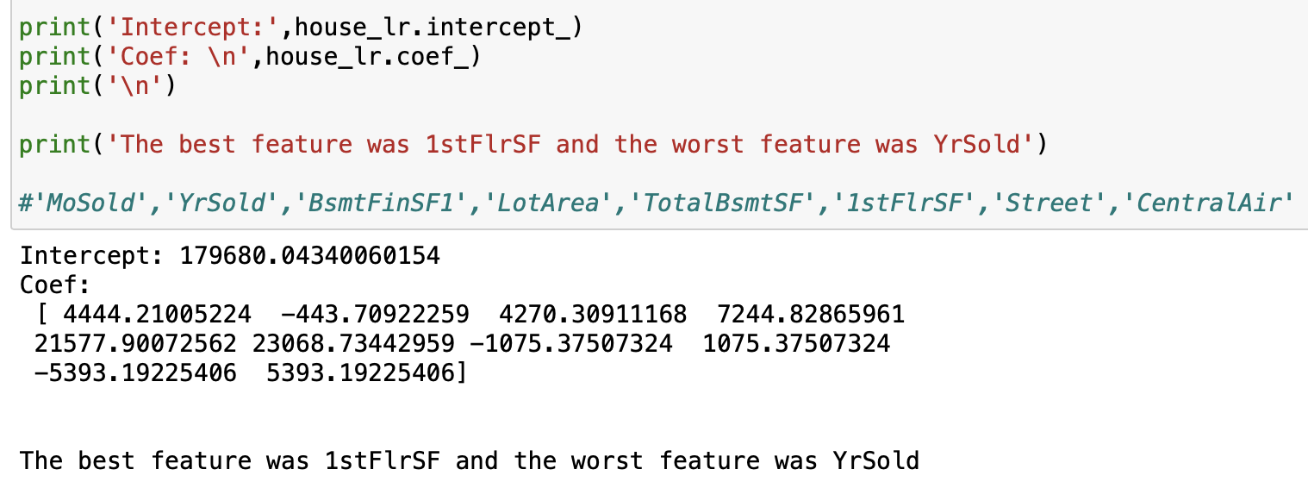
Linear Regression Best and Worst Feature
The best feature that we included in our data was 1st Floor Square Footage.
The worst feature was YrSold.

Slide 8

Best Feature Against our Label
After plotting all our features against the label (SalePrice), we found First Floor Square Footage to be our best feature.

Slide 9
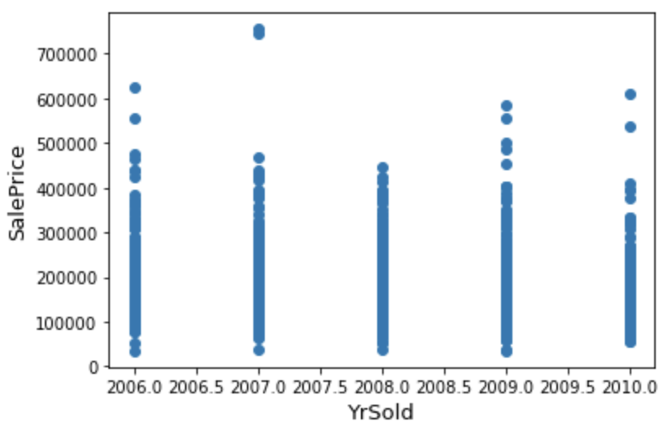
Worst Feature Against our Label
After plotting all our features against the label (SalePrice), we found YrSold to be our worst feature.

Slide 10
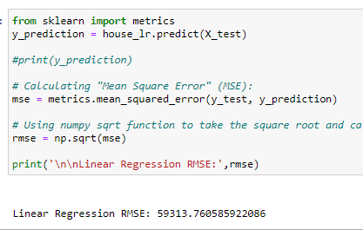
Linear Regression
Implemented Linear Regression algorithm:
Root mean square error is 59313.76

Slide 11
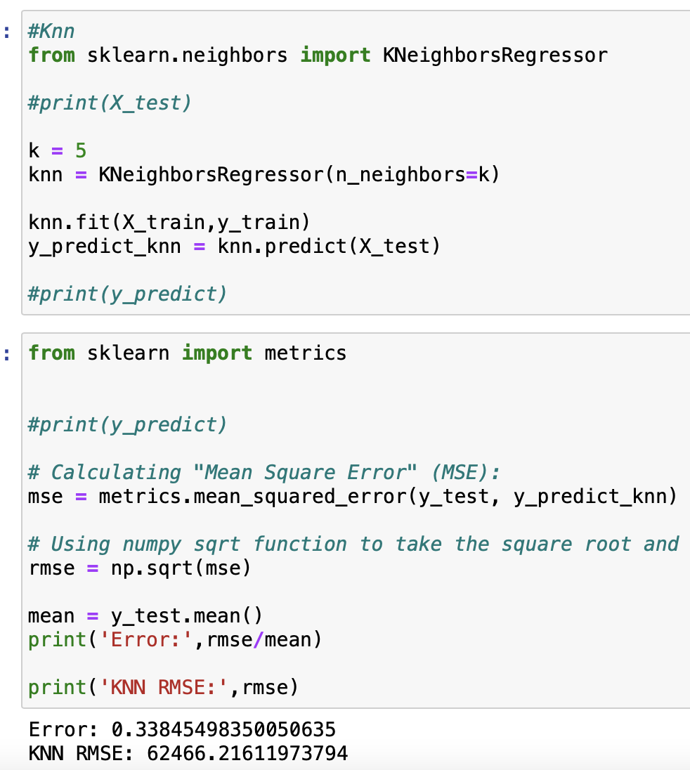
KNN
Implemented KNN algorithm with n_neighbors = 5
Root mean square error is 62466.22

Slide 12
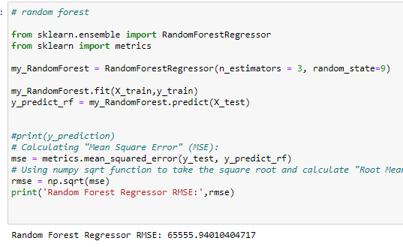
Random Forest
Implemented Random Forest algorithm with n_estimators of 3 and random state of 9
Root mean square error is 65555.94

Slide 13
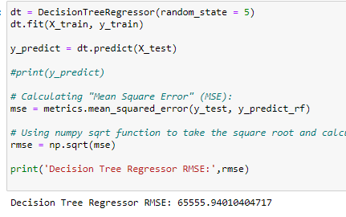
Decision Tree
Implemented Decision Tree algorithm with a random state of 5
Root mean square error is 65555.94
Same rmse as random forest

Slide 14
Cross Validation
Linear Regression | 59617.63
KNN | 61025.45
Random Forest | 63716.70
Decision Tree | 79676.10
10-fold cross validation for all algorithms

Slide 15
Comparing RMSE values
Algorithms | RMSE | Cross Validation RMSE
Linear Regression | 59098.06 | 59617.63
KNN | 62466.22 | 61025.45
Random Forest | 65555.94 | 63716.70
Decision Tree | 65555.94 | 79676.10
Decision Tree algorithm has the same RMSE as the Random Forest algorithm and the highest cross validation RMSE value from all the algorithms.

Slide 16
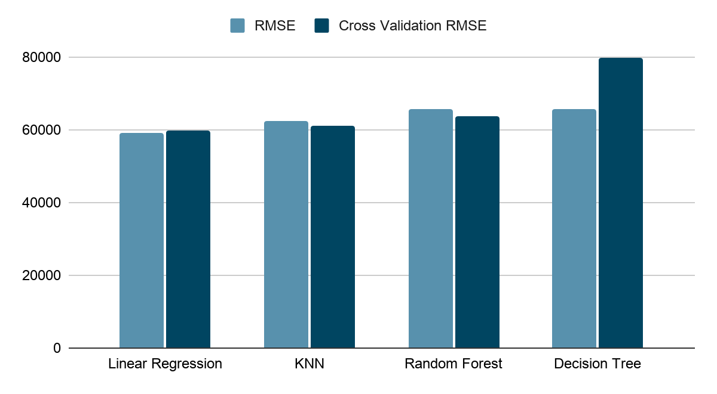
Visual Comparison
Notes:
KNN values need to be fixed in this chart.

Slide 17
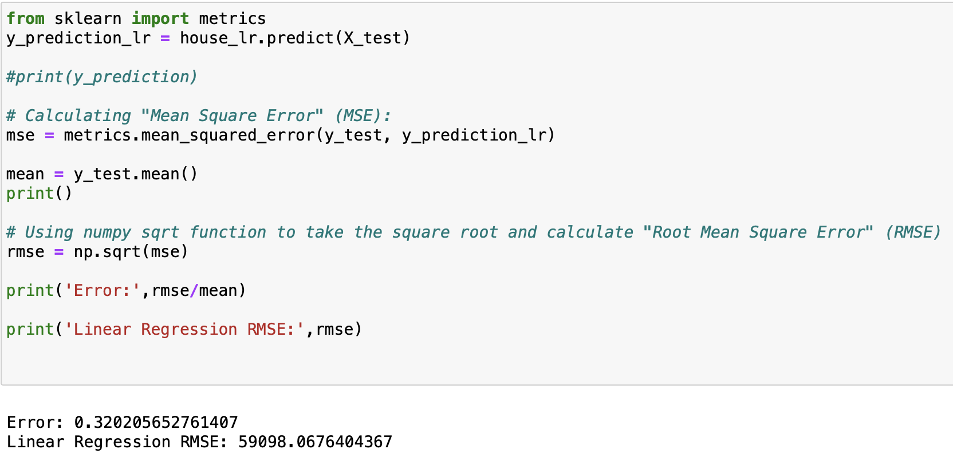
Best Algorithm for our prediction model
The best algorithm for our
prediction model was Linear
Regression. From calculating
RMSE, the error was at the lowest
with 32% error.

Slide 18
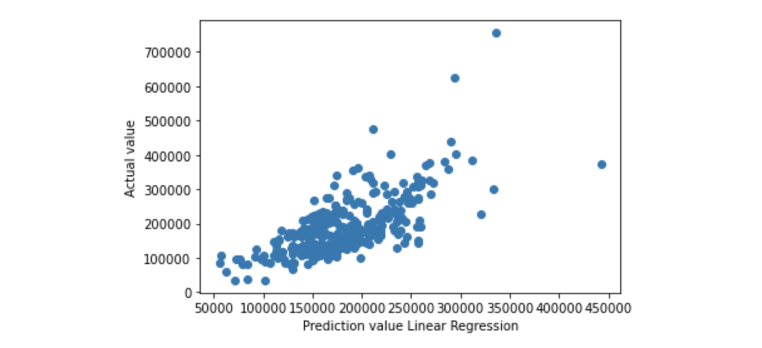
Goal: Sale Price for all house prices
We plotted our predictions against
the label SalePrice. We saw that our
prediction and label values were close.

