Slide 1
COVID-19 World Vaccine Adverse Reactions
Prepared by:
Christian Esqueda
Sana Shaikh
Funing Yang
Gauri Phatale
Prof. Navid Amini
Department of Computer Science
California State University, Los Angeles

Slide 2
Introduction & Significance
Our project aims to find patterns within the Vaccine Adverse Event Reporting System's (VAERS) data regarding the COVID-19 vaccine and the adverse reactions reported by the patients who have participated in receiving the vaccine.

Slide 3
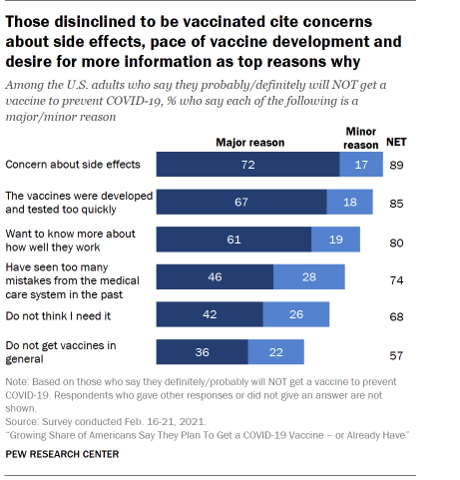
Introduction & Significance
Our findings from this report are significant due to our current predicament with the pandemic and the widespread contrasting opinions about the experimental vaccine, which can easily cause confusion and misinformation for those pursuing the vaccination. We aim to find and visualize data that makes it easier to know the risks involved in participating in the vaccine and which groups of people have higher stakes in participating than others.

Slide 4
Target Audience
The target audience are the people who are considering vaccination and need to know the potential risks and side effects. Utilizing the feedback data, they can better prepare themselves.
It can also be the people who are already vaccinated and looking to confirm or deny whether the negative effects they experienced are associated with the vaccine.

Slide 5
About Dataset
The dataset contains three comma separated values files with information such as the following: patient gender, patient age, symptoms experienced from the vaccine, vaccination date, whether or not the patient died from an adverse reaction, the US State where vaccine was administered, and vaccine manufacturer.
The dataset titled COVID-19 World Vaccine Adverse Reactions can be found in the website www.kaggle.com.

Slide 6
About Dataset
The dataset contains 5,352 rows of data.
Our group plotted different categories of data from the dataset using Tableau software to look for patterns and connections within the data. By using bar charts, treemaps, symbol maps and other visualization tools, we were able to produce knowledge that can be helpful for people with concerns about receiving or not receiving the COVID-19 vaccine at this time.

Slide 7
Dataset Overview
3,358 out of the 5,352 patients are Female.
1,681 patients are Male.
Reported reactions range from mild symptoms such as dizziness and fatigue to more severe symptoms such as swelling, seizures, and painful respiration.

Slide 8
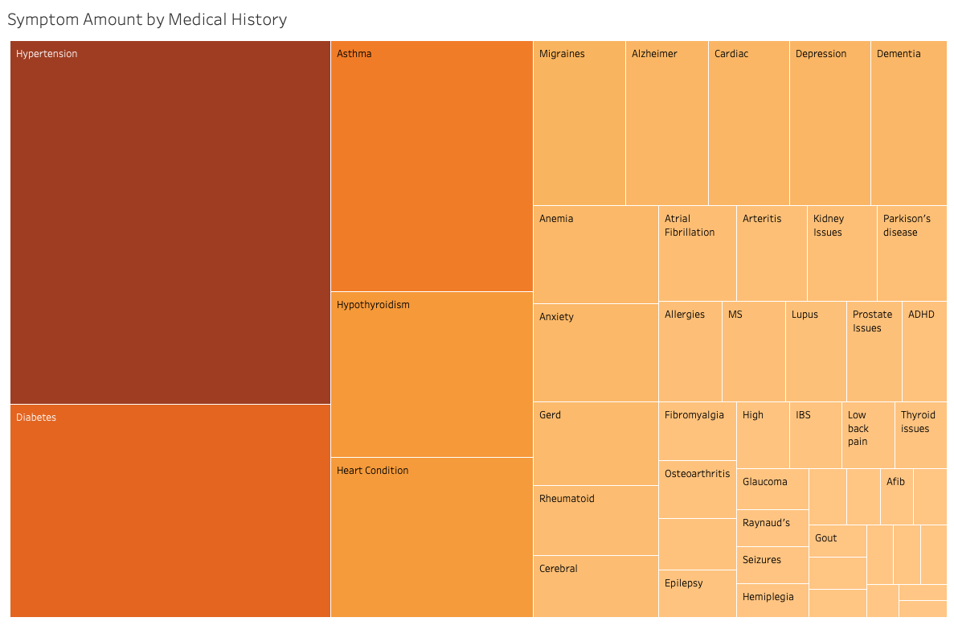
Symptom Amount by Medical History
Goal: To find out which groups of people reported having symptoms according to their reported medical history. According to our data, the three largest groups with reported adverse reactions were those with Hypertension issues, Diabetes issues, and asthma.
Encoding:
Darker shade of orange to highlight higher amount and lighter shade for smaller amounts
Size increases with count, decreases with smaller count.

Slide 9
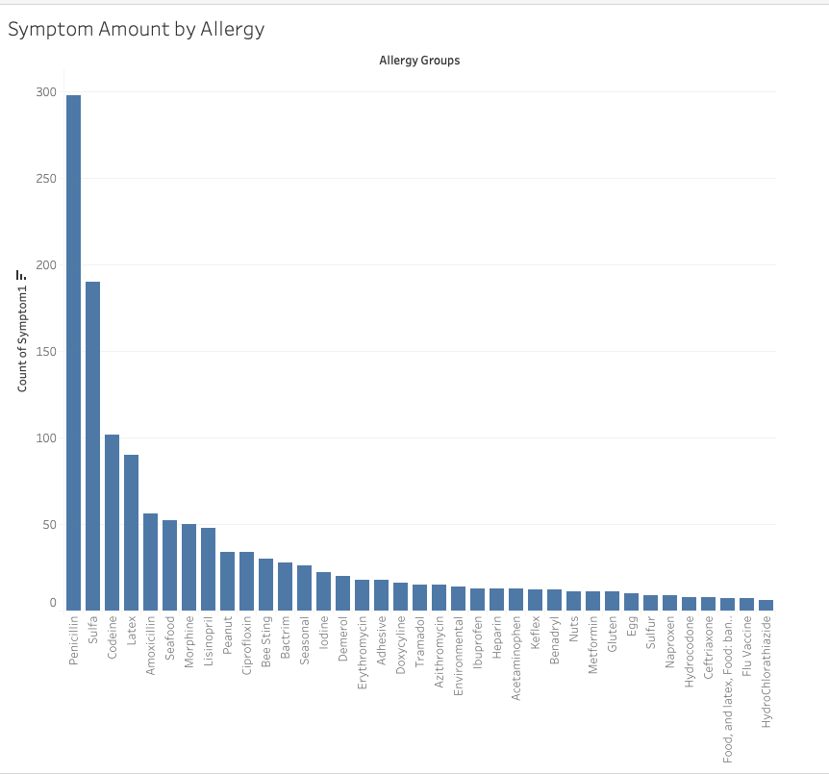
Symptom Amount by Reported Allergy
Goal: To find out which groups of people reported having symptoms according to their reported pre-existing allergies. According to our data, the three largest groups with reported adverse reactions were those with Penicillin, Sulfa, and Codeine allergies.
Encoding:
Single shade of blue was used in all of the bars in the chart.
Size increases with count, decreases with smaller count.

Slide 10
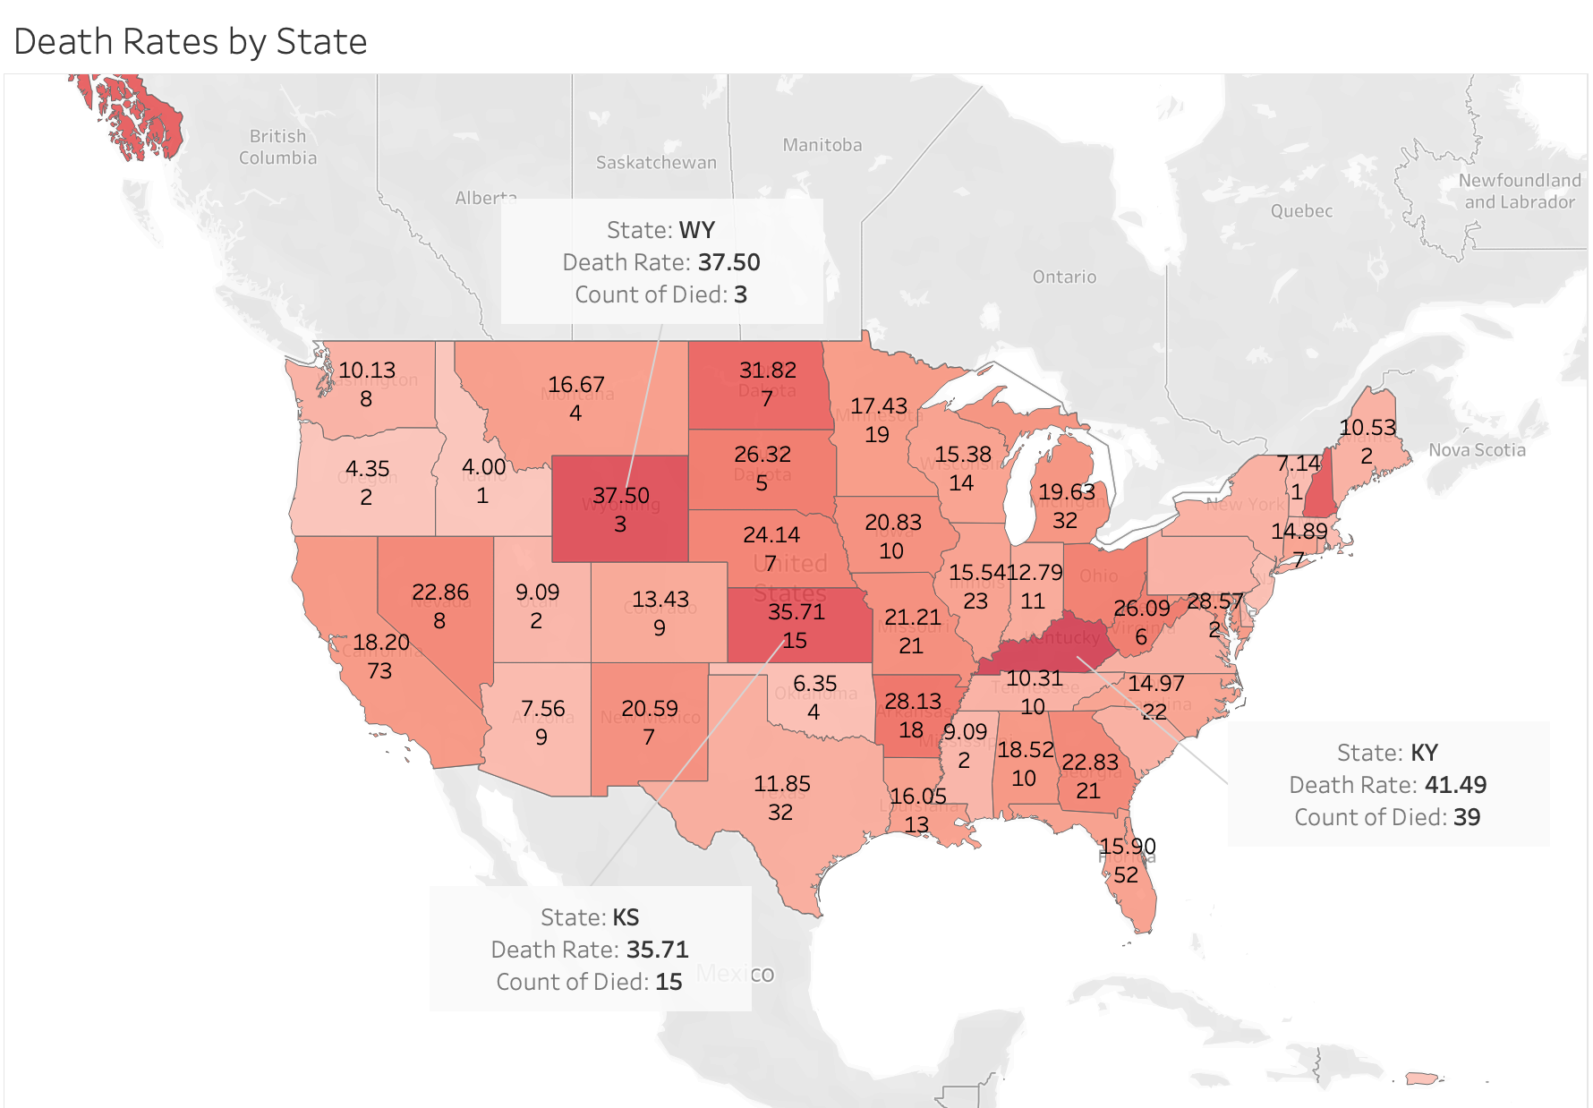
Death Rates by State
Goal: To find out the number of severe adverse reactions that resulted in deaths in each state along with the death rates. According to our data, the top three states with the highest death rates were Kentucky, Wyoming, and Kansas.
Encoding:
Darker shade of red to indicate a higher number and lighter shade for a smaller number
Each state labeled with rate of death (in percentage) and number of deaths reported in that state

Slide 11
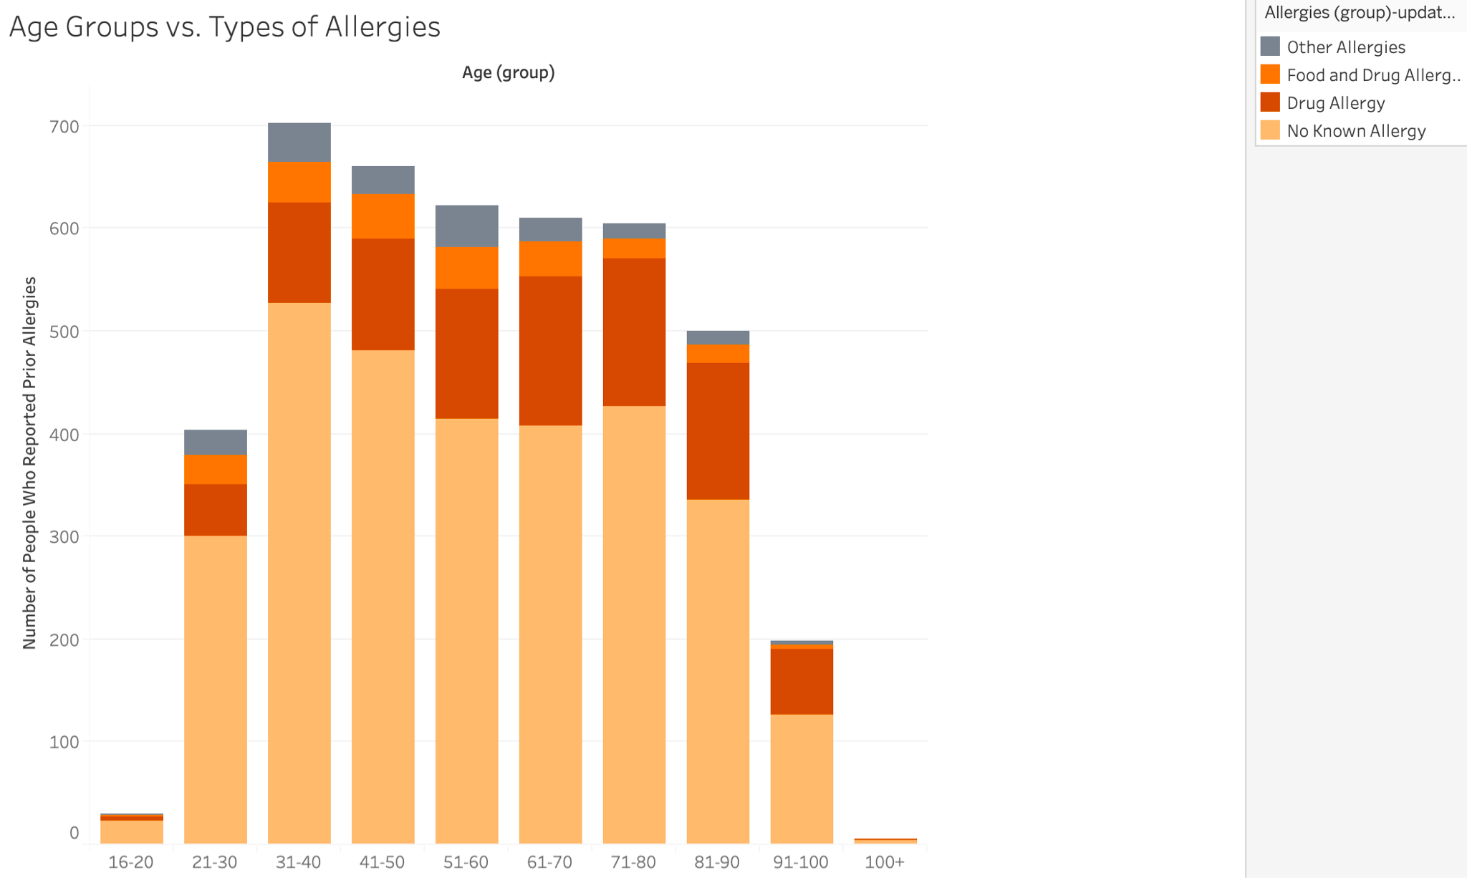
Most Affected Age Groups
Goal: To find out the most common types of allergic reactions according to different age groups. Our data shows a large number of people reported to have no known prior allergies, while some had a known drug allergy and others had both food and drug allergies.
Encoding:
CVD-friendly Stacked Bar Chart showing a part-whole comparison between different types of allergies
The horizontal-axis shows the distribution of affected age groups

Slide 12
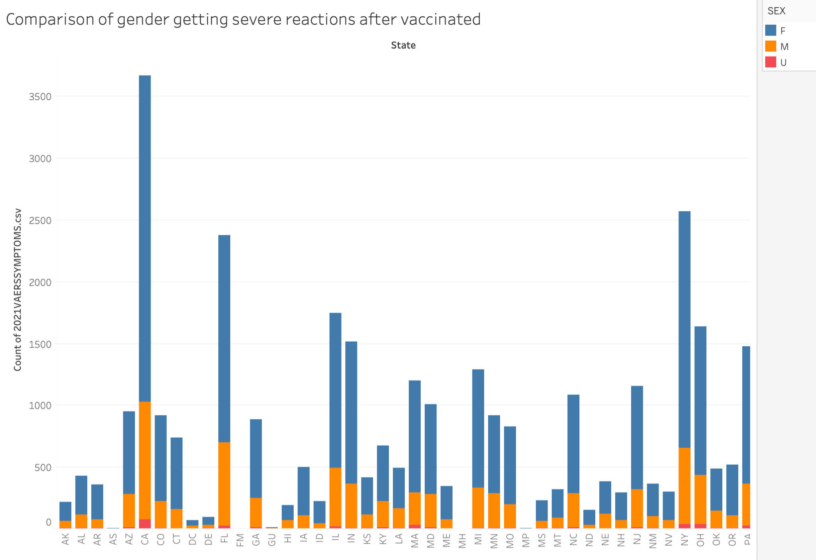
Gender-wise comparison
Goal: To compare genders getting severe adverse reactions after getting vaccinated categorized state wise. According to the data, females got more adverse reactions than men almost in all the states.
Encoding:
Blue color shows symptoms reported by female.
Orange color shows symptoms reported by male gender.
Red color shows symptoms reported by unknown.

Slide 13
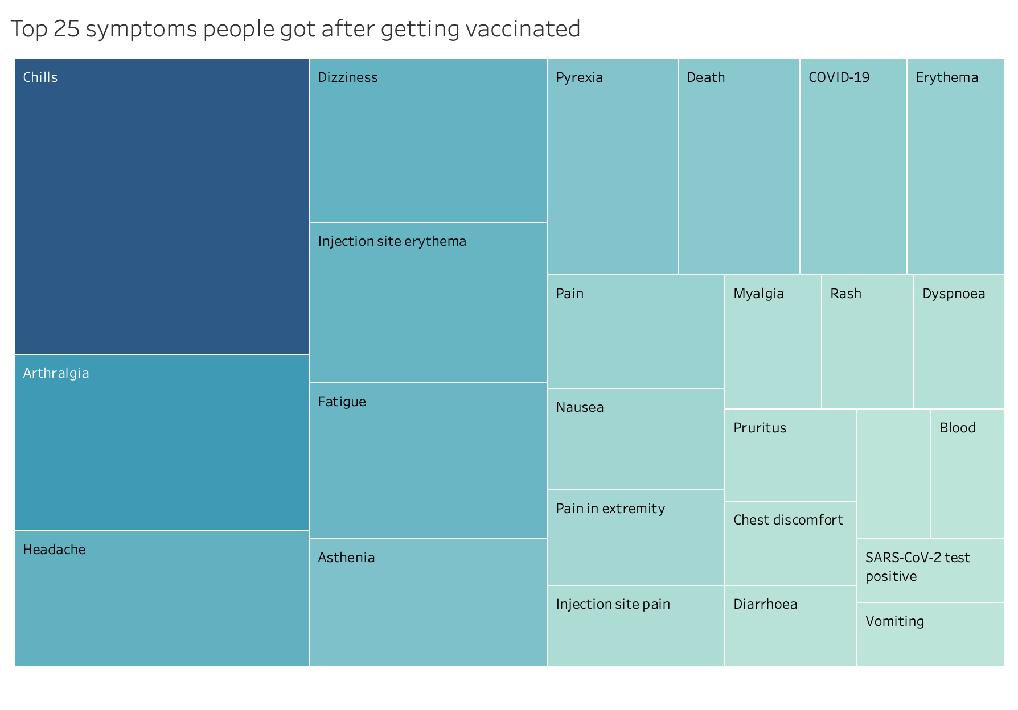
Top 25 symptoms
Goal: To display top 25 adverse reactions reported by people who got vaccinated. According to the data, most of the people got chills, headache, dizziness etc
Encoding:
Blue color shows symptoms reported by people after getting vaccinated.
As the blue color fades, the number of symptoms reported decreases.

Slide 14
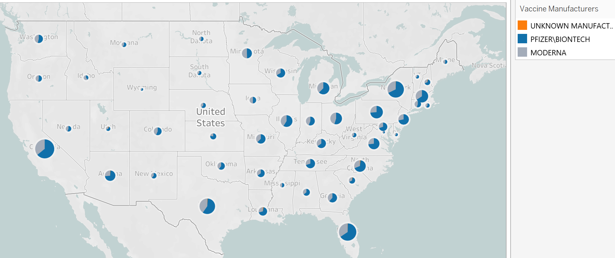
Manufacturer’s Popularity
Goal: This symbol map displays the share of vaccines by different manufacturers used in the States. According to our data, the Pfizer/Biontech vaccine is overwhelmingly more popular across most states.
Encoding:
The blue slice of each pie indicates Pfizer/Biontech as the manufacturer.
The grey slice of each pie indicates Moderna as the manufacturer.
The small orange slice of each pie indicates unknown manufacturers.

Slide 15
Live Demo
Tableau Desktop

Slide 16
Summary of Findings and Insights
The largest 3 categories of people with medical history account for less than 15% of people reporting adverse reactions.
Kentucky, Wyoming, and Kansas had the highest number of death rates.
Most people who reported an allergic reaction after receiving the vaccine had no known prior allergies.
Pfizer’s vaccine is more popular all around.
Female gender seemed to get more severe adverse reactions as compared to males.

Slide 17
Extensions and Future Work
The data and the predictions will get better as more people get vaccinated in the future so that more data can be generated and can be analysed.

Slide 18
Reference
https://www.kaggle.com/ayushggarg/covid19-vaccine-adverse-reactions
https://www.pewresearch.org/science/2021/03/05/growing-share-of-americans-say-they-plan-to-get-a-covid-19-vaccine-or-already-have/

