Slide 1

Tic-Tac-Toe
Discover how a simple game reveals deep strategy and rich history.

Slide 2
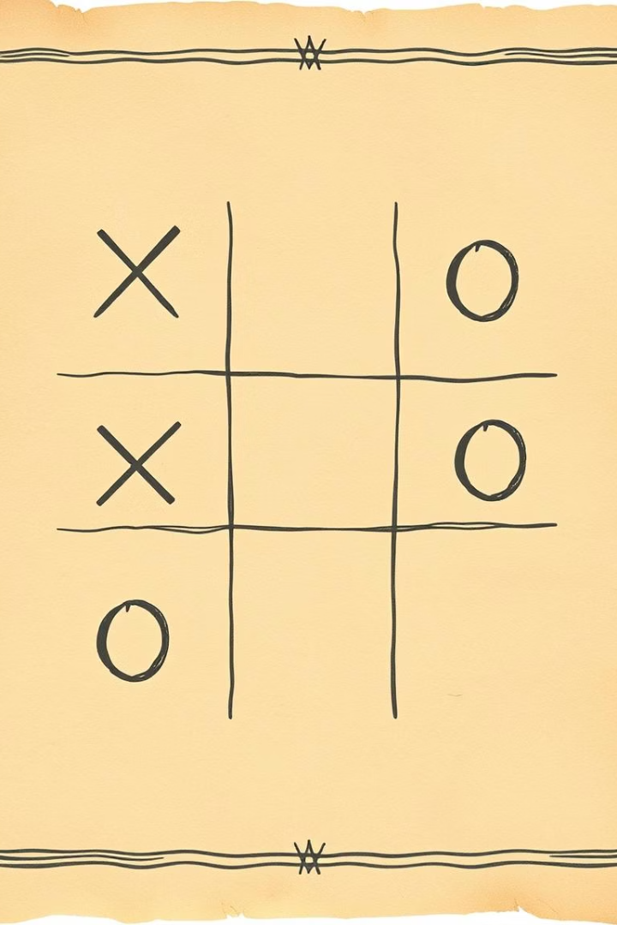
A History of X's and O's
Ancient Origins
Roots date back to Egypt, around 1300 BC.
Roman Times
Known as "Terni Lapilli" with early grid rules.
19th Century
Called "Noughts and Crosses" in England.
First Computer Game
OXO in 1952 marked digital gameplay beginnings.

Slide 3
Game Mechanics
Players & Grid
Winning Condition
Draw Situation
Two players, X and O, alternate turns on a 3x3 grid.
Place three marks in a row horizontally, vertically, or diagonally.
Full board with no winner results in a tie or "cat's game".

Slide 4
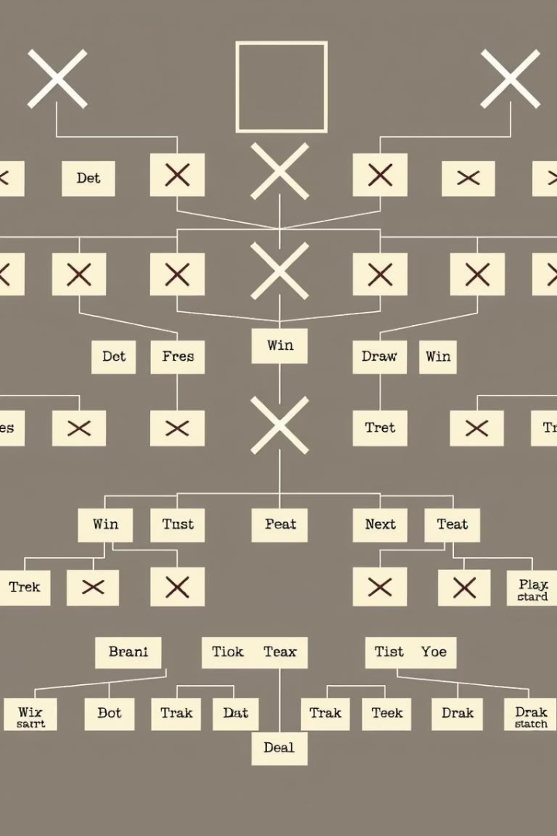
The Math of Tic-Tac-Toe
Possible Games
Unique Games
255,168 total game sequences.
26,830 when ignoring symmetry and rotations.
Optimal Play
Leads to a guaranteed draw.

Slide 5
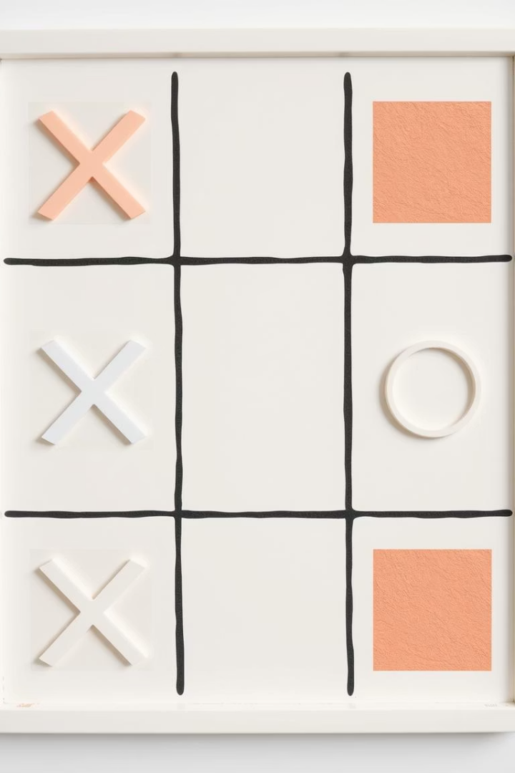
Basic Strategies: The Opening Move
Center
Strongest position; four winning lines involve it.
Corners
Next best, each part of three winning lines.
Edges
Weakest; only involved in two winning lines.

Slide 6

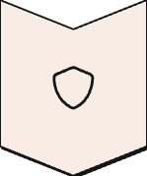
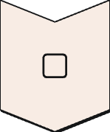
Basic Strategies: Blocking
Defense Focus
Prioritize blocking your opponent's winning chances.
Immediate Blocking
Block any two marks in a row before they win.

Slide 7
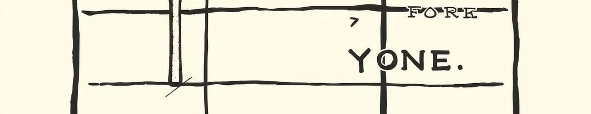
Basic Strategies: Forking
Dual Threats
Opponent's Dilemma
Create two winning options simultaneously.
They can block only one, allowing your win.

Slide 8
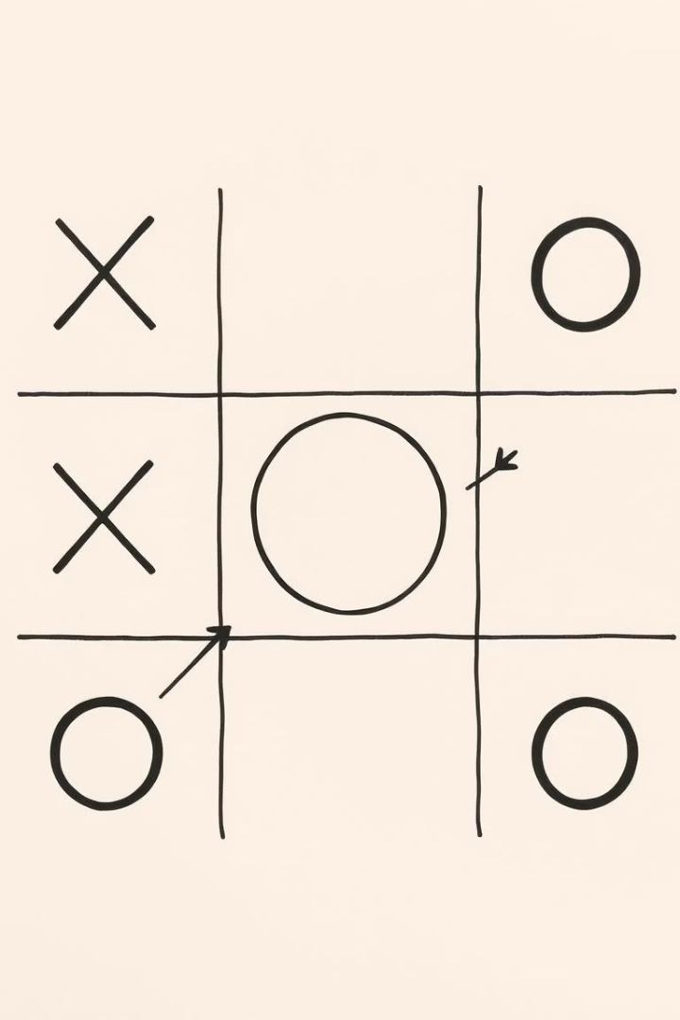
Basic Strategies: Trap Setups
1
Force Opponent
Drive them toward specific moves.
2
Secure Win
Set traps that guarantee victory.

Slide 9
Advanced Strategies: Pattern Recognition
Recognize Situations
Plan Ahead
Predict Opponent
Identify common board states quickly.
Think multiple moves in advance.
Anticipate and counter their responses.

Slide 10
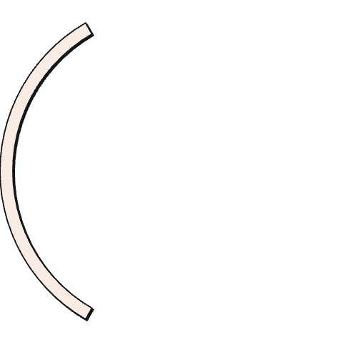
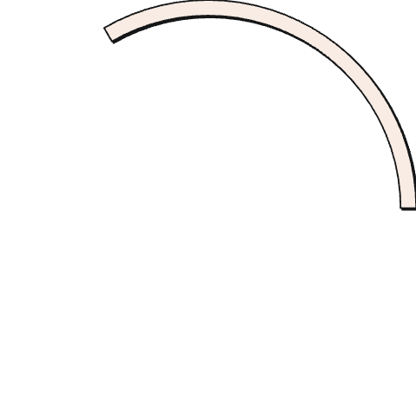
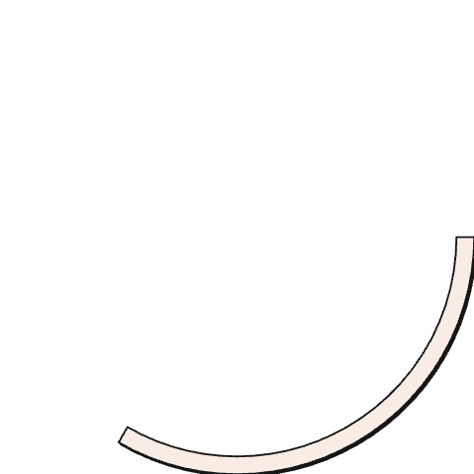
Conclusion: Simple, Yet Complex
2
Complex Strategy
Requires careful planning and skill.
Simple Rules
1
Easy to learn for all ages.
Enduring Fun
Enjoyed across centuries worldwide.
3

