Slide 1

BREAST POWER Awareness - Model on Breast Cancer
By Sana Sharma

Slide 2

Introduction
Significant public health problem
Most common cancers
Early diagnosis can improve a chance to survival
Accurate classification of tumors –
Malignant groups
Benign groups
Machine Learning for Breast Cancer Predictions

Slide 3

Motivation
October is known as the Breast Cancer Awareness month
Second leading cause of cancer deaths among U.S. women
Develop a machine learning algorithm
Available on UCI Machine Learning Repository, sklearn and Kaggle
The dataset was created by Dr. William H. Wolberg

Slide 4
Goal
The goal is to answer the following questions through our analysis -
What is the accuracy of the training set?
What is the accuracy of the test set?
What is the precision of the test set?
What is the recall of the test set?
What is the area over the curve of the test set?
What is the F1 score of the test set?
Hypothesis - I predict that most of the feature's values are near to 0. Another hypothesis is that, both the classes(M, B) depends on the features values and feature values are different for each class.

Slide 5

Proposed Method
Exploratory data analysis and machine learning techniques
SciKit Learn, Classification Algorithm
Confusion Matrix
Dataset Information
Breast Cancer Wisconsin dataset, created by Dr. William H. Wolberg
sklearn.data website, UCI Machine Learning website and Kaggle.
It has 569 entries and 30 columns.
Attribute Information:
ID number
Diagnosis (M/0 = malignant, B/1 = benign)
Ten real-valued features are computed for each cell nucleus

Slide 6
Experiments
Jupyter notebook – python programming language
Exploratory analysis
NaN values
Dataframe Info, Attributes
Proposed Method
RandomForestRegressor
DecisionTreeRegressor

Slide 7
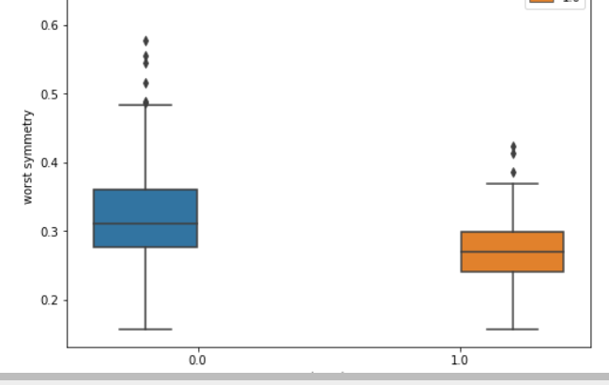
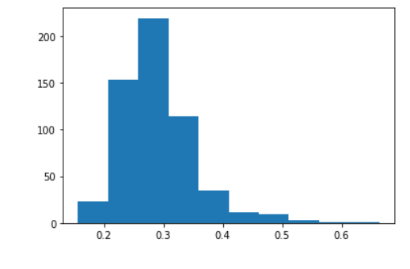
Results & Conclusion
The results to the goal questions are below -
The accuracy of the test set: 0.9300699300699301
The precision of the test set: 0.9424867021276595
The recall of the test set: 0.9125
The area over the curve of the test set: 0.9125000000000001
The F1 score of the test set: 0.9456521739130435
Proof of Hypothesis -
most of the values lie between 0.2 to 0.35; therefore, hypothesis is true.
we observe that the Worst Symmetry feature has a different impact on both classes, in one class maximum values lie at .3 and for the other it lies slighter over .25. Similarly for other feature 'worst concavity’.
accuracy was over 90% which could mean the model is overfitting

Slide 8
Limitations and later work
The model is over fitting
work on keeping the model simple
reduce variance
use regularization techniques such as LASSO
Hence, work on a better classification model that can prevent overfitting with this dataset.

Slide 9
Thank you! - Sana Sharma

