Slide 1

Topic Churn_analysis
Summary
This dashboard visualizes how churn varies across customer demographics, payment methods, contract types, and tenure, helping identify patterns that contribute to customer loss.
Programming language : Python
Libraries : Pandas , NumPy , Matplotlib , Seaborn
Concept Applied : Data Cleaning , Exploratory Data Analysis(EDA) , Data Visualization
Tools : Jupyter Notebook
Notes:
AAa

Slide 2

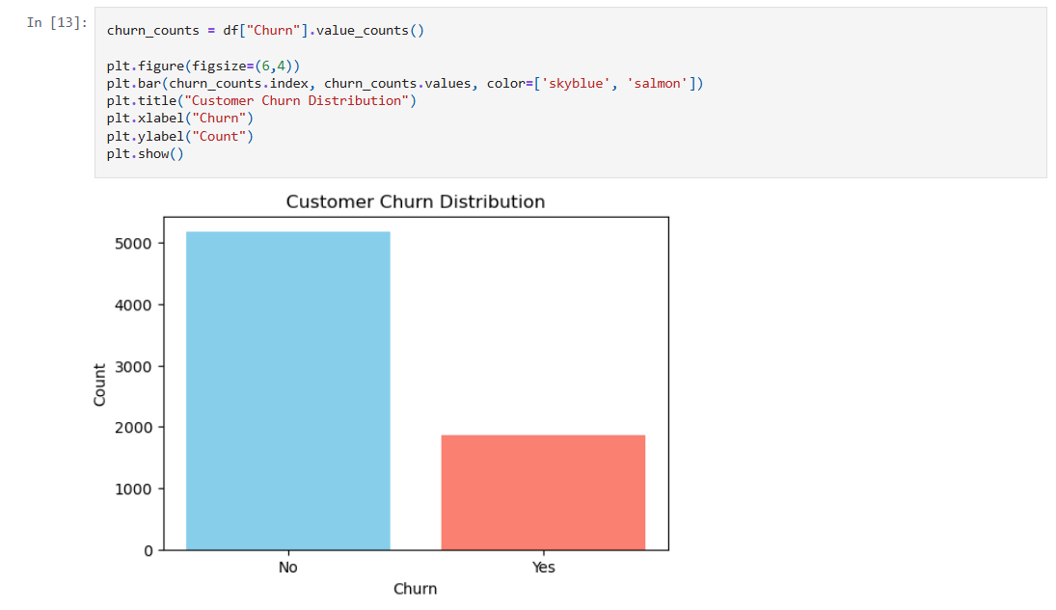




Slide 3
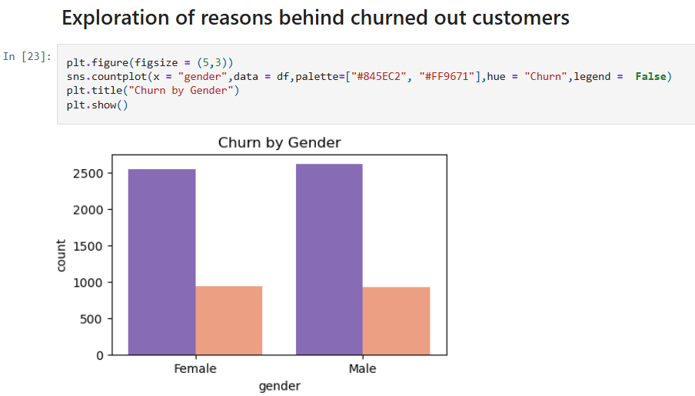

Slide 4
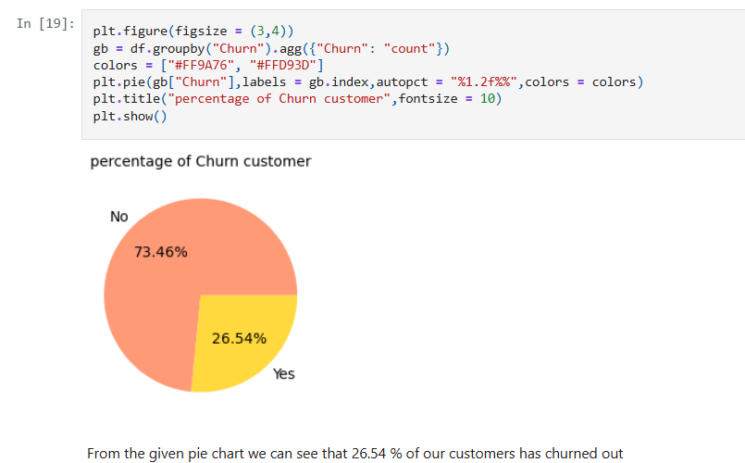

Slide 5
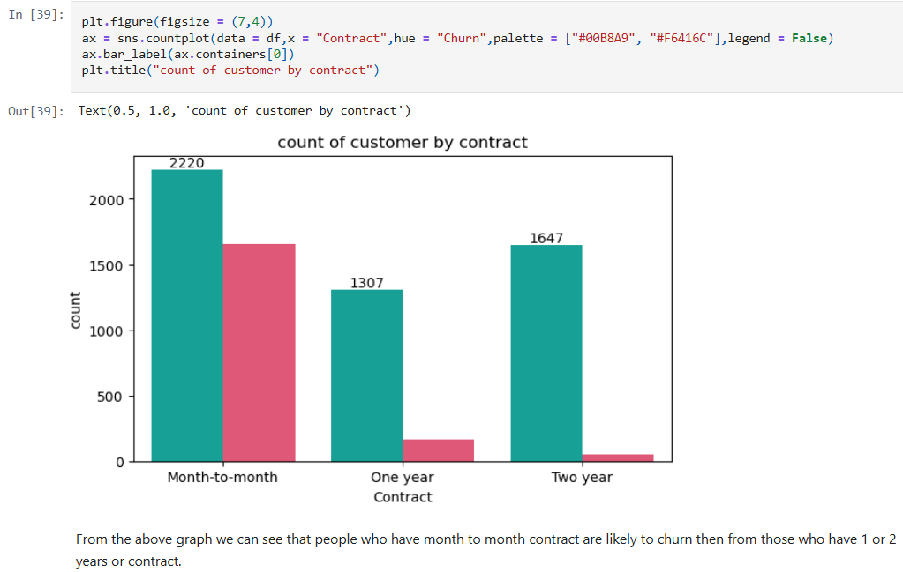

Slide 6
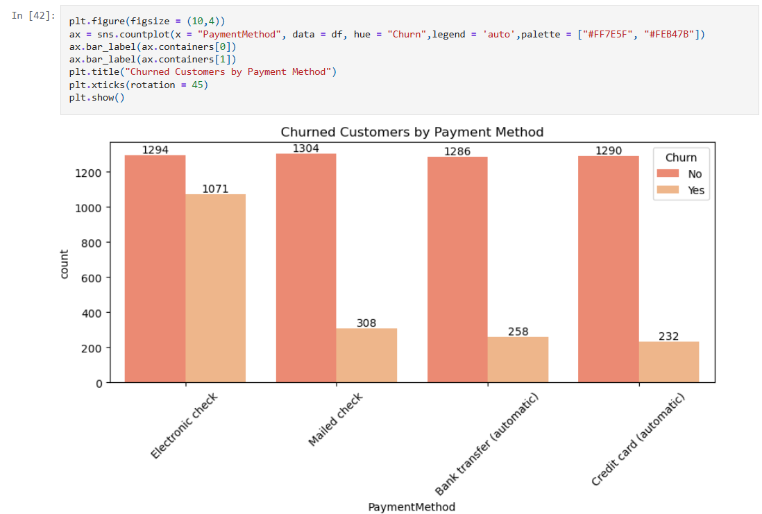




Slide 7
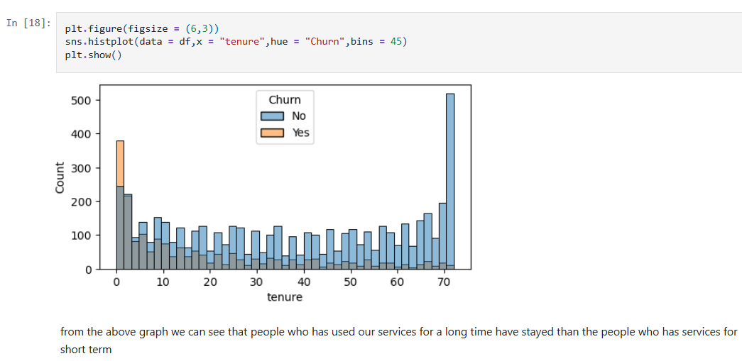

Slide 8
