Slide 1
Project Title
Diwali sales analysis
Description
This project performs an exploratory data analysis (EDA) on Diwali sales data. Using Python libraries such as Pandas, NumPy, Matplotlib, and Seaborn, the dataset is cleaned, processed, and visualized to identify patterns based on demographics, purchase behaviour, and spending trends. The analysis highlights factors influencing sales performance, helping understand customer preferences and business opportunities during the festive season
Programming language : Python
Libraries : Pandas , NumPy , Matplotlib , Seaborn
Concept Applied : Data Cleaning , Exploratory Data Analysis(EDA) , Data Visualization
Tools : Jupyter Notebook
Intro
1
2
3
4
5
6

Slide 2
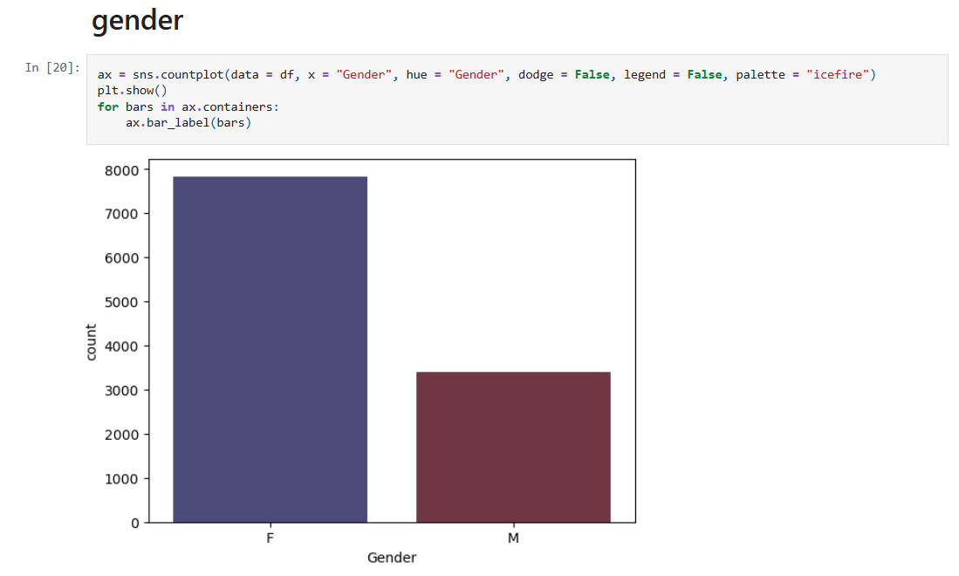
intro
1
2
3
4
5
6

Slide 3
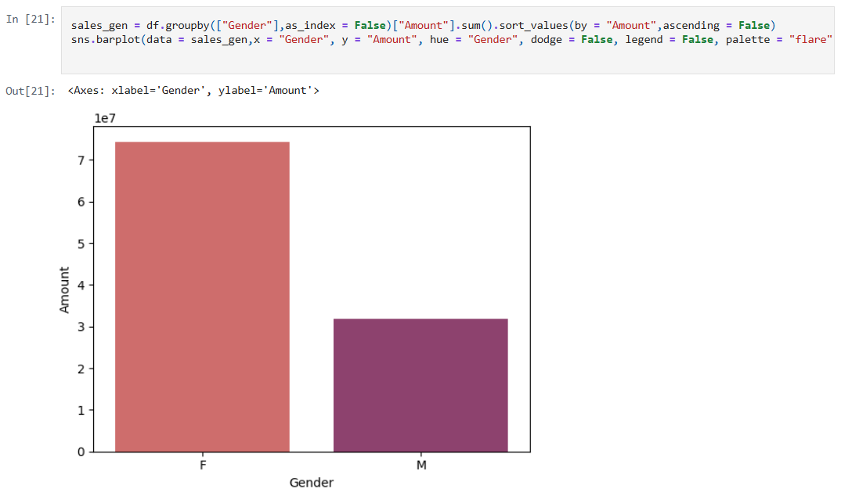
intro
1
2
3
4
5
6

Slide 4
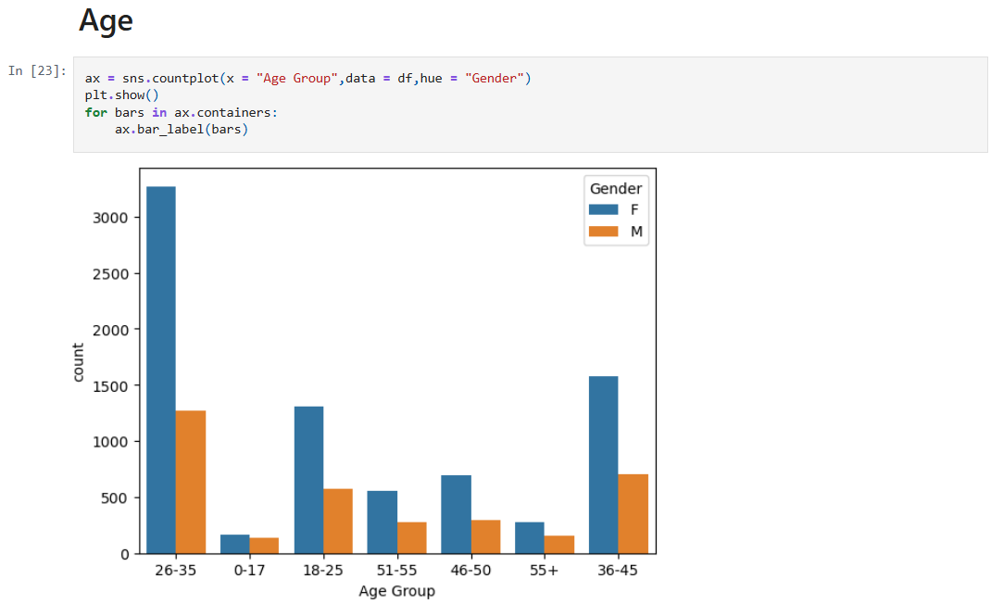
intro
1
2
3
4
5
6

Slide 5
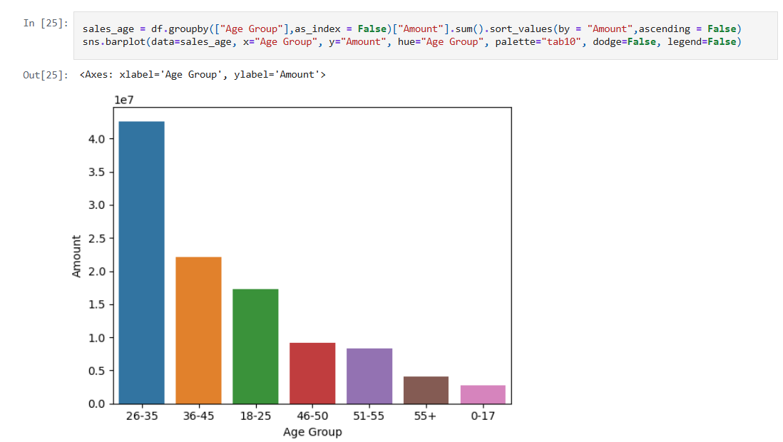
intro
1
2
3
4
5
6

Slide 6
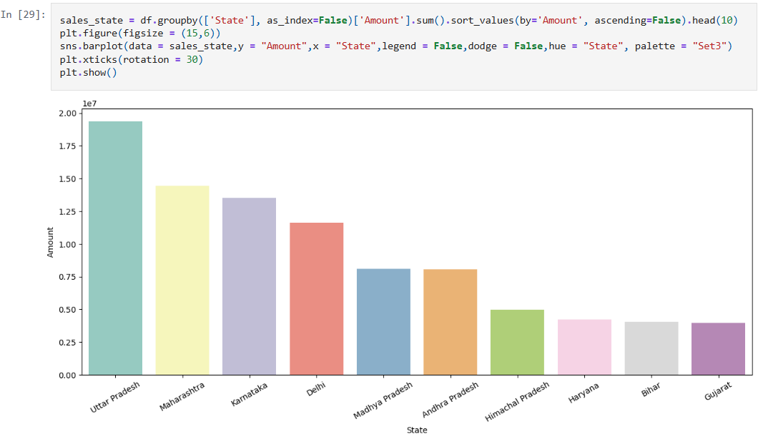
intro
1
2
3
4
5
6

Slide 7
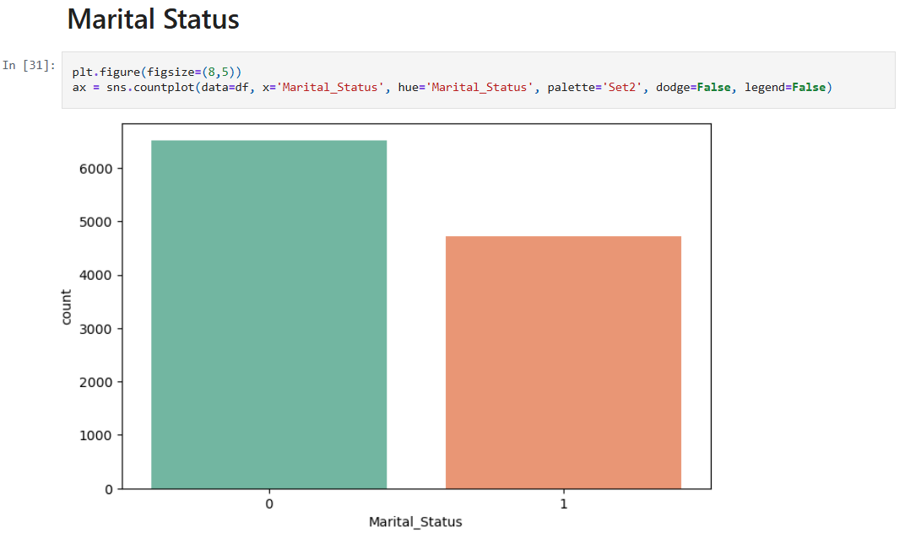
intro
1
2
3
4
5
6

Slide 8
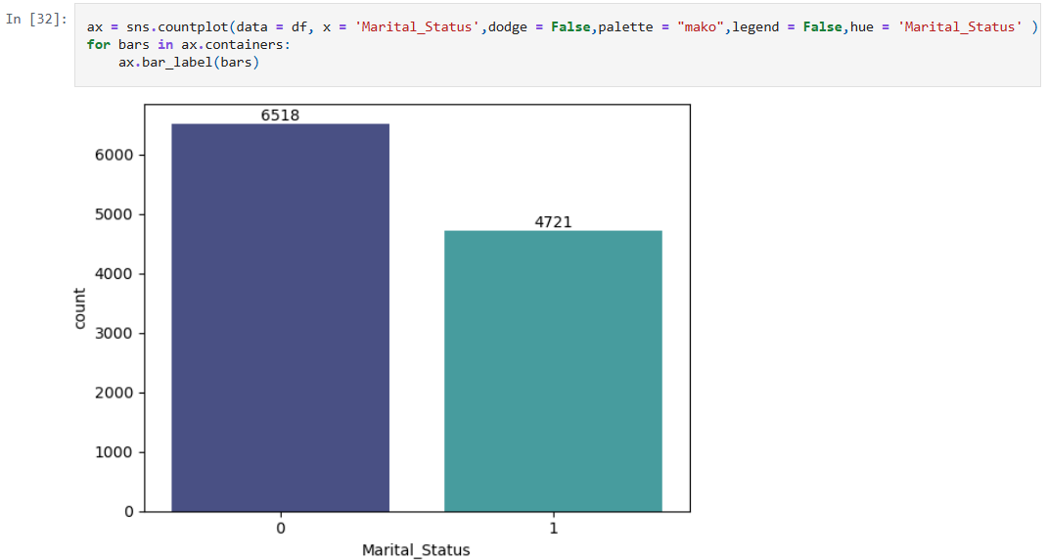
7
8
9
10
11
12
13

Slide 9
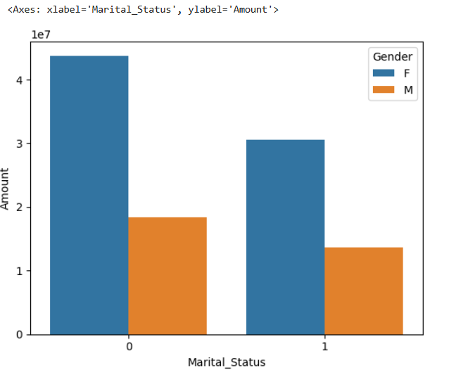
7
8
9
10
11
12
13

Slide 10
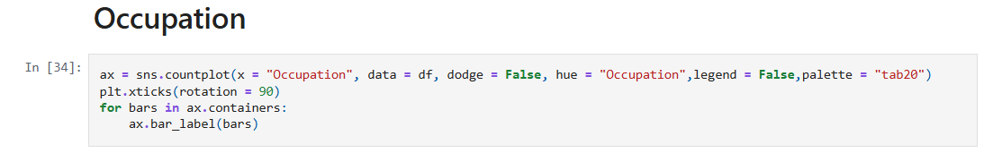
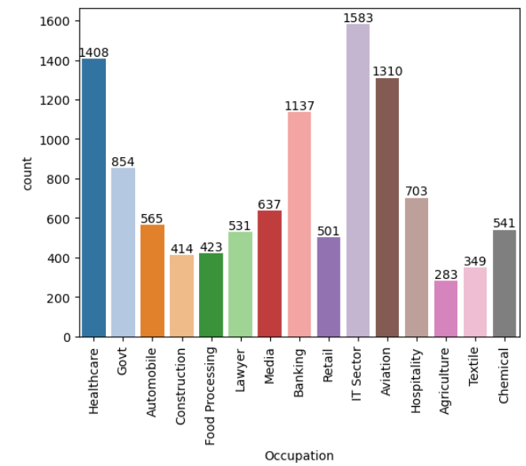
7
8
9
10
11
12
13

Slide 11
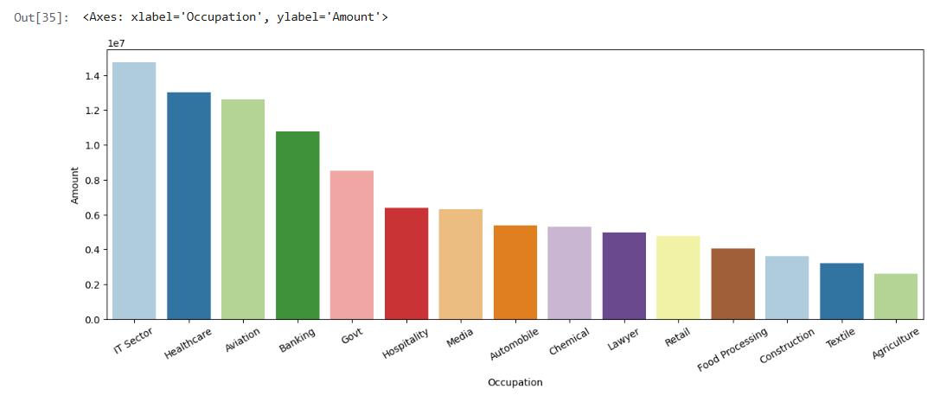
7
8
9
10
11
12
13

Slide 12
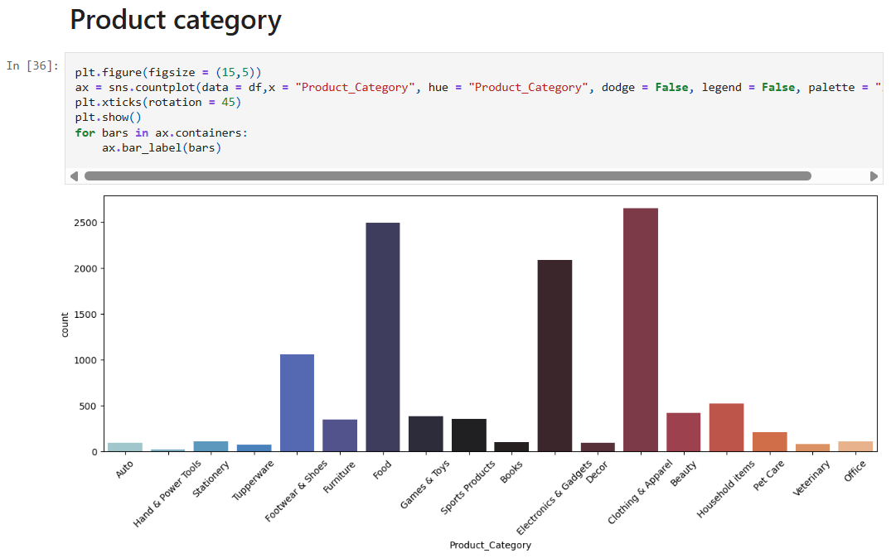
7
8
9
10
11
12
13

Slide 13
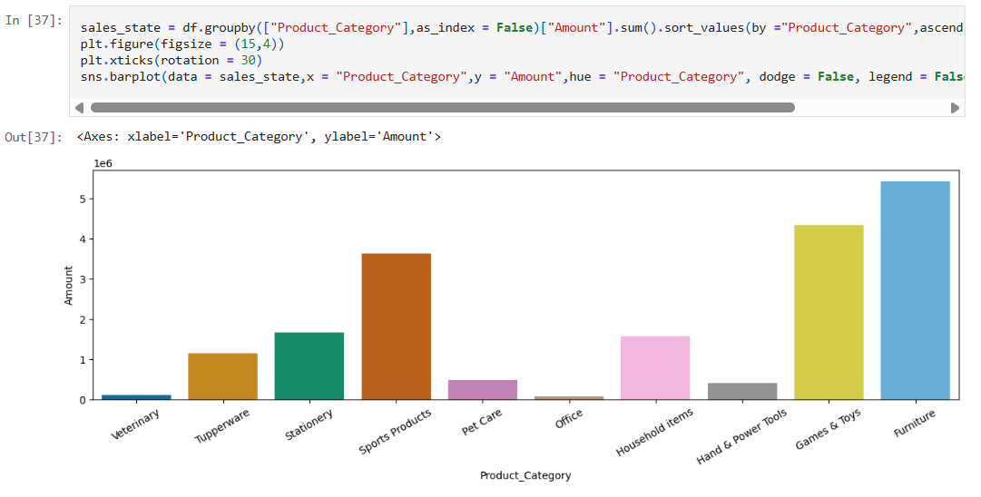
7
8
9
10
11
12
13

Slide 14
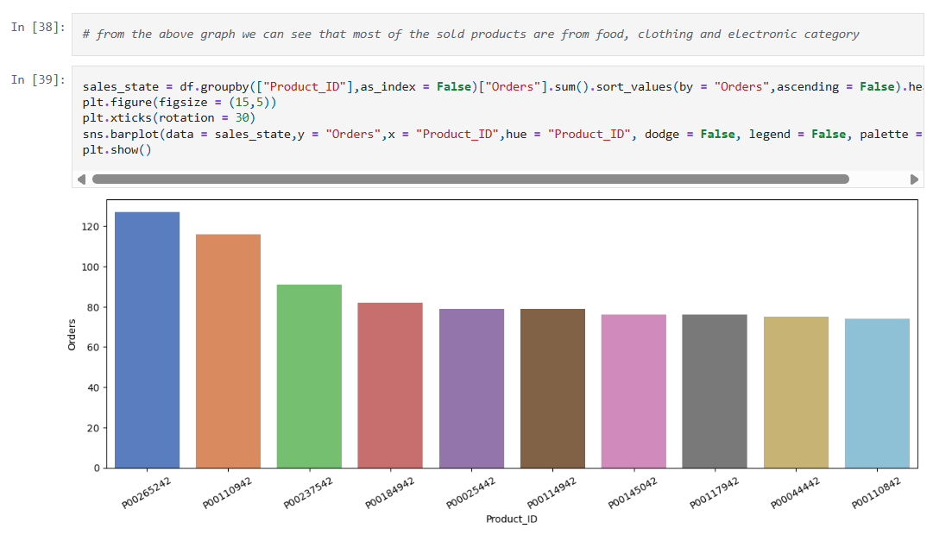
7
8
9
10
11
12
13

