Slide 1




Project Title
Netflix Data Analysis Using Python
Description
Netflix is known for its work in data science, AI, and ML, particularly for building strong recommendation models and algorithms that understand customer behavior and patterns.
Programming language : Python
Libraries : Pandas , NumPy , Matplotlib , Seaborn
Concept Applied : Data Cleaning , Exploratory Data Analysis(EDA) , Data Visualization
Tools : Jupyter Notebook

Slide 2
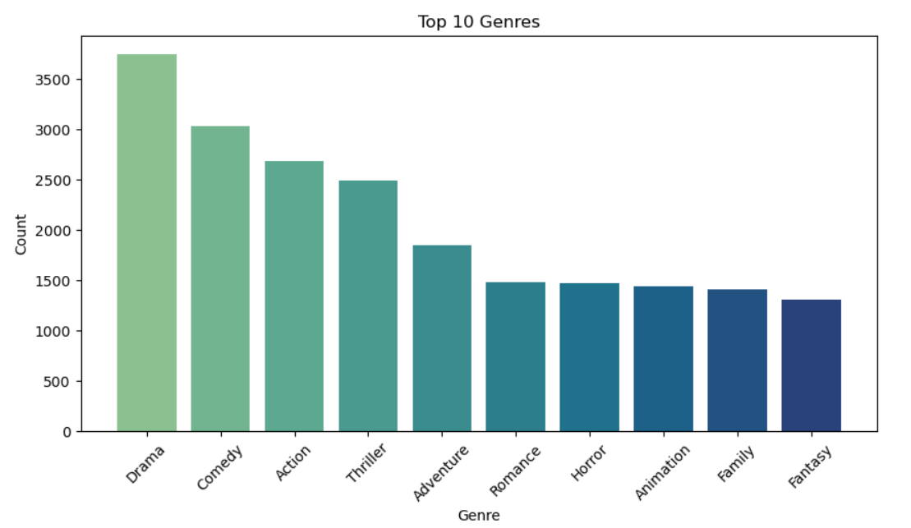
The most frequent Genera in the Database

Slide 3
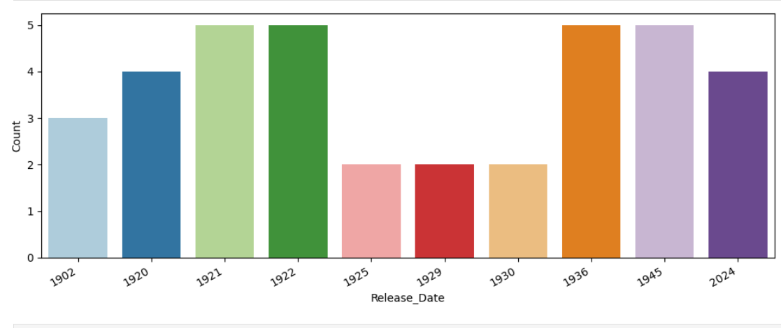
Count of movies release each year

Slide 4
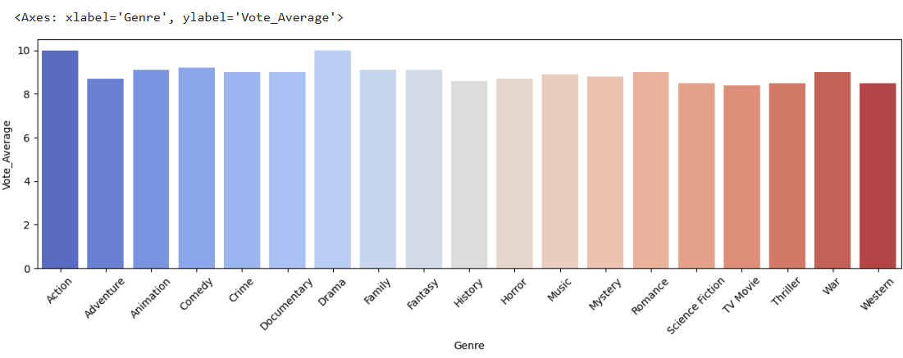
Genre and their highest vote

