Slide 1

Overview
This project demonstrates the development of a Library Management System using SQL to efficiently organize and analyse library data.
Created and managed normalized tables for books, members, employees,
and transactions.
Performed CRUD operations to simulate real-world library database workflows.
Applied JOIN, GROUP BY, and HAVING clauses for advanced data retrieval.
Built summary tables using CTAS for tracking book issue frequency and rental
performance.
Showcases understanding of database design, data manipulation,
and query optimization.

Slide 2
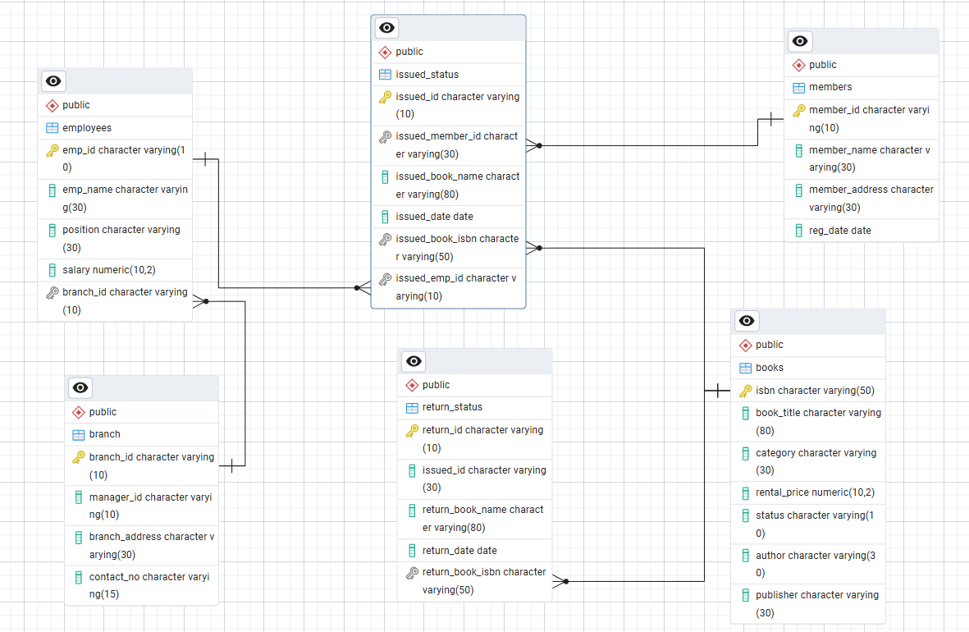
Project
Schema

Slide 3
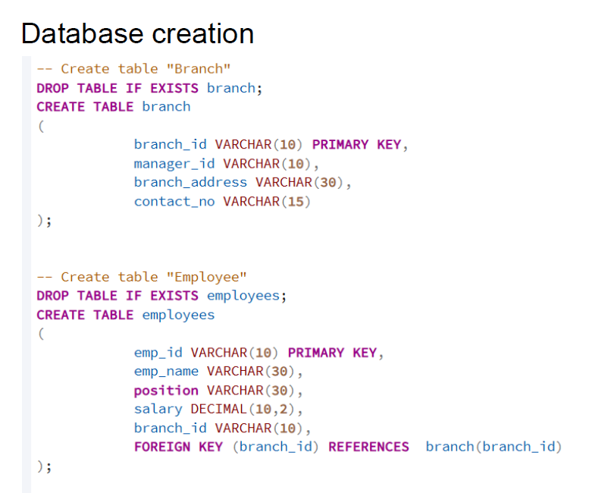

Slide 4
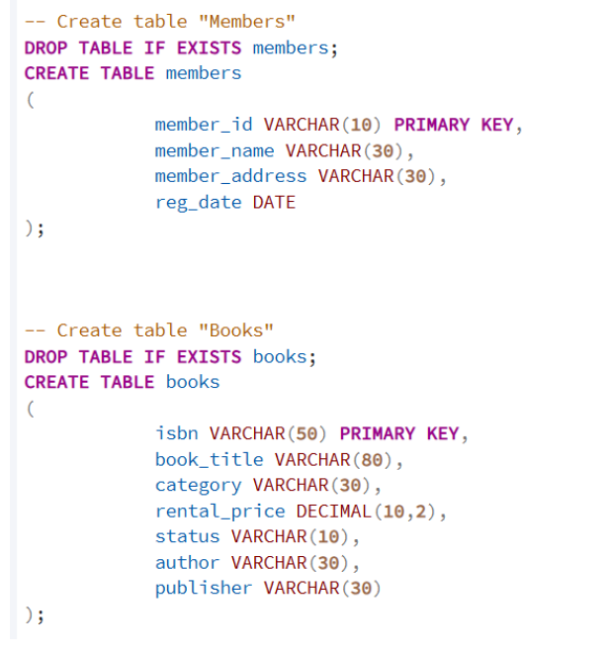

Slide 5
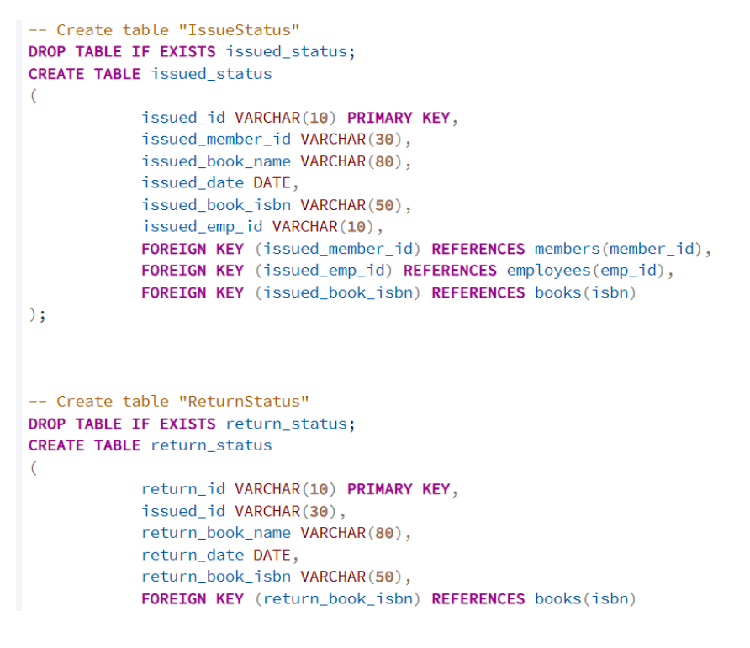

Slide 6
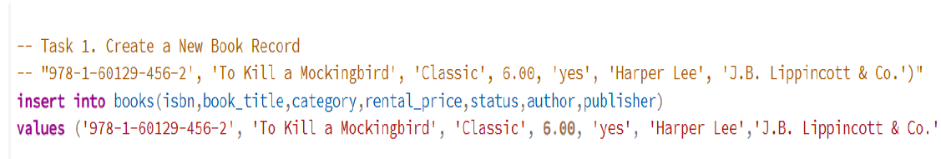
Crud Operations
Create: Inserted sample records into the books table.
Read: Retrieved and displayed data from various tables.
Update: Updated records in the Employees table.
Delete: Removed records from the members table as needed

Slide 7
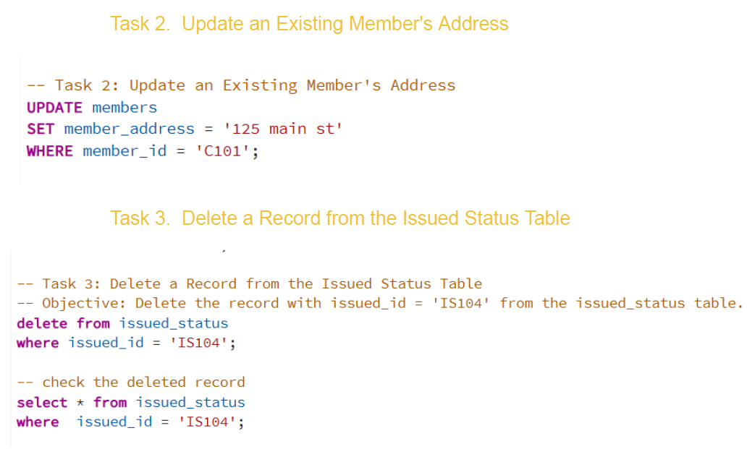

Slide 8
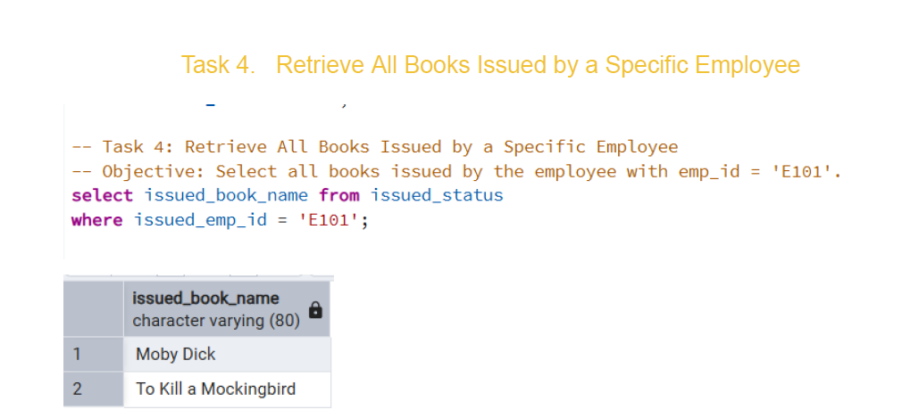

Slide 9

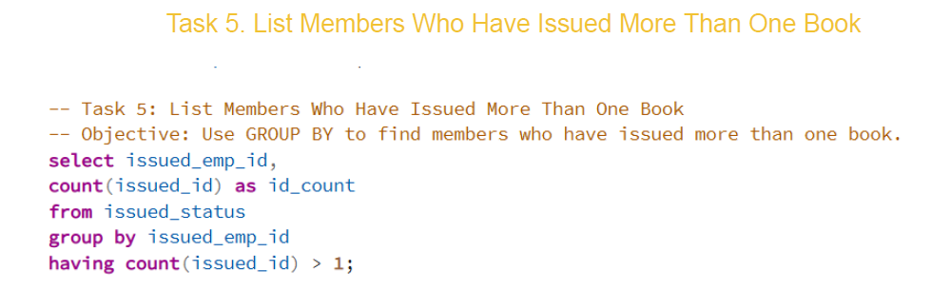
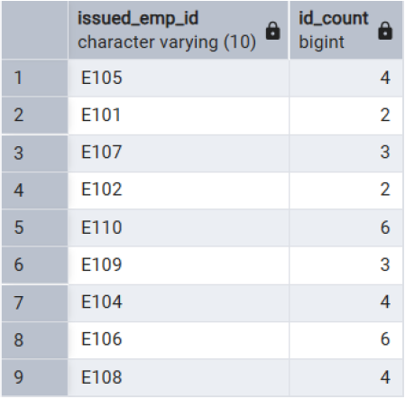

Slide 10
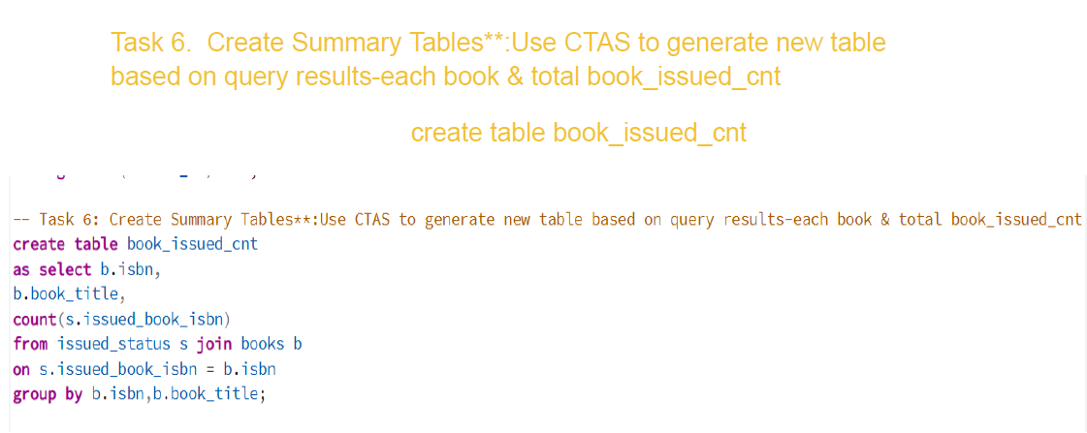
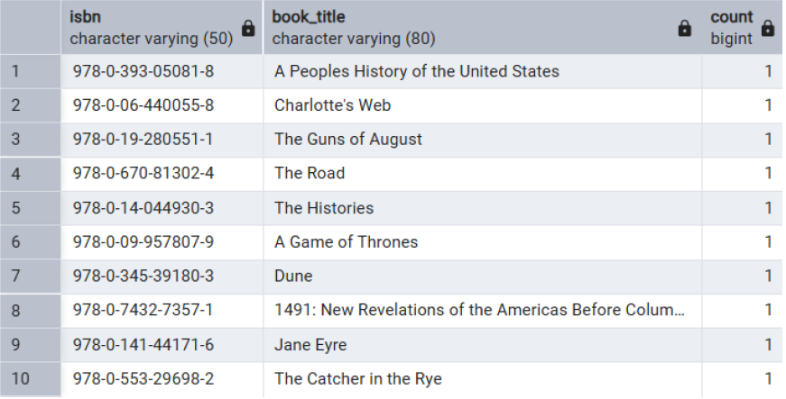

Slide 11
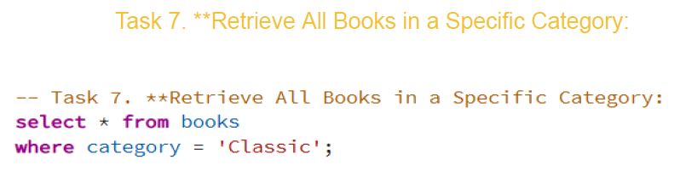
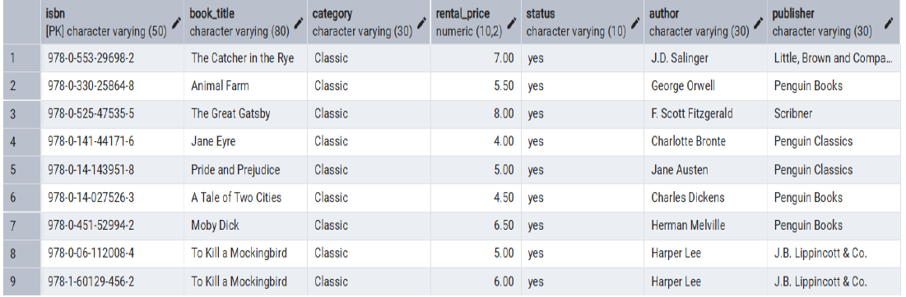

Slide 12
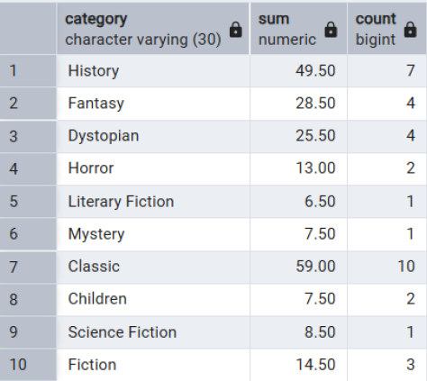
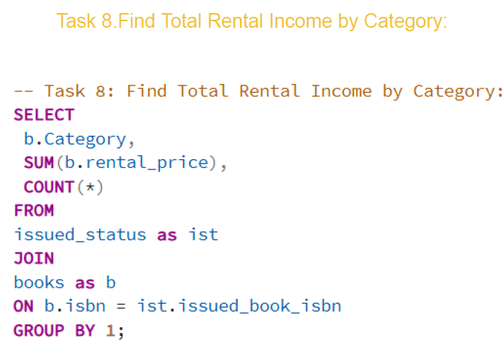

Slide 13
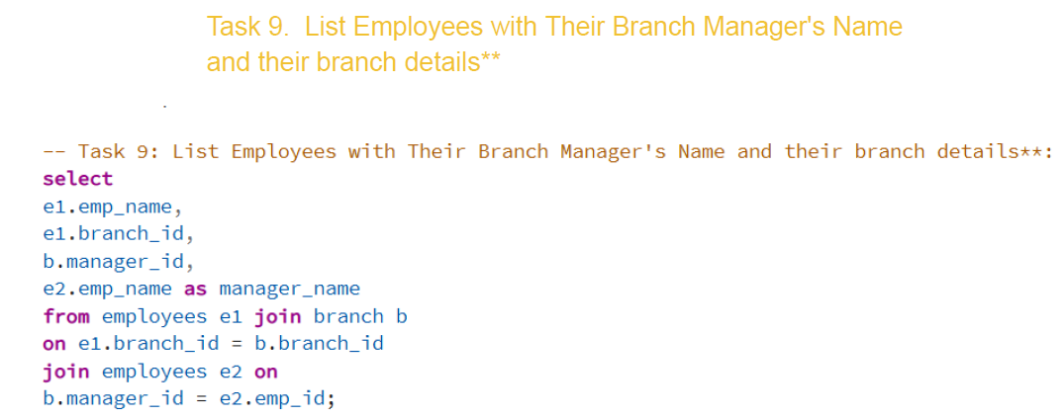
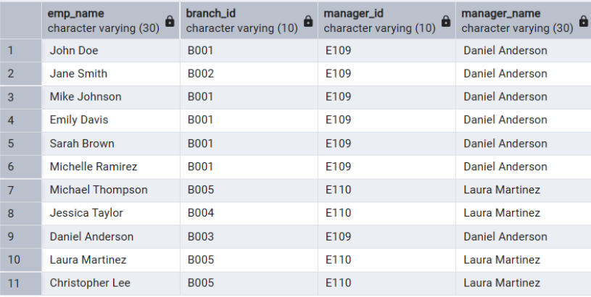

Slide 14
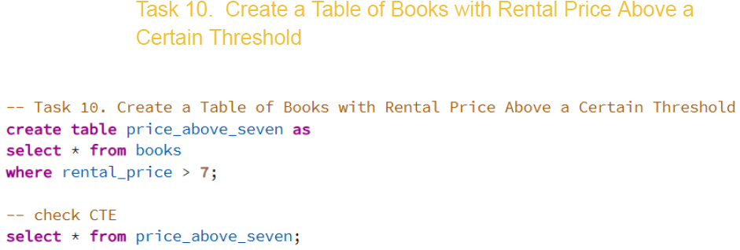
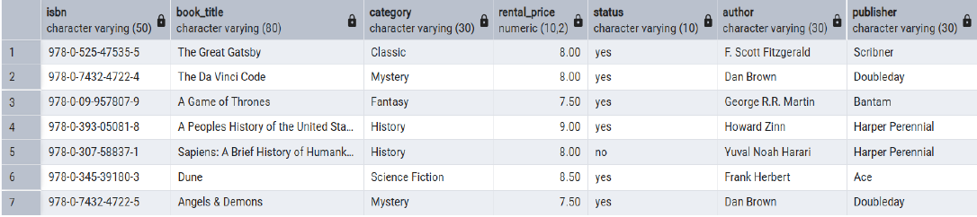

Slide 15
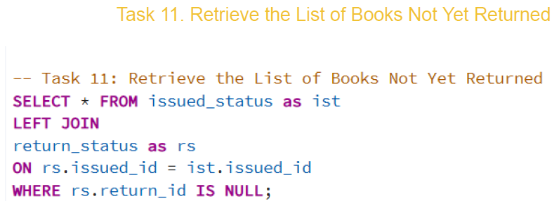
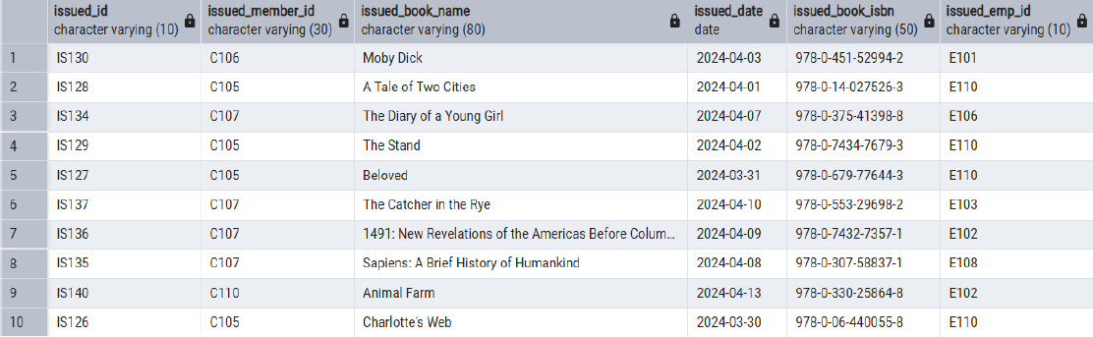

Slide 16
Conclusion
This project highlights the use of SQL for efficient library database management. It demonstrates capabilities in data handling, advanced querying, and analytical reporting, strengthening the foundation for data analysis and relational database design.

