Slide 1
Provenance Lab
A two-layer, contrastively trained framework for detecting AI-generated essays, code, images and speech
Sanatan Sharma (CO23355) Ryanveer Singh (CO23353)
Mentor: Prof. Varun Gupta CS756 Project-I
Notes:
Introduce the project: Provenance Lab detects whether content was made by a person or a generative AI model, across four kinds of content, and explains which layer of the system made the decision.

Slide 2




AI-made content is now hard to tell apart
Academic integrity
Code authenticity
Misinformation
Voice fraud
Essays and assignments written by chatbots
AI-written code submitted as original work
Photorealistic synthetic images spread as real
Cloned voices used in scam calls
One detector per problem doesn't scale. We need one framework that covers all four, works on generators it hasn't seen, and says why it decided.
Notes:
Motivation. Each of these is a real, current harm. The common thread: content alone no longer tells you who made it.

Slide 3

What existing detectors get wrong
Single modality
Text detectors, image detectors and voice anti-spoofing are separate systems with separate interfaces.
Break on new generators
Classifiers learn one model's quirks and fail when a newer model arrives.
Watermarks only help if present
SynthID and C2PA prove origin, but most tools don't add them and edits strip them.
Over-confident verdicts
A forced yes/no wrongly accuses people; there is no 'not sure' outcome.
Notes:
Research gap. Each of our design choices answers one of these four problems.

Slide 4
Two layers: proof first, then a trained detector
Layer 1: provenance
AI-generated
C2PA credentials, AudioSeal and text watermarks
Verifiable proof, stop here
Input
Essay, Python file, image or voice clip
nothing found
Layer 2: forensic detector
Verdict
Deep encoder + forensic features, trained with contrastive loss
Over 70% AI, under 30% human; in between goes to human review
Notes:
The core design. Layer 1 is cheap and certain when a signal exists. Layer 2 covers everything else, including content from tools that never watermark. The uncertain band avoids false accusations.

Slide 5


Layer 2: a specialised detector per content type
Deep encoder
Hand-crafted forensic signals (fused with the encoder)
Essays
BERT (bert-base-uncased)
Perplexity and its spread under DistilGPT-2, sentence burstiness, vocabulary richness
Code
CodeBERT
Syntax-tree depth and node mix, function length, identifier style, comment ratio
Images
Vision Transformer + frequency CNN (224 px)
2-D FFT spectrum branch, radial power profile, noise-residual statistics
Voice
wav2vec 2.0 (frozen) + linear head
Compared with a spectrogram CNN using MFCC, spectral-shape and phase cues
Notes:
Hybrid design: a pretrained deep encoder captures semantics; hand-crafted forensic features capture statistical fingerprints known to separate AI from human content. They are concatenated and fused by an MLP.

Slide 6
Contrastive learning: what all AI content shares
Every detector is trained with two losses on the fused embedding:
Binary cross-entropy for the human/AI decision
Supervised contrastive loss (SupCon, temperature 0.1) that pulls same-label samples together and pushes human and AI apart
L = BCE + 0.5 × SupCon
Why: the model is rewarded for a shared notion of 'AI-made' across all generators in a batch, not one generator's quirks, which should help on unseen models.
AI (any generator)
Human
Learned embedding space
Notes:
SupCon (Khosla et al., 2020). Positives are all samples with the same label in the batch. This is why batch sizes are kept at 16 to 32: each batch needs several positives.

Slide 7
Real public benchmarks, leakage-free splits
Content | Dataset | Human vs AI | Train / test | Leakage control
Essays | HC3 + MAGE | Humans vs ChatGPT and 27 LLMs | 16,000 / 1,000 + 1,000 | By question; OPT held out
Code | CoDET-M4 (Python) | GitHub, LeetCode, Codeforces vs 5 LLMs | 12,000 / 1,000 | Official split
Images | GenImage + CIFAKE | Real photos vs 7 modern generators | 14,000 / 3,500 | Official split
Voice | ASVspoof 2019 + modern TTS | Bona fide vs 2019 attacks, ElevenLabs, Polly... | 4,339 / 1,527 | By speaker / recording
All subsets are class-balanced. 10% of each training set is held out for validation. These are deliberately small subsets so the full pipeline trains on one laptop; full-scale training is future work.
Notes:
Every dataset is a real, public benchmark downloaded from Hugging Face. Splits avoid leakage: the same question, or the same speaker, never appears in both train and test.

Slide 8

Training built to avoid over- and underfitting
Validation hold-out
Early stopping
10% of each training set, never trained on
Stop after 2 epochs without validation improvement; keep the best epoch
Regularisation
Shortcut removal
Dropout, weight decay, SpecAugment for voice, gradient checkpointing
HC3 spacing and \n escapes; ASVspoof silence; GenImage JPEG vs PNG
Hardware: Apple M4 laptop, 16 GB unified memory, PyTorch on the Metal GPU, every job capped at 3 GB by a memory watchdog.
Notes:
Shortcut removal matters: human HC3 answers contain tokenisation artefacts like "it 's", and ASVspoof bona fide clips have more silence. Left in, a model could score highly without learning anything about AI generation.

Slide 9
Results on held-out test data
Content | Prec. | Recall | Test n
Essays | 97.1% | 99.6% | 1000
Code | 96.5% | 98.8% | 1000
Images | 90.8% | 90.5% | 3500
Voice | 96.2% | 93.6% | 1527
Baseline results on small subsets; full datasets and longer training are expected to improve them.
Notes:
Main results of the full model (BCE + SupCon + forensic features) for each modality, on test sets never seen during training or validation.
Essays: accuracy 98.3%, F1 98.3%, AUC 0.999.
Code: accuracy 97.6%, F1 97.6%, AUC 0.996.
Images: accuracy 90.7%, F1 90.6%, AUC 0.971.
Voice: accuracy 95.0%, F1 94.9%, AUC 0.988.

Slide 10
Built for today's generators, not 2019's
A 2019-trained voice model flags real speech and misses modern clones (31.9%); adding modern TTS fixes it. With Midjourney removed from training, 56.4% of Midjourney images are still caught (vs 84.8%).
Notes:
The deployed models are trained on current generators: voice on ASVspoof plus modern text-to-speech (split by recording and generation, so no clip family is in both train and test), images on GenImage at full resolution with every image re-encoded the same way so file format can't give the answer away.

Slide 11
Beating simple methods on the same data
Simple methods: perplexity threshold, TF-IDF + logistic regression, forensic features + logistic regression
Essays: -0.1 pts (±1.1), within noise
Code: +4.5 pts (±1.8)
Images: +14.4 pts (±1.8)
Voice: +20.3 pts (±2.9)
Notes:
Baselines are trained and tested on exactly the same splits. On essays even a single perplexity number scores highly: HC3 is an easy benchmark, which is why we also test out of distribution on the next slides. The deep model's gain is largest where simple features fall short (images, voice, code).

Slide 12
Compared with detectors people actually use
* trained on that same benchmark (home advantage). Commercial tools are closed: Weber-Wulff et al. (2023) found 14 tools incl. Turnitin "neither accurate nor reliable"; RAID (Dugan et al., ACL 2024) found detectors "easily fooled" by unseen models and simple attacks.
Notes:
Public detectors from Hugging Face, run unchanged on our exact test sets. Be precise when presenting: on these test sets we have a home advantage because we trained on the same benchmarks, except where a public model was trained on it too (marked *). The fair comparison is MAGE, where everyone is out of domain. Commercial tools could not be run without paid API access, so we cite published independent evaluations.

Slide 13
Today's AI content: ours vs public detectors
None of these test sets was used to train any public model, so this is the fair comparison. Every model is run unchanged; essays use our calibrated diverse-data model, images and voice our modern-data models.
Notes:
The headline comparison. On benchmarks a specialised public model can win (dima806 on CIFAKE), but on current generators every public detector we could run drops to 52-78%, while our detectors trained on diverse, modern data stay at 78-94%.

Slide 14
Honest check: no detector is 100% accurate
Tested without retraining on 1000 MAGE texts: 14 domains, 27 AI models never seen in training.
Every method drops. Benchmark accuracy overstates real-world accuracy, which is why we report this gap, keep an 'uncertain' band, and put verifiable provenance first.
Notes:
This answers 'can a detector be 100% accurate?' directly: no. On familiar data we score very high; on new generators and topics every method, including ours, loses accuracy. Our contribution is a system that measures and admits this, rather than claiming perfection.

Slide 15
The fix: train on many AI models, not one
MAGE accuracy: 57.1% → 85.3%
HC3 accuracy stays 97.2%; 86.2% of human texts still cleared
Threshold calibrated on MAGE validation data (0.85), never on test.
OPT was never in training: its bar is a true unseen-generator result.
Notes:
Diagnosis and fix. The HC3-only model learned ChatGPT's style. Adding diverse training data (many generators and topics from MAGE's training split) changes that. OPT was held out entirely, so its bar is a genuine unseen-generator result. Report the numbers exactly as they came out.

Slide 16
Does contrastive learning help?
Essays: -0.6 pts (±1.0), within noise
Code (4k): +1.1 pts (±1.9), within noise
Images (CIFAKE): +0.1 pts (±1.0), within noise
Voice (CNN): +0.7 pts (±3.5), within noise
± is the 95% confidence interval of the difference.
Notes:
Same architecture, same data, same epochs; the only change is removing the SupCon term. In distribution, contrastive learning barely moves accuracy: differences sit inside the 95% confidence interval. Its claimed benefit is generalisation to unseen generators, tested on the next slide.

Slide 17
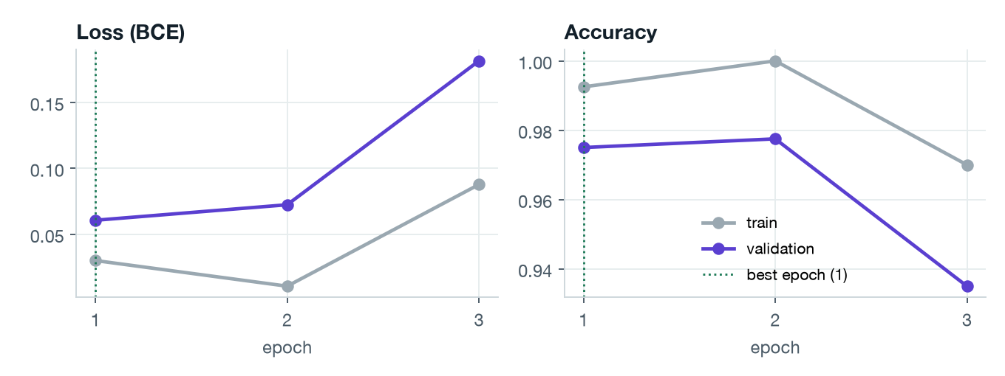
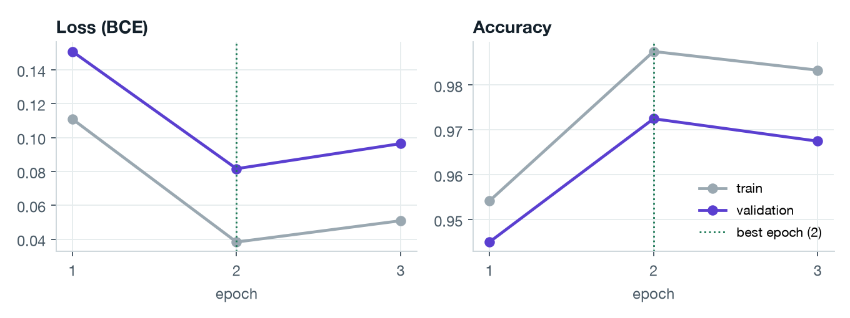
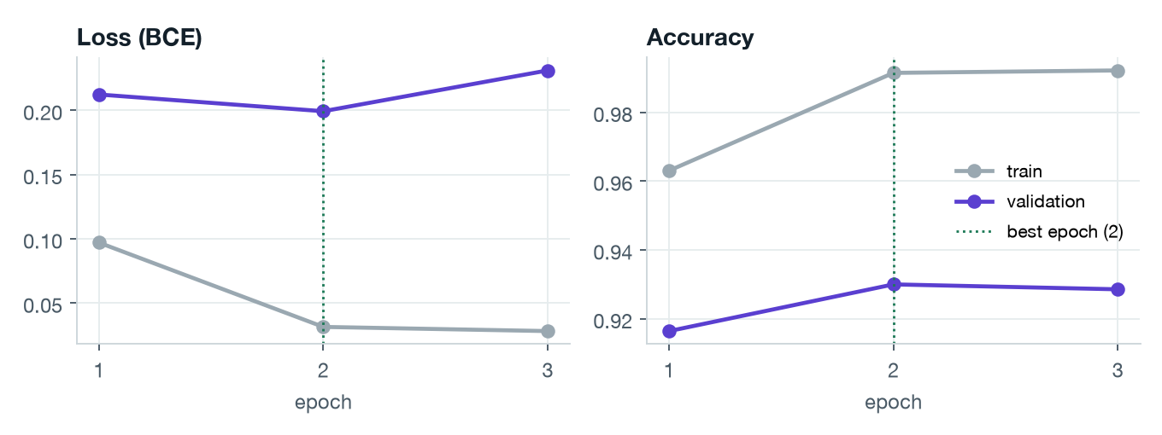
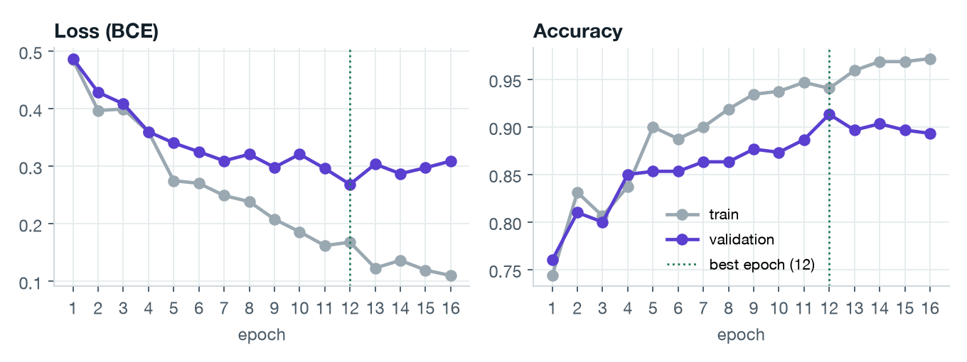
It generalises: train and validation move together
Essays
Code
Images
Voice (spectrogram CNN)
Train minus test accuracy (pts): Essays +1.0 Code +1.2 Images +8.5 Voice +4.2. Voice is tested on unseen speakers.
Notes:
Left of each plot: loss; right: accuracy. Validation loss tracking training loss means no overfitting; both being low means no underfitting. The best-validation epoch is restored before testing.

Slide 18
Which generators and attacks are hardest
Notes:
Breaking results down by source shows where the detector is weakest. ASVspoof attacks A07 to A19 include some generators that are notoriously hard to detect (A17, A18).

Slide 19
Catching a generator it never saw in training
Leave-one-generator-out test
All GPT-written code removed from training; the test set still contains it.
Unseen GPT code is still caught 78–85% of the time (vs 94% when GPT is in training).
SupCon vs cross-entropy: -7.0 pts (±10.7), within noise. At this scale contrastive learning gave no measurable gain.
Notes:
The abstract's generalisation claim, tested directly. Finding 1: the detector does transfer to an unseen LLM, losing about 10-16 points. Finding 2: contrastive learning did not improve that transfer here; the difference is inside the confidence interval (only 100 GPT samples). Present this as an honest negative result and future work: more generators, larger batches for SupCon.

Slide 20
Watermarks hold only until the content is edited
C2PA image credentials were lost after a single JPEG re-save. False positives on unwatermarked human content: 0% in every test.
Notes:
Real experiment: we embedded real watermarks, then attacked them. Speed change and added noise erase the audio watermark; shuffling words erases text watermarks; re-saving a JPEG strips C2PA. This is why Layer 2 exists.

Slide 21
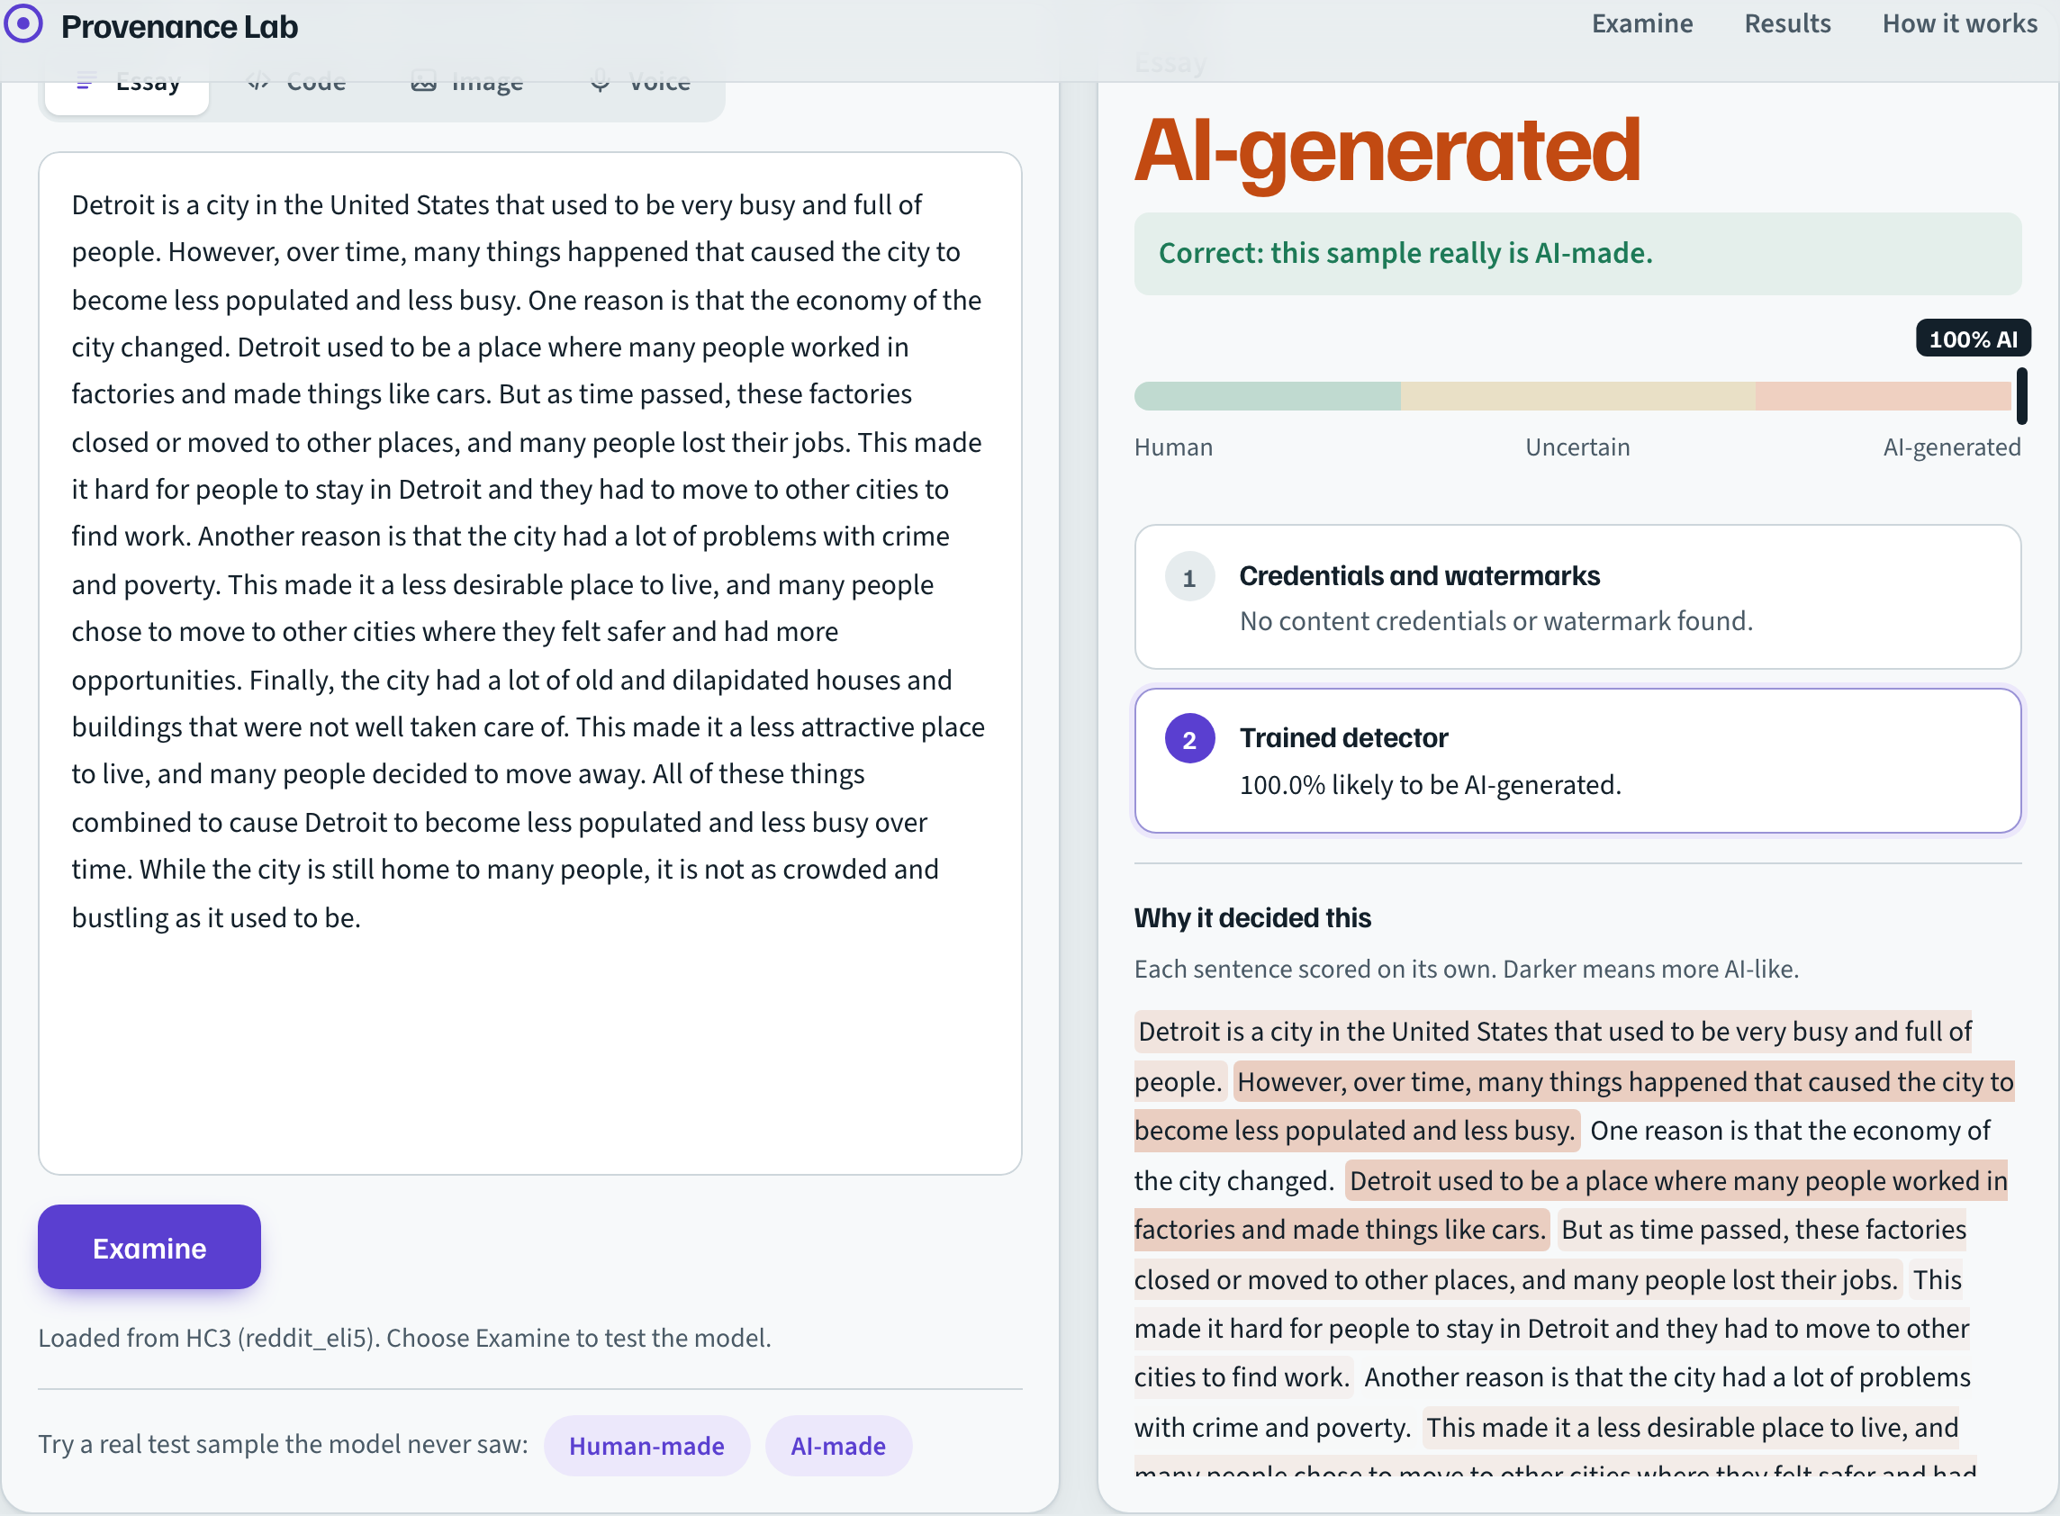
The working system: drop in anything, get a verdict
Web app (FastAPI + custom front end)
Auto-detects the kind of file dropped in
Shows which layer decided, and the AI probability on a human-to-AI scale
Loads real held-out test samples and marks whether the model was right
Live results page with ROC and learning curves
Notes:
Live demo: run `python server.py` in the code folder and open http://127.0.0.1:8000. Load an AI-made sample, examine it, show the verdict scale and the correct/wrong banner.

Slide 22

What we found
High accuracy on held-out benchmark data
Essays 98.3%, Code 97.6%, Images 90.7%, Voice 95.0%. Pretrained wav2vec 2.0 features lifted voice from 80.7%.
Ahead of popular public detectors
Best in 2 of 3 benchmark comparisons; a CIFAKE-specialised model trained on 16× more data edges us on images.
Benchmarks overstate real-world accuracy
All essay detectors drop on unseen models; ours fell to 57.1%, diverse training lifted it to 85.3%.
Contrastive loss: no measurable gain at this scale
Every with/without difference sits inside the 95% confidence interval, including on an unseen generator.
Proof beats prediction when it exists
Watermarks and C2PA are decisive when present but break under simple edits, so both layers are needed.
Notes:
The five takeaways. Lead with the honest ones: a detector that admits its limits and measures them is more credible than one claiming 100%.

Slide 23
Limitations and next steps
Limitations
Next steps
Accuracy drops on unseen generators and topics (see MAGE test)
Small training subsets on one laptop
Unseen generators stay hard (Midjourney held out: 56% caught)
Google's SynthID image/audio detectors aren't public; we use open equivalents
Text and code detectors see only English and Python
Full datasets and longer training on a GPU
Test voice on newer synthesis (ASVspoof 5) and fine-tune wav2vec 2.0
Train on many more generators; retest contrastive loss with larger batches
Extend code detection beyond Python
Robustness training against paraphrase and compression
Notes:
Be upfront: these are baseline results. The architecture is in place for the next semester's work.

Slide 24
Thank you
Questions, and a live demo
Notes:
Offer the live demo.

