Slide 1

e-COMMERCE SALES MODELING & FORECASTING SANDIP MAJI SANATAN PAUL MOUSUMI MAITY Supervised by Prof. G. Ravindran Indian Statistical Institute, Chennai

Slide 2
Need and Relavance of the Study
In order to enhance the logistic service experience of customers in the ecommerce industry chain it is required that commodities are stocked in advance in local warehouse of various markets, which helps to reduce logistic time.
Sale forecasting is more vital for supply chain management in e-commerce with a huge amount of transaction data .
Algorithm and technologies of data analysis and machine learning algorithms are widely applied to predict sale of ecommerce of commodities.

Slide 3
Aim : Objective 1: To perform exploratory data analysis and visualize the data using visualization techniques using inbuilt python libraries such as seaborn and matplotlib. And finding the attributes which are affecting the overall sales. Objective 2: To test and validate different models such as ARIMA, RANDOM FOREST,REGRESSION TREE, Xgboost by using performance metrics. Objective 3: To forecast overall sales by splitting the initial data into train and test data and selecting the best model.

Slide 4
Data Collection:
Kaggle allows users to find and publish data sets, explore and build models in a web based data-science environment. We took our dataset from kaggle data dictionary.
Dataset link: https://www.kaggle.com/datasets/olistbr/brazilian-ecommerce .

Slide 5
DATA DESCRIPTION:
This is a Brazilian ecommerce public dataset of orders made at Olist Store.
The dataset has information of 100k orders from 2016 to 2018 made at multiple marketplaces in Brazil.
There are nine separate data sets
9.Product category name translation dataset
1. Customer dataset
8.Sellers dataset
2.Geolocation dataset
7.Product dataset
3. Order item dataset
4. Order payment dataset
5. Order review dataset
6. Orders dataset

Slide 6
DATA : Customer dataset:
Shape of the dataframe is : (99441, 5)
Data columns (total 5 columns):
# Column Non-Null Count Dtype
0 customer_id 99441 non-null object
1 customer_unique_id 99441 non-null object
2 customer_zip_code_prefix 99441 non-null int64
3 customer_city 99441 non-null object
4 customer_state 99441 non-null object

Slide 7
Seller dataset:
Shape of the dataframe is : (3095, 4)
Data columns (total 4 columns):
# Column Non-Null Count Dtype
--- ------ -------------- -----
0 seller_id 3095 non-null object
1 seller_zip_code_prefix 3095 non-null int64
2 seller_city 3095 non-null object
3 seller_state 3095 non-null object

Slide 8
Geolocation dataset:
Shape of the dataframe is : (1000163, 5)
Data columns (total 5 columns):
# Column Non-Null Count Dtype
0 geolocation_zip_code_prefix 1000163 non-null int64
1 geolocation_lat 1000163 non-null float64
2 geolocation_lng 1000163 non-null float64
3 geolocation_city 1000163 non-null object
4 geolocation_state 1000163 non-null object

Slide 9
Product dataset:
Shape of the dataframe is : (32951, 9)
Data columns (total 9 columns):
# Column Non-Null Count Dtype
0 product_id 32951 non-null object
1 product_category_name 32341 non-null object
2 product_name_lenght 32341 non-null float64
3 product_description_lenght 32341 non-null float64
4 product_photos_qty 32341 non-null float64
5 product_weight_g 32949 non-null float64
6 product_length_cm 32949 non-null float64
7 product_height_cm 32949 non-null float64
8 product_width_cm 32949 non-null float64

Slide 10
category name translation dataset:
Shape of the dataframe is : (71, 2)
Data columns (total 2 columns):
# Column Non-Null Count Dtype
--- ------ -------------- -----
0 product_category_name 71 non-null object
1 product_category_name_english 71 non-null object

Slide 11
Orders dataset:
Shape of the dataframe is : (99441, 8)
Data columns (total 8 columns):
# Column Non-Null Count Dtype
0 order_id 99441 non-null object
1 customer_id 99441 non-null object
2 order_status 99441 non-null object
3 order_purchase_timestamp 99441 non-null object
4 order_approved_at 99281 non-null object
5 order_delivered_carrier_date 97658 non-null object
6 order_delivered_customer_date 96476 non-null object
7 order_estimated_delivery_date 99441 non-null object

Slide 12
Order items dataset:
Shape of the dataframe is : (112650, 7)
Data columns (total 7 columns):
# Column Non-Null Count Dtype
0 order_id 112650 non-null object
1 order_item_id 112650 non-null int64
2 product_id 112650 non-null object
3 seller_id 112650 non-null object
4 shipping_limit_date 112650 non-null object
5 price 112650 non-null float64
6 freight_value 112650 non-null float64

Slide 13
Order payments dataset :
Shape of the dataframe is : (103886, 5)
Data columns (total 5 columns):
# Column Non-Null Count Dtype
0 order_id 103886 non-null object
1 payment_sequential 103886 non-null int64
2 payment_type 103886 non-null object
3 payment_installments 103886 non-null int64
4 payment_value 103886 non-null float64

Slide 14
Order reviews dataset :
Shape of the dataframe is : (99224, 7)
Data columns (total 7 columns):
# Column Non-Null Count Dtype
0 review_id 99224 non-null object
1 order_id 99224 non-null object
2 review_score 99224 non-null int64
3 review_comment_title 11568 non-null object
4 review_comment_message 40977 non-null object
5 review_creation_date 99224 non-null object
6 review_answer_timestamp 99224 non-null object

Slide 15
DATA CLEANING :
Removing Duplicate ROWs and Columns:
First we removed all the duplicate rows and columns from all the data sets.
Missing Value Treatments:
After removing duplicate rows and columns
Drop columns that are least significant and has majority of missing value.
Dropping records with at least one missing value.
Missing values present in product_data are replaced by mean.
While data preparation data from order_data is extracted so null values have no impact
so left as it is.

Slide 16
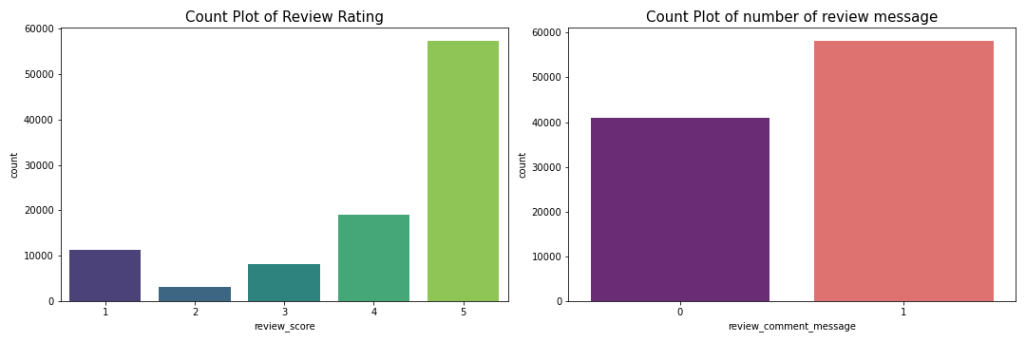
DATA ANALYSIS WITH VISUALIZATION:
ORDER REVIEW DATA ANALYSIS :
Interpretation:
In general, all the orders have high review ratings, with over 77% of high ratings (4,5)
Over half of customer don't leave comments (around 58.7%)

Slide 17
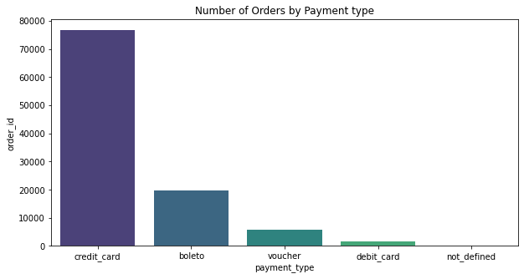
About Payment types ?
Interpretation:
We see that most of the payment done by credit_card.

Slide 18
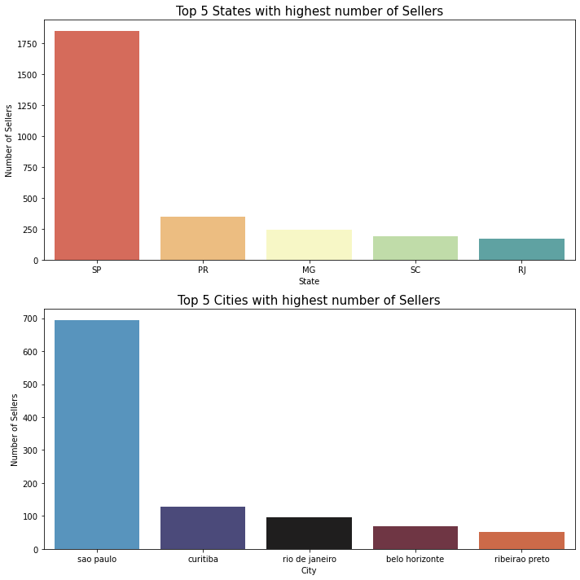
Which Cities have highest number of Sellers ?

Slide 19
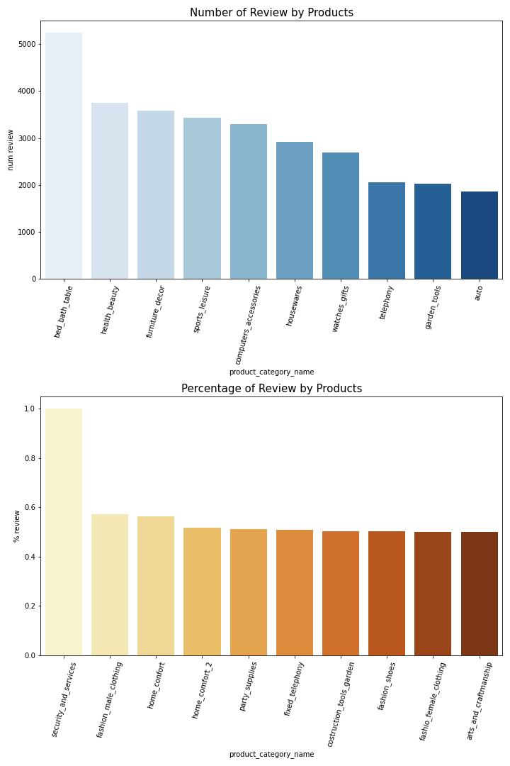
Average Rating and Number of Review by Product categories

Slide 20
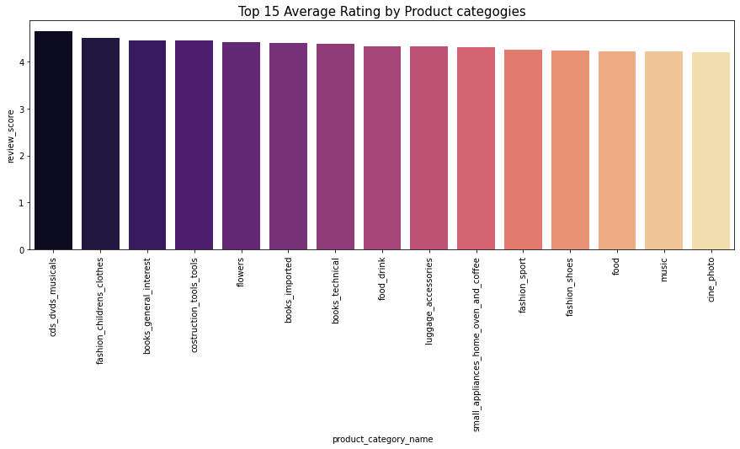
Top 15 Average Rating By Product Categories:

Slide 21
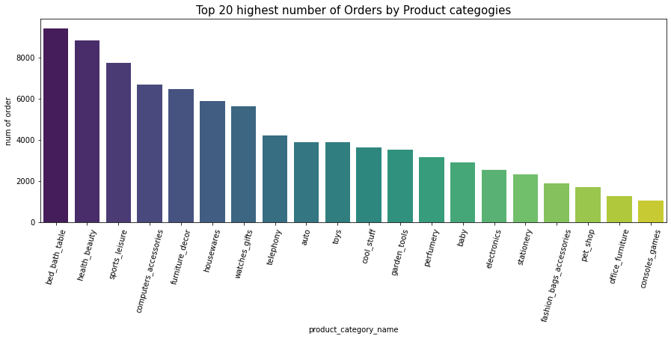
Number of orders by Product categories

Slide 22
Target Products Should Be 'bed_bath_table’ ‘garden_tools’ watches_gift 'pet_shop’ ‘stationery’ 'small_appliances’ 'consoles_games’ 'cool_stuff’ 'auto’, 'electronics’, 'musical_instruments’ 'home_construction’ ‘perfumery’ 'furniture_living_room’ ‘baby’ 'housewares’, 'luggage_accessories’ 'sports_leisure’ 'office_furniture’ 'fashion_bags_accessories'
,

Slide 23
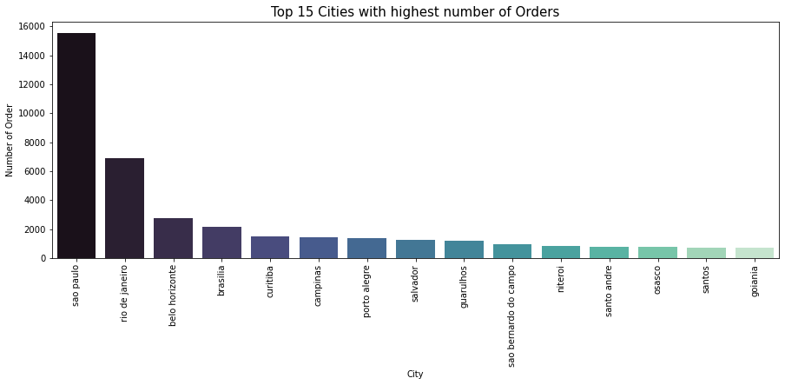
Which Cities have highest number of Orders ?

Slide 24
DATA PREPARATION
Remove Row
Date Time Format
Remove Column
Remove Duplicate row
Of each data frame.
Date time object to
Proper date-time format.
Remove unimportant column
Not significant to creating a model.
Merge Data
Missing value
Merge two data frame
Using a unique column
Numerical value replace by Mean and Categorical replace by most frequency

Slide 25
MERGE DATA
Product Category
Name
Product Data
Category name trn
Order Id
Order Item
Order Payment
Order Id
New data
Order data
Product Id
New Data
Product Data.
Seller Id
New data
Seller Data
Customer Id
New data
Customer Data
1
2
3
4
5
6

Slide 26
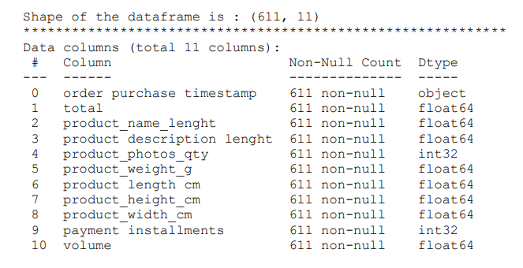
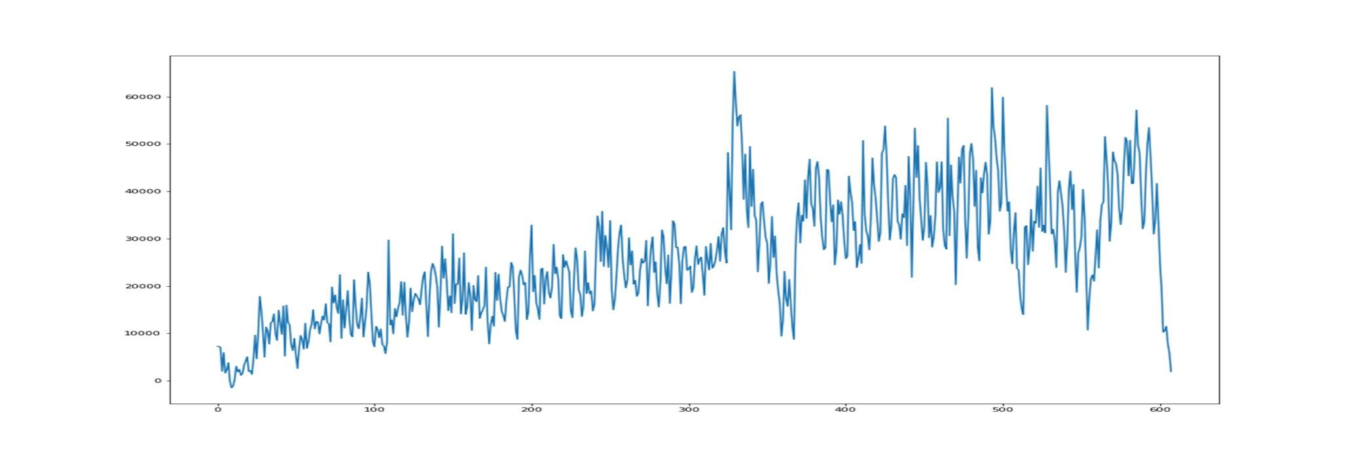
PREPARED DATA

Slide 27
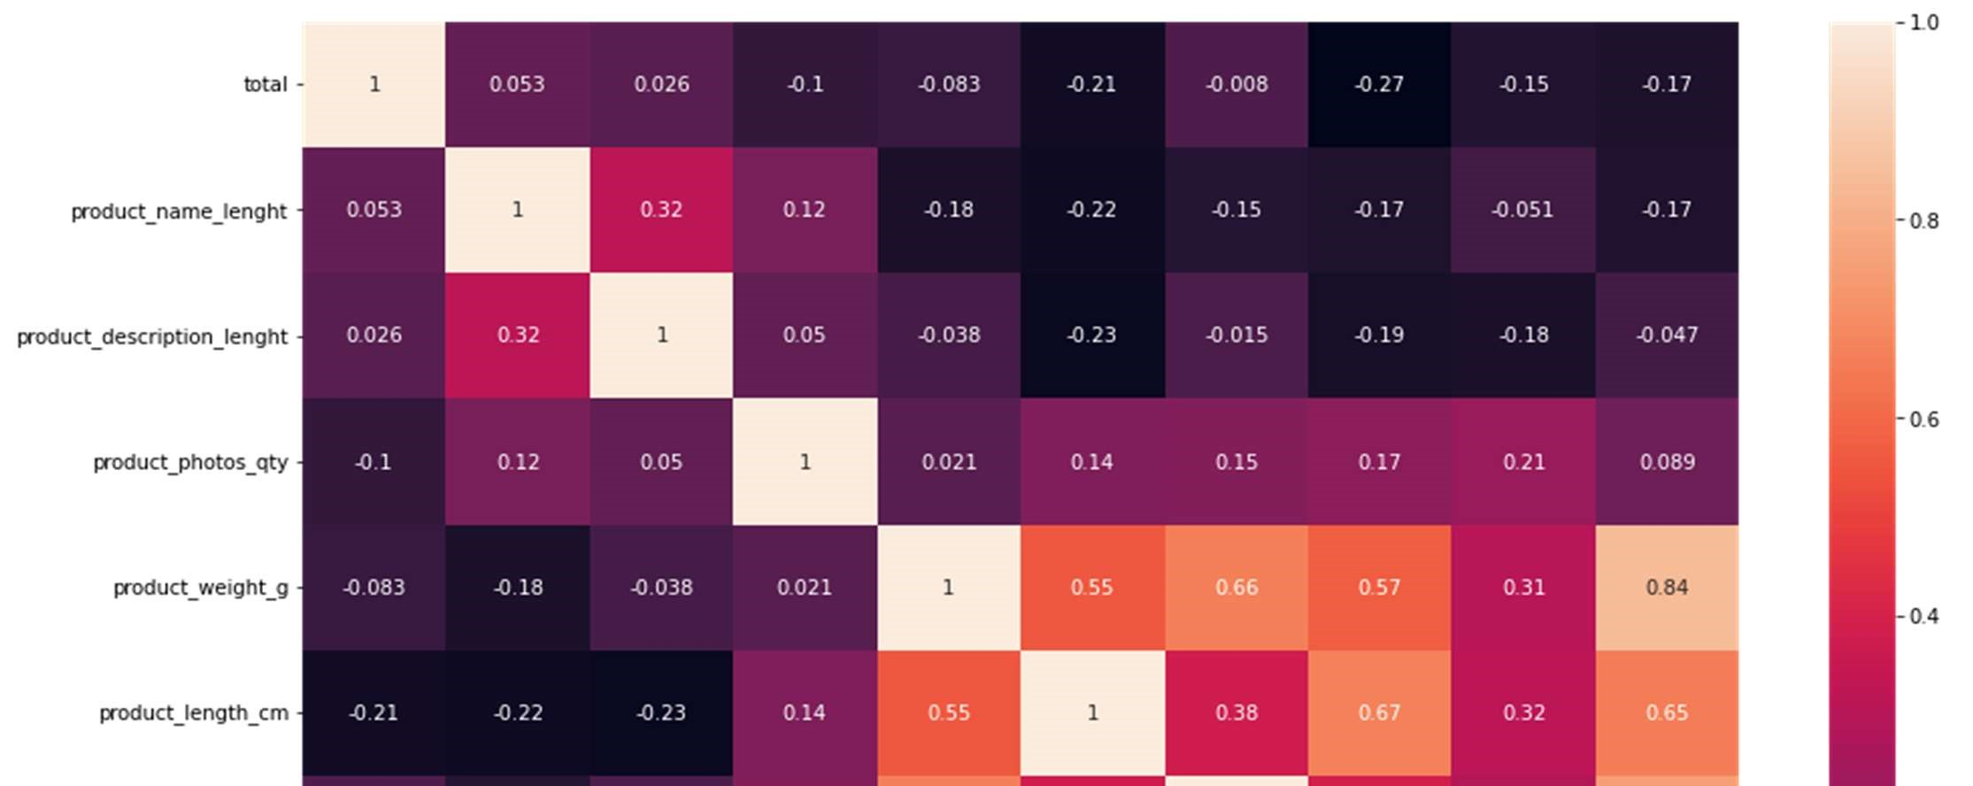
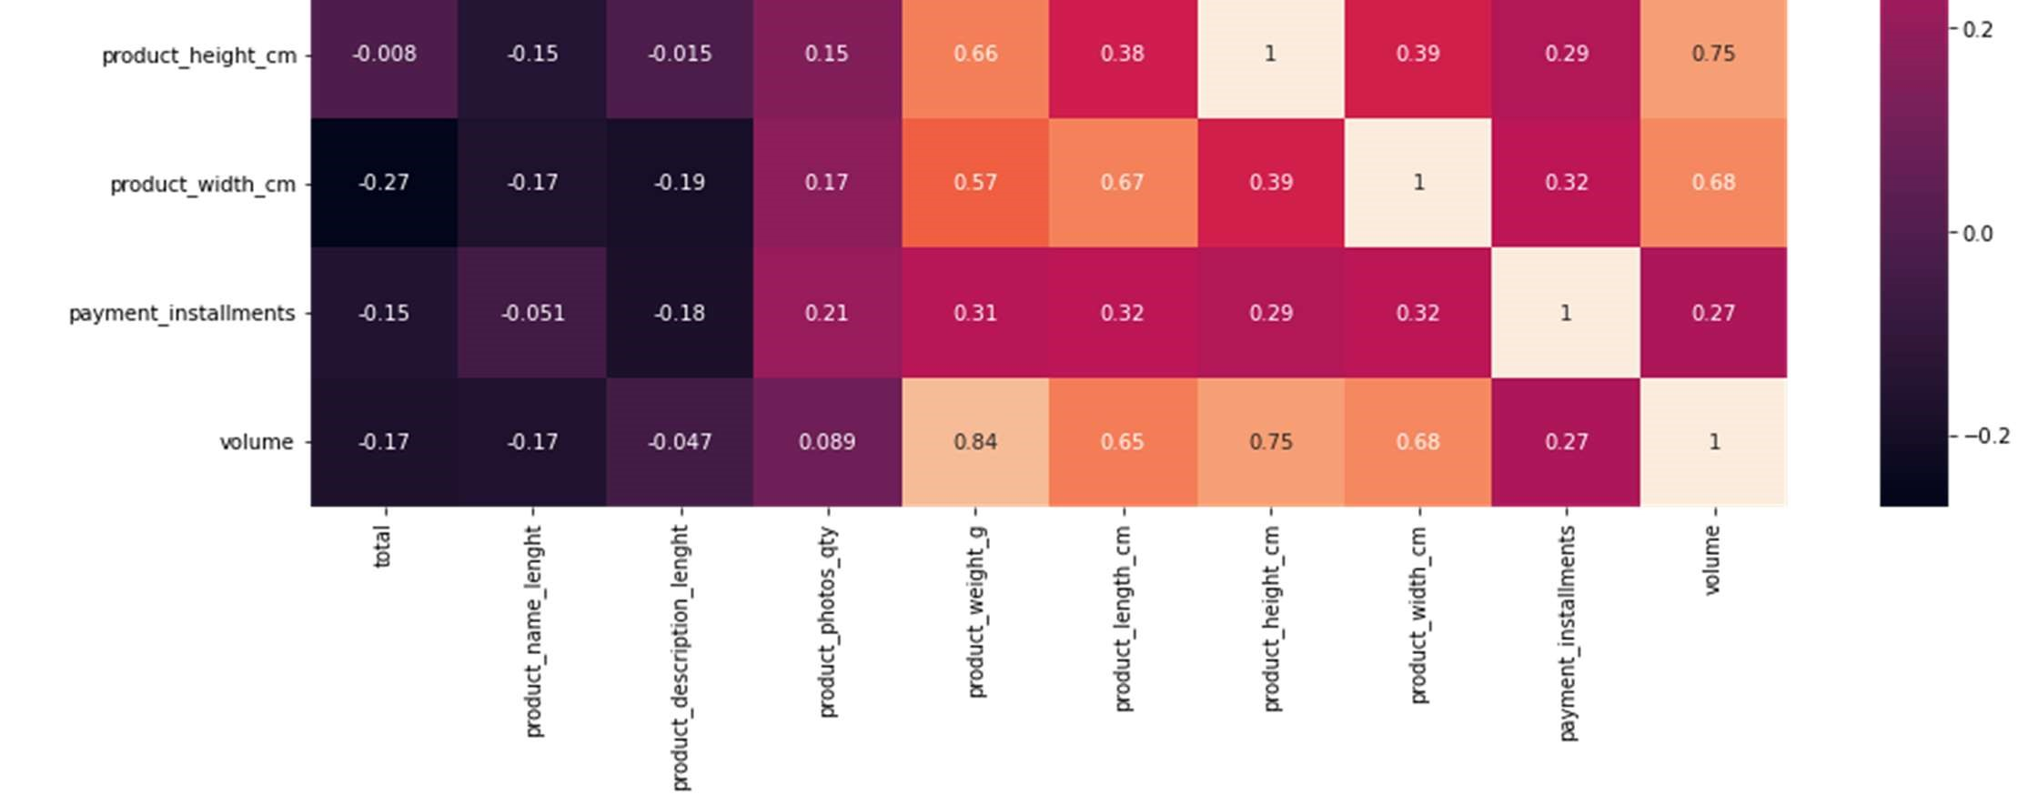
CORRELATION DIAGRAM

Slide 28
Important attributes affecting overall sales From the correlation heatmap we can say that Product_length_cm product_width_cm payment_installments product_photos_quantity are affecting in overall sales

Slide 29
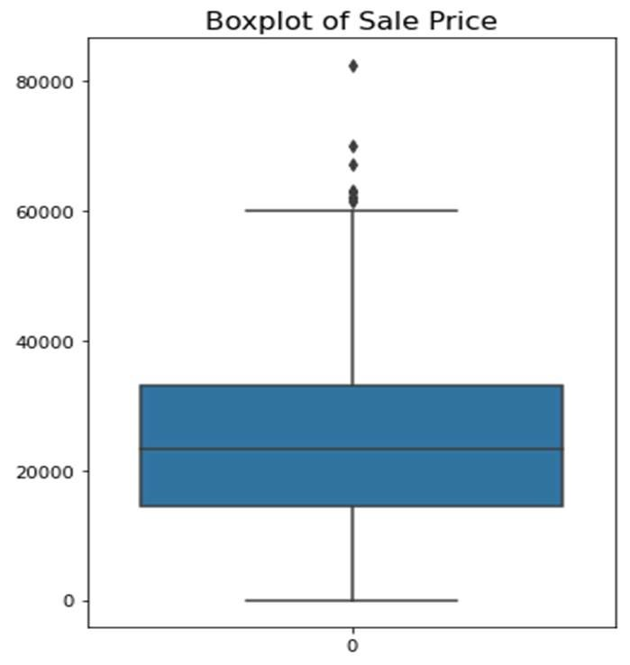
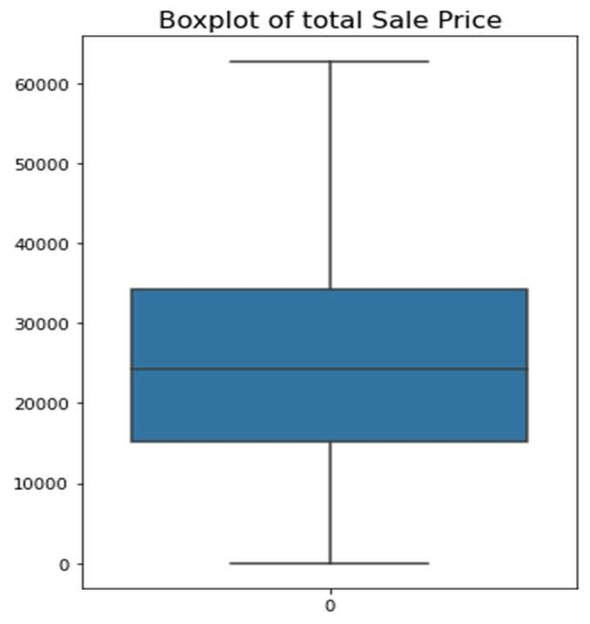
OUTLIER TREATMENT
This Plots clearly shows there are some outliers present in the data. So, outlier treatment is done and we have got outlier-free data. Here outlier is replaced by the mean of before and after data of the outlier.

Slide 30
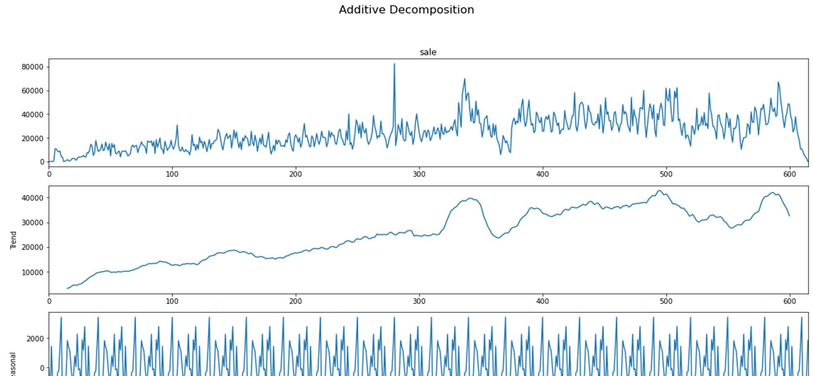
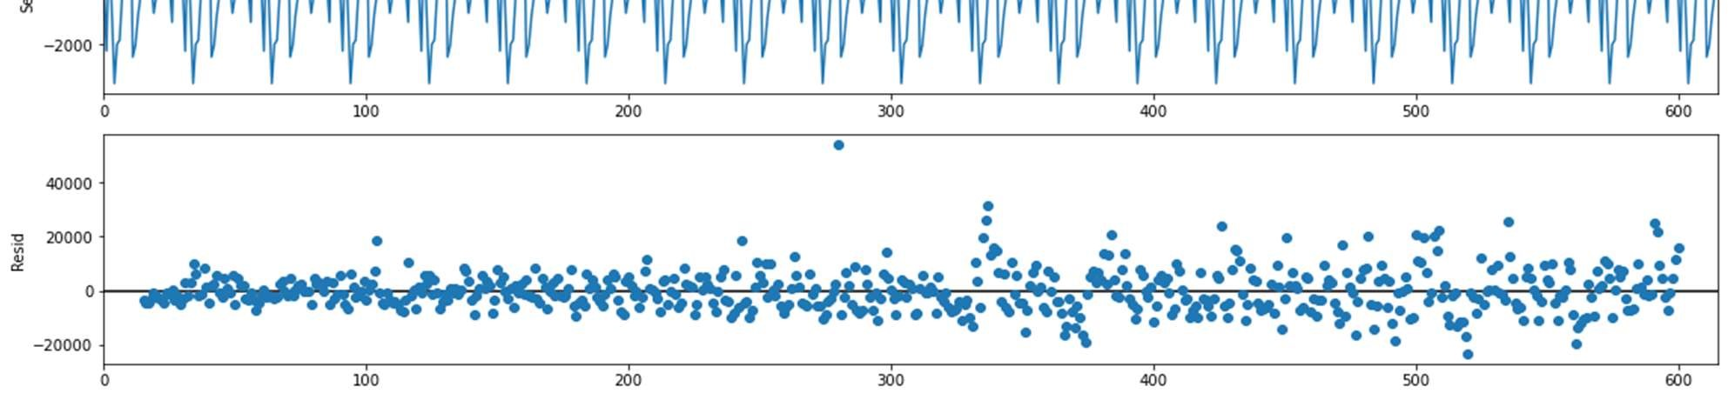
SEASONAL DECOMPOSITION(ADDITIVE)

Slide 31
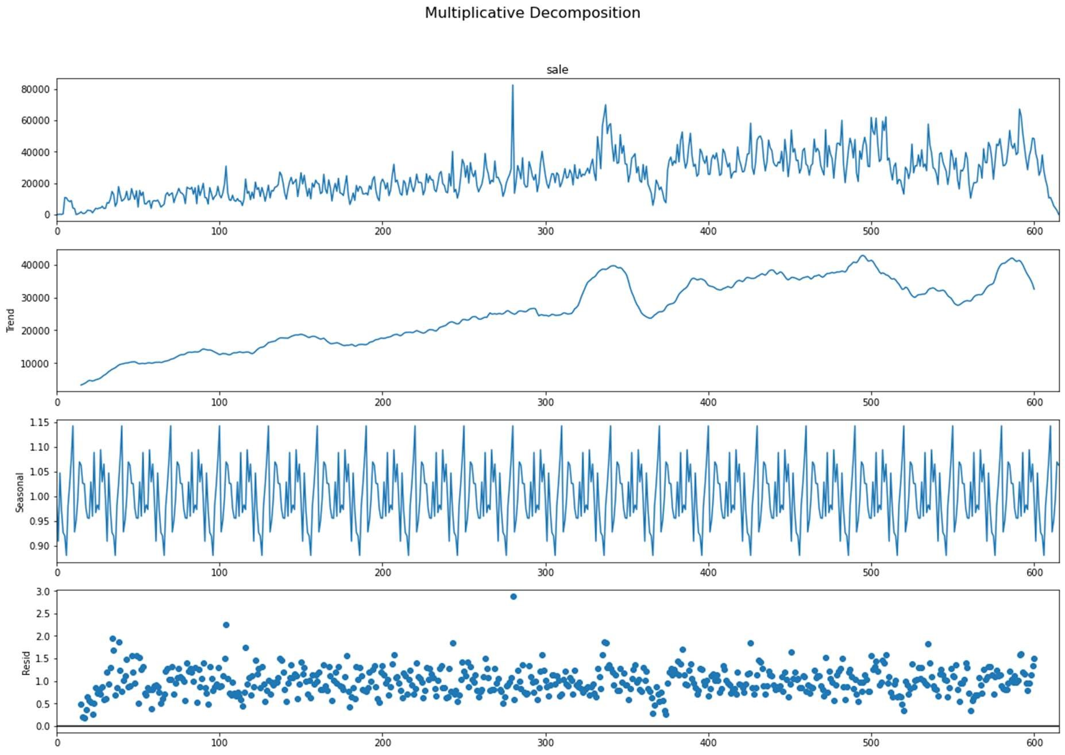
SEASONAL DECOMPOSITION(MULTIPLICATIVE)

Slide 32
WHICH SEASONAL DECOMPOSITION TO USE Here in additive model residual increases over time so additive model is not suitable to use so multiplicative model is used to determine seasonality. Deseasonalised series Using multiplicative model seasonal component is subtracted from overall sale component and deseasonalised series is obtained.

Slide 33
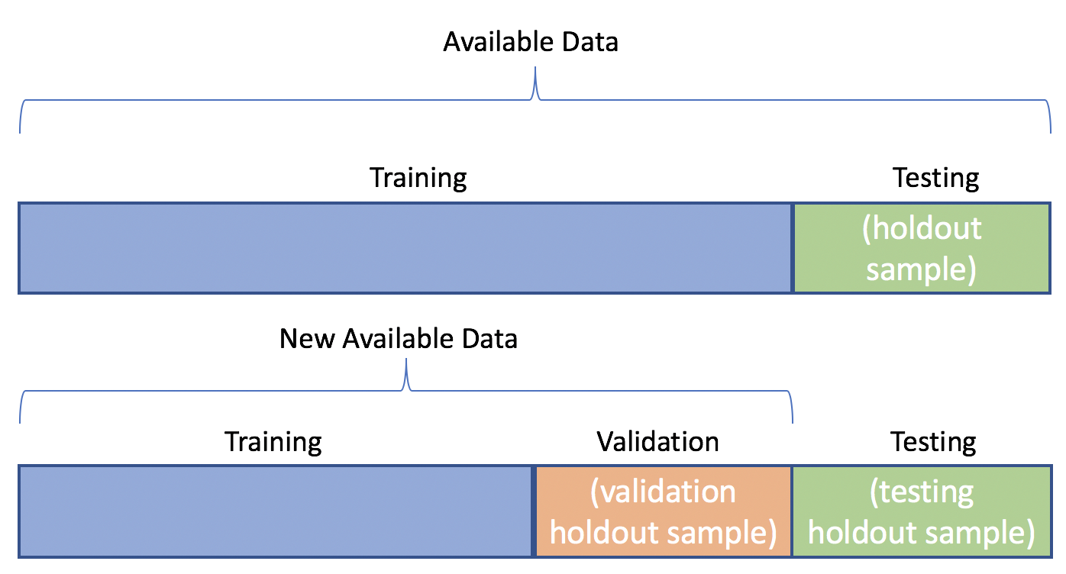
Creating training and validation set to check model performance

Slide 34
Performance measure of different model We are using two methods to measure the performance of the model 1. RMSE: RMSE stands for root mean square error. And the equation of this is 2. MAPE: MAPE stands for mean absolute percentage error using mape we can compare among different models

Slide 35
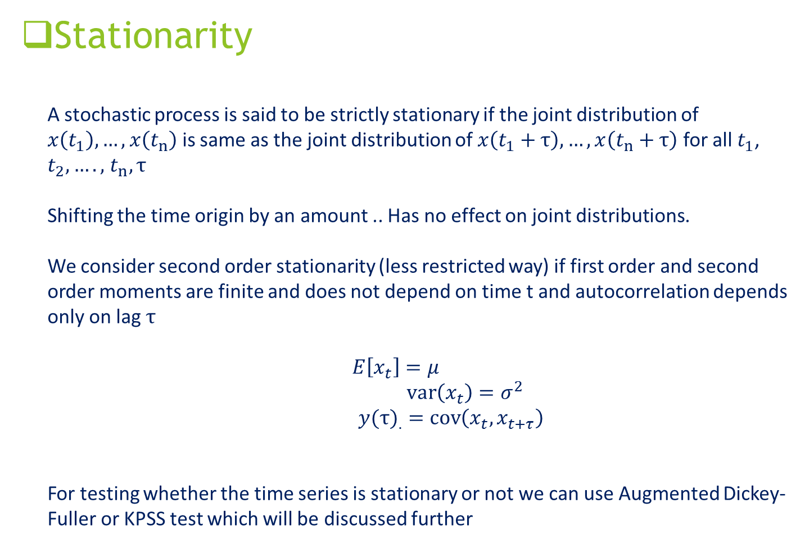
Stationarity A stochastic process is said to be strictly stationary if the joint distribution of $x\left(t_{1}\right),…,x\left(t_{n}\right)$ is same as the joint distribution of $x\left(t_{1}+τ\right),…,x\left(t_{n}+τ\right)$ for all $t_{1}$, $t_{2},….,$ $t_{n},τ$ Shifting the time origin by an amount .. Has no effect on joint distributions. We consider second order stationarity (less restricted way) if first order and second order moments are finite and does not depend on time t and autocorrelation depends only on lag $τ$ $E\left[x_{t}\right]=μ$ $\operatorname{var}\left(x_{t}\right)=σ^{2}$ ${y(τ)}_{.}=\operatorname{cov}\left(x_{t},x_{t+τ}\right)$ For testing whether the time series is stationary or not we can use Augmented Dickey-Fuller or KPSS test which will be discussed further

Slide 36
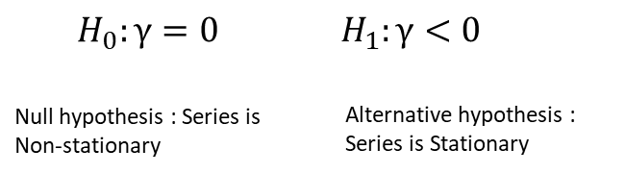
Test for stationarity: ADF test
Results of Dickey-Fuller Test after performing first differencing:
Test Statistic -2.909227
p-value 0.044285
#Lags Used 14.000000
Number of Observations Used 601.000000
Critical Value (1%) -3.441278
Critical Value (5%) -2.866361
Critical Value (10%) -2.569338
So overall sale is now stationary.

Slide 37
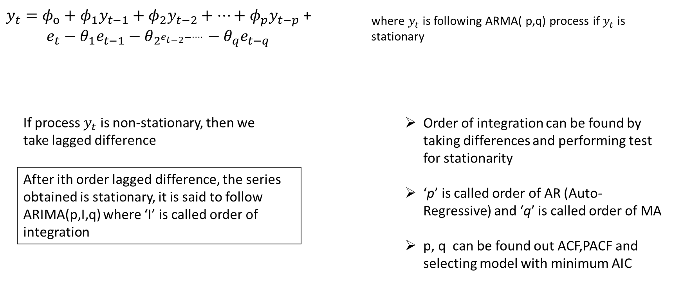
Model Building (ARIMA)

Slide 38
Model Building (Arima Summary) We have taken the help of python library pmdarima which calculates all the ACF,PACF plots and depending on the results and AIC criteria it fits the best ARIMA(p,d,q).Applying it on total sales we have got the best model The best model here to model the sale is ARIMA(4,1,5)

Slide 39
Dep. Variable: | y | No. Observations: | 547
Model: | SARIMAX(4, 1, 5) | Log Likelihood | -5477.103
Date: | Wed, 22 Jun 2022 | AIC | 10974.207
Time: | 13:48:26 | BIC | 11017.233
Sample: | 0 | HQIC | 10991.026
 | coef | std err | z | P>|z| | [0.025 | 0.975]
ar.L1 | 0.8049 | 0.017 | 47.860 | 0.000 | 0.772 | 0.838
ar.L4 | -0.9792 | 0.015 | -64.834 | 0.000 | -1.009 | -0.950
ma.L1 | -1.3625 | 0.043 | -31.668 | 0.000 | -1.447 | -1.278
ma.L5 | -0.5246 | 0.042 | -12.580 | 0.000 | -0.606 | -0.443
sigma2 | 3.635e+07 | 2.83e-10 | 1.28e+17 | 0.000 | 3.64e+07 | 3.64e+07
Model performance on validation set: rmse = 13024.2736235761
mape is = 80.00905854894125

Slide 40
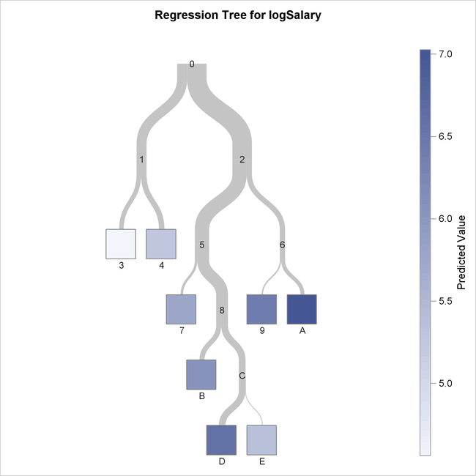
Model Buliding using Regression Tree
A regression tree is a type of decision tree.
It uses sum of squares and regression analysis to
predict values of the target field. The predictions are based on combinations of values in the input fields.
A regression tree calculates a predicted mean value for each node in the tree. This type of tree is generated when the target field is continuous.

Slide 41
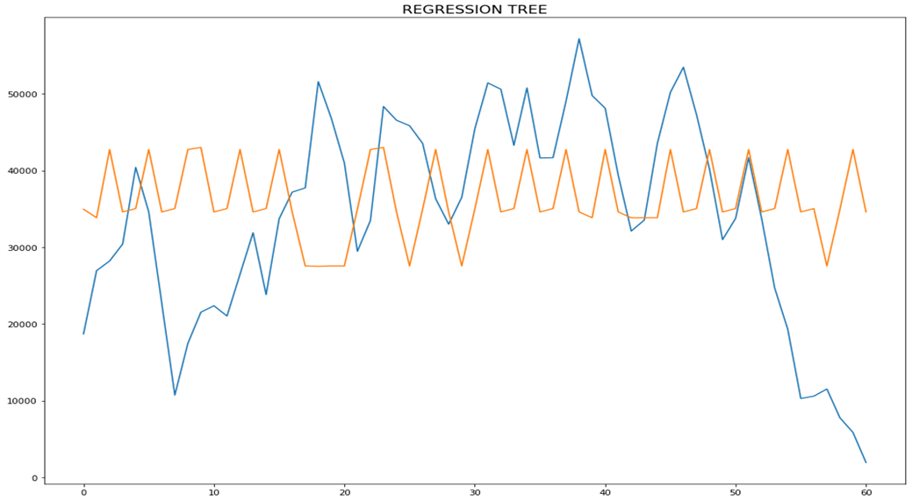
Results using Regression tree
Model performance: rmse = 14499.882697563018
mape is = 84.71271415142084

Slide 42
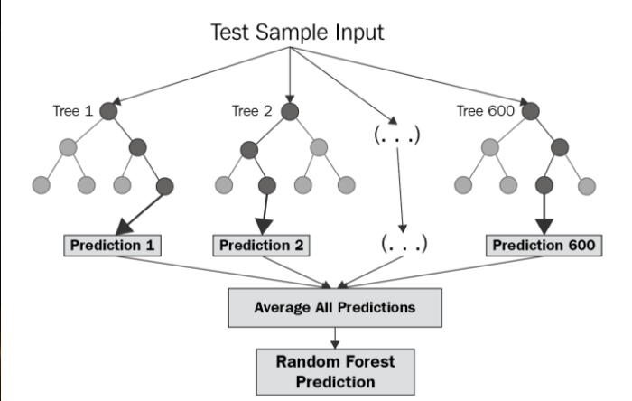
Random Forest Regression
Random Forest Regression is a supervised learning algorithm that uses ensemble learning method for regression. Ensemble learning method is a technique that combines predictions from multiple machine learning algorithms to make a more accurate prediction than a single model.

Slide 43
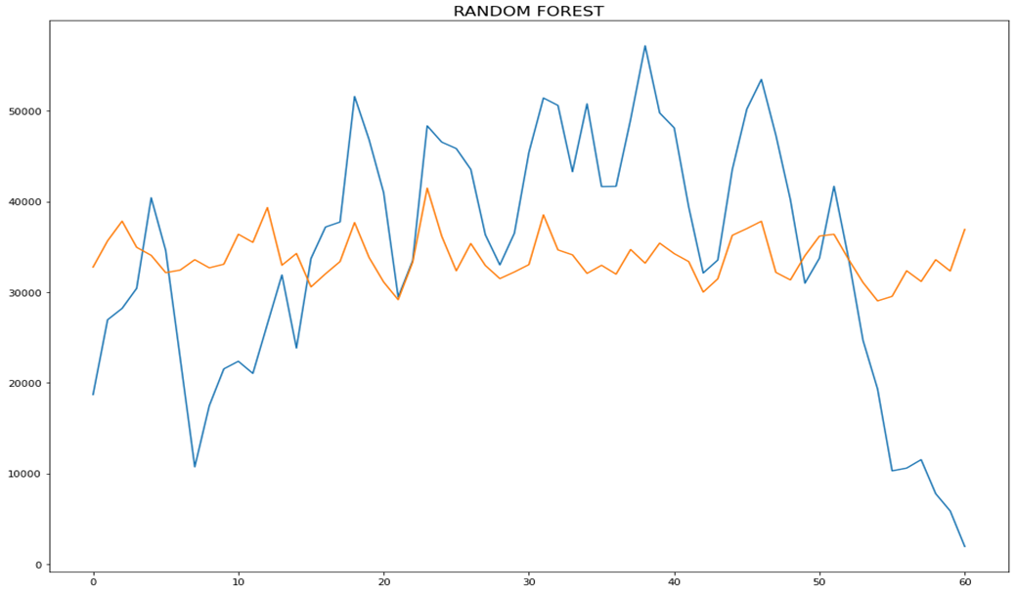
Results using Random Forest Regression
Model performance: rmse = 12948.245190958638
mape is = 78.10149522682453

Slide 44
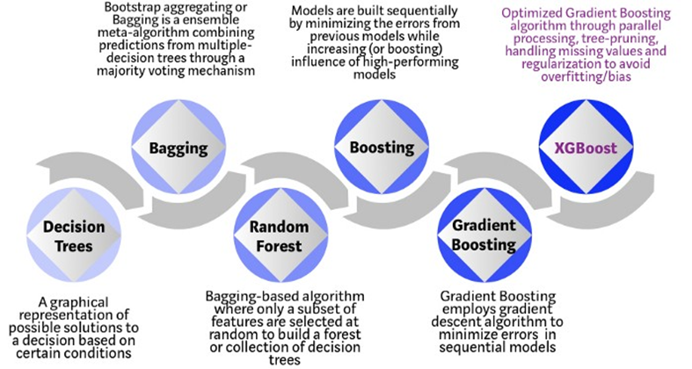
XGboost
XGBoost is an optimized distributed gradient boosting library designed to be highly efficient, flexible and portable. It implements machine learning algorithms under the Gradient Boosting framework. XGBoost provides a parallel tree boosting (also known as GBDT, GBM) that solve many data science problems in a fast and accurate way

Slide 45
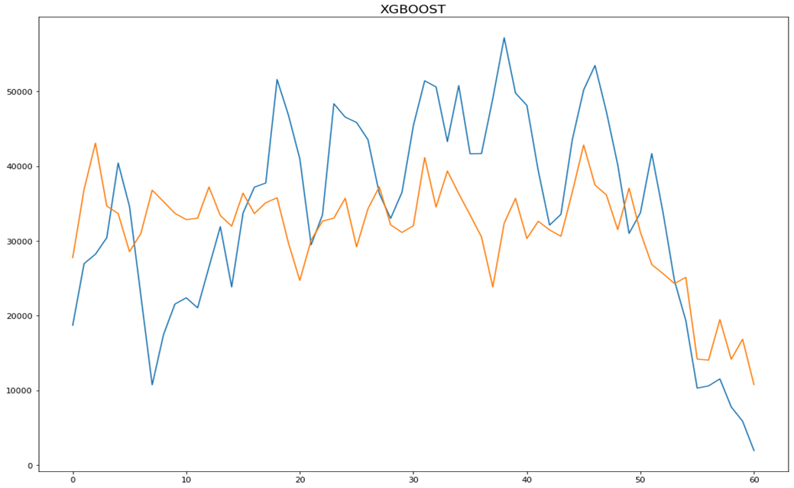
Results using XGboost
Model performance: rmse = 11284.767918070555
mape is = 31.3110130025276

Slide 46


Slide 47
THANK YOU!

