Slide 1
Spotlight Empowering Users to Report and Act on Human Rights Violations

Slide 2
Spotlight
Team Members:
. Sanath
Chiragkumar Maisuria
Parv Patel
Meet Karnik

Slide 3
Spotlight - Overview
Technology Stack
Frontend: ReactJS with TypeScript (TSX, TS)
Backend: Node.js with ExpressJS
Database: MongoDB

Slide 4
Introduction
Purpose of the Application: Our platform is dedicated to empowering individuals and communities by providing a safe and accessible space for reporting human rights violations.
Target Audience: Activists, victims of violations, and general public.
Vision: Our vision is to create a world where accountability and transparency in human rights are enhanced through the power of technology and community.

Slide 5
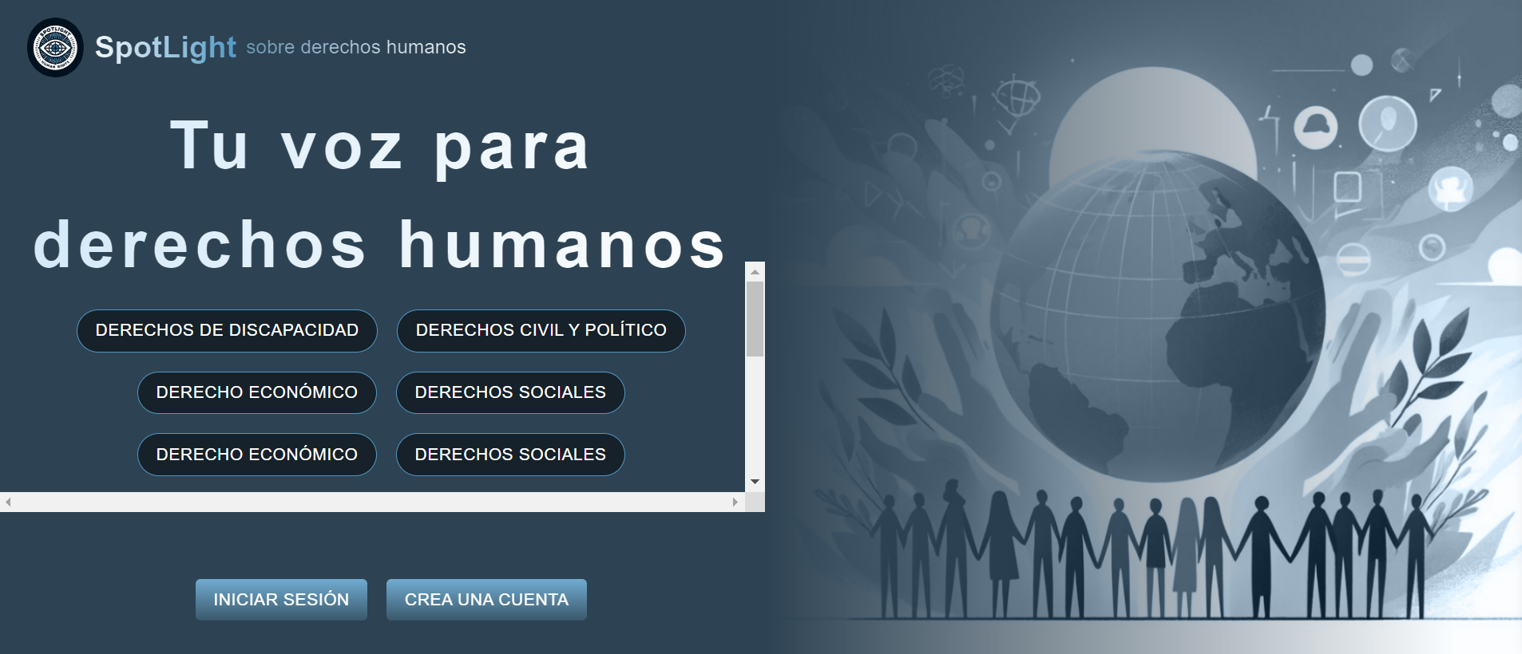
Key Features
Welcoming Interface: The landing page serves as the gateway to the platform, designed to be both inviting and informative for new and returning users.

Slide 6
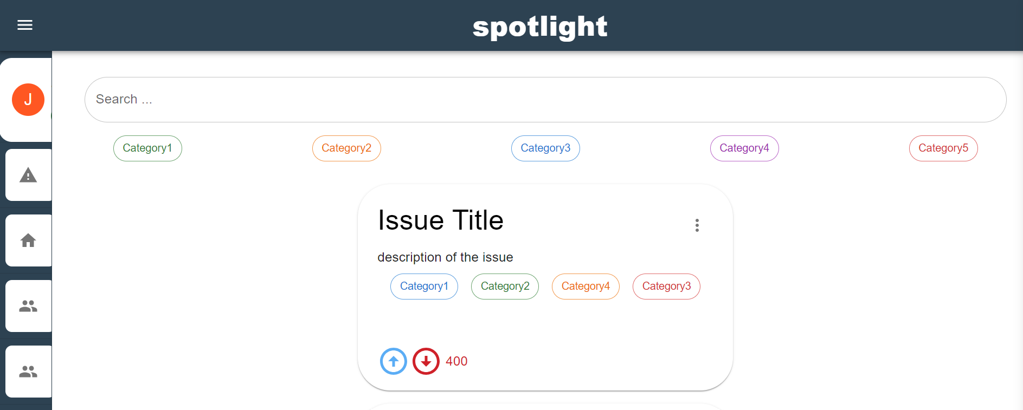
Key Features
Issue Reporting: Users can post issues related to human rights violations and search for keywords

Slide 7
Key Features
Comments and Upvotes: Features allowing community engagement through comments and upvotes.

Slide 8
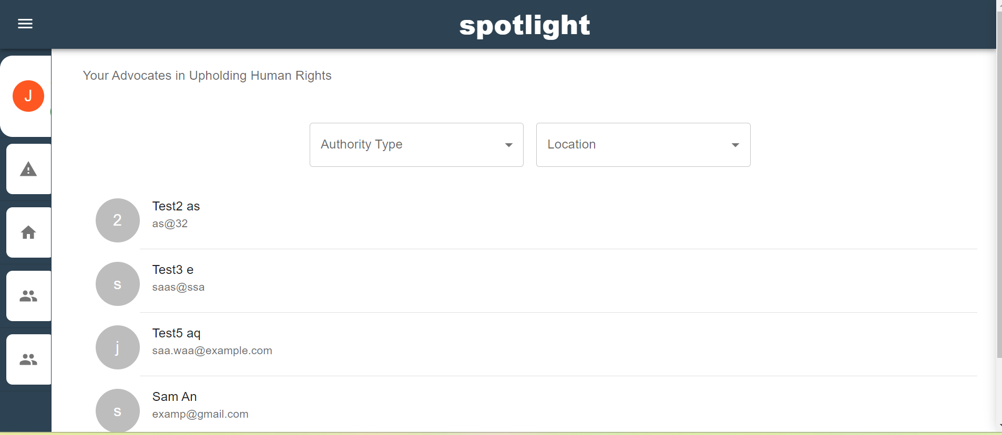
Key Features
Authority Interaction: Mechanisms for users to directly contact authorities or receive guidance and filter authorities by location and authority type

Slide 9
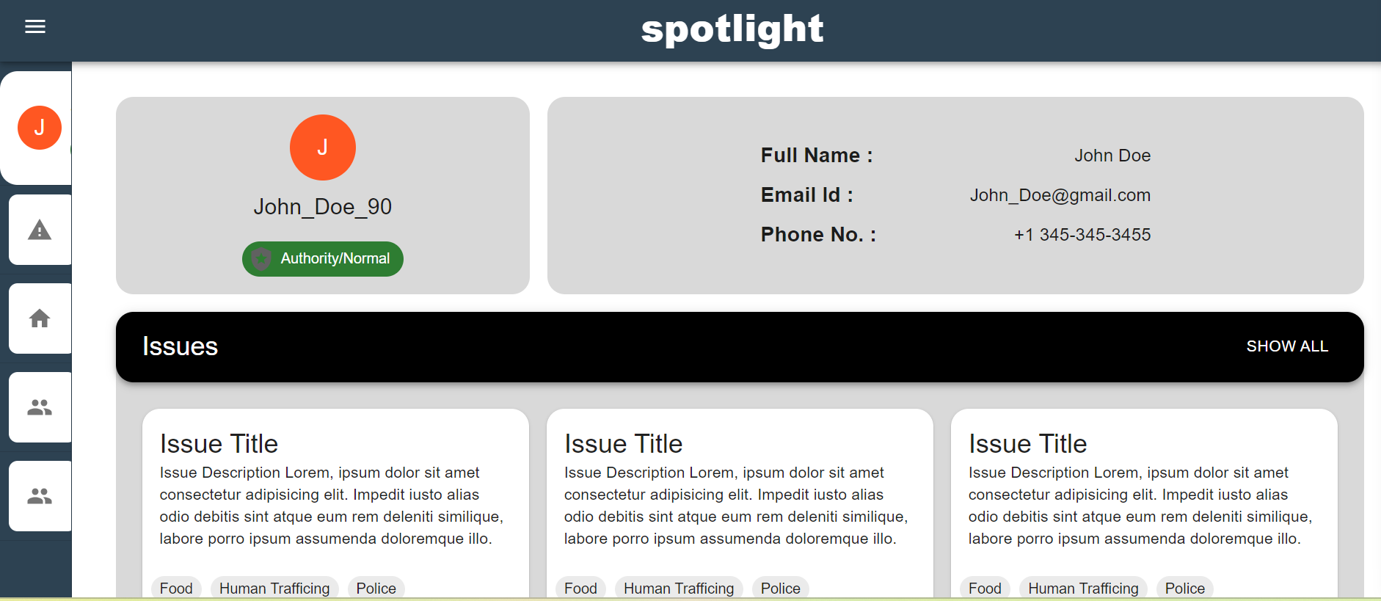
Key Features
Personal User Profiles:
Each user has a personal profile where they can easily view and manage their reported issues and comments.

Slide 10
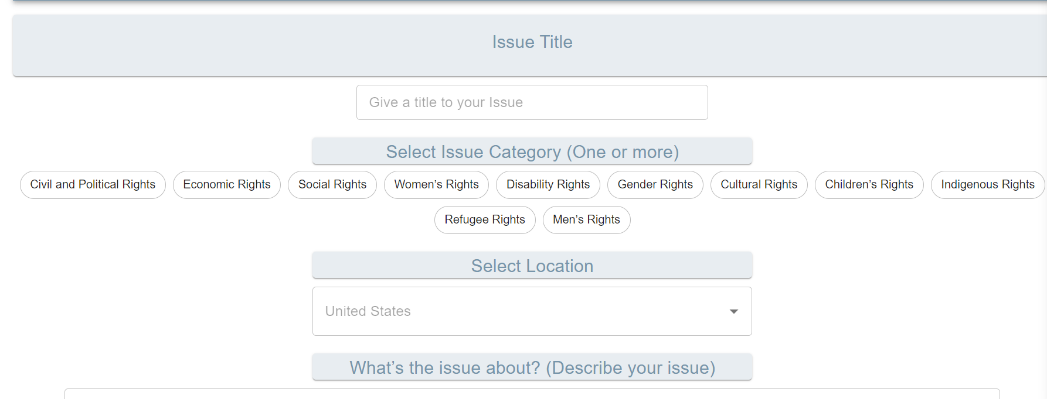
Key Features
Issue Reporting System: Users can report human rights violations by filling out a comprehensive form that captures essential details about the incident.

Slide 11
Key Features
Issue Reporting System: Users can report human rights violations by filling out a comprehensive form that captures essential details about the incident.

Slide 12
THANK YOU

