Slide 1

Streaming, Processing, & Visualization of BikeShare Data
Project:
Data Engineering 2: Big Data Architectures
By:
Sanath Haritsa (11038004)
Aniket Ghetla (11038043)
Vandit Bhalla (11038246)

Slide 2
About the Data Source
Name of the Data Source: Capital Bikeshare
It is the “Bikesharing” or the bikes for rent publicly available in Washington DC data.
The source provides system data in two forms:
Trip History Data (Zipped CSVs)
Real-Time System Data
Data features: Trip History are entirely different from the data features available in the Real-Time System Data.
Project Focus: As this project focuses on stream processing, Real-Time System Data was chosen.
2

Slide 3
APIs and Data Features
APIs
[GET] https://gbfs.lyft.com/gbfs/2.3/dca-cabi/en/station_information.json
[GET] https://gbfs.lyft.com/gbfs/2.3/dca-cabi/en/station_status.json
Data Features
Station ID
Timestamp
Name
Latitude
Longitude
Number of Bikes Available
Number of E-Bikes Available
Number of Docks Disabled
Number of Bikes Disabled
3

Slide 4
Motivation
User Stories
As a Maintenance Supervisor, I want to schedule maintenance based on bike usage data, so that we can minimize downtime and maintain a high level of service quality.
As a customer, I want to find the nearest bike station to the location entered using a map interface, so that I can see the number of bikes available.
4

Slide 5
Technologies Used
Since one of our goals was to achieve seemless integration, we decided to use the tools only provided by GCP
Cloud Scheduler
Pub/Sub
Cloud Function
Python3 (Libraries – requests, pandas, google.cloud pubsub, time, os)
DataFlow
BigQuery
Looker Studio
5

Slide 6
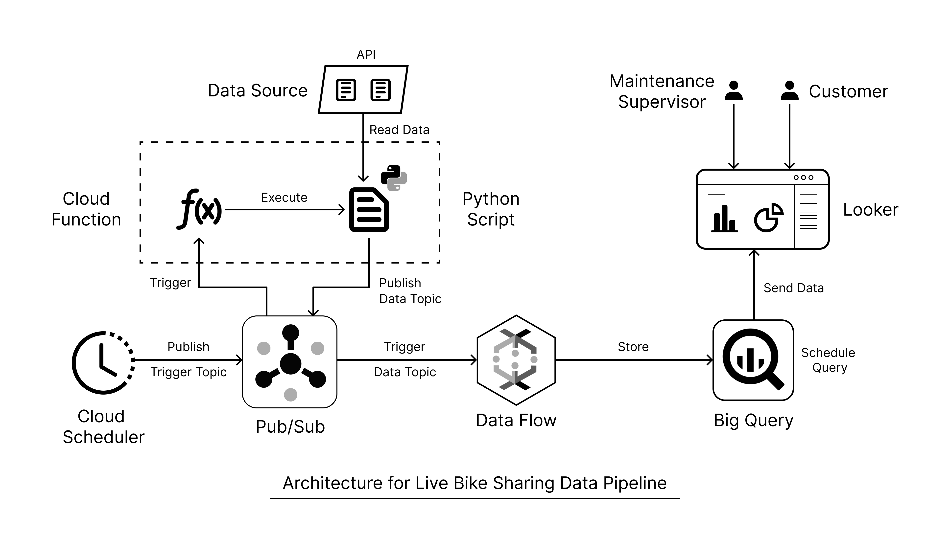
Data Pipeline
6

Slide 7
Live Pipeline Demo
7

Slide 8
Problems Faced
Apart from the learning curve of GCP tools, the difficulties that we faced were:
Discrepancy between the values of certain data points between the two APIs.
Lack of proper API documentation resulting in increased time needed for understanding.
GCP Cloud shell was not being provisioned hence had to resort to using GUI for performing all actions.
Dataflow VM was not getting created, after debugging it was found out that “Europe-West3 (Frankfurt)” region was the issue, thus had to deploy in another region.
Lack of experience with Looker Studio, thus leading to increased time for dashboard creation.
8

Slide 9
Future Scope
Use Apache Beam with Dataflow, currently Big Query only supports batch processing, and its functionality is limited. Using Apache Beam will enable us achieve stream processing and calculate aggregations in real-time.
Use a visualization tool that gets refreshed automatically as Looker Studio needs to be refreshed manually to see changes in the free version.
9

Slide 10
Conclusion
By using the tools available on GCP we were able to build a prototype for streaming, processing, & visualizing real-time data.
By using the interactive dashboard created on Looker Studio one can easily see the number of defective bikes and docks, as well as the available bikes at various stations spread across Washington DC, thus fulfilling both user stories.
10

Slide 11
References
[1] https://capitalbikeshare.com/system-data
[2] https://cloud.google.com/scheduler/docs
[3] https://cloud.google.com/pubsub/docs
[4] https://cloud.google.com/functions/docs
[5] https://docs.python.org/3/
[6] https://pypi.org/project/requests/
[7] https://pandas.pydata.org/docs/
[8] https://cloud.google.com/bigquery/docs
[9] https://cloud.google.com/dataflow/docs
[10] https://developers.google.com/looker-studio
[11] https://medium.com/@dogukannulu/gcp-cloud-engineering-project-part-1-[12] google-cloud-storage-bigquery-functions-scheduler-c2c68b092561
[13] https://www.youtube.com/watch?v=6ahfcLa3oG8
11

Slide 12
Thanks

