Slide 1
AI ENGINEER TAKE-HOME · TASK B
Document Knowledge Base
with Source Grounding
SOURCE
Codebase: sanath95/Document-Knowledge-Base-with-Source-Grounding: Semorai - Technical Interview Task
EVIDENCE
Reliable, evidence-grounded Q&A across multilingual documents
ANSWER + CITATION
Answer only from retrieved evidence, cite the supporting document and page, and state clearly when evidence is insufficient.
Grounded by design
Prepared by Sanath Vijay Haritsa
Notes:
[Sources]
- C:\All\Personal\Semorai\Technical Interview Docs\Technical Interview Docs\AI_Engineer_Take_Home_Options.pdf (Task B requirements)
- C:\All\Personal\Semorai\Document-Knowledge-Base-with-Source-Grounding\README.md
[/Sources]

Slide 2
INGESTION
Page-aware ingestion preserves source traceability
Header-aware
chunking
Generate
embeddings
PDF files
Parse PDF
ChromaDB
PyMuPDF4LLM
vectors + source metadata
LangChain splitter
text-embedding-3-small
Structured extraction
Semantically
coherent chunks
Efficient local index
Markdown-oriented parsing preserves document structure, with OCR fallback for scanned content.
Headings retain section context; page boundaries keep every chunk attributable to its source.
A small multilingual embedding model and embedded vector store minimize cost and operational setup.
Operational lifecycle Ingestion is decoupled from serving: run it once for the initial corpus, then rerun when PDFs are added or updated.
02
Notes:
[Sources]
- C:\All\Personal\Semorai\Document-Knowledge-Base-with-Source-Grounding\assets\ingestion-flow.png (visual reference)
- C:\All\Personal\Semorai\Document-Knowledge-Base-with-Source-Grounding\README.md (implemented ingestion lifecycle and choices)
- https://developers.openai.com/api/docs/models/text-embedding-3-small
- https://openai.com/index/new-embedding-models-and-api-updates/ (multilingual benchmark and efficiency context)
[/Sources]

Slide 3
QUERY ORCHESTRATION
Stateful orchestration controls the answer path
FastAPI backend · LangGraph orchestration · Langfuse observability · Docker runtime
Resolve
Follow-up queries
Safety
gate
Document
QA agent
Validate
answer
Answer +
citations
POST /query
GPT-5.4 nano
GPT-5.4 nano
Pydantic AI · GPT-5.4
GPT-5.4 nano
on failure
if unsafe
Request rephrasing
Guardrail response
Conversation-aware
Capability matched
to task
Validation is explicit
Recent turns resolve references;
fresh evidence is retrieved for
every factual answer.
Smaller models handle control
steps; GPT-5.4 plans searches
and synthesizes evidence.
Two Boolean checks report
faithfulness and context
sufficiency separately.
Validation design Confidence scores can vary and drift; Boolean judgments provide clearer decisions, with reasoning.
03
Notes:
[Sources]
- C:\All\Personal\Semorai\Document-Knowledge-Base-with-Source-Grounding\assets\query-flow.png (visual reference)
- C:\All\Personal\Semorai\Document-Knowledge-Base-with-Source-Grounding\README.md (implemented orchestration and validation behavior)
- https://developers.openai.com/api/docs/models/gpt-5.4-nano (speed- and cost-sensitive structured tasks)
- https://developers.openai.com/api/docs/models/gpt-5.4
[/Sources]

Slide 4
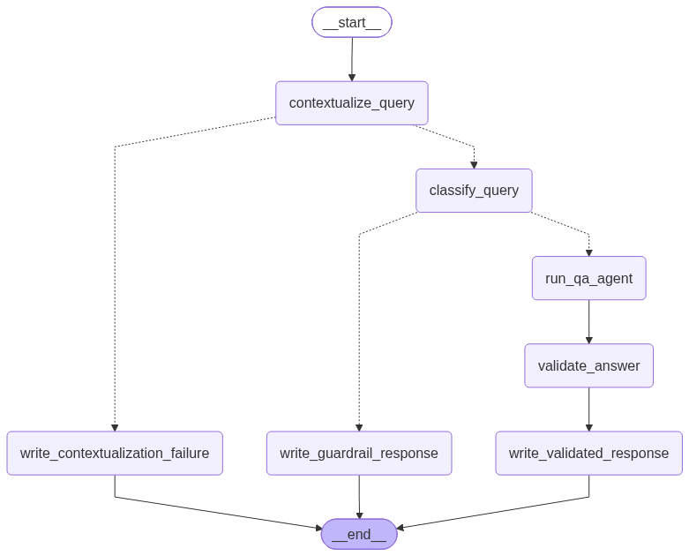
LANGGRAPH ORCHESTRATION
LangGraph makes workflow state explicit
Compiled application graph · State persisted by conversation ID
Explicit control flow
Compiled branches expose success,
guardrail, and failure paths for
inspection and testing.
Checkpointed conversations
SQLite persists state by conversation ID,
enabling contextual follow-ups across
requests and container restarts.
Deliberate failure paths
Ambiguous and unsafe queries exit through
defined responses instead of failing
silently or reaching generation.
04
Notes:
[Sources]
- C:/All/Personal/Semorai/Document-Knowledge-Base-with-Source-Grounding/docs/query_graph.png (compiled LangGraph visual)
- C:/All/Personal/Semorai/Document-Knowledge-Base-with-Source-Grounding/README.md (workflow and checkpoint behavior)
- C:/All/Personal/Semorai/Document-Knowledge-Base-with-Source-Grounding/src/orchestration/query_graph.py (compiled state graph)
- C:/All/Personal/Semorai/Document-Knowledge-Base-with-Source-Grounding/src/serve.py (SQLite checkpointer wiring)
[/Sources]

Slide 5
AGENTIC RAG
Hybrid retrieval strengthens evidence
ChromaDB vector similarity
Dense retrieval
QA agent
Focused
search query
Reciprocal
Rank Fusion
Cross encoder
reranking
Top
evidence
BM25 retrieval
Pydantic AI · GPT-5.4
mmarco-mMiniLMv2
Exact terms · names · identifiers
Semantic recall
Exact-match
coverage
Evidence-level
ranking
Dense retrieval finds related passages across paraphrases and languages, even when wording differs.
BM25 retains specialist terms, names, and identifiers that semantic similarity can underweight.
Fusion combines rank signals; the cross-encoder then scores each query–passage pair jointly.
Agentic retrieval The agent formulates focused search queries, evaluates the evidence, and retrieves again when the result is insufficient.
05
Notes:
[Sources]
- C:\All\Personal\Semorai\Document-Knowledge-Base-with-Source-Grounding\assets\query-flow.png (visual reference)
- C:\All\Personal\Semorai\Document-Knowledge-Base-with-Source-Grounding\README.md (implemented dense + BM25 + RRF + cross-encoder pipeline)
- https://developers.openai.com/api/docs/models/text-embedding-3-small
[/Sources]

Slide 6
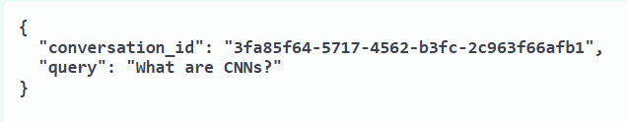
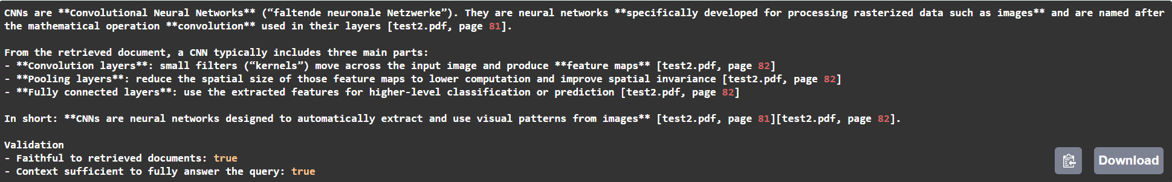
EXAMPLE RESPONSE
A question returns a cited, validated answer
REQUEST
GROUNDED RESPONSE
Cross-lingual
Traceable
Validated
English query → German evidence
Source PDF and page number
Faithfulness + context sufficiency
Screenshots taken in Swagger UI API documentation generated by FastAPI.
06
Notes:
[Sources]
- C:/All/Personal/Semorai/Document-Knowledge-Base-with-Source-Grounding/assets/example input.png
- C:/All/Personal/Semorai/Document-Knowledge-Base-with-Source-Grounding/tmp/latest-deck/cropped-assets/example-output-cropped.png
[/Sources]

Slide 7
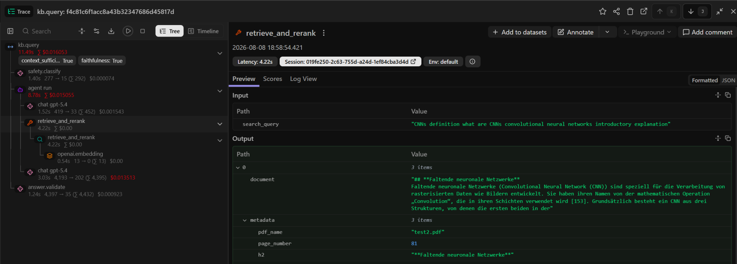
TRACE-LEVEL OBSERVABILITY
Every step is inspectable
One view links the execution tree to each step’s input, output, latency, and cost.
07
Notes:
[Sources]
- C:/All/Personal/Semorai/Document-Knowledge-Base-with-Source-Grounding/tmp/latest-deck/cropped-assets/langfuse-trace-cropped.png
[/Sources]

Slide 8
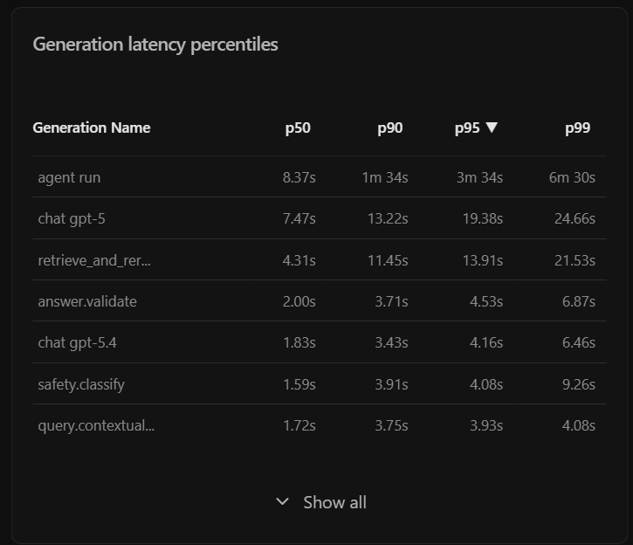
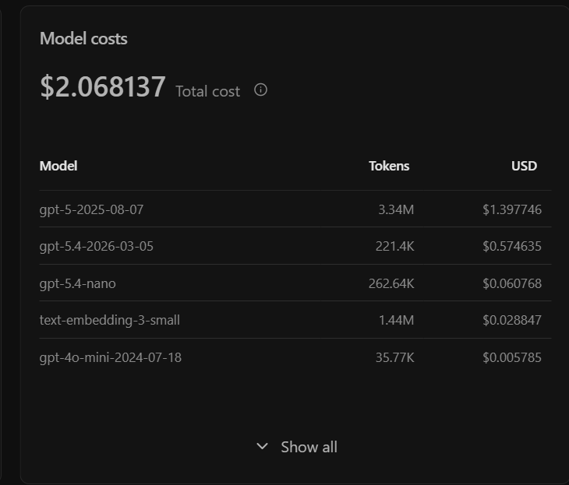
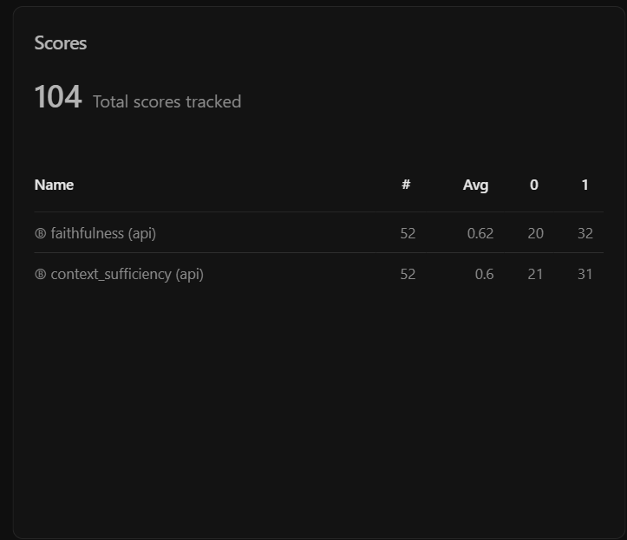
OPERATIONAL MONITORING
Monitor latency, cost, and quality signals
Latency
Cost
Quality
p50–p99 by workflow step reveals
bottlenecks and tail behavior.
Token and USD spend by model shows
where budget is consumed.
Faithfulness and context sufficiency
make regressions measurable.
08
Notes:
[Sources]
- C:/All/Personal/Semorai/Document-Knowledge-Base-with-Source-Grounding/assets/langfuse - latency.png
- C:/All/Personal/Semorai/Document-Knowledge-Base-with-Source-Grounding/assets/langfuse - costs and scores.png
[/Sources]

Slide 9
ENGINEERING JUDGEMENT
Grounded answers over unsupported confidence
Each added component must improve traceability, evidence selection, or transparent failure handling.
DESIGN DECISION
WHAT IT IMPROVES
TRADEOFF / FAILURE MODE
Page-aware, header-aware chunks
Reliable page citations and coherent section context
Cross-page context can be separated; chunk sizes vary
Hybrid retrieval + reranking
Semantic recall, exact terminology, and stronger final ranking
Higher startup cost, latency, and runtime complexity
Models matched to task complexity
Lower-cost control steps; capability reserved for evidence synthesis
Multiple LLM calls increase latency and failure surface
Independent answer validation
Faithfulness and context sufficiency are reported separately
Model-based checks are signals—not formal guarantees
Operating principle: when the evidence is incomplete, the system should say so rather than invent an answer.
06
Notes:
[Sources]
- C:\All\Personal\Semorai\Technical Interview Docs\Technical Interview Docs\AI_Engineer_Take_Home_Options.pdf (evaluation criteria and Task B guidance)
- C:\All\Personal\Semorai\Document-Knowledge-Base-with-Source-Grounding\README.md (implemented decisions and known limitations)
[/Sources]

Slide 10
FUTURE SCOPE
Path to production readiness
Three priorities turn a working system into dependable operation.
Prove quality
Strengthen knowledge
Operate safely
Evaluate individual system components such as models, retrieval, and tool calling.
Run continuous evaluations and detect drift.
Resolve conflicting, stale, and duplicate documents.
Add episodic, semantic, and procedural memory.
Defend against document-based prompt injection.
Reduce latency and cost with FAQ caching.
10
Notes:
[Sources]
- User-provided production-readiness roadmap priorities
[/Sources]

