Slide 1

Project: Hush Hush Recruiter
Big Data Programming: Python
By Team 12:
Sanath Haritsa
Aniket Ghetla
Spoorti Basarkod Math
Kshema Iliger
Vandit Bhalla

Slide 2
Task at hand
To build a robust data architecture for the Hush-Hush Recruiter application which can guide the development process.
In order to attain this goal we had to conduct a requirement analysis, that is we had to understand the types of data the application will be handling.
(Hush! Hush!)
2

Slide 3
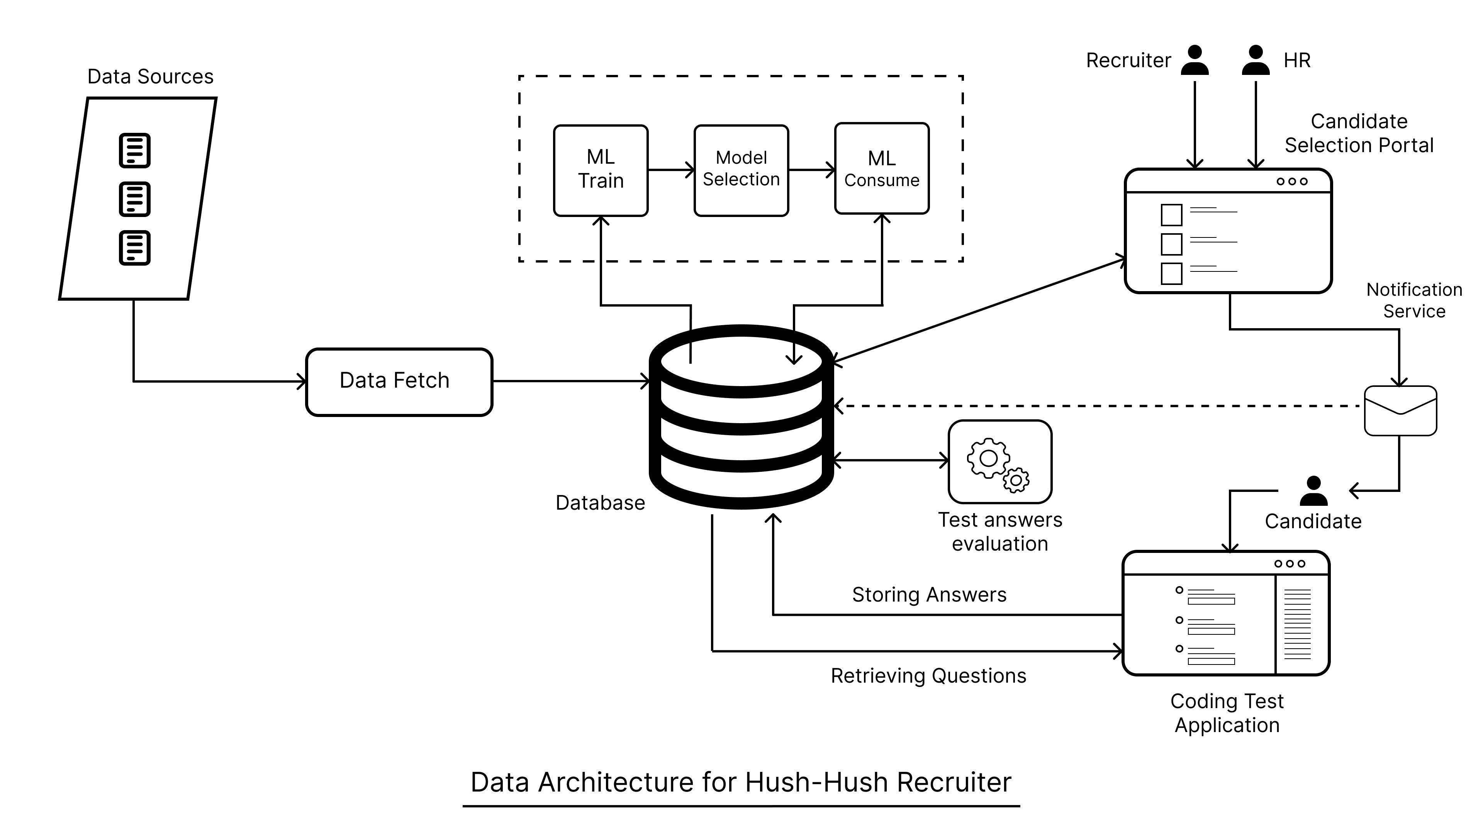
Data Architecture

Slide 4
Technologies
Now that we have a brief understanding of our data requirements, we can make decisions regarding the selection of technologies, weighing their respective advantages and disadvantages.
Backend – Python, Flask framework
Frontend – Plotly Dash
Database – PostgreSQL
5

Slide 5
Data Sources
The first step towards understanding the data is to finalise the data sources.
Stack Overflow – StackExchange API
Github – github Api
4

Slide 6
Data Points
Github and Stack Overflow offer a multitude of features but selecting the right ones is the key to a successful application.
Stack Overflow features:
User reputation
Number of Badges earned along with the type
Top tags in which user has been active in
Average question and answer score
7

Slide 7
Data Points
Github and Stack Overflow offer a multitude of features but selecting the right ones is the key to a successful application.
Stack Overflow API:
[GET] /users/{ids}
[GET] /users/{ids}/badges
[GET] /badges/tags
[GET] /users/{id}/top-tags
[GET] /users/{id}/top-question-tags
[GET] /users/{id}/top-answer-tags
8

Slide 8
Data Points
Github and Stack Overflow offer a multitude of features but selecting the right ones is the key to a successful application.
Github features:
Owner
Stargazers count
Watcher’s count
Language
Forks count
Open issues count
Topics
Email id (generated)
9

Slide 9
Data Points
Github and Stack Overflow offer a multitude of features but selecting the right ones is the key to a successful application.
Github API:
[GET] /repositories
[GET] /users
[GET] /search/repositories?q=Q
[GET] /search/users?q=Q
10

Slide 10
ML Algorithm
But how do we select a user is a good candidate?
The answer is simple, we use Machine Learning
Potential ML algorithms that could be implemented:
Cluster Algorithms:
K-Means Clustering Algorithm
DBSCAN
Affinity Propagation clustering algorithm
Divisive Clustering
Gaussian Mixture model algorithm
6

Slide 11
ML Algorithm
But how do we select a user is a good candidate?
The answer is simple, we use Machine Learning
Potential ML algorithms that could be implemented:
Neural Networks:
Artificial Neural Networks
Pre Trained ANN (using transfer learning)
6

