Slide 1
G E G A I V I D E O I N T E L L I G E N C E C H A L L E N G E
🛡
WareGuard AI
An AI field intelligence assistant for warehouse loading & unloading
Watches warehouse footage, explains why a handling action is risky, and tells the
supervisor what to do about it — before the product is damaged, not after.
Team PixelDock
Atul Bharadwaj · Sanath M Koushik · Tarun
WAREGUARD AI
01 / 06

Slide 2
F R O M S U R V E I L L A N C E T O I N T E L L I G E N C E
Problem, Solution & User Journey
TRADITIONAL CCTV
Camera
Recording
Human review
Incident discovered
Corrective action
WAREGUARD AI
Camera
AI perception
Behaviour understanding
Risk detection
Alert
Intervention
Learning
SUPERVISOR JOURNEY
– Select or upload a shift's footage in the dashboard.
– Pipeline detects and tracks people + handled material (YOLOv8 + ByteTrack).
– Behaviour engine flags drop / throw / drag / improper-stack / rough-handling events, each with a plain-English “why.”
– Risk engine scores every event Low → Critical and rolls the shift into one index.
– Supervisor asks the AI assistant a question — gets an answer grounded only in detected events, plus a recommended fix.
– Repeat-offender loads and shift trends surface automatically for training and process fixes.
WAREGUARD AI
02 / 06
PROBLEM & SOLUTION

Slide 3
H O W I T ' S B U I L T
Technical Architecture & Technology Stack
👁
Computer Vision
🧠
Behaviour Intelligence
🤖
AI / ML
– YOLOv8n (Ultralytics)
– ByteTrack multi-object tracking
– OpenCV ingestion + HUD overlay
– Custom heuristic engine, stdlib-only
– Kinematics normalised in object-heights/sec
– 5 detectors: drop, throw, drag, stack, rough
– Temporal + overlap resolution
– PyTorch, MPS-accelerated (Apple Silicon)
– COCO-pretrained detector +
– warehouse-object classification layer
💬
LLM / Assistant
🖥
Front-end
🗄
Data & Edge / Cloud
– Optional OpenAI-compatible endpoint
– Offline heuristic responder by default
– Grounded only in detected-event JSON
– Streamlit dashboard, 5 tabs
– Video + HUD, kinematics, risk panel,
– detections log, AI chat
– Structured JSON + CSV logs per shift
– No database dependency
– Behaviour/risk core: zero vision-stack deps
– — runs fully on-device
WAREGUARD AI
03 / 06
ARCHITECTURE

Slide 4
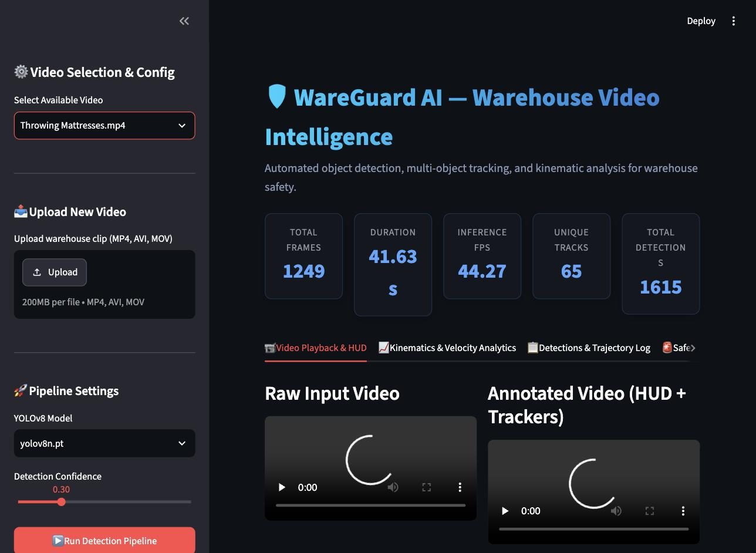
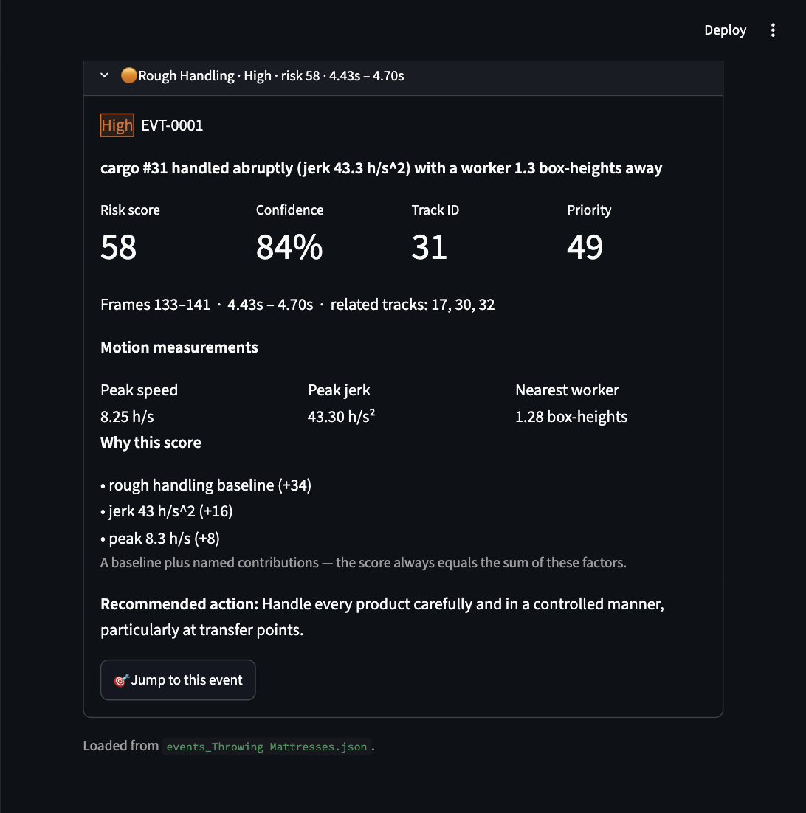
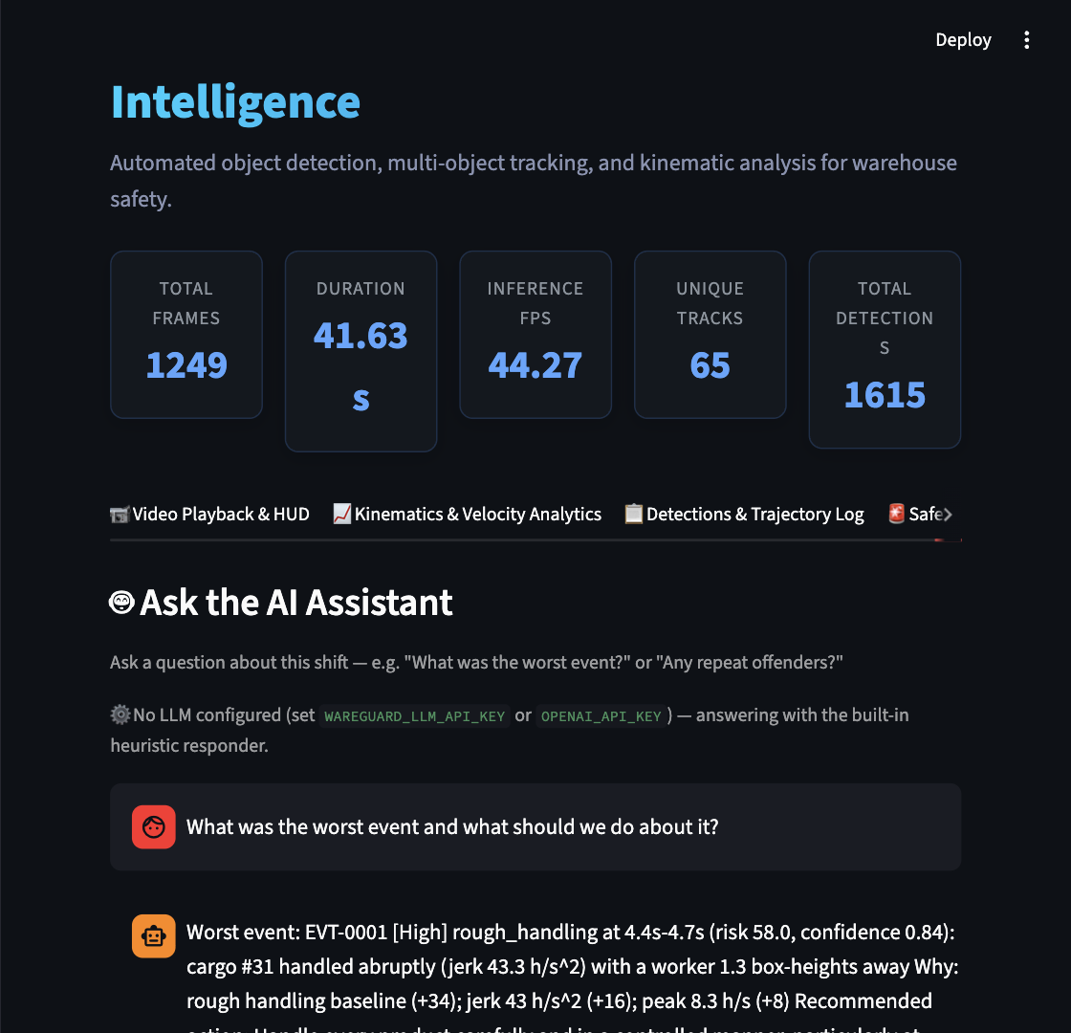
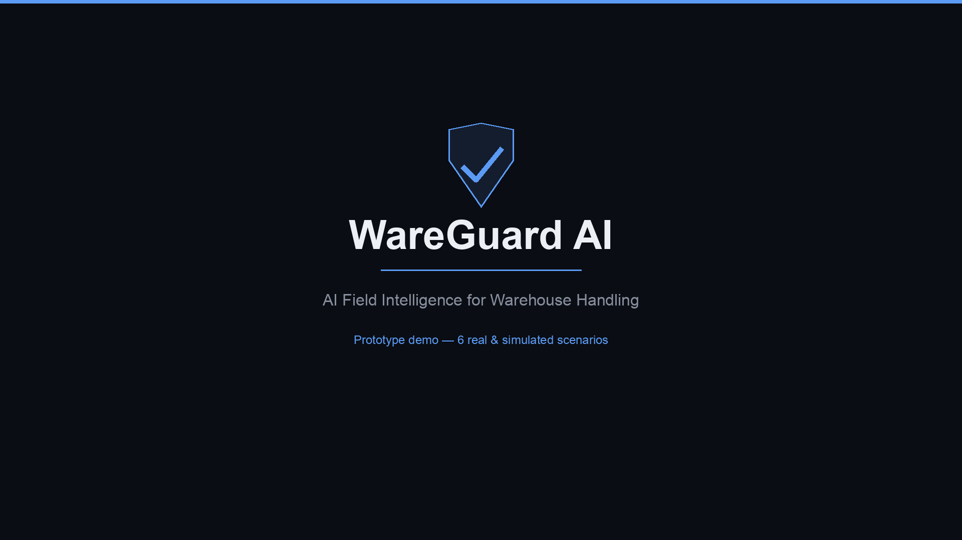
N O T S T A G E D
Prototype Screenshots & Demo
Real footage: Throwing Mattresses.mp4 — a genuine warehouse handling clip, unedited.
Detection + tracking overview — 65 tracks, 1,615 detections
Risk event card: score, confidence, “why,” recommended action
AI assistant — offline, grounded in detected events only
Demo video — 6 scenarios, real dashboard runs
(silent, captioned — click to play in PowerPoint)
If it doesn't play here: docs/demo_video.mp4
WAREGUARD AI
04 / 06
LIVE RESULTS

Slide 5
R E F R A M E D , P E R T H E B R I E F
Damage Prevention & User Validation
“We identified 1 high-risk handling event across 7 real shift clips and gave the supervisor a specific corrective action — before damage occurred.”
1
4
3
5 / 5
High-risk event confirmed
Confident clean shifts
Honest data-quality flags
Behaviours proven
Rough handling, risk 58/100, 84% confidence
Genuine “no unsafe handling” reads
Insufficient tracking — never a false all-clear
Simulated ground-truth self-test, sub-second
12 scenario demonstrations total — 7 real clips + 5 simulated behaviour types (drop, throw, drag, improper-stack, rough-handling). Brief requires ≥10.
VALIDATION STATUS — HONESTLY LABELLED
RESPONSIBLE AI, BUILT IN
DONE TODAY (internal, real)
NOT YET DONE (needs real users)
Never reports empty events as “all clear.” Severity and priority kept separate. Assistant answers only from detected data. Runs fully offline.
– Ran all 7 real clips + simulated self-test end to end
– Found + fixed a real bug: 0 cargo tracks classified on real footage
– 63 / 63 automated tests passing after the fix
– Real supervisor / operator review of alerts + recommendations
– Precision / recall against labelled ground truth
– Measured business impact (financial, incident reduction)
WAREGUARD AI
05 / 06
IMPACT & VALIDATION

Slide 6
W H A T ' S R E A L V S . W H A T ' S N E X T
Innovation, Roadmap & Judging-Criteria Fit
ALREADY TRUE TODAY
JUDGING CRITERIA — SELF-ASSESSMENT
ROADMAP, HONESTLY LABELLED
– Edge AI / offline inference — zero vision-stack dependency in the core engine
– Explainable risk scoring — every event ships a “why” breakdown, not just a number
– Recommended actions pulled from this brief's own Good-Practice table
– Data-quality honesty — never reports “all clear” on unusable tracking
– 63 / 63 automated tests passing
Innovation & Creativity (15%)
– Orientation classification (vertical-vs-horizontal handling)
– Dock-level / floor-condition detection
– Warehouse-specific fine-tuned detector, replacing the COCO-proxy classification on real footage
– Multi-camera tracking, PPE compliance detection
– Precision/recall against labelled ground truth
STRONG
Honest risk gating, brief-sourced recommendations
Technical Execution (20%)
STRONG
End-to-end pipeline, real bugs found + fixed today
AI + Video Integration (20%)
STRONG
Detection → behaviour → risk → LLM, fully wired
UX & User Feedback (10%)
PARTIAL
Dashboard dogfooded; no real supervisor feedback yet
Damage Prevention & Impact (20%)
PARTIAL
Reframed + actionable; financial impact not quantified
Presentation Quality (15%)
STRONG
This deck + a 6-scenario demo video
WAREGUARD AI
06 / 06
INNOVATION & ROADMAP

