Slide 1

BVM Engineering College
Course name: Minor Project II (IT442)(UDP)
Presented By : Sanat Dhobi(15IT027)
Ujas Thummar(15IT033)
Ravi Vaniya(15IT036)
Meet Patel(15IT071)

Slide 2
Disease prediction in cotton plant using drone.
Project Guide: Dr. Zankhana Shah

Slide 3

Outline
Objective
Scope
Modules
Capturing and uploading of image
Pre-processing of Image Module
Feature extraction from image
Classification of diseases present in image
Result analysis & Notification
Conclusion
Future work
References

Slide 4
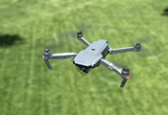
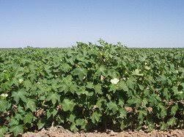
Objective
To detect disease in cotton plant by examining leaf of plant and provide support for disease and its control measures.

Slide 5
Scope
The proposed system will be able to detect four common diseases(Alternaria, Anthracnose, Bacterial Blight, Cercospora) found in cotton plant.
The proposed system will only detect diseases caused by fungi and bacteria in cotton leaf.

Slide 6
Modules
Capturing and uploading of image
Preprocessing of image
Feature extraction from image
Classification of diseases present in image
Notification.

Slide 7
Capturing and Uploading of Image
Capturing of image is performed by three different ways:
1. By camera equipped in a drone.
2. By mobile’s camera.
3. Leaf is grounded and image is captured.
The image will be uploaded to the server with the help of mobile application.

Slide 8
Preprocessing of image
Perform Denoise techniques using OpenCV.
RGB to Gray conversion by which color image will be converted into gray form.
Perform Smoothing by Gaussian Blur method.
Edge Detection in which appropriate portion of the leaf is selected.
Apply Canny Edge detection using a wide threshold,tight threshold,and automatic determined threshold.

Slide 9
Preprocessing of image
Segmentation : In this method image will be segmented into clusters.Method used are Thresh-Binary,Thresh-Binary-Inverse,Thresh-Truncated,Thresh-to-zero,Thresh-to-zero-Inverse.
Histogram Equalization : The main purpose of this techniques is to improve contrast of image.

Slide 10
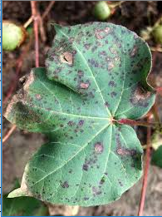
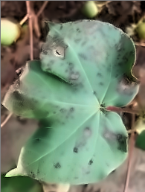
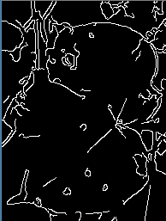
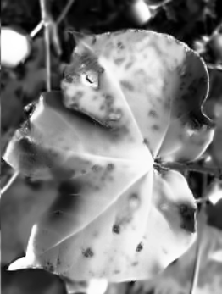
Pre-processing for Image
Original Image De-noising Edge Detection Histogram
Courtesy: Anand Agriculture University [For Images]

Slide 11
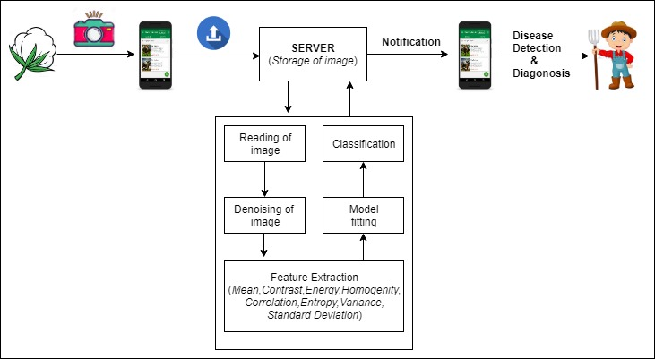
Feature extraction from image

Slide 12
Gray Level Co-occurence matrix
GLCM is a feature extraction technique.
An image is composed of pixels each with an intensity, the GLCM is a tabulation of how often different combinations of gray levels co-occur in an image or image section.
Texture feature calculations use the contents of the GLCM to give a measure of the variation in intensity at the pixel of interest.

Slide 13
Feature extracted using GLCM
Contrast : measure of the intensity contrast between a pixel and its neighbour over the whole image.
Energy : Returns the sum of squared elements in the SGDM.
Homogeneity : measures the closeness of the distribution of elements in the SGDM to the SGDM diagonal.
Correlation : Returns a measure of how correlated a pixel is to its neighbour over the whole image.

Slide 14
Feature extracted
Entropy : Return the randomness of pixels as compared to its neighbour.
Mean : Returns an estimate of the intensity of all pixels in the relationships that contributed to the GLCM.
Variance : Variance is a measurement of the spread between numbers in a data set.
Standard Deviation : The deviation from mean of the intensities of all reference pixels.

Slide 15
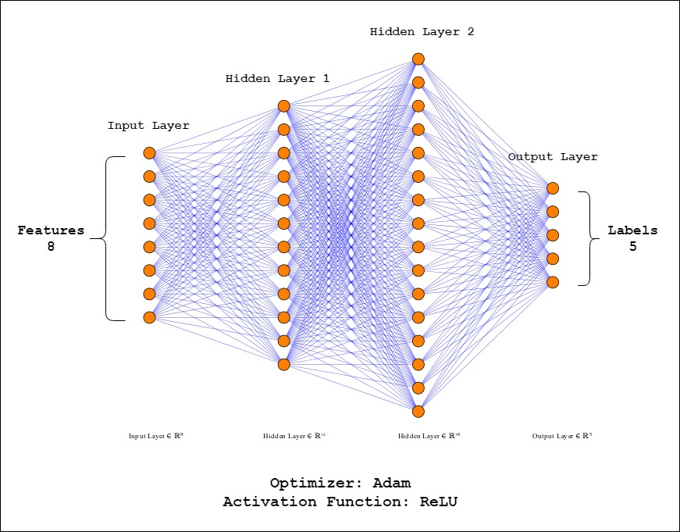
Classification of diseases

Slide 16
Result Analysis
The statistics of dataset used to develop this system is shown as below:
1. Total No. of images in the dataset - 275
2. No. of images for Alternaria disease - 40
3. No. of images for Anthracnose disease - 72
4. No. of images for Bacterial Blight disease - 72
5. No. of images for Cercospora disease - 34
6. No. of images for Healthy cotton - 57
7. No. of images used for training a model - 220
8. No. of images used for testing a model - 55

Slide 17
Classification accuracy for each disease
Disease | Accuracy
Alternaria | 85%
Bacterial Blight | 79%
Cercospora | 70%
Anthracnose | 31%

Slide 18
Test Cases
Observed Disease | Captured by drone | Captured from surface | Captured by mobile camera | Classification
Alternaria | Alternaria | Alternaria | Alternaria | True
Healthy | Alternaria | Alternaria | Alternaria | False
Alternaria | Alternaria | Alternaria | Alternaria | True
Alternaria | Alternaria | Alternaria | Alternaria | True
Healthy | Healthy | Healthy | Alternaria | False

Slide 19
Test Cases
Observed Disease | Captured by drone | Captured from surface | Captured by mobile camera | Classification
Bacterial Blight | Bacterial Blight | Bacterial Blight | Bacterial Blight | True
Bacterial Blight | Bacterial Blight | Bacterial Blight | Bacterial Blight | True
Cercospora | Cercospora | Cercospora | Cercospora | True
Cercospora | Healthy | Healthy | Cercospora | False
Cercospora | Cercospora | Cercospora | Cercospora | True

Slide 20
Conclusion
With the introduction of following proposed system reduction in cotton crop failure will be reduced by substantial rate.Hence, increasing productivity in cotton farming.
Introduction of various Machine learning and Image processing techniques will change crop cultivation.

Slide 21
Future work
More disease can be included that occurred on the cotton ball.
By collecting more images for each disease we can improve accuracy.

Slide 22
References
[1] Prakash M. Mainkar, Shreekant Ghorpade, Mayur Adawadkar, “Plant Leaf Disease Detection and Classification using Image Processing Technique” International Journal of Innovative and Emerging Research in Engineering, Volume 2, 2015
[2] Premalatha V., Valarmathy. S., Sumithra M.G., “Disease Identification in Cotton Plant Using Spatial FCM & PNN Classifier” International Journal Innovative Research in Computer and Communication Engineering, Volume 3, April 2015
[3] Anuradha Badage, “Corp Disease Detection using Machine Learning: Indian Agriculture” International Research Journal of Engineering and Technology, Volume 5, September 2018
[4] Reena Tijare, Pawan Khade, Rashmi Jain, “The Survey of Disease Identification of Cotton Leaf” International Journal Innovative Research in Computer and Communication Engineering, Volume 3, November 2015

Slide 23
References
[5] Sachin D. Khirade, A. B. Patil, “Plant Disease Detection Using Image Processing” International Conference on Computing Communication Control and Automation, 2015
[6] https://en.wikipedia.org/wiki/Gaussian_blur
[7] https://dzone.com/articles/introduction-to-perceptron-neural-network
[8] https://towardsdatascience.com/activation-functions-neural-networks-1cbd9f8d91d6
[9] https://en.wikipedia.org/wiki/Histogram_equalization
[10] http://matlab.izmiran.ru/help/toolbox/images/enhanc15.html

Slide 24
Thank You!

