Slide 1
M.SC. / THESIS DEFENCE · TRUSTWORTHY CLINICAL AI
Making AI More Trustworthy
Context Labelling & Original-Source Tracking for Clinical Question Answering
A World-Model–Guided, Calibrated & Interpretable Retrieval-Augmented Generation Framework
GRAPES-SHAP
10.1 M Parameters
100,000 Samples
DeepSeek LLM
Author Name
Department / Institution · Supervisor: [Name] · 2026

Slide 2
PRESENTATION ROADMAP
Outline
01
Motivation & Problem
02
Objectives & Contributions
Why fluent LLMs are not yet trustworthy
Six goals; two core trust mechanisms
03
Approach & Architecture
04
Data & Preprocessing
Pipeline, world model, neural core
DDXPlus · MedMCQA · MedQA (100k)
05
Training & Evaluation
06
Results & Impact
Convergence, calibration, generalisation
Head-to-head vs strong RAG baseline
07
Planning · Risk · Economics
08
Conclusion & Future Work
Engineering & responsible-AI view
Findings, limits, next steps
Making AI More Trustworthy · Clinical QA via Context Labelling & Source Tracking
01

Slide 3
01
Motivation & Problem
Why fluent clinical LLMs are not yet trustworthy

Slide 4
SECTION 01 · MOTIVATION
The Trust Gap in Clinical LLMs
▸ Fluency ≠ trustworthiness. LLMs encode rich medical knowledge yet remain hard to deploy safely.
▸ Hallucination. Confident, well-formed claims unsupported by any source.
▸ Opaque confidence. A 0.95-confidence answer and a borderline one look identical.
▸ No provenance. Clinicians cannot see which evidence actually drove the answer.
▸ RAG helps, but is reactive. Retrieve–concatenate–generate delegates all reasoning & self-checking to one opaque pass.
Three properties canonical RAG lacks
Prospective reasoning
Simulate how a patient responds before committing to an action.
Calibrated self-knowledge
Know what it does not know; expose honest uncertainty.
Provenance
State which documents were decisive — auditable, not decorative.
Making AI More Trustworthy · Clinical QA via Context Labelling & Source Tracking
03

Slide 5
SECTION 01 · GOALS
Research Objectives
1
Augment retrieval with a world model
2
Calibrated uncertainty
action-conditioned latent dynamics for prospective, tree-of-thought planning
deep ensemble with epistemic / aleatoric decomposition
3
Original-source tracking
4
Compact & efficient core
Shapley-value evidence attribution with explicit citations
~10 M parameters, < 20 min training on one consumer GPU
5
Rigorous trust evaluation
6
Honest scope & limitations
calibration, generalisation, significance, controlled baseline comparison
explicit boundaries of validity for responsible interpretation
Making AI More Trustworthy · Clinical QA via Context Labelling & Source Tracking
04

Slide 6
02
Approach & Architecture
Two trust mechanisms realised in a 12-stage pipeline

Slide 7
SECTION 02 · CORE IDEA
Two Coupled Trust Mechanisms
① Context Labelling
② Original-Source Tracking
▸ Attach a structured, machine-checkable record to every answer:
– Retrieved evidence set
– Causal knowledge-graph relations
– Predicted diagnostic state
– Calibrated uncertainty estimate
▸ Trace each claim back to the documents that supported it:
– Shapley value per retrieved document
– Quantifies marginal contribution
– Explicit, auditable citations
– Converts an opaque generator into an accountable assistant
Making AI More Trustworthy · Clinical QA via Context Labelling & Source Tracking
06

Slide 8
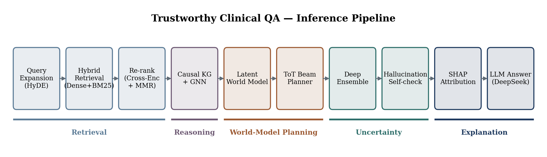
SECTION 02 · PIPELINE
End-to-End Inference Pipeline
Twelve-stage pipeline: retrieval → graph reasoning → world-model planning → uncertainty → explanation.
Making AI More Trustworthy · Clinical QA via Context Labelling & Source Tracking
07

Slide 9
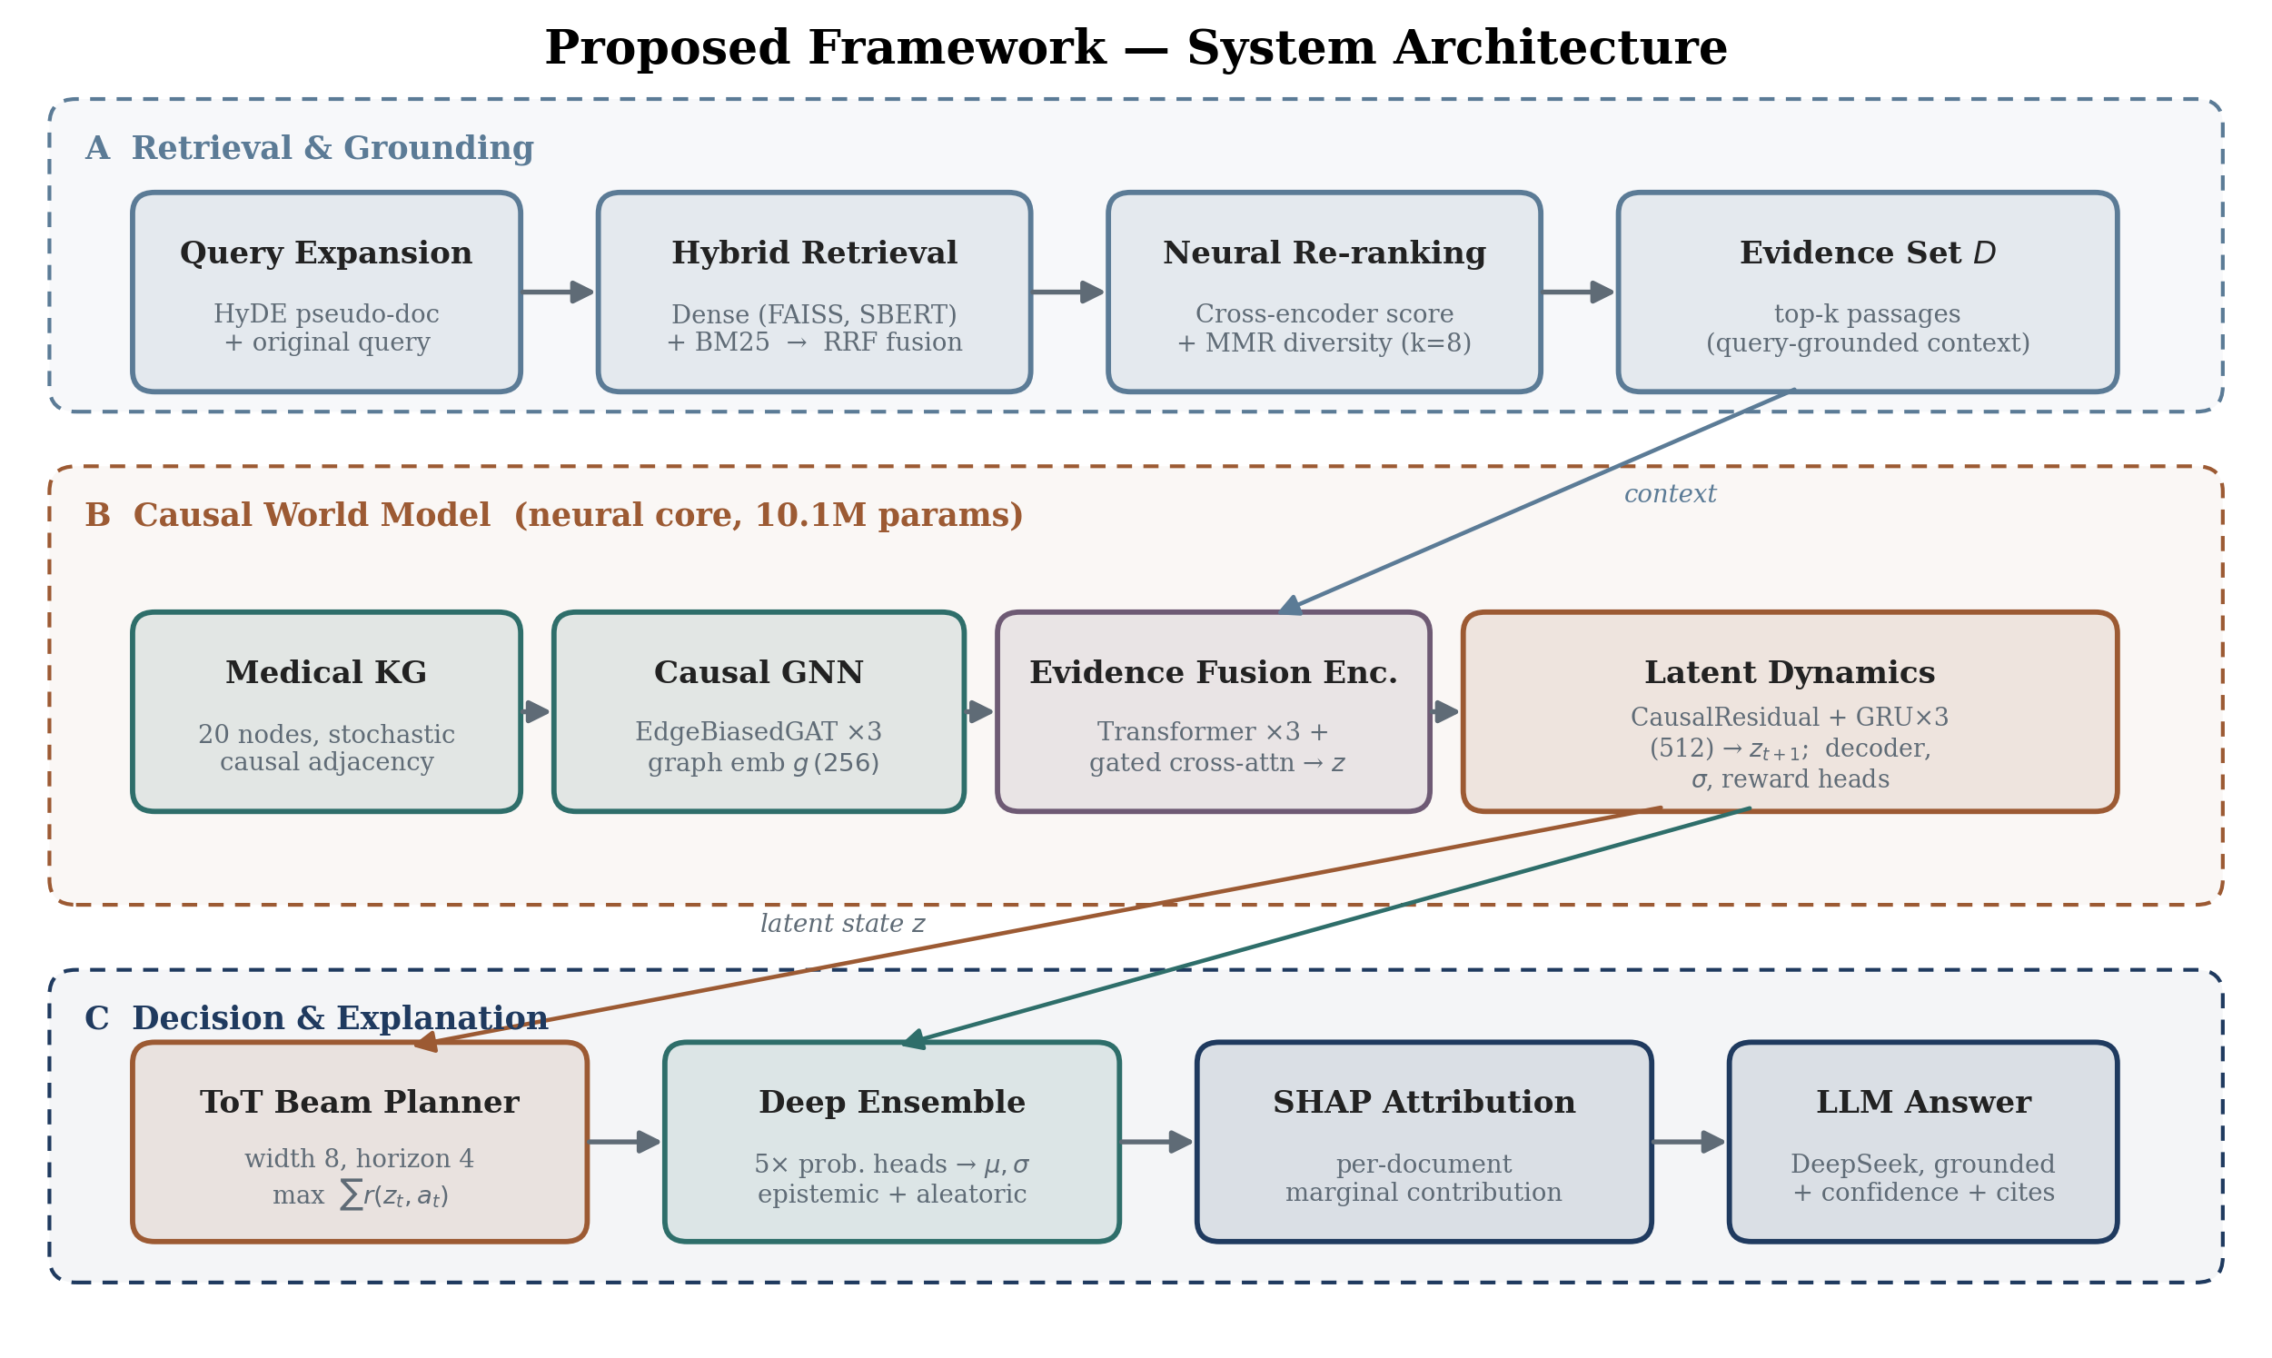
SECTION 02 · SYSTEM
System Architecture (Lanes A–C)
Retrieval & grounding · causal world model (10.1M params) · decision & explanation.
Making AI More Trustworthy · Clinical QA via Context Labelling & Source Tracking
08

Slide 10
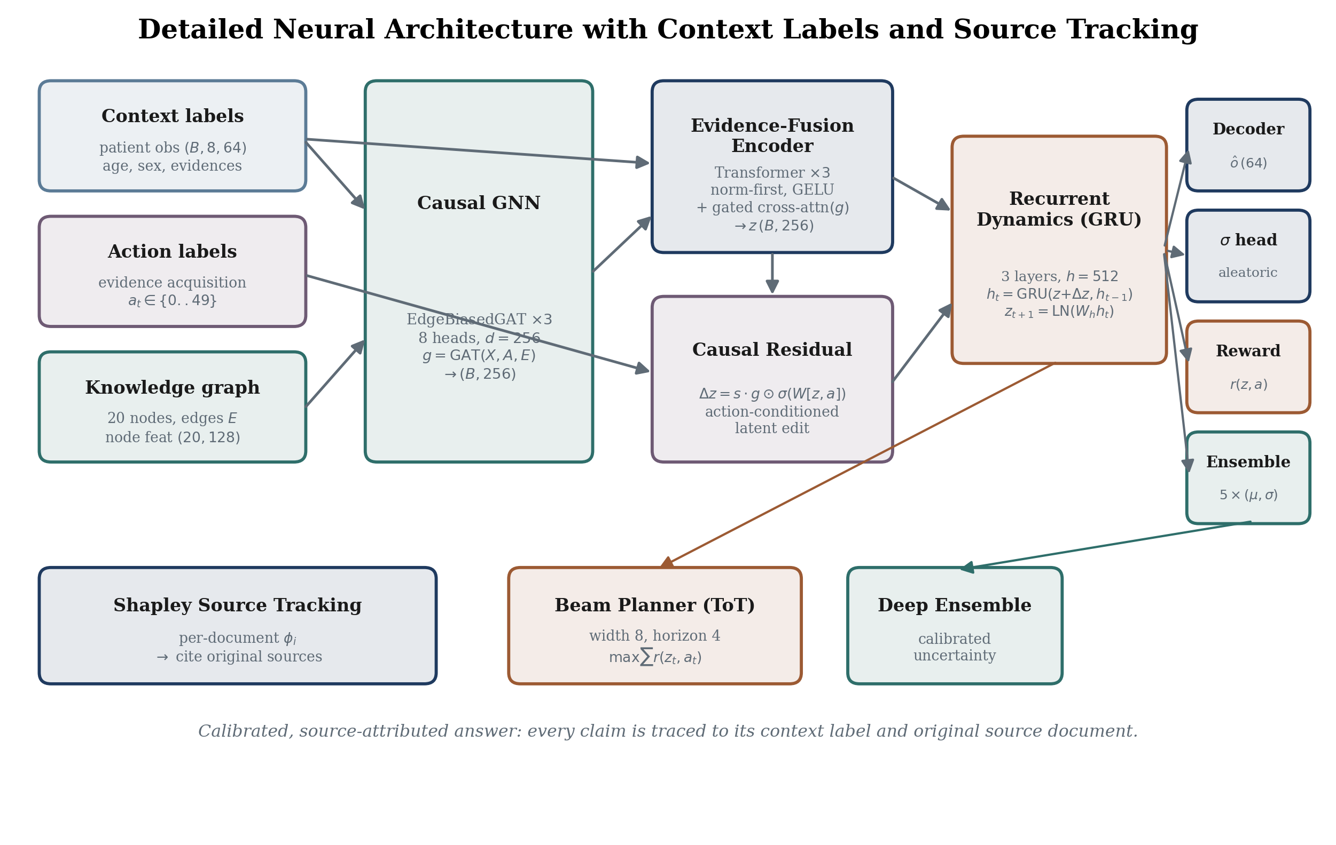
SECTION 02 · NEURAL CORE
Detailed Neural Architecture
Context labels enter left; Shapley source-tracking produces a calibrated, attributed answer.
Making AI More Trustworthy · Clinical QA via Context Labelling & Source Tracking
09

Slide 11
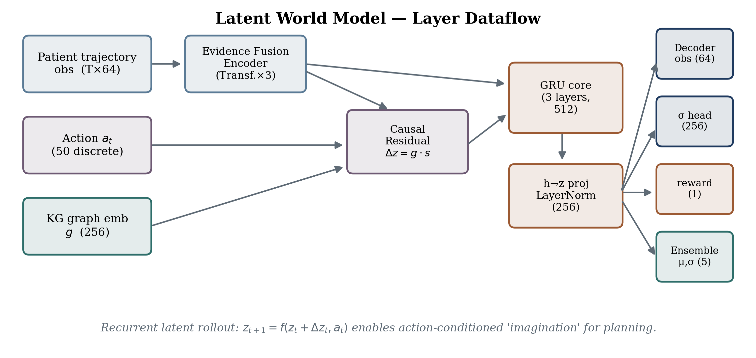
SECTION 02 · WORLD MODEL
Latent World Model — Dataflow
Recurrent latent rollout z_{t+1}=f(z_t+Δz_t, a_t) enables action-conditioned planning.
Making AI More Trustworthy · Clinical QA via Context Labelling & Source Tracking
10

Slide 12
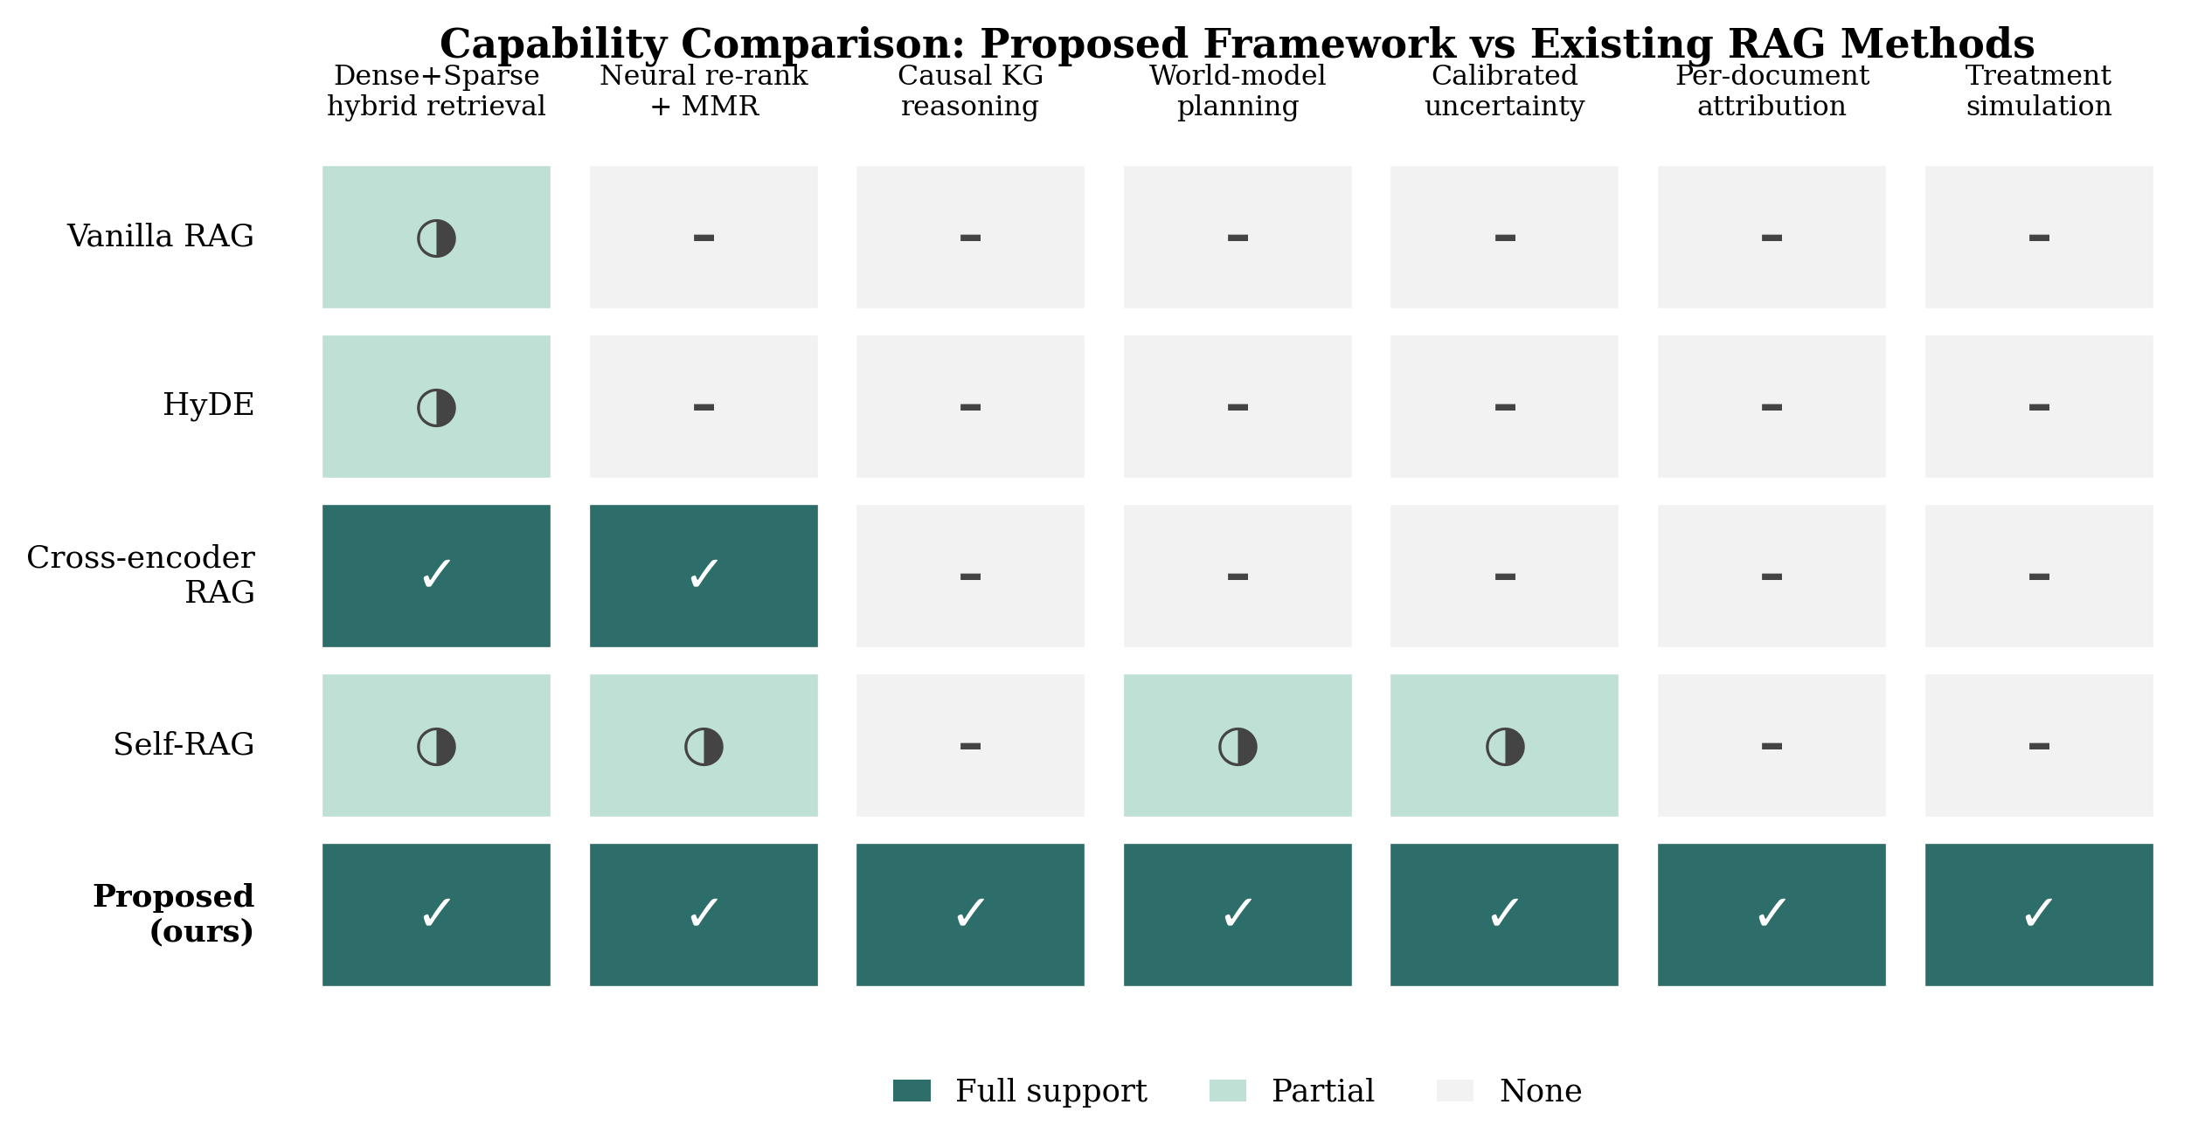
SECTION 02 · CAPABILITY
Capability vs Existing RAG Methods
Full / partial / no support across seven trust-relevant capabilities.
Making AI More Trustworthy · Clinical QA via Context Labelling & Source Tracking
11

Slide 13
03
Data & Training
100,000 samples · preprocessing · convergence

Slide 14
SECTION 03 · DATA
Datasets & Corpus
Dataset | Role | Samples | Source
DDXPlus | Diagnosis trajectories (train/val/test) | 80k / 10k / 10k | HuggingFace
MedMCQA | Retrieval corpus (evidence) | 50,000 docs | HuggingFace
MedQA (USMLE) | Evaluation queries | 1,000 | HuggingFace
Total | Integrated multi-source corpus | 100,000 | Open / free
DDXPlus at a glance
49 pathology classes (long-tailed)
223 normalised evidence codes (from 504)
39.6 yr mean patient age
▸ Zero-barrier. All datasets are public, free, and auto-downloaded from HuggingFace — no credentials required.
▸ Integration. Heterogeneous sources joined into a single 64-dim observation + 5-dim outcome tensor format.
19 median evidences per patient
100% records retained after cleaning
Making AI More Trustworthy · Clinical QA via Context Labelling & Source Tracking
13

Slide 15
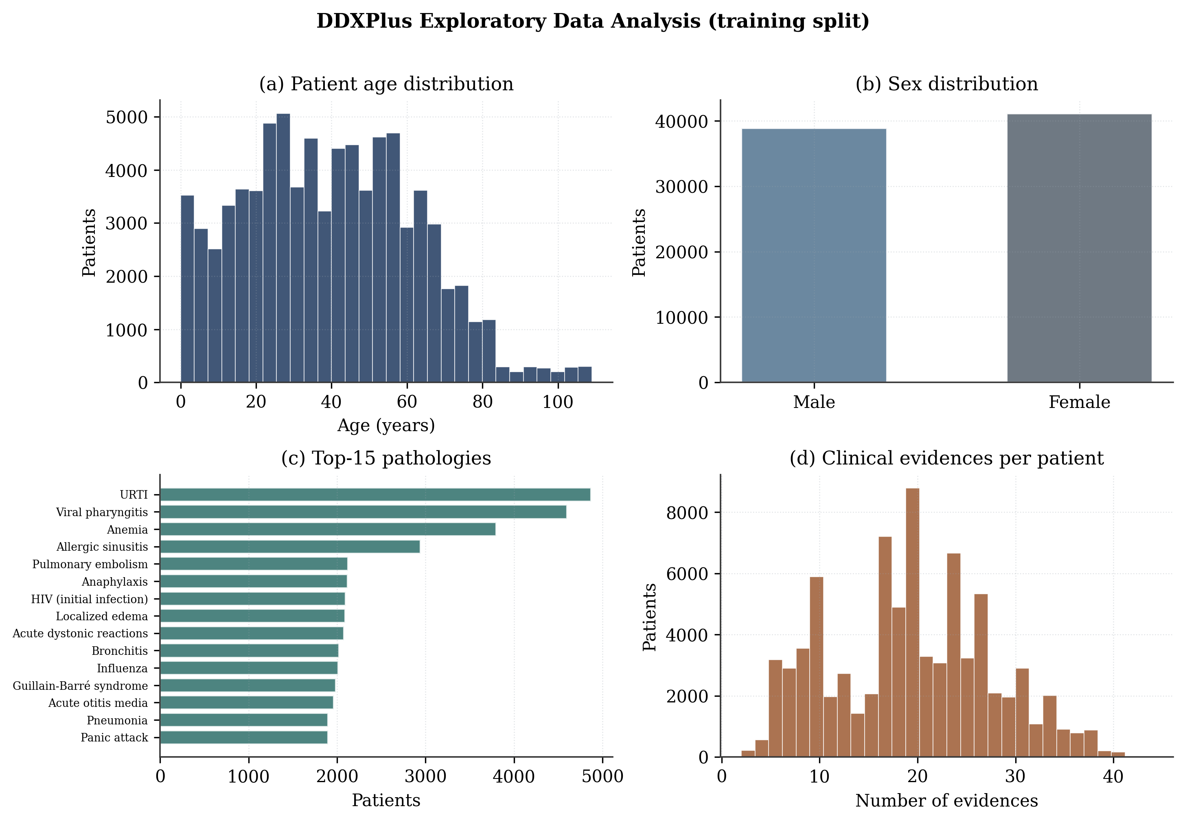
SECTION 03 · EDA
Exploratory Data Analysis (DDXPlus)
Age & sex distributions, top-15 pathologies, evidences per patient.
Making AI More Trustworthy · Clinical QA via Context Labelling & Source Tracking
14

Slide 16
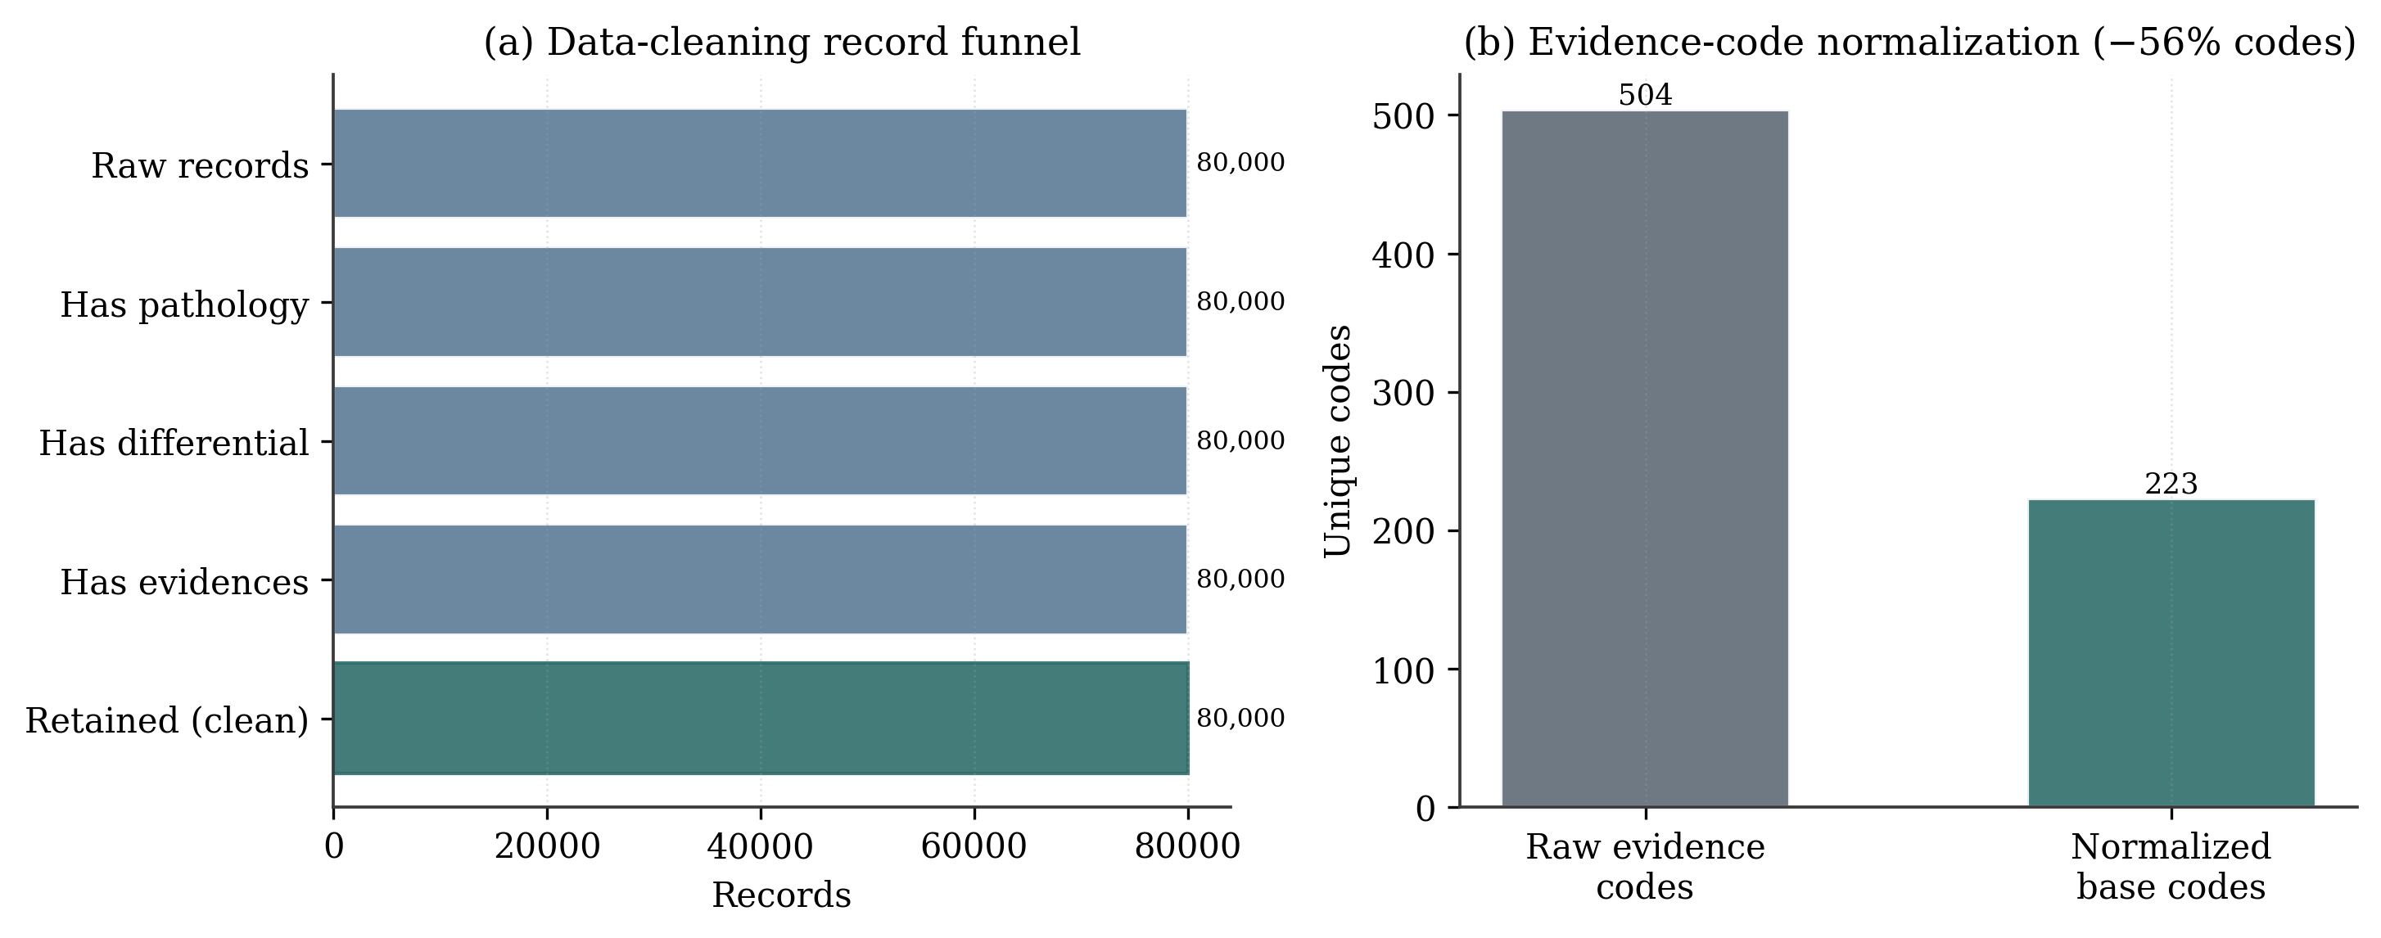
SECTION 03 · CLEANING
Data Cleaning & Code Normalisation
Record funnel (100% retained) and 504→223 evidence-code normalisation.
Making AI More Trustworthy · Clinical QA via Context Labelling & Source Tracking
15

Slide 17
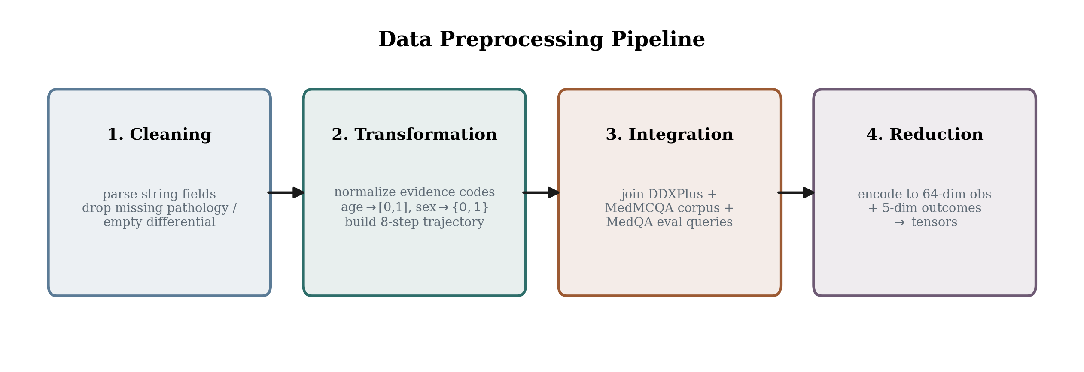
SECTION 03 · PREPROCESSING
Preprocessing Pipeline
Clean → transform → integrate → reduce to 64-dim obs + 5-dim outcomes.
Making AI More Trustworthy · Clinical QA via Context Labelling & Source Tracking
16

Slide 18
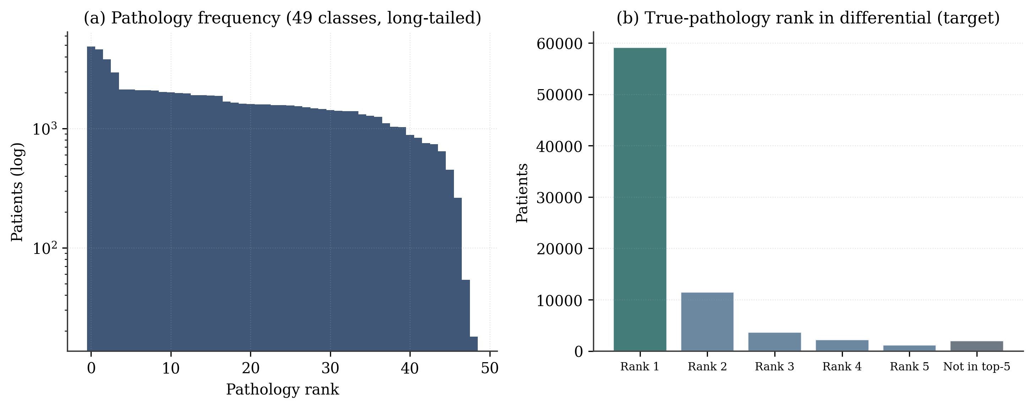
SECTION 03 · IMBALANCE
Class Imbalance & Target Structure
49 long-tailed pathologies; true-pathology rank within the differential.
Making AI More Trustworthy · Clinical QA via Context Labelling & Source Tracking
17

Slide 19
SECTION 03 · CONFIGURATION
Model & Training Configuration
Architecture | Value
Observation / action dim | 64 / 50
Latent / hidden dim | 256 / 512
Graph nodes / node dim | 20 / 128
Transformer layers / heads | 3 / 8
GRU layers | 3
Ensemble members | 5
Sequence length | 8
Training | Value
WM / predictor epochs | 15 / 10
WM / predictor LR | 2e-4 / 1e-3
Batch size | 64
Optimiser / AMP | Adam / fp16
Top-k retrieval | 6
SHAP permutations | 32
Plan horizon / beam | 4 / 8
10.13 M
18.8 min
RTX 4080S
PyTorch
Trainable parameters
Training time
Single GPU
2.6.0 + CUDA
Making AI More Trustworthy · Clinical QA via Context Labelling & Source Tracking
18

Slide 20
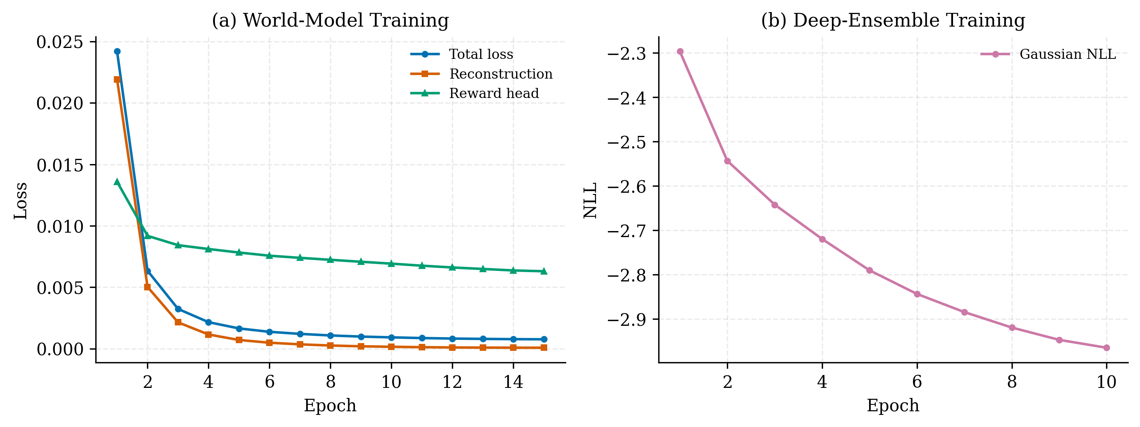
SECTION 03 · CONVERGENCE
Training Convergence
World-model total/reconstruction/reward losses and deep-ensemble Gaussian NLL.
Making AI More Trustworthy · Clinical QA via Context Labelling & Source Tracking
19

Slide 21
04
Results & Impact
Calibration, generalisation & a controlled baseline comparison

Slide 22
SECTION 04 · HEADLINE
Key Results & Impact
0.039
0.029
0.80
< 0.002
World-model MAE
Calibration error (ECE)
1σ coverage
Train→test MAE gap
0.70 → 0.97
0.50 → 0.84
2.0 → 5.1
9 / 10
Clinical concept coverage
Answer completeness
Evidence citations / answer
Vignettes won vs baseline
Statistically significant improvement over a strong hybrid-RAG baseline — Wilcoxon signed-rank p = 0.046, mean +0.27 (95% CI ±0.21) — while adding calibrated uncertainty and per-document source tracking the baseline cannot provide.
Making AI More Trustworthy · Clinical QA via Context Labelling & Source Tracking
21

Slide 23
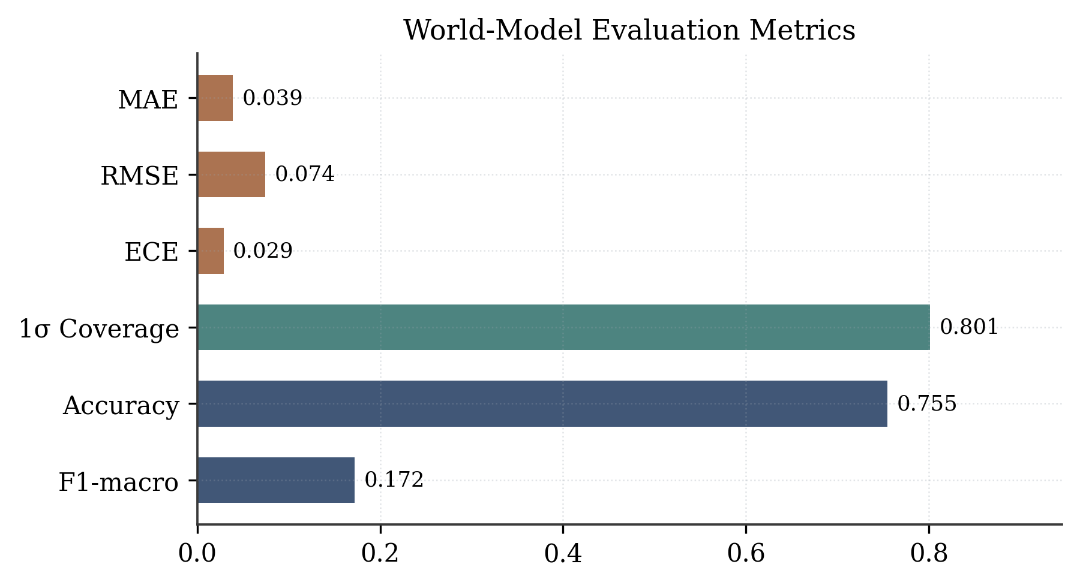
SECTION 04 · EVALUATION
Held-out Evaluation Metrics
Metric | Value | Target | Status
MAE (outcome regression) | 0.039 | lower better | ✓
RMSE | 0.075 | lower better | ✓
1σ coverage (calibration) | 0.80 | ≈ 0.68–0.95 | ✓
Expected Calibration Error | 0.029 | < 0.05 | ✓
Diagnosis accuracy (top-k) | 0.755 | — | ✓
F1-macro | 0.172 | long-tail (49 cls) | △
Mean |SHAP| | 0.744 | — | —
Headline: 1σ coverage 0.80 with ECE 0.029 — the ensemble's uncertainty is trustworthy, not over-confident.
Making AI More Trustworthy · Clinical QA via Context Labelling & Source Tracking
22

Slide 24
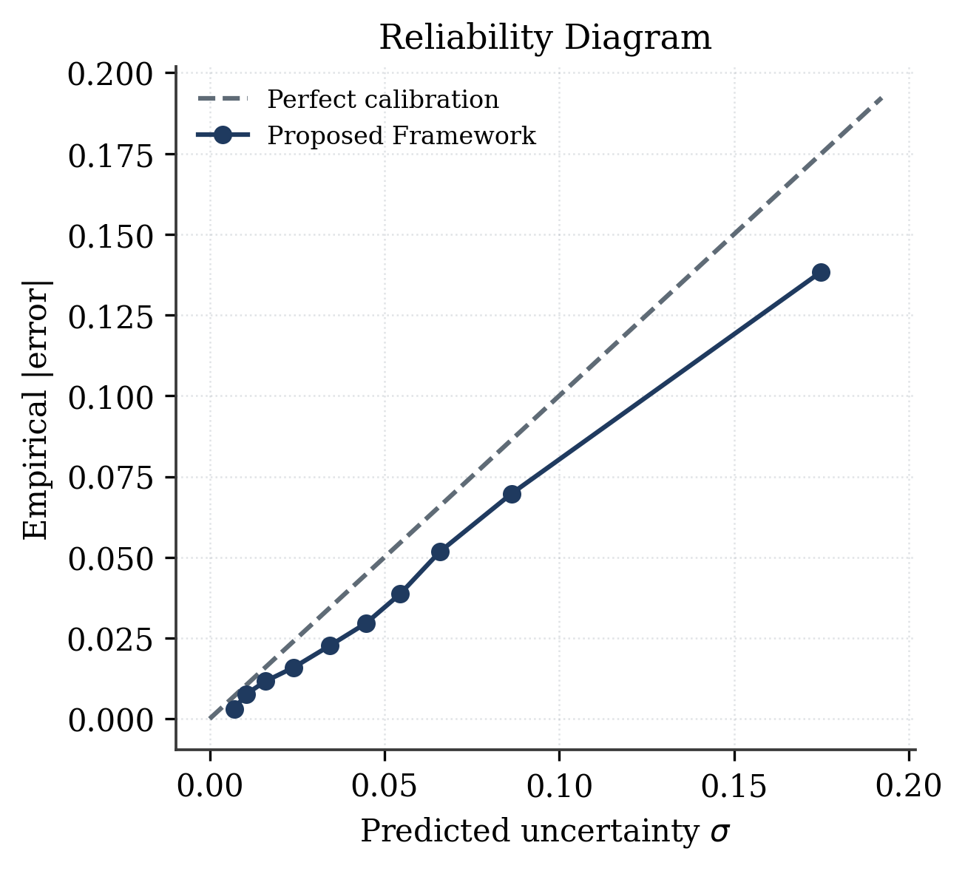
SECTION 04 · CALIBRATION
Reliability / Calibration Diagram
Predicted uncertainty tracks empirical error — close to the perfect-calibration line.
Making AI More Trustworthy · Clinical QA via Context Labelling & Source Tracking
23

Slide 25
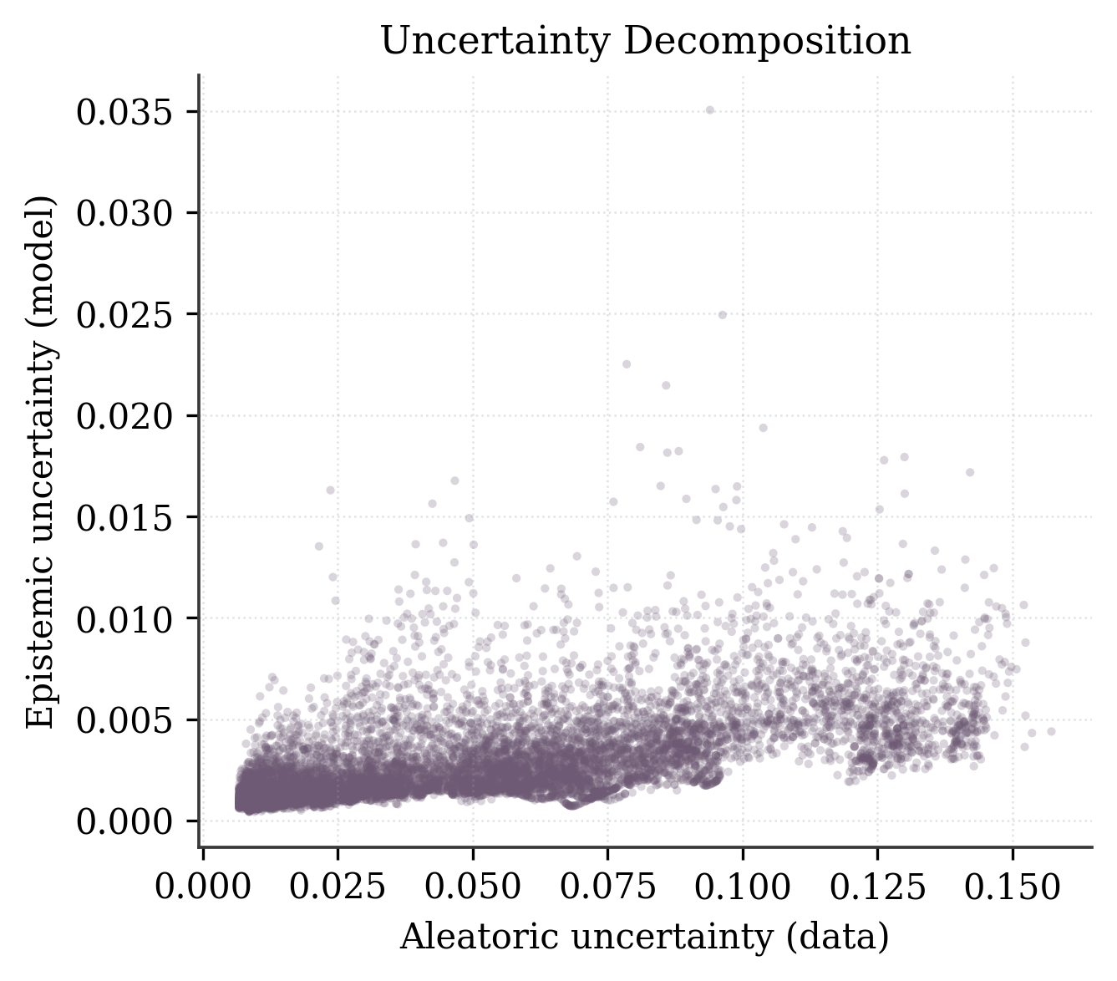
SECTION 04 · UNCERTAINTY
Uncertainty Decomposition
Epistemic (model) vs aleatoric (data) uncertainty per case.
Making AI More Trustworthy · Clinical QA via Context Labelling & Source Tracking
24

Slide 26
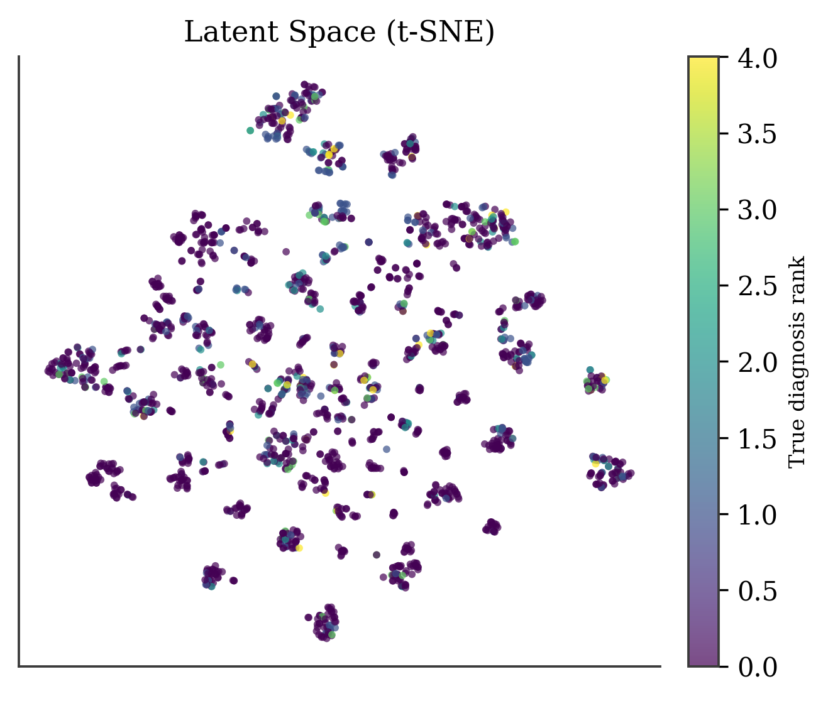
SECTION 04 · REPRESENTATION
Latent Space (t-SNE)
Evidence-Fusion-Encoder latents form clinically meaningful, pathology-aligned clusters.
Making AI More Trustworthy · Clinical QA via Context Labelling & Source Tracking
25

Slide 27
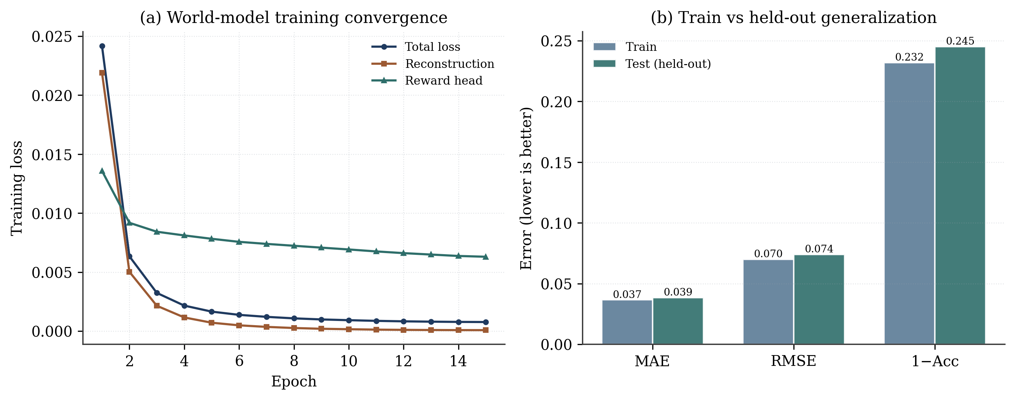
SECTION 04 · GENERALISATION
Train vs Held-out Generalisation
World-model convergence and a train→test error gap below 0.002 MAE.
Making AI More Trustworthy · Clinical QA via Context Labelling & Source Tracking
26

Slide 28
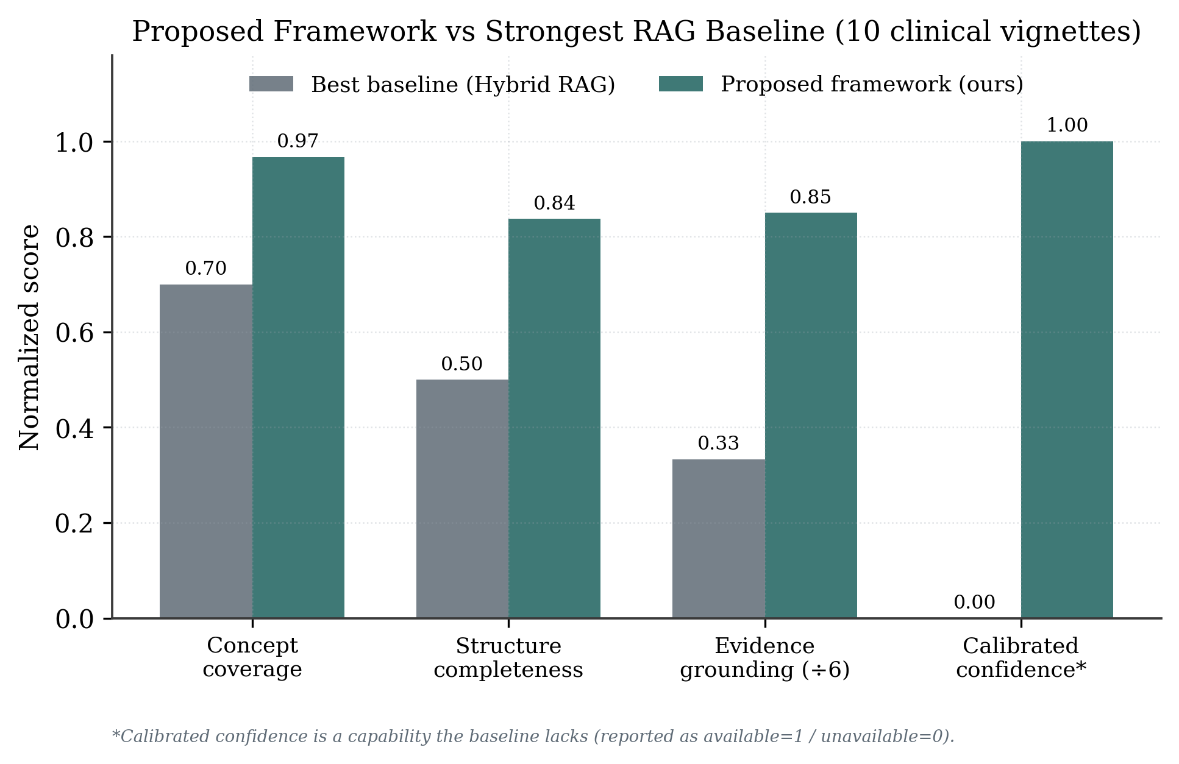
SECTION 04 · COMPARISON
Proposed Framework vs Strongest RAG Baseline
Concept coverage, structure, evidence grounding and calibrated confidence over 10 vignettes.
Making AI More Trustworthy · Clinical QA via Context Labelling & Source Tracking
27

Slide 29
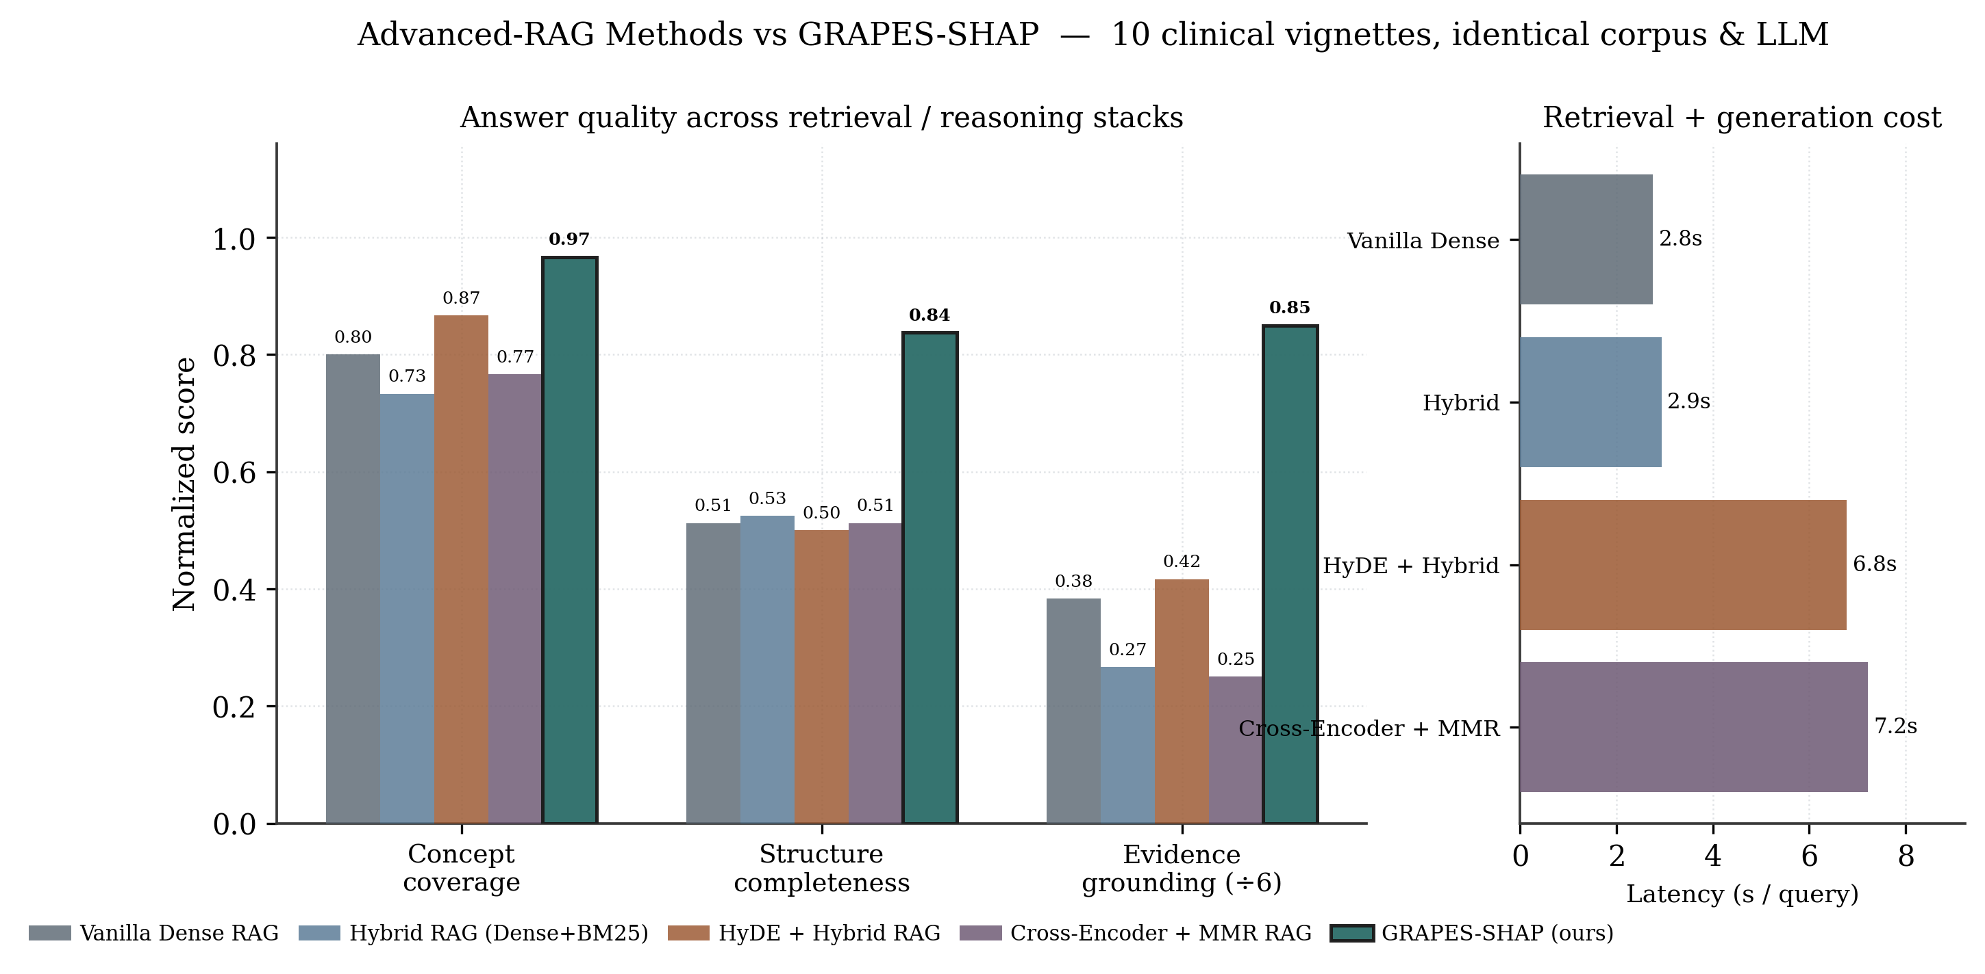
SECTION 04 · ADVANCED RAG
Benchmarked Against Four Advanced-RAG Pipelines
Live run — identical MedMCQA corpus, same DeepSeek LLM and rubric across all five systems; only the retrieval / reasoning stack varies.
▸ Stronger retrieval alone is not enough. HyDE leads retrieval-only coverage (0.87); hybrid fusion and cross-encoder + MMR do not uniformly help, and all plateau near 0.50 on answer structure.
▸ Our reasoning stack drives the trust-relevant gains. Coverage 0.97 (+10 pts over HyDE), structure 0.84, grounding 5.1 citations — plus calibrated uncertainty, SHAP attribution and plan simulation that no baseline provides.
Making AI More Trustworthy · Clinical QA via Context Labelling & Source Tracking
28

Slide 30
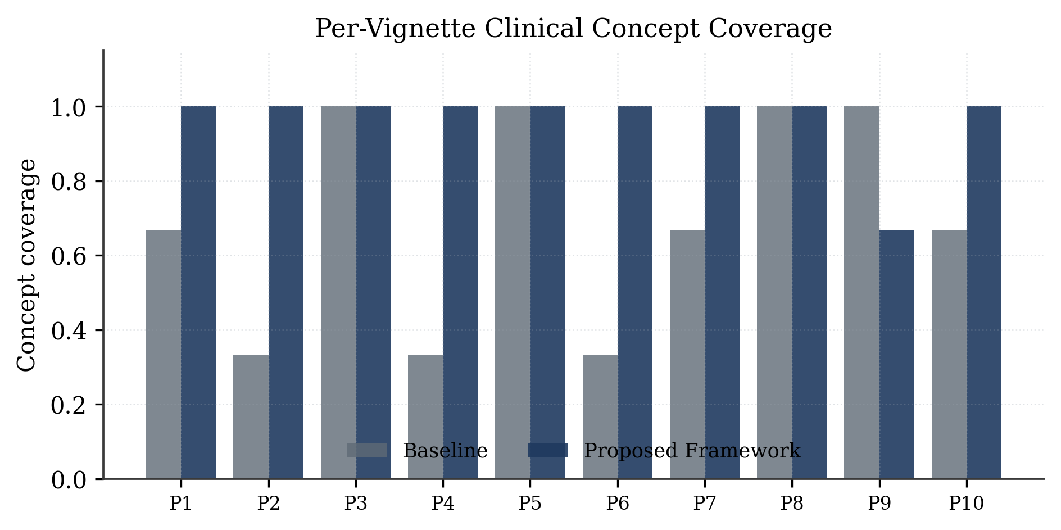
SECTION 04 · PER-VIGNETTE
Per-Vignette Concept Coverage
Concept coverage per clinical scenario (P1–P10).
Making AI More Trustworthy · Clinical QA via Context Labelling & Source Tracking
29

Slide 31
SECTION 04 · ANSWER DEMO
Worked Answer Comparisons — Baseline vs Ours
Scenario | Baseline RAG | GRAPES-SHAP (ours)
P1 · STEMI (chest pain, ST-elevation II/III/aVF) | Inferior-wall STEMI; reperfusion — PCI or thrombolysis. [coverage 0.67 · 2 cites · conf 0.95] | STEMI confirmed; PCI vs thrombolysis weighed (PCI: lower bleed risk); full supportive bundle; plan score -0.29. [coverage 1.00 · 4 cites · conf 0.70]
P2 · Septic shock (fever, lactate 3.2, BP 88/52) | Septic shock; fluids, oxygen, norepinephrine if fluids fail. [coverage 0.33 · 1 cite · conf 0.90] | Three pillars — source control + early broad-spectrum antibiotics + pressors; reconciles dopamine-vs-norepinephrine evidence. [coverage 1.00 · 6 cites · conf 0.70]
P4 · Ischaemic stroke (AF, NIHSS 14, 1.5 h onset) | Ischaemic stroke (left MCA); IV alteplase within 4.5 h. [coverage 0.33 · 2 cites · conf 0.95] | Localisation → cardioembolic AF → eligibility → tPA; SHAP ranks the time-window & no-haemorrhage evidence as decisive. [coverage 1.00 · 4 cites · conf 0.70]
Same top-line diagnosis — but ours surfaces explicit trade-offs, the outcome-critical missing step, calibrated confidence and per-evidence attribution.
Making AI More Trustworthy · Clinical QA via Context Labelling & Source Tracking
30

Slide 32
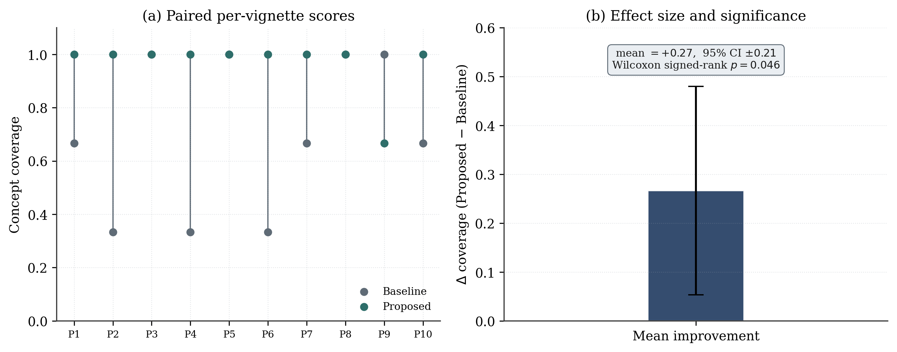
SECTION 04 · SIGNIFICANCE
Statistical Significance
Paired per-vignette scores and effect size (Wilcoxon p = 0.046, mean +0.27).
Making AI More Trustworthy · Clinical QA via Context Labelling & Source Tracking
31

Slide 33
05
Planning · Risk · Economics
Engineering execution and responsible-AI considerations

Slide 34
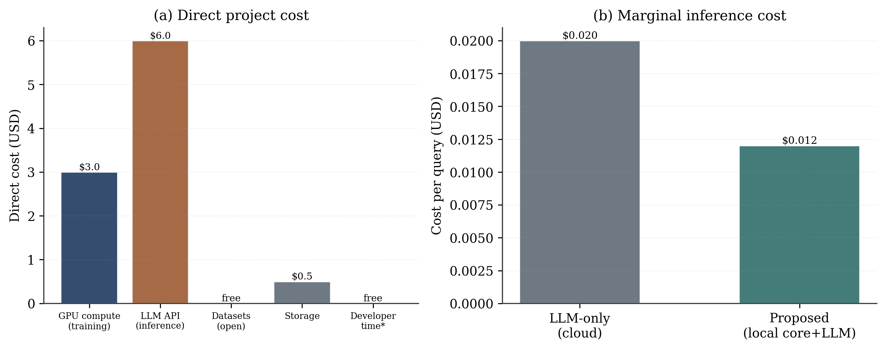
SECTION 05 · ECONOMICS
Economic Analysis
Direct project cost and marginal cost per query vs an LLM-only cloud baseline.
Making AI More Trustworthy · Clinical QA via Context Labelling & Source Tracking
33

Slide 35
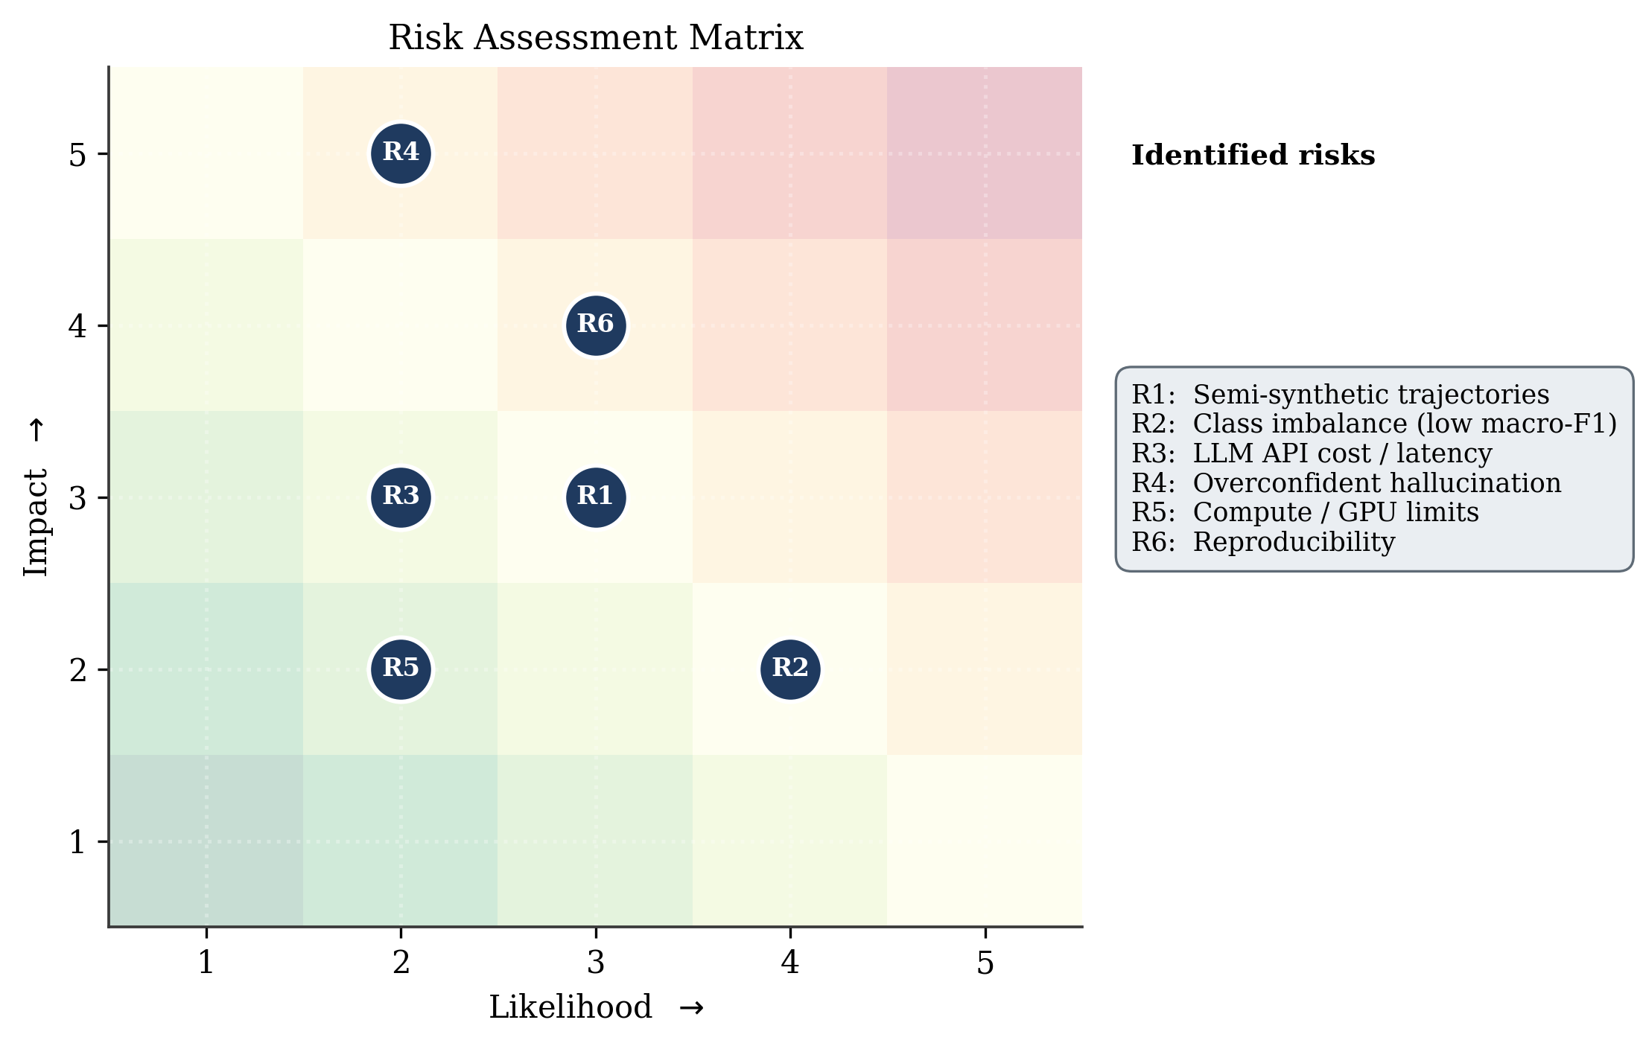
SECTION 05 · RISK
Risk Assessment Matrix
Likelihood × impact for six identified project risks with mitigations.
Making AI More Trustworthy · Clinical QA via Context Labelling & Source Tracking
34

Slide 36
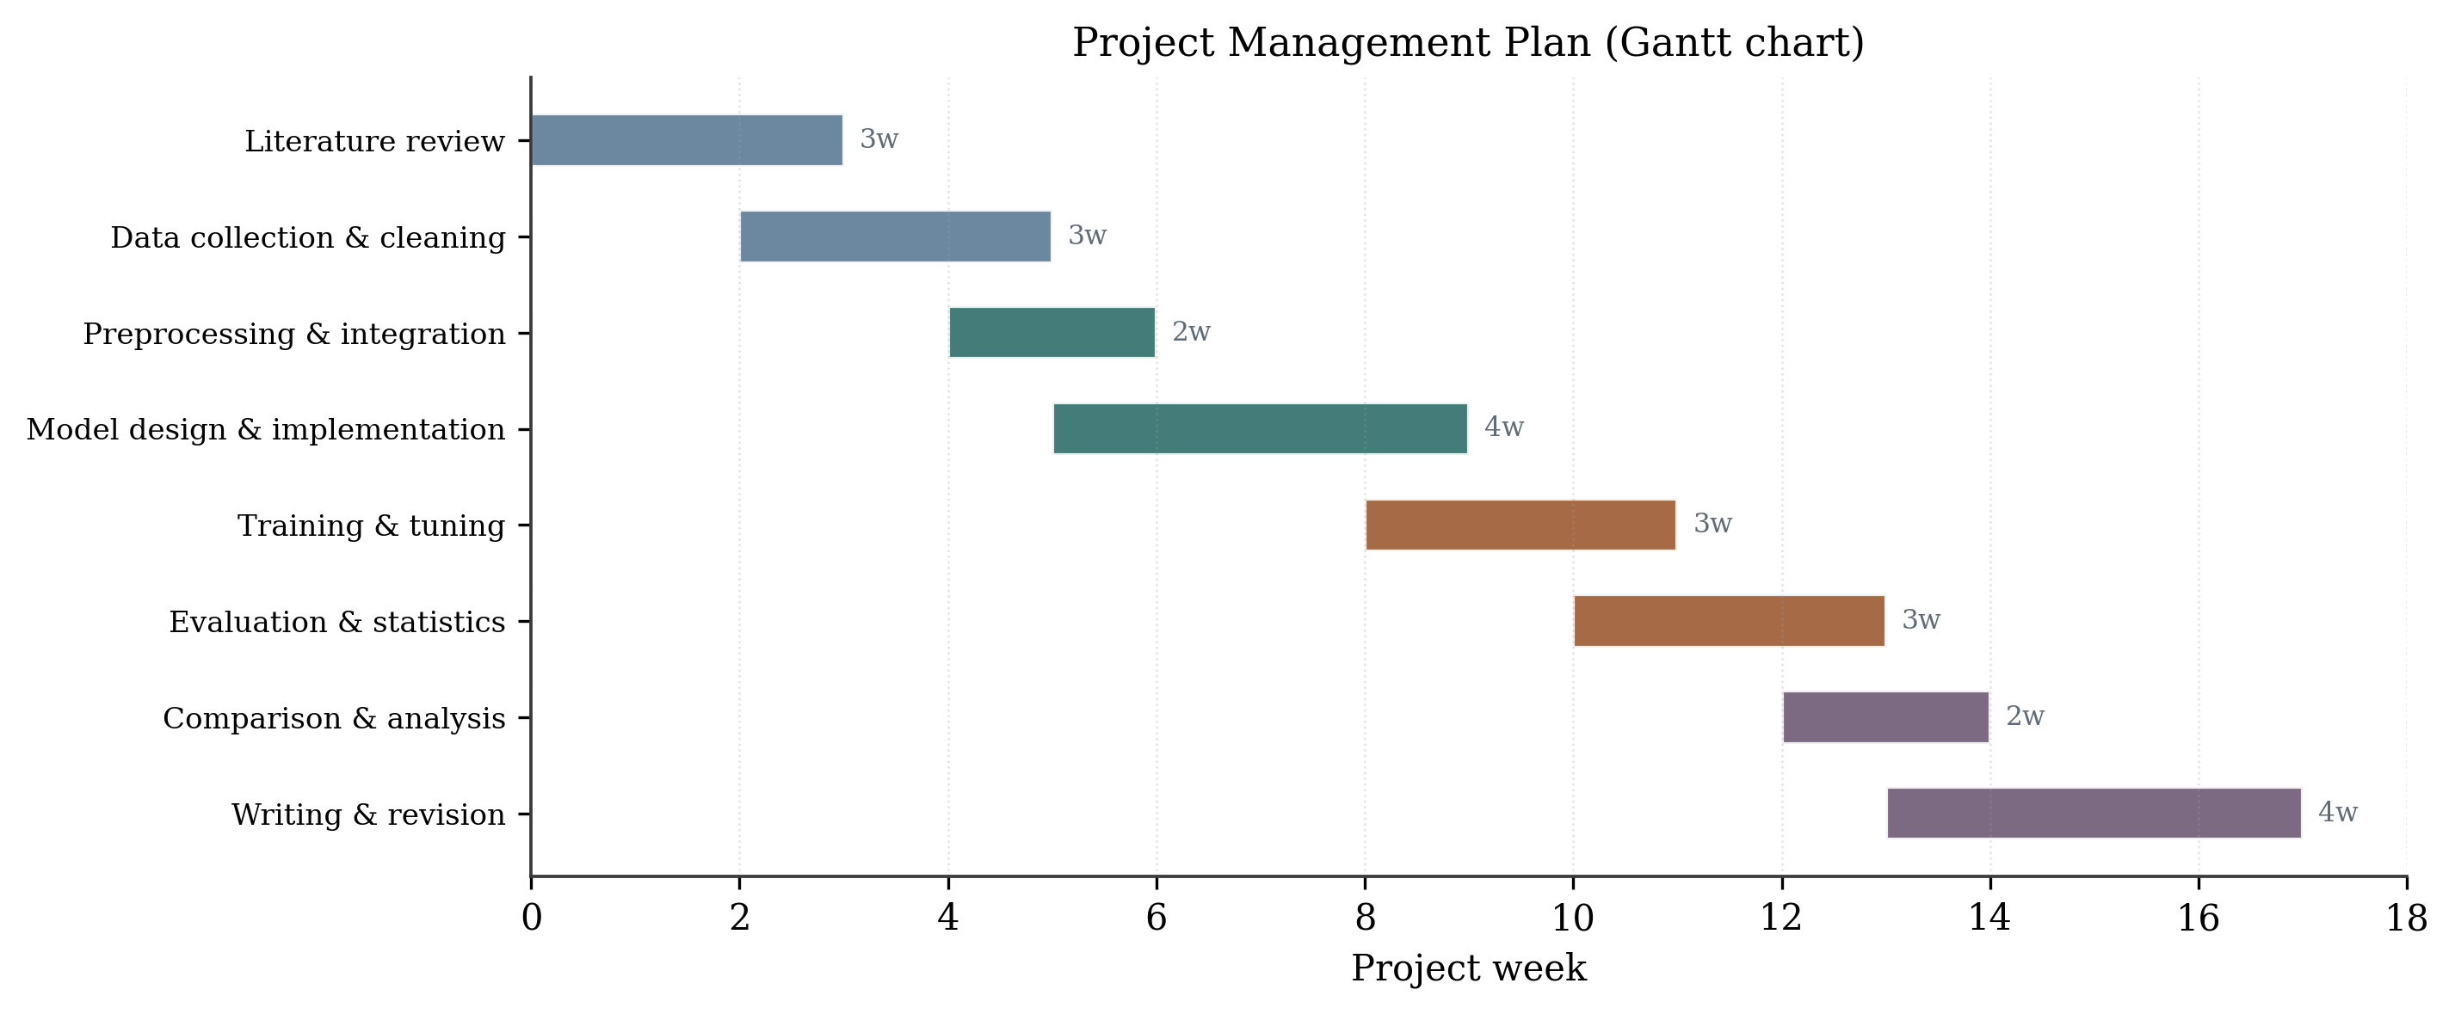
SECTION 05 · PLAN
Project Management Plan
Eighteen-week Gantt across literature, data, modelling, evaluation and writing.
Making AI More Trustworthy · Clinical QA via Context Labelling & Source Tracking
35

Slide 37
SECTION 05 · RESPONSIBLE AI
Societal · Ethical · Environmental
Societal Impact
Ethical Safeguards
Environmental
▸ Calibrated confidence + traceable sources reduce automation bias
▸ Widens access to structured clinical reasoning
▸ Human clinician remains the final decision-maker
▸ Only public, de-identified data (DDXPlus, MedMCQA, MedQA)
▸ Decision-support, not autonomous diagnosis
▸ Calibration + source tracking guard against confident error
▸ Compact 10.1M-param core; < 20 min training
▸ Few milliseconds of local compute per query
▸ Negligible footprint vs foundation-model training
Making AI More Trustworthy · Clinical QA via Context Labelling & Source Tracking
36

Slide 38
06
Conclusion & Future Work
Findings, contributions, limitations and next steps

Slide 39
SECTION 08 · CLOSING
Contributions to the Field
1
Trust-oriented reframing of RAG — organised around context labelling and original-source tracking.
2
Compact world-model core — supervised reward shaping + beam-search planning adds prospective reasoning to retrieval.
3
Native calibrated uncertainty — explicit epistemic / aleatoric decomposition via a deep ensemble.
4
Shapley source tracking — attributes answers to individual documents for auditability.
5
Honest, reproducible science — all code, configs & figure scripts released; scope stated explicitly.
Making AI More Trustworthy · Clinical QA via Context Labelling & Source Tracking
38

Slide 40
SECTION 08 · OUTLOOK
Limitations & Future Work
Honest Limitations
Future Directions
▸ Semi-synthetic dynamics. trajectories reveal evidence sequentially; transitions near-deterministic.
▸ Evidence-acquisition actions rather than physical interventions.
▸ Stochastic causal prior rather than a curated ontology.
▸ Low macro-F1 from fine-grained, imbalanced 49-class ranking.
▸ Logged intervention data (e.g. ICU records) for true treatment planning.
▸ Curated ontology (e.g. SNOMED-CT) to strengthen graph reasoning.
▸ Class re-weighting / focal loss to raise macro-F1 without hurting calibration.
▸ Clinician-in-the-loop study to test reduction of automation bias.
Making AI More Trustworthy · Clinical QA via Context Labelling & Source Tracking
39

Slide 41
Conclusion
▸ A compact 10.1 M-parameter framework makes clinical QA more trustworthy via context labelling and original-source tracking.
▸ Accurate (MAE 0.039), well-calibrated (ECE 0.029) and generalising (train→test gap < 0.002 MAE).
▸ Significantly better coverage, completeness and evidence grounding than a strong RAG baseline (p = 0.046).
▸ Adds calibrated uncertainty and per-document attribution that the baseline cannot provide — at negligible cost.
Graph-grounded retrieval + world-model planning + ensemble uncertainty ⇒ more accurate, better-grounded, and more trustworthy clinical recommendations.

Slide 42
Thank You
Questions & Discussion
GRAPES-SHAP Framework
Reproducible · Open
Trustworthy Clinical AI
Author Name · Department / Institution · 2026

