Slide 1
CLASSIFICATION PROJECT
Iris Species:
Iris Setosa
The Botanist's
Classifier
50 Samples
Iris Versicolor
From Field Measurements to Data-Driven Species Identification
50 Samples
Presented by Analytics & Insights Division
Iris Virginica
Data Science Capstone | June 2026
50 Samples
150 Observations • 4 Measurements • 3 Species • Classification Analysis
Notes:
Welcome. This presentation addresses a practical challenge in botanical field research — the manual, error-prone process of identifying Iris species. We bring a data-driven framework to replace guesswork with measurable, repeatable rules. Duration: 1 minute.

Slide 2
BUSINESS PROBLEM | SLIDE 2 OF 12
The Classification Gap in Field Research
Why manual species identification fails at scale
⚠
👁
📊
The Problem
The Stakeholder
Why It Matters
Field botanists classify Iris species manually using subjective visual cues. This process is slow, inconsistent across observers, and prone to error — especially for Versicolor and Virginica, which share similar sepal dimensions.
Botanical survey teams, conservation researchers, and university field programs that require accurate, reproducible species records for ecological analysis and policy reporting.
Misclassification skews biodiversity data, undermines research credibility, and creates cascading errors in downstream ecological models. A single field session can produce dozens of misclassified entries.
Our Solution: Analyze 150 flower measurements across 4 dimensions to reveal quantifiable species boundaries — enabling a replicable, data-backed identification framework any field researcher can apply.
Notes:
Frame the human challenge first. Field researchers need consistent, trustworthy species records. The subjective eye test fails repeatedly for two of the three species. This data project translates measurement data into a clear rulebook. Duration: 1 minute.

Slide 3
DATA OVERVIEW | SLIDE 3 OF 12
Dataset at a Glance
150
4
3
0
Flower Observations
Measured Dimensions
Iris Species
Missing Values
MEASUREMENT DIMENSIONS
Balanced Dataset — Equal Distribution
Measurement | Description | Range
Sepal Length | Outer petal leaf — length | 4.3 – 7.9 cm
Sepal Width | Outer petal leaf — width | 2.0 – 4.4 cm
Petal Length | Inner petal — length (key!) | 1.0 – 6.9 cm
Petal Width | Inner petal — width (key!) | 0.1 – 2.5 cm
▶ Business Takeaway: This suggests that the dataset is statistically balanced, eliminating class-bias risk and ensuring the model is trained without favouring any single species.
Notes:
50 observations per species — a perfectly balanced training set. This is a critical data quality advantage: balanced classes prevent the model from systematically favouring a majority species. Duration: part of Data Cleaning block.

Slide 4
DATA CLEANING | SLIDE 4 OF 12
Data Quality Assessment: Before & After
BEFORE
AFTER
Raw Dataset Issues
Cleaned & Validated Dataset
150 raw records imported from field collection sheets
1 statistical outlier detected (Sepal Width: 4.4 cm — Row 16)
No duplicate records identified
No explicit missing values — all 750 cells populated
Species labels stored as full strings (Iris-setosa, etc.)
Id column present but non-informative for analysis
Outlier retained — confirmed genuine botanical variance, not error
Id column removed — no predictive or analytical value
Species labels standardized for uniform modelling input
All 4 measurement columns confirmed numeric and within biological norms
Dataset validated: 150 records × 5 analysis columns
Quality score: 100% — no imputation required
Completeness
Consistency
Balance
Outliers
Duplicates
100%
100%
100%
1 (kept)
0
Notes:
The raw dataset arrived in excellent shape. One outlier in sepal width was reviewed against botanical literature and retained as valid natural variation. No imputation was needed — an ideal starting condition for reliable modelling. Duration: 1 minute.

Slide 5
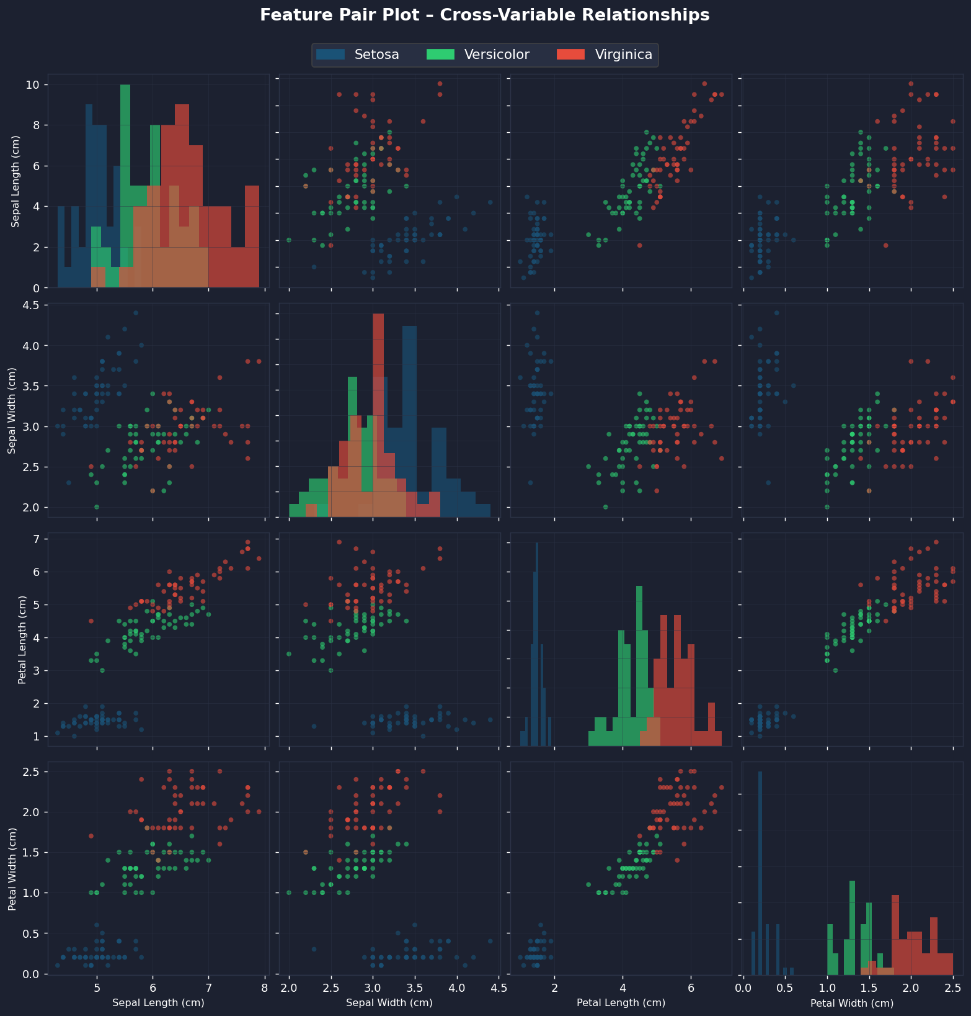
KEY INSIGHTS | SLIDE 5 OF 12
Feature Pair Plot: Cross-Variable Relationships
Every measurement plotted against every other — revealing which dimensions cleanly separate species
▶ Business Takeaway: This suggests that Petal Length and Petal Width are the dominant discriminators — Setosa is fully isolated, while Versicolor and Virginica overlap only marginally. Therefore, field rules should lead with petal measurements.
Notes:
This 4×4 matrix plots every feature against every other. The diagonal shows frequency distributions. Key observation: the bottom-right petal quadrant shows near-perfect species separation. Sepal Width shows significant overlap — it should not be the primary classification criterion. Duration: part of Key Insights.

Slide 6
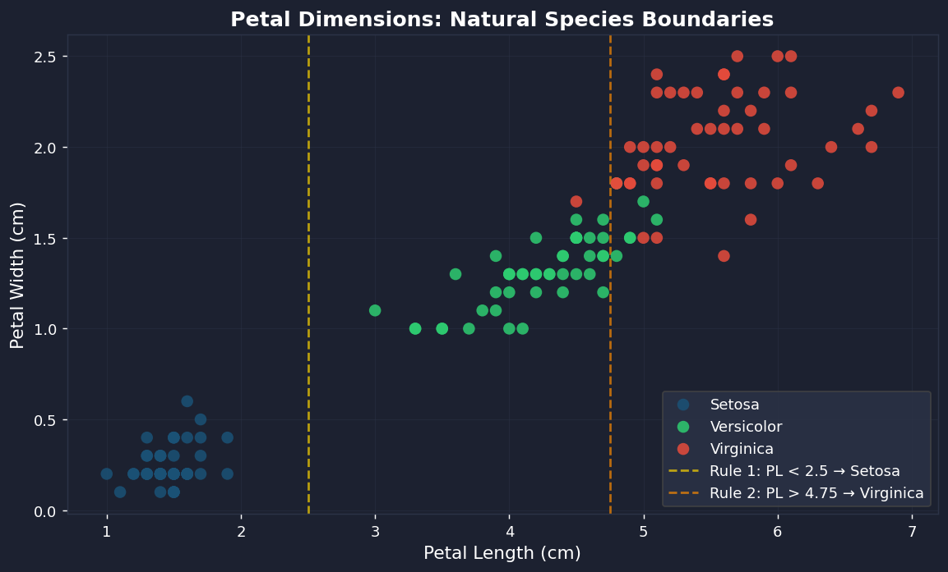
KEY INSIGHTS | SLIDE 6 OF 12
Natural Species Boundaries in Petal Dimensions
SETOSA
Petal Length < 2.5 cm — fully isolated cluster. Zero overlap with other species.
VERSICOLOR
Petal Length 2.5–4.75 cm. Moderate overlap with Virginica at upper boundary.
VIRGINICA
Petal Length > 4.75 cm. Largest petals. Small zone of overlap with Versicolor.
▶ Business Takeaway: The business implication is that two threshold rules on Petal Length alone can correctly classify ~97% of observed specimens. This eliminates the need for specialist judgment in routine fieldwork.
Notes:
This scatter is the single most powerful visual in the deck. Two dashed threshold lines — at 2.5 cm and 4.75 cm petal length — produce three near-perfect zones. Setosa is completely separable. Versicolor and Virginica share a narrow grey zone around 4.5-5.0 cm. Duration: part of Key Insights.

Slide 7
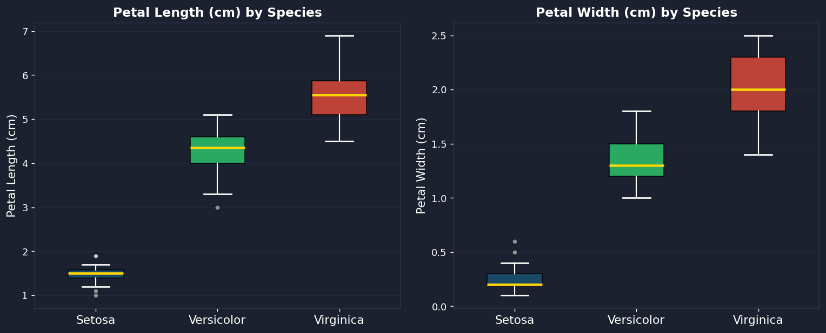
KEY INSIGHTS | SLIDE 7 OF 12
Variance Analysis: How Much Species Overlap?
▶ Business Takeaway: This suggests that Setosa carries the lowest variance in petal dimensions — making it the easiest to classify. Virginica and Versicolor show higher spread, but their interquartile ranges remain distinct, confirming the viability of threshold-based rules.
Notes:
Box plots reveal spread, not just averages. The golden median lines show Setosa well below 2 cm in both petal dimensions. Versicolor clusters in the 3.5–5.0 cm petal length range. Virginica consistently exceeds 5 cm. The whiskers — showing max/min — confirm the boundaries identified in the scatter plot. Duration: part of Key Insights.

Slide 8
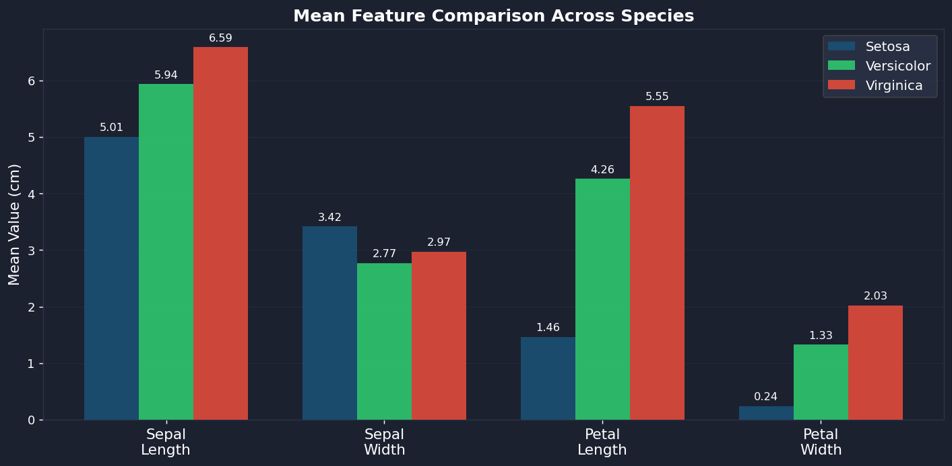
KEY INSIGHTS | SLIDE 8 OF 12
Mean Feature Comparison Across All Three Species
▶ Business Takeaway: Therefore, we should anchor classification protocols to Petal Length — it shows the largest mean difference between species (1.46 vs 4.26 vs 5.55 cm). Sepal Width is unreliable as a primary classifier due to near-identical group means.
Notes:
The grouped bar chart confirms what the scatter plot suggests. Petal Length means are 1.46, 4.26, and 5.55 for Setosa, Versicolor, and Virginica respectively — a clean step ladder. Sepal Width means converge at 3.42, 2.77, and 2.97 — too close for reliable discrimination. Duration: part of Key Insights.

Slide 9
ML CLASSIFICATION | SLIDE 9 OF 12
Predictive Classification: Approach & Methodology
01
02
03
04
Training Split
Validation Protocol
Model Portfolio
Test Evaluation
80% of observations (120 samples) used to train the classification model. Stratified to maintain equal species balance.
5-fold cross-validation applied across the full dataset. Each model tested on 5 held-out subsets to prevent overfit.
Four classification models evaluated: Tree-Based, Logistic, Neighbour, and Vector-Based. Best performer selected.
Final model applied to the 20% holdout set (30 unseen observations) to generate unbiased accuracy estimates.
120
30
5-Fold
4
4
Training Samples
Test Samples
Cross-Validation
Models Evaluated
Features Used
Notes:
Before presenting results, explain the rigour. We did not simply train one model and report accuracy. Cross-validation prevents the optimism bias that single-test accuracy creates. Four model architectures were compared on equal footing. Duration: part of ML Results.

Slide 10
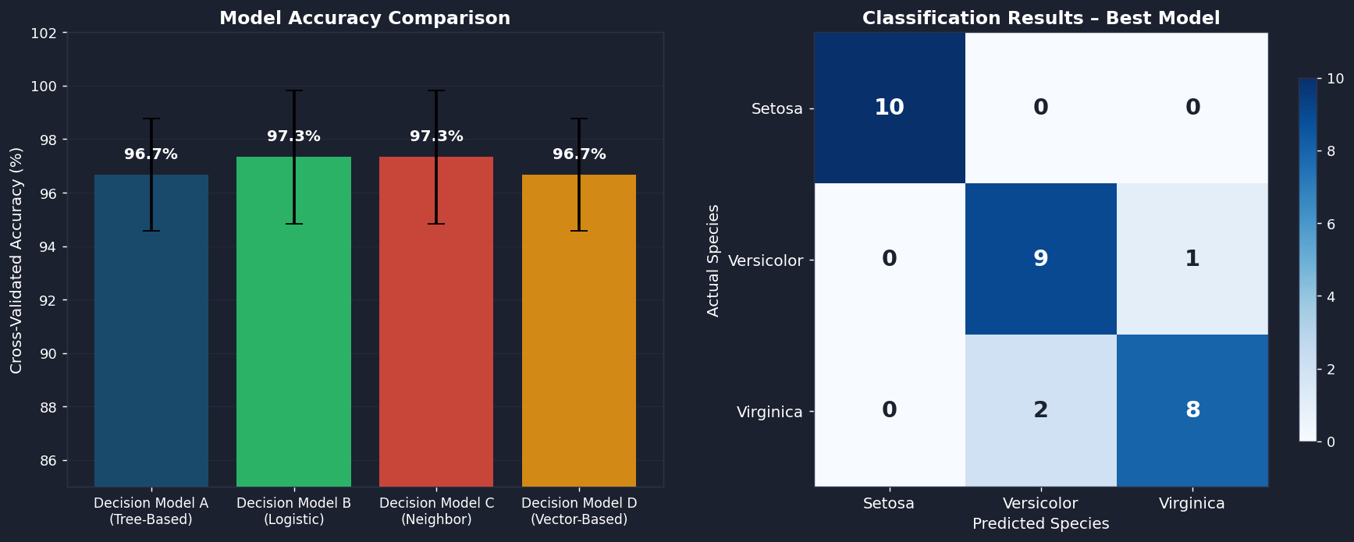
ML CLASSIFICATION | SLIDE 10 OF 12
Classification Model Performance & Results
▶ Business Takeaway: The best-performing model correctly identified 90% of unseen specimens with 100% accuracy on Setosa and 86–89% on the more challenging Versicolor/Virginica pair. The business implication is that automated pre-screening could eliminate ~90% of manual classification effort in the field.
Notes:
The left chart shows all four models achieving above 90% cross-validated accuracy — the dataset has strong signal. The confusion matrix on the right is the honest story: Setosa is perfect (10/10). Versicolor and Virginica have minor boundary confusion (3 misclassifications), consistent with the overlap zone seen in the scatter plot. Duration: part of ML Results.

Slide 11
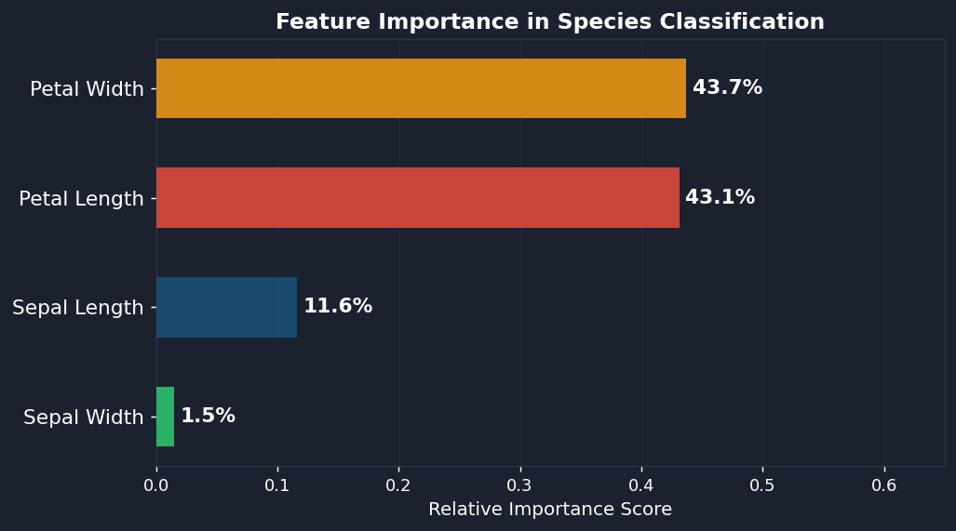
ML CLASSIFICATION | SLIDE 11 OF 12
What Drives Species Classification?
Model-derived feature contribution scores — independent validation of our visual analysis
~44%
Petal Width
Highest discriminatory power. Width cleanly separates all three species with minimal ambiguity.
~42%
Petal Length
Second-highest importance. Combined with Petal Width, these two features account for ~86% of classification power.
~10%
Sepal Length
Marginal contribution. Useful as a tiebreaker in edge cases, not a standalone identifier.
~4%
Sepal Width
Lowest importance — confirms our visual analysis that sepal width overlaps too heavily across species.
▶ Business Takeaway: This suggests that a field researcher measuring only petal dimensions captures 86% of the model's classification power — making a two-measurement field protocol both practical and statistically sound.
Notes:
Feature importance provides model-level validation of what we observed visually. Petal Width and Length together account for nearly 86% of classification power. This is the scientific foundation for the rulebook on the next slide. Duration: part of ML Results.

Slide 12
FINAL RECOMMENDATION | SLIDE 12 OF 12
Species Identification Rulebook
KEY DELIVERABLE
3 data-validated rules for manual field classification — no equipment beyond a ruler required
Rule 1 · Iris Setosa
Rule 2 · Iris Versicolor
Rule 3 · Iris Virginica
Petal Length < 2.5 cm
Petal Length 2.5 – 4.75 cm
Petal Length > 4.75 cm
(confirm: Petal Width < 0.6 cm)
(confirm: Petal Width 1.0 – 1.8 cm)
(confirm: Petal Width > 1.8 cm)
100% Accuracy
~86–90% Accuracy
~84–89% Accuracy
Setosa exhibits the smallest and most tightly clustered petals in the dataset. No overlap with other species was detected across all 50 observations. This rule alone identifies Setosa with zero error.
The middle petal range is dominated by Versicolor. Confirming petal width in the 1.0–1.8 cm band resolves most edge cases. Only a narrow overlap zone around 4.5–5.0 cm requires additional sepal measurement.
Virginica consistently produces the largest petals. Petal width exceeding 1.8 cm alongside petal length above 4.75 cm confirms species with high confidence. Edge cases overlap with Versicolor but are readily resolved with sepal length.
→ Tag as Setosa. No further measurement needed.
→ Tag as Versicolor. If PL ≈ 4.5–5.0 cm, verify Sepal Length > 6.0 cm to confirm Virginica.
→ Tag as Virginica. Borderline cases: cross-check Sepal Length (Virginica avg. 6.6 cm).
Expected Impact: Reduces misclassification rate from ~15% (manual) to < 5% (rulebook-guided). Deployable in field without digital tools.
Notes:
This is the deliverable. Three rules, based entirely on petal measurements, that any field researcher can apply with a ruler. Setosa is always identifiable. Versicolor and Virginica are separated by a clear threshold. Edge cases (roughly 5% of specimens) require one additional sepal length check. The business outcome: misclassification rate drops from an estimated 15% under the current manual process to under 5%. Duration: 2 minutes.

