Slide 1

A SEMINAR ON
VISWAJYOTHI COLLEGE OF ENGINEERING AND TECHNOLOGY ,VAZHAKULAM
An Architecture Combining Blockchain, Docker and Cloud Storage for Improving Digital Processes in Cloud Manufacturing
Under the guidance of,
Mrs. Remya Paul
Assistant Professor
Department of CSE
By,
San Baby Francis
Roll No. 52
S7 CSE A

Slide 2
CONTENTS
INTRODUCTION
RELATED WORKS
MAIN TECHNIQUE
PERFORMANCE EVALUATION
CONCLUSION
REFERENCES

Slide 3
1. INTRODUCTION
Blockchain – It is a decentralized, distributed, peer-to-peer system used to record transactions across many computers so that the record cannot be altered.
Docker – It is a software platform that allows you to build, test, and deploy applications quickly using containers that have everything the software needs to run including libraries, code, etc.
Cloud Storage – It is a data storage in which the data is stored in across multiple servers and the physical environment is typically owned by a company.
Digital Processes – It refers to those software tasks that has to be performed using the system.
Cloud Manufacturing – It is a service-oriented business model to share manufacturing capabilities and resources on a cloud platform.

Slide 4
2. RELATED WORKS
Authors | Proposed System | Date
J. Leng, S. Ye, M. Zhou, J. L. Zhao, Q. Liu, W. Guo, W. Cao, and L. Fu | Blockchain-secured Smart Manufacturing in Industry 4.0 | Jan 2020
A. Haridas, A. A. Samad, D. Vysakh, and V. Pathari | A Blockchain based platform for Smart Contracts and Intellectual Property Protection for the Additive Manufacturing Industry | Mar 2022

Slide 5
3. MAIN TECHNIQUE
This paper introduces a novel approach for implementing BPM in Blockchain by using the features of two of the most popular cloud technologies: Docker and Cloud Storage.
Docker is used in the process execution phase, supposed that the process to be executed is a digital process.
The inputs and outputs are stored in a traditional cloud storage and we use Blockchain and Smart Contracts for process implementation and monitoring.
We also introduce a basic task assignment problem based on execution time prediction performed through an ANN trained with past process runs metrics.

Slide 6
3.1 COMPONENTS
There are five main components in the proposed platform:
Process Owner
Process Consumer
Process Runner
Permission Granting Application (PGA)
Data Mining Algorithm

Slide 7
3.1 COMPONENTS (contd.)
Process Owner - It represents the entity that creates the process core logic and codes the algorithm. It packs the algorithm to a docker file and executes CreateProcess.
Process Consumer - It represents the entity that needs to perform an instance of the digital process for its business purposes.
Process Runner - It provides the computational resources to execute the process instance by running the related image in a container.
Permissions Granting Application - This component assigns and revokes permissions on files in the cloud storage.
Data Mining Algorithm – It collects past instances metrics and trains the execution time prediction ANN for each runner on a regular time basis.

Slide 8
3.2 SMART CONTRACTS
The whole process life cycle rely on two smart contracts developed using Solidity.
Process Smart Contract – It stores data of processes, runners and instances. In addition, it provides CreateProcess and ProcessInstance functions that, in the proposed platform, represent the two main transactions of the Blockchain.
Oracle Smart Contract – It is used to store the calculated weights of each ANN trained on past instance metrics. The weights are updated on a regular time basis.

Slide 9
3.2 SMART CONTRACTS (contd.)
ProcessInstance function selects the fastest ProcessRunner by predicting the execution time for each registered available runner.
If it accepts, it is immediately granted the needed permissions on the cloud Storage by the PGA to retrieve the instance inputs.
Once the inputs are available, the process instance is executed in a docker container with the requested image.
At the end of the execution, the smart contract is notified and the outputs are stored on the cloud storage to be finally retrieved by the consumer.

Slide 10
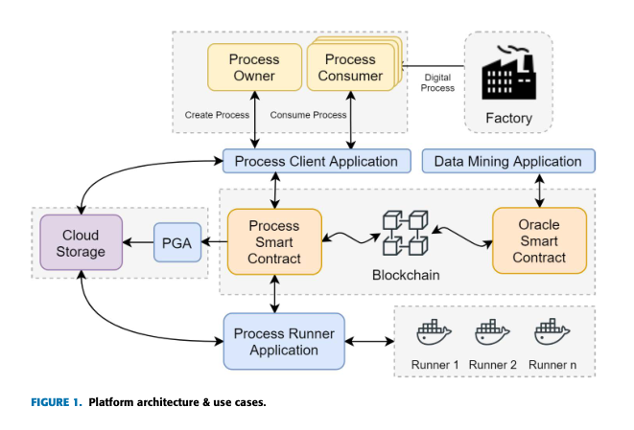
3.3 PLATFORM ARCHITECTURE

Slide 11
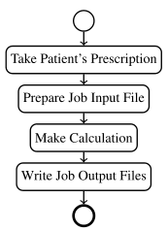
3.4 OPHTHALMIC LENSES MANUFACTURING (CASE STUDY)
The process of lens manufacturing is typically made of five steps in sequence: Calculation, in which the lens surface to be machined is computed, Surfacing, Polishing, Coating and, finally, Edging.
In this work, we focus on Calculation, which is a pure digital process. A typical lens calculation software is called Lens Design System (LDS).
A LDS takes the patient’s ophthalmic prescription as input and performs a mathematical calculation that produces the data to be sent to a CNC machine to realize a surface on the back of a semi-finished lens.

Slide 12
3.4 CASE STUDY (contd.)
Firstly, we identify the actors of the case study as follows: Process Owner is the Lens Designer, Process Consumer is the Lens Manufacturer and Process Runner is the Surface Calculator.
Lens Designer implements its calculation algorithm with the programming language of his choice and packs the compiled application along with all libraries and dependencies in a Docker image.
Consequently, the implementation of CreateProcess and ConsumeProcess functions for respectively adding new lens design and requesting new calculation.
Process Client Application is connected to the lens manufacturer’s information system to allow the CNC machine to retrieve the calculated surface.

Slide 13
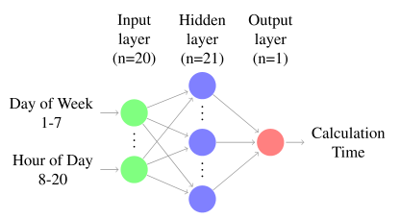
3.4 CASE STUDY (contd.)
Data Mining Application collects metrics from past lens calculation instances and trains a model for each runner and for each process to predict the running time of a single lens design instance on the runner at a specified time.
After generating the dataset, we build the ANN. The resulting network consists of 20 neurons in the input layer, 21 neurons in the hidden layer and a single neuron in the output layer which represents the calculation time.

Slide 14
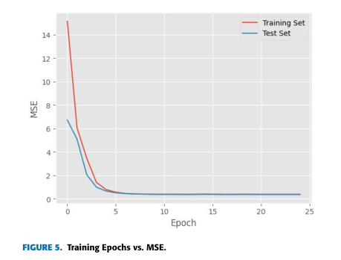
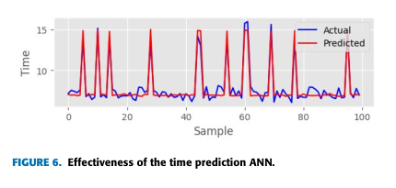
4. PERFORMANCE EVALUVATION

Slide 15
4. PERFORMANCE EVALUVATION (contd.)
By implementing an LDS system in the proposed Blockchain platform, the following improvements are achieved over existing systems like ProCrea.
Collaboration - It provides a shared and decentralized platform on which multiple Lens Designers can make their algorithms available in form of self-contained Docker images. The integration of new or updated designs is therefore easier, as it does not require any structural change or any significant reconfiguration of the environment.
Performance - The provided solution is distributed and fault tolerant. The manufacturer can run multiple calculations, that are executed simultaneously on different runners.

Slide 16
4. PERFORMANCE EVALUVATION (contd.)
Cybersecurity - Since the Blockchain is tamper-proof, the economic transactions of the fees charged to the manufacturer and paid to lens designers and surface calculators cannot be altered.
Costs - Since the cloud storage service has typically low fares, a long term storage is guaranteed for input and output files. This feature also prevents data loss on manufacturer’s side.

Slide 17
5. CONCLUSION
In short, this paper presents s a novel platform for improving digital processes in a Blockchain environment in which we integrate two of the most popular cloud technologies: Docker and Cloud Storage.
We identify and describe the roles of Process Owner, Process Consumer and Process Runner.
A simple task assignment problem, implemented through an ANN approach, is also introduced for the purpose of improving the performance by decreasing instances execution times.
Finally, we provide a case study regarding the implementation of this platform in Ophthalmic Lenses Manufacturing environment and specifically in Lens Design Systems.

Slide 18
6. REFERENCES
A. Haridas, A. A. Samad, D. Vysakh, and V. Pathari, ‘‘A Blockchain-based platform for Smart Contracts and Intellectual Property Protection for the Additive Manufacturing Industry’’, IEEE Int. Conf. Signal Process., Informat., Commun. Energy Syst., Mar 2022.
J. Leng, S. Ye, M. Zhou, J. L. Zhao, Q. Liu, W. Guo, W. Cao, and L. Fu, ‘‘Blockchain-secured Smart Manufacturing in Industry 4.0’’, IEEE Trans. Syst., Man, Cybern., Syst, Jan 2020.
T. Hewa, A. Braeken, M. Liyanage, and M. Ylianttila, ‘‘Fog Computing and Blockchain-based Security Service Architecture for Industrial IoT- enabled Cloud Manufacturing’’, IEEE Trans. Ind. Informat., Oct. 2022.

