Slide 1
‘C’ Programming for 8051
PROLIFIC SYSTEMS & TECHNOLOGIES PVT. LTD.

Slide 2
Introduction
8051 Programming language options: Assembler or High Level Language(HLL).
Among HLLs, ‘C’ is the choice.
‘C’ for 8051 is more than just ‘C’ language

Slide 3
What we will discuss today:
Writing 8051 applications in ‘C’ is much different than writing computer applications.
Special considerations for writing 8051 applications in ‘C’.
Familiarity with ‘C’ language is presumed.

Slide 4
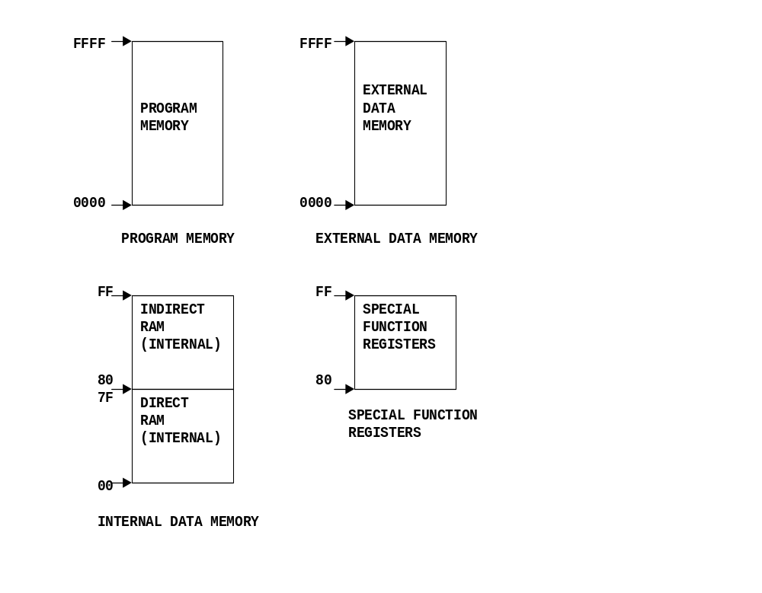
8051 Memory Map

Slide 5
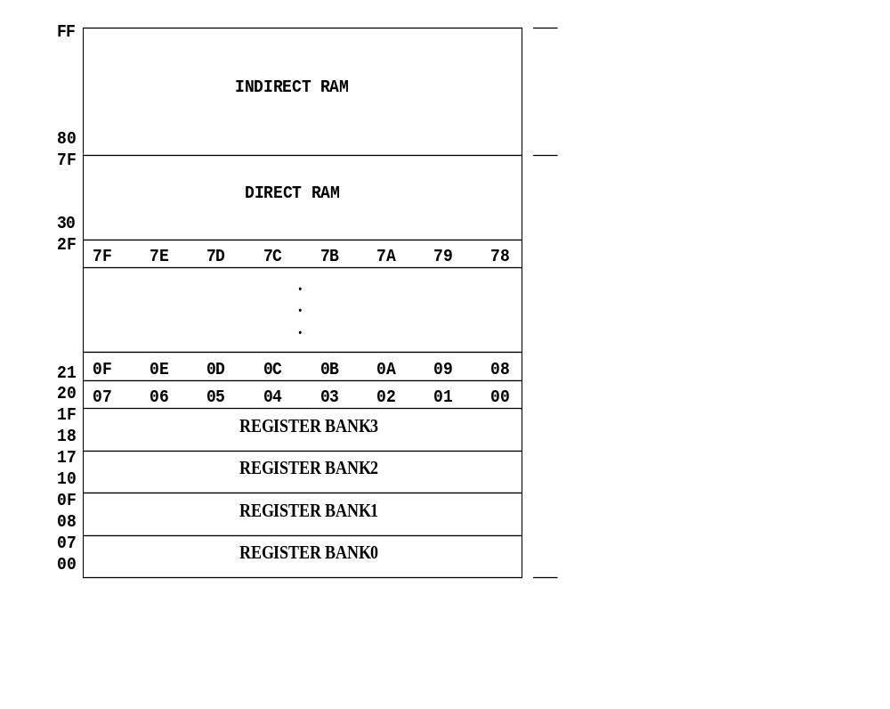
8051 Internal Memory Map

Slide 6
8051 extensions to ANSI C
“bit” data type
Using SFRs as variables
Keeping variables in different memory areas
Using pointers to different memory areas
Declaring variables at specific address.
Writing ISRs (interrupt functions) in ‘C’

Slide 7
8051 memory areas:
data: internal RAM, 00-7F, directly and indirectly accessible
bdata: internal RAM, 20-2F, directly, indirectly and bitwise accessible
idata: internal RAM, 00-FF, indirectly accessible
pdata: a 256 byte page in external data memory, XX00-XXFF, accessed with movx @Ri
xdata: external data memory, 0000-FFFF, accessed with movx @dptr
code: program memory, 0000-FFFF, accessed with movc instructions

Slide 8
Declaring variables in specific memory area:
New keywords: data, idata, bdata, pdata, xdata, code (memory specifiers)
Can be used to declare a variable in the specified memory area.
Examples:
idata char ch ; // char var in idata area
xdata int Counts[50] ;
// array of int in xdata area

Slide 9
Variables without memory specifier (default):
By default, all global variables are placed in data memory area.
By default, all local variables and parameters are placed on stack (data / idata memory area)
Memory specifier can be used only on global variables

Slide 10
Generic pointers:
By default, all pointers are generic pointers
Generic pointer can point to any memory area
Example #1: char *name ;
Example #2: float *values ;
Generic pointers are 3 bytes long

Slide 11
Memory specific pointers:
Use of a memory specifier in pointer variable declaration will make it a memory specific pointer.
idata char *ptr ; /* pointer to char, pointing to idata memory area, pointer value stored in default memory area (data/idata) */
xdata int *vptr ; /* pointer to int, pointing to xdata memory area, pointer value stored in default memory area (data/idata) */

Slide 12
More about pointers:
Memory specific pointers are smaller than generic pointers. (pointer to data/idata/bdata/pdata is single byte, pointer to xdata/code is two byte)
Memory specific pointers are faster, but less flexible
Generic pointers are slow, but more flexible

Slide 13
Declaring variables at specific address:
Special notation supported to declare variables at specific address. Example:
unsigned char @0x4000 lcd_data ;
Can be used only for xdata memory.
Useful for accessing external memory mapped peripherals.

Slide 14
bit / SFR / BIT keywords:
“bit” is a new keyword (new data type); used to declare single bit Boolean variables. Example: bit flag ;
“SFR” is a new keyword, used to declare Special Function Register. Example: SFR P1 0x90
“BIT” is a new keyword, used to declare bits in a bit-accessible SFR. Example: BIT motor P1.2

Slide 15
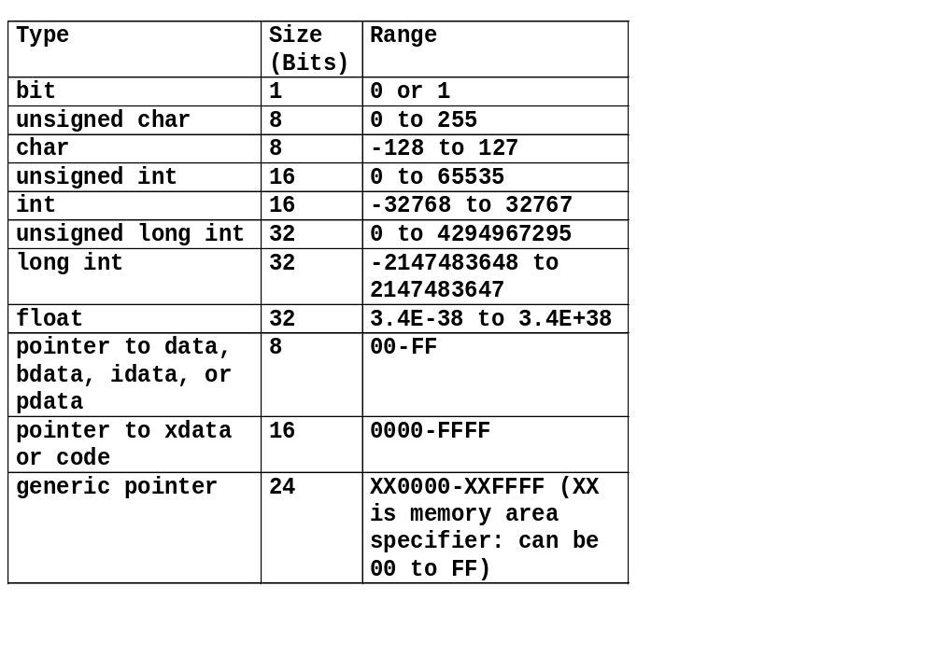
SC51 data types:

Slide 16
Restrictions on “bit” variables:
Arrays of / Pointer to bit variables not allowed.
A bit type variable must be a global variable. It can not be declared as a local variable or a parameter.
Maximum 120 bit variables in any project.
While assigning a constant value to a bit variable, only one of the two values can be assigned : 0 or 1.
In expression, if one of the operands is bit variable, then the other operand also must be bit variable.
Only logical / compare operations can be performed on bit type variables. Arithmetic operators (such as +, -, *) or rotate operators are not allowed on bit variables.

Slide 17
Interrupt function (ISR) Versus ordinary function
ISR is never called by user program (can not have parameters / can not return a value)
ISR must save/restore context (Register bank must be switched)
ISR has associated “vector” location
ISR ends with RETI rather than RET

Slide 18
“interrupt” and “using” keywords
Specific syntax required to define an ISR
interrupt (intr_type) func_name () using N
intr_type indicates type of interrupt (and hence it’s vector location). intr_type == 1 means EXT0, 2 means TMR0 and so on.
Vector location = ((intr_type – 1) * 8) + 3
Use symbolic constants defined STANDARD.H
N is register bank number (0 to 3)
Bank0 is always used for all non-interrupt functions

Slide 19
Absolute register addressing
By default, absolute register addressing is used. (For example, to push contents of register R2, the instruction “push AR2” is used)
Absolute register addressing can be turned off/on by #pragma directives.
#pragma NOAREGS will turn it off.
#pragma AREGS will turn it on.
If a function is called by interrupt function as well as non-interrupt function, then absolute register addressing must be turned off (for that particular function)

Slide 20
Special considerations for writing 8051 applications in ‘C’.
Try to minimize code size
Try to use minimum amount of data memory
Do not terminate program (use an infinite loop)

Slide 21
How to write “efficient” 8051 applications in ‘C’
Use smaller data types (1 bit or 8 bit is most preferred)
As far as possible, use unsigned data types
Keep variables in more “efficient” memory area – most preferred is data, then idata, then pdata, then xdata.
Use special ‘C’ operators / constructs

Slide 22
Effect of memory area on code size:
Consider the C statements:
unsigned char x,y,z ;
x = y + z ;
Depending on the memory area (data, idata,
pdata or xdata) of variables x,y,z, the code
generated is different.

Slide 23
x, y, z in data memory:
mov a,y
add a,z
mov x,a

Slide 24
x, y, z in idata memory:
mov r1,#y
mov a,@r1
mov r1,#z
add a,@r1
mov r1,#x
mov @r1,a

Slide 25
x, y, z in pdata memory:
mov r1,#y
movx a,@r1
mov r4,a
mov r1,#z
movx a,@r1
add a,r4
mov r1,#x
movx @r1,a

Slide 26
x, y, z in xdata memory:
mov dptr,#y
movx a,@dptr
mov r4,a
mov dptr,#z
movx a,@dptr
add a,r4
mov dptr,#x
movx @dptr,a

Slide 27
Effect of ‘C’ special operators on code size:
Consider the C variable:
unsigned char x ;
Assume that ‘x’ is in idata memory.
Consider the ‘C’ statement: x = x + 1 ;
This can be re-written using ‘C’ special
operators and it will result in reduced code
size.

Slide 28
Conventional addition and assignement:
C statement: x = x + 1 ;
mov r1,#x
mov a,@r1
add a,#1
mov r1,#x
mov @r1,a

Slide 29
Combined addition and assignement:
C statement: x += 1 ;
mov r1,#x
mov a,@r1
add a,#1
mov @r1,a

Slide 30
Increment operator:
C statement: x ++ ;
mov r1,#x
inc @r1

Slide 31
Introduction to SC51 toolset:
Includes several components:
Integrated Development Environment (IDE)
Program Editor with syntax highlighting
Project Manager
C Compiler, Assembler, Linker, Library
Simulator
ISP programming software (SPJTerminal)

Slide 32
More about SC51 toolset:
Toolset starting point is SIDE51 (IDE)
Create / edit C or Assembler source programs
Create project, add source programs in it
Build a project (compile, assemble, link)
Start the simulator to debug program
Start SPJTerminal to download HEX file into ISP compatible controllers

Slide 33
Hints and tips:
Interrupt function (ISR) can cause wrong timing in non-ISR functions.
Stack overflow may happen only when a "worst case" combination occurs.
Using a variable without initialization.
Missing function prototype can cause in-correct behavior.
Mismatch of printf format specification and corresponding parameters.
In-correct / out of range comparison - e.g. if (g_byCh > 324)

