Slide 1
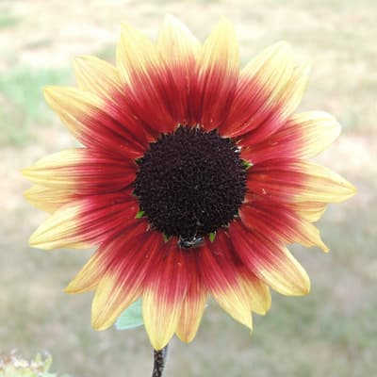

VISIONKNOB
Ask images
without losing
your hands.
A tactile local vision assistant powered by Arduino UNO Q,
Modulino controls, Gemma, and GenieX.
LOCAL-FIRST AI
Notes:
Open with the core promise: VisionKnob makes image understanding physical and immediate. The user selects an image with a knob and submits a question with a button; the answer is generated locally rather than sent to a cloud service.

Slide 2
THE FRICTION
02
Image understanding is powerful.
The interface is still a bottleneck.
SELECT
ASK
UNDERSTAND
Finding the right image interrupts the flow.
Keyboard-first workflows exclude hands-busy moments.
Cloud-only vision creates privacy and latency concerns.
Three actions.
One physical loop.
Notes:
Frame the problem as interaction friction, not a lack of model capability. Vision models can answer questions, but the path from a physical image library to a grounded answer is still awkward.

Slide 3
THE SOLUTION
03
A physical control surface
for a local vision model.
01
02
03
Turn
Press A
See
Choose the image
Submit the typed question
Get a grounded answer
Notes:
Explain the interaction in three beats. The browser remains useful for typing and seeing the answer, while the Arduino controller removes the need to reach for the mouse or keyboard during selection and submission.

Slide 4
UNDER THE HOOD
04
One loop. Four layers.
MODULINO
UNO Q
STREAMLIT
GEMMA
>
>
>
Knob + buttons
USB serial bridge
Selection + chat
Grounded vision
JSON events in. Status commands out.
The image stays local; the answer stays grounded in the selected frame.
Notes:
Walk left to right. The hardware emits JSON events over USB serial. Streamlit owns the interaction state and attaches the selected image to the request. GenieX serves the cached Gemma VLM locally. Status commands return to the Pixels module for immediate feedback.

Slide 5
THE DEMO
05
A question becomes a visible event.
TURN KNOB
Select the sunflower image
TYPE QUESTION
What colors are visible?
PRESS A
Gemma answers from this image
Notes:
Use this as the live demo slide. Demonstrate the knob changing the selected image, type a short question, press Button A, and point to the Pixel status feedback while the local model processes the request.

Slide 6
WHY LOCAL
06
Private by default.
Responsive by design.
PRIVATE
GROUNDED
TACTILE
Images remain on the
local machine.
The selected frame is
attached to each request.
The controller gives
feedback at a glance.
Notes:
The important differentiator is not merely that the model is local. The full interaction is local: image storage, retrieval, inference, and physical feedback all happen without sending the image to a hosted vision API.

Slide 7
THE HARDWARE
07
Small modules. Clear roles.
KNOB
Select image
BUTTON A
Submit question
BUTTON B
Next image
PIXELS
Ready / working / result
Notes:
Tie each physical component to a user outcome. Button C is intentionally open for a future action such as clearing the conversation, toggling retrieval mode, or returning to the first image.

Slide 8
THE ASK
08
Make image understanding
feel as immediate as looking.
NEXT
NOW
Button C + richer
physical feedback
Try the local
vision loop
VisionKnob | Arduino UNO Q | Gemma | GenieX
Notes:
Close with the invitation: try the loop. The prototype already proves the interaction. The next step is expanding the control vocabulary, especially assigning Button C to a high-value workflow action and refining feedback for hands-busy use cases.

