Slide 1
Intro to the Arduino
Topics:
The Arduino
Digital IO
Analog IO
Serial Communication

Slide 2
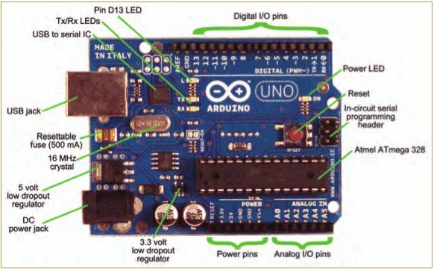
Topic 1: Meet Arduino Uno

Slide 3
Getting Started
Check out: http://arduino.cc/en/Guide/HomePage
  Download & install the Arduino environment (IDE) (not needed in lab)
  Connect the board to your computer via the USB cable
  If needed, install the drivers (not needed in lab)
  Launch the Arduino IDE
  Select your board
  Select your serial port
  Open the blink example
  Upload the program

Slide 4
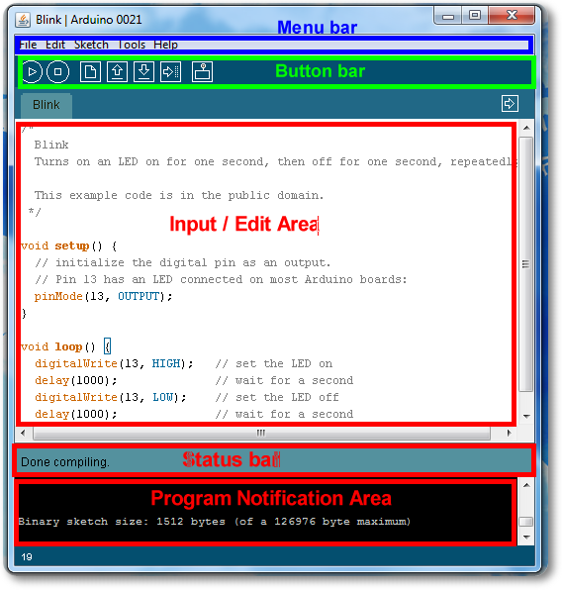
Arduino IDE
See: http://arduino.cc/en/Guide/Environment for more information

Slide 5
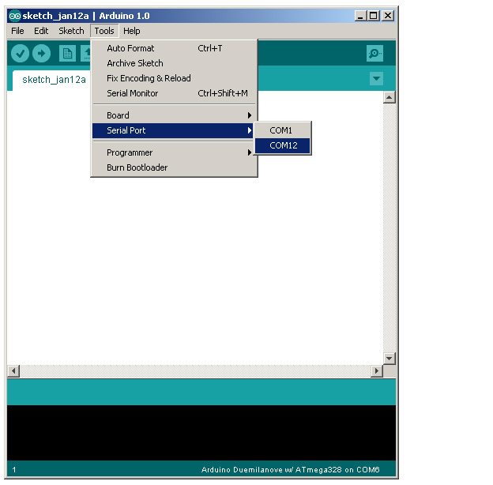
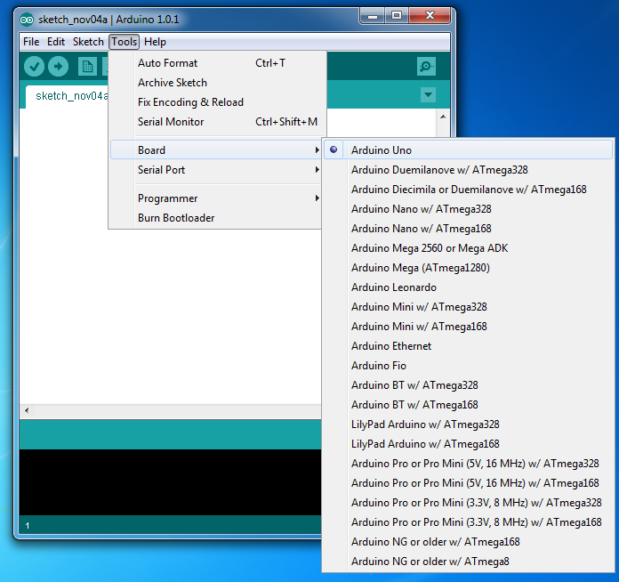
Select Serial Port and Board

Slide 6
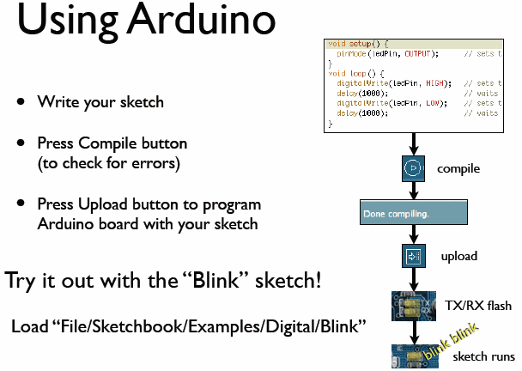
todbot.com/blog/bionicarduino

Slide 7
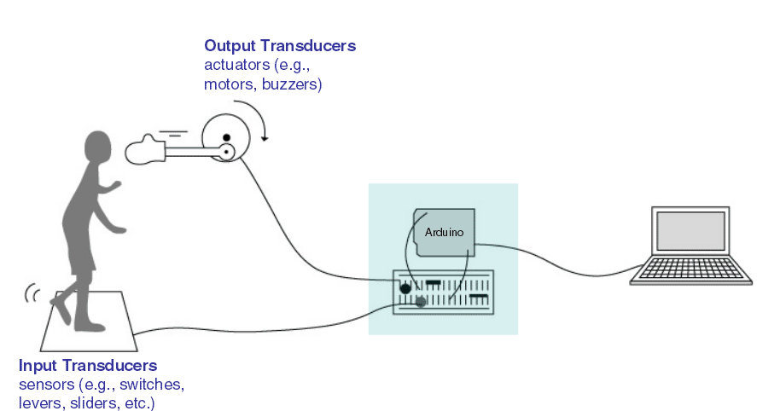
Input/Output
Image from Theory and Practice of Tangible User Interfaces at UC Berkley

Slide 8
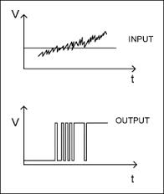
Topic 2: Digital Input/Output
1
Digital IO is binary valued—it’s either on or off, 1 or 0
Internally, all microprocessors are digital, why?
0

Slide 9
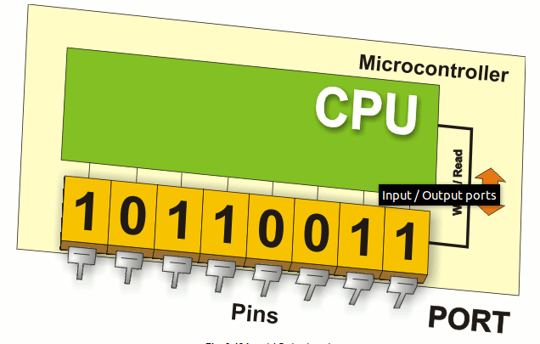
Arduino Digital I/0
www.mikroe.com/chapters/view/1
pinMode(pin, mode)
  Sets pin to either INPUT or OUTPUT
digitalRead(pin)
  Reads HIGH or LOW from a pin
digitalWrite(pin, value)
  Writes HIGH or LOW to a pin
Electronic stuff
  Output pins can provide 40 mA of current
  Writing HIGH to an input pin installs a 20KΩ pullup

Slide 10
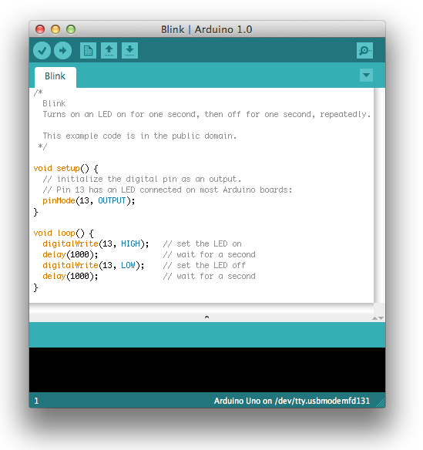
Our First Program

Slide 11
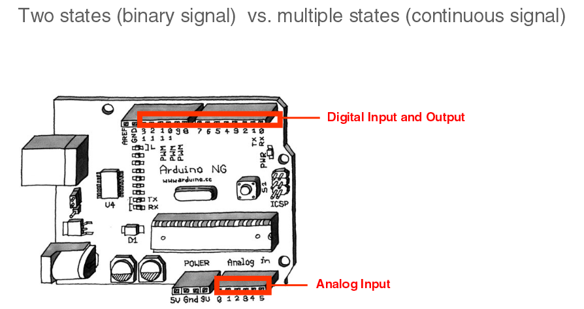
IO Pins
Image from Theory and Practice of Tangible User Interfaces at UC Berkley

Slide 12
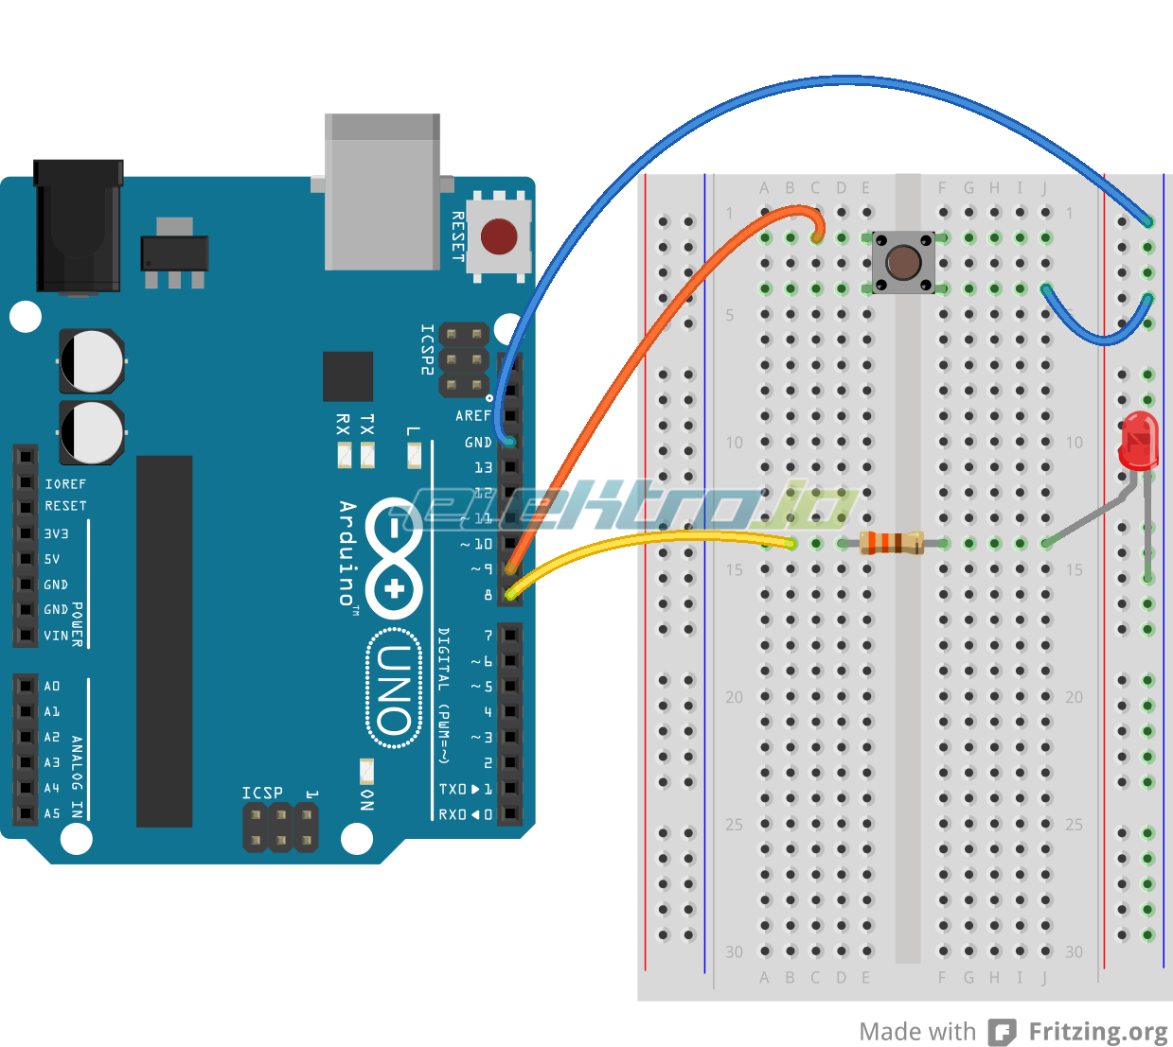
In-class Exercise 1: Digital IO
Use a push-button to turn ON/Off LED

Slide 13
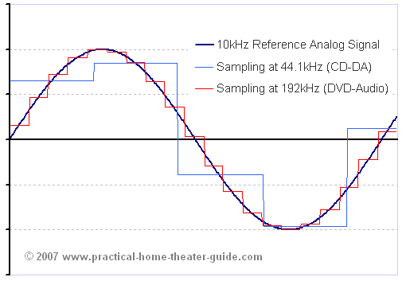
Topic 3: Analog Input
Think about music stored on a CD---an analog signal captured on digital media
  Sample rate
  Word length

Slide 14
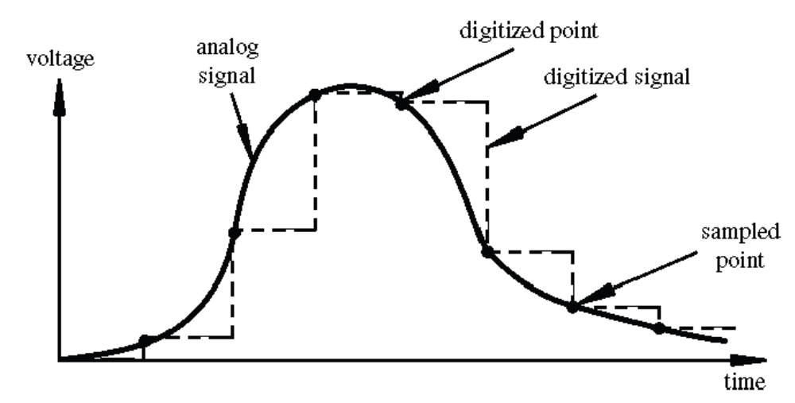
Arduino Analog Input
Image credit: Tod Kurt
Resolution: the number of different voltage levels (i.e., states) used to discretize an input signal
Resolution values range from 256 states (8 bits) to 4,294,967,296 states (32 bits)
The Arduino uses 1024 states (10 bits)
Smallest measurable voltage change is 5V/1024 or 4.8 mV
Maximum sample rate is 10,000 times a second

Slide 15
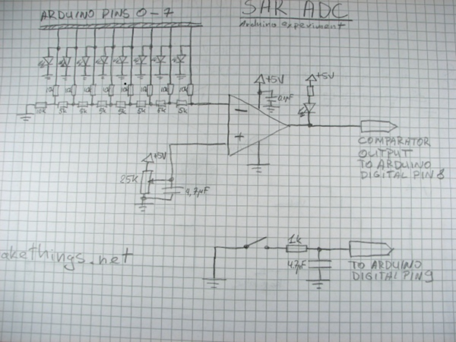
How does ADC work?
How does ADC work
Excel Demonstration

Slide 16
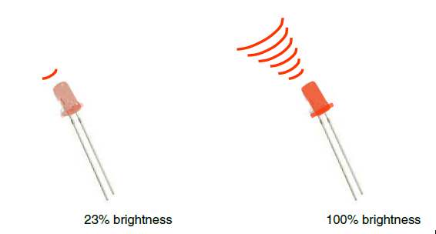
Topic 3: Analog Output
Can a digital devise produce analog output?
Image from Theory and Practice of Tangible User Interfaces at UC Berkley
Analog output can be simulated using pulse width modulation (PWM)

Slide 17
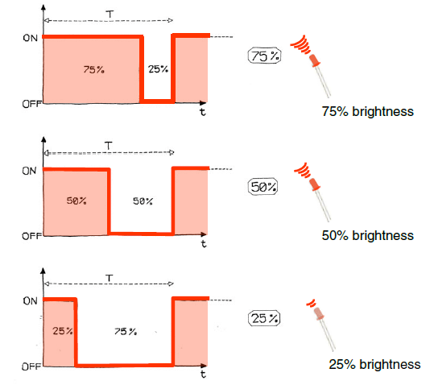
Pulse Width Modulation
Can’t use digital pins to directly supply say 2.5V, but can pulse the output on and off really fast to produce the same effect
The on-off pulsing happens so quickly, the connected output device “sees” the result as a reduction in the voltage
Image from Theory and Practice of Tangible User Interfaces at UC Berkley

Slide 18
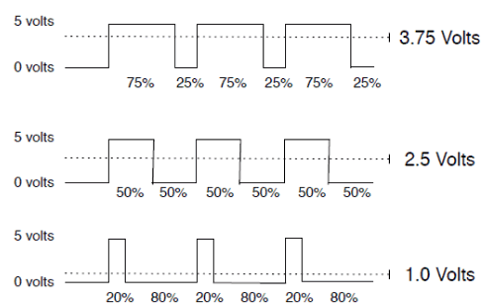
PWM Duty Cycle
output voltage = (on_time / cycle_time) * 5V
Image credit: Tod Kurt
Fixed cycle length; constant number of cycles/sec

Slide 19
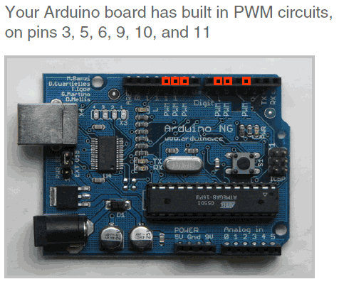
PMW Pins
Command: analogWrite(pin,value)
value is duty cycle: between 0 and 255
Examples:
analogWrite(9, 128)
for a 50% duty cycle
analogWrite(11, 64)
for a 25% duty cycle
Image from Theory and Practice of Tangible User Interfaces at UC Berkley

Slide 20
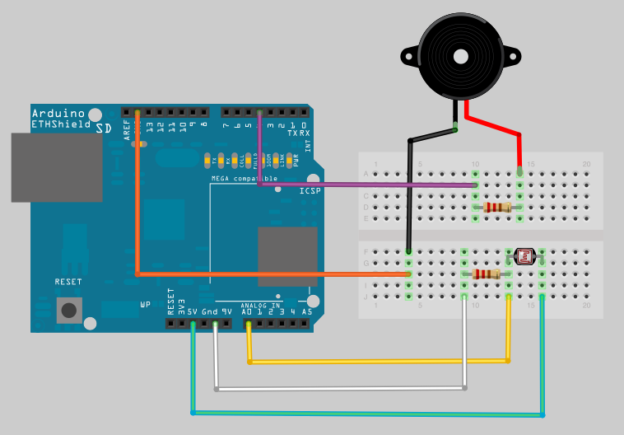
In-class Exercise 2: Analog IO
Part 1:
A light theremin

Slide 21
In-class Exercise 2: Analog IO
Part 2: Add an LED
Add a 330 ohm resistor and an LED to pin 9
Using the analogWrite() command, set the intensity of the LED as a function of the value of prReading

Slide 22
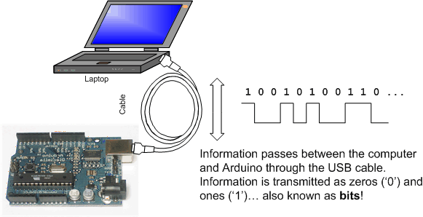
Topic 4: Serial Communication
Image from http://www.ladyada.net/learn/arduino/lesson4.html

Slide 23
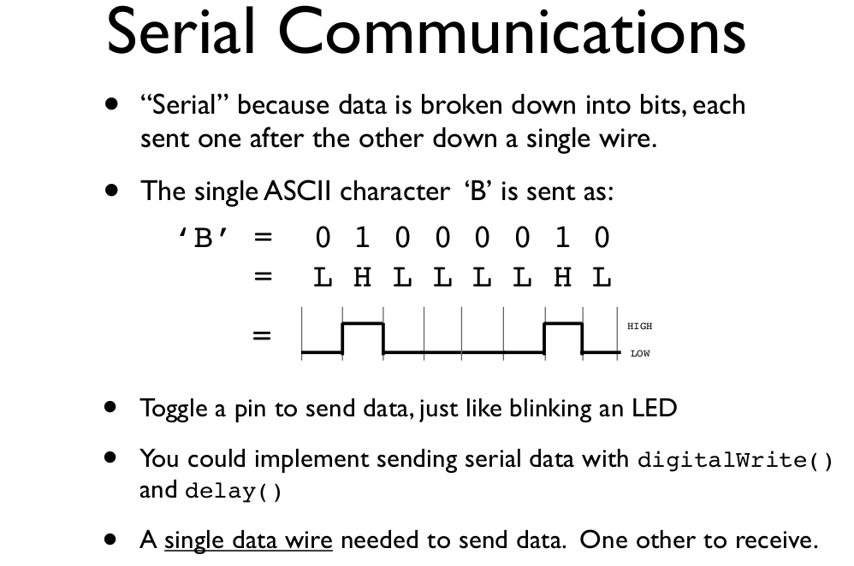
todbot.com/blog/bionicarduino

Slide 24
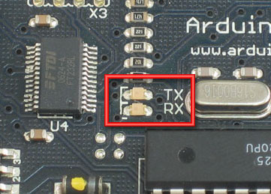
Serial Communication
Compiling turns your program into binary data (ones and zeros)
Uploading sends the bits through USB cable to the Arduino
The two LEDs near the USB connector blink when data is transmitted
  RX blinks when the Arduino is receiving data
  TX blinks when the Arduino is transmitting data
todbot.com/blog/bionicarduino

Slide 25
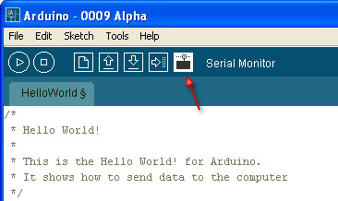
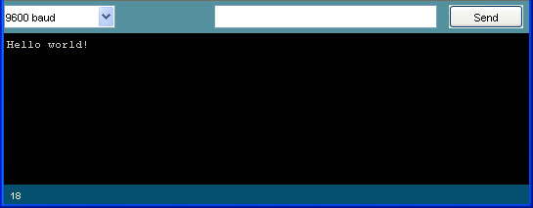
Open the Serial Monitor and Upload the Program

Slide 26
Some Commands
Serial.begin()
- e.g., Serial.begin(9600)
Serial.print() or Serial.println()
- e.g., Serial.print(value)
Serial.read()
Serial.available()
Serial.write()
Serial.parseInt()
Example Program

Slide 27
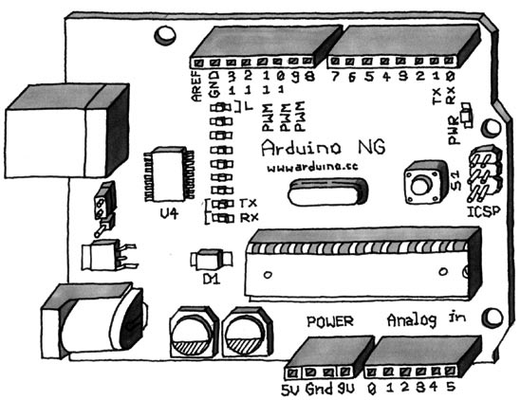
Serial-to-USB chip---what does it do?
The LilyPad and Fio Arduino require an external USB to TTY connector, such as an FTDI “cable”.
In the Arduino Leonardo a single microcontroller runs the Arduino programs and handles the USB connection.
Image from Theory and Practice of Tangible User Interfaces at UC Berkley

Slide 28
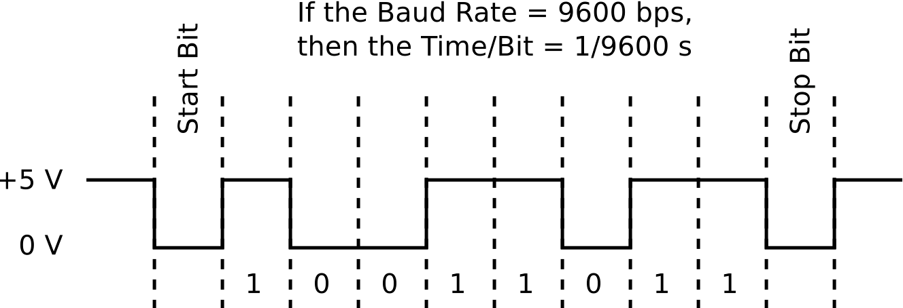
Two different communication protocols
Serial (TTL):
Image from http://www.fiz-ix.com/2013/02/introduction-to-arduino-serial-communication/

Slide 29
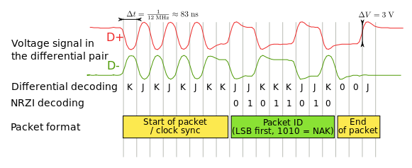
USB Protocol
Image from http://en.wikipedia.org/wiki/USB
Much more complicated

Slide 30
In-class Exercise 3: Serial Communication
Modify your program from in-class exercise 2-part 2 to control the intensity of the LED attached to pin 9 based on keyboard input.
Use the Serial.parseInt() method to read numeric keyboard input as an integer.
An input of 9 should produce full intensity and an input of 0 should turn the LED off.

