Slide 1


Slide 2

Introduction
Bionic eye is a bio-electronic eye.
Bionic eye replaces the functionality of a part or whole of the eye.
In our proposed method of bionic eye, a small and a powerful camera powered by nanogenerator, is implanted inside the patient’s eye rather than worn on a pair of glasses

Slide 3



The Human eye : Structure and function
The Human eye is an organ that reacts to light
for several purposes.
The important part of the eye responsible for the vision is the retina.
The retina is a light sensitive tissue lining the inner surface of the eye. Light falling on the eye is focused on to a sheet of light sensitive cells.

Slide 4
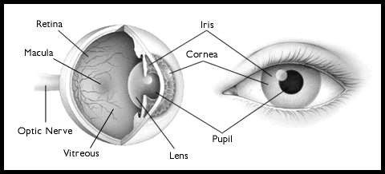
Fig.: Internal Structure of Human Eye

Slide 5

Diseases of the Eye
Retinitis Pigmentosa
Macular Degeneration

Slide 6




Retinitis Pigmentosa
Hereditary Genetic Disease
Peripheral Rods degenerate
Gradually progresses towards center of eye
Spares the foveal region
Tunnel vision results

Slide 7

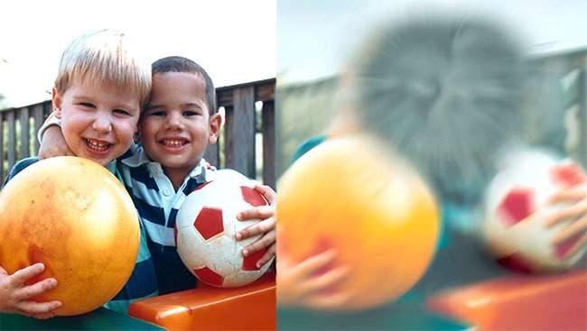
Macular Degenration
Genetically Related
Cones in Macula region degenrate
Loss or damage of central vision
Peripheral Retina spared
Common among old people

Slide 8

BIONIC EYE
A visual prosthesis or bionic eye is a form of neural prosthesis intended to partially restore lost vision or amplify existing vision.

Slide 9
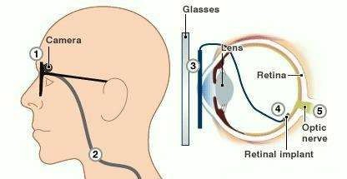

Fig: Bionic eye

Slide 10

Working of Bionic eye
A bionic eye works by stimulating nerves,
which are activated by electrical impulses.
In this case the patient has a small device implanted into the body that can receive radio signals and transmit those signals to nerves.

Slide 11
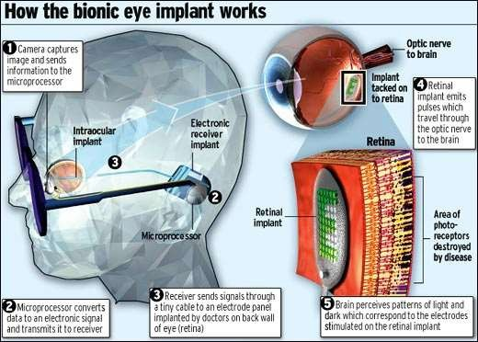

Slide 12

METHOD
ASR (Artificial silicone Retina) system
MARC (Multiple unit Artificial Retina Chip) system

Slide 13
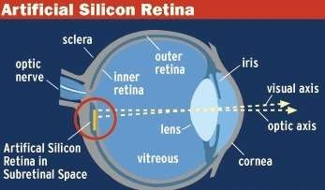

A. Artificial silicon retina
Artificial Silicon
Retina (ASR) is which contains
a solid state an array of
biocompatible chip
photoreceptors, and is implanted to replace the functionality of the defective photoreceptor.

Slide 14
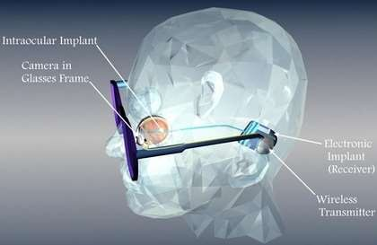

B. The MARC system
The MARC system are a power and signal transceiver and processing chip, a stimulation- current driver , and a proposed electrode array fabricating on a material such as silicone rubber,thin silicone or polyimide with a ribbon cables connecting the device.

Slide 15

Application
Treating patient with total vision loss.
Ceramic detectors are biocompatible
Wonderful optical properties.
Naturally porous structure allows nutrients to flow from the back to the front of the eye

Slide 16

Future prospects
Planning a third version that has 1,000 electrodes on the
retinal implant, which they believe could allow for facial- recognition capabilities and hope to allow the user to see colorful images.
Hopefully, the technology may enable people to recognize faces and facial expressions.
“The thing is to significantly improve the quality of life for blind patients".

Slide 17

Conclusion
Bionic devices are being developed to do more
than replace defective parts
We may not restore the vision fully, but we can help them at least to find their way, recognize faces, read books, distinguish between objects such as cups and plates, above all lead an independent life

Slide 18

References
K. Pradeep, K.Vasantha Kokilam and C. Sunitha Proceedings of
National Conference on New Horizons in IT - NCNHIT 2013
Bionic Eye Technology: An Advanced Version of Artificial Vision”, Academia, Volume 2, Issue 7, July, 2012
C. V. Krishnaveni, 2Ramesh B Lakkakula, 3Sunki Manasa 1,2,3Dept. of IT, Bhoj Reddy Engineering College, Hyderabad, AP,India
Praveenkumar Narayanan, Guhan Senthil2011 International Conference on Life Science and Technology IPCBEE vol.3 (2011) © (2011) IACSIT Press, Singapore

Slide 19

Thank you

