Slide 1

Recent
Add
Subtract
Clear
Overwrite
Virtual (temporary)
Temporary SL

Slide 2
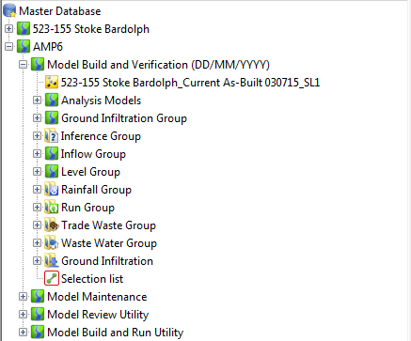
Select Recent
Append
Subtract
Clear
Overwrite
Create Temporary
Create Temporary
Select Recent
Append
Subtract
Clear
Overwrite
Selection lists
Selection lists

