Slide 1

Fashion Data Warehouse Implementation on Snowflake
Transforming Raw Data into Business Intelligence
Team 226
Sanchal Kalengada
Tejal Meda
Pavithran Murugan

Slide 2

The Data Source: FashionDataset2.csv
Initial Data Challenges
Price columns contained currency symbols (Rs) and text formatting that required parsing into numeric formats for analysis and aggregation.
Key Data Columns
Sample Data Structure
▸
Brand Name
– The manufacturer or label
Column
Example Value
▸
Details
– Descriptive text (e.g., "solid cotton blend collar neck womens a-line dress")
Brand Name
Nike, Adidas, Zara
▸
Sizes
– Available sizes (e.g., "Large, Medium, Small")
Details
Cotton blend dress
▸
MRP & Sell Price
– Maximum Retail Price and actual selling price
Sizes
S, M, L, XL
▸
MRP
Rs 2,999
Discount
– Discount percentage offered
▸
Category
– High-level product category (e.g., "Westernwear-Women")
Sell Price
Rs 1,999
Discount
33.3%
Category
Westernwear-Women
Data Characteristics
• Format: CSV (Comma-Separated Values) with standard headers
• Raw State: Unmodified source data, exact replica of the original file

Slide 3

Project Architecture: The Medallion Approach
An industry-standard three-layer architecture ensuring data quality, governance, and usability across the organization.
01
02
03
Bronze Layer
Silver Layer
Gold Layer
Raw Data
Curated Data
Business Ready
Ingestion of raw, untransformed data. Exact copy of the source CSV with no modifications.
Data cleaning, transformation, and structuring into a relational Star Schema model with Facts and Dimensions.
Aggregated, business-specific data for reporting and analytics. Highly summarized tables tailored to use cases.
Key Task: Initial loading and storage
Key Task: Data consistency and quality
Key Task: Direct BI support
Value Proposition: The Medallion Architecture ensures data quality through progressive refinement, enables governance at each stage, and provides business users with clean, aggregated data ready for analytics and reporting.

Slide 4

Bronze Layer: Establishing the Raw Data Foundation
The Bronze layer stores the raw FashionDataset2.csv exactly as received, providing an auditable historical record and a single source of truth for downstream work.
Key Tasks & Accomplishments
What We Created
▸
Schema Creation:
Created the BRONZE schema in the project database
Schema Name
▸
Table Definition:
BRONZE
Defined FASHION_BRONZE_RAW table with columns matching the
CSV structure
Table Name
▸
FASHION_BRONZE_RAW
Data Loading:
Used Snowflake's COPY INTO command to efficiently load the entire CSV dataset
Table Columns
•
ROW_IDX
▸
Auditability:
Added _INGESTION_TIMESTAMP column to track when raw data was
loaded
•
BRANDNAME
•
DETAILS
•
SIZES
Data Integrity
•
MRP
•
SELLPRICE
Maintained exact replica of source data with no modifications or transformations.
•
DISCOUNT
•
CATEGORY
•
_INGESTION_TIMESTAMP
Loading Method
Snowflake COPY INTO command for efficient bulk data ingestion
Verification
Confirmed successful load with row count verification

Slide 5

Silver Layer: Structured Data Warehouse Design
Transforming raw data into a structured Star Schema optimized for querying and analytical performance.
Dimension Table
DIM_BRAND
•
BRAND_ID
(PK)
Fact Table
•
BRAND_NAME
FACT_FASHION
•
(Unique)
•
PRODUCT_KEY
•
BRAND_ID
Dimension Table
(FK)
•
CATEGORY_ID
Additional Attributes
(FK)
Dimension Table
•
MRP (FLOAT)
DIM_CATEGORY
•
SELL_PRICE (FLOAT)
•
Product Details
•
DISCOUNT_PERCENT
•
Available Sizes
•
CATEGORY_ID
(PK)
•
CATEGORY_NAME
•
Pricing Info
•
(Unique)
Data Transformation
Referential Integrity
Price columns cleaned using REGEXP_REPLACE and cast to FLOAT for numerical analysis and aggregation.
Foreign key constraints enforce data consistency across Fact and Dimension tables, ensuring reliable relationships.

Slide 6
Gold Layer: Business Reporting Focus
The 3 Business Use Cases
1
Brand Performance Report
Analyze brand-level pricing and discounting strategies to identify premium vs. budget brands
Purpose
Category Inventory Summary
2
The Gold layer is where data is pre-calculated and summarized to directly answer key business questions. It contains highly aggregated, business-specific tables tailored to specific use cases.
Assess stock value and item count per category for inventory planning
3
Price Tier Analysis
Classify products into Budget, Mid-Range, and Premium segments for market understanding
Gold Layer Characteristics
Purpose: Direct support for business intelligence, dashboards, and reporting
Each use case generates a dedicated table in the Gold layer, optimized for specific business decisions and analytics workflows.
Content: Pre-aggregated tables aligned with business use cases
Key Task: Create tables that answer specific business questions

Slide 7

Gold Layer Insights: Brand Performance and Inventory
Two critical business intelligence tables that enable strategic decision-making and operational optimization.
Brand Performance Report
Category Inventory Summary
GOLD.BRAND_PERFORMANCE
GOLD.CATEGORY_INVENTORY
Key Metrics
Key Metrics
▪
Total Products
– Count of products per brand for volume analysis
▪
Total Products
– Total number of products in each category
▪
Average MRP
– Mean retail price to identify price positioning
▪
Total Inventory Value
– Sum of sell prices (total capital invested)
▪
Average Sell Price
– Mean selling price for revenue analysis
▪
Average Item Value
– Mean price per item in the category
▪
▪
Discounted Items Count
– Number of items with active discounts per brand
Category Performance
– Ordered by total inventory value for priority ranking
Business Value
Business Value
Enables strategic decisions on brand partnerships, pricing strategies, and promotional focus. Identify which brands are premium (high average price) and which are budget (high discount rate).
Supports inventory optimization, warehouse planning, and capital allocation decisions across categories. Assess stock value and item count per category for strategic resource allocation.

Slide 8

Gold Layer Insights: Price Tiers and Data Flow
Price Tier Analysis
Incremental Data Loading
Budget Tier
1
Create Test Data File
Small new data file created with same format/columns as original dataset but with handful of rows and new data to simulate incoming data.
< Rs 1,000
Entry-level, high-volume products designed for price-sensitive customers seeking affordable fashion options.
2
Implement Loading Mechanism
Mid-Range Tier
Appropriate mechanism (e.g., Snowflake Stream/Task or manual execution) to load incremental data automatically into Bronze layer.
Rs 1,000 – 3,000
Core customer segment products offering balanced quality and price, representing the largest market segment.
3
Update Silver & Gold Layers
Execute SQL to propagate new data through Silver layer transformations and into Gold layer aggregations.
Premium Tier
> Rs 3,000
4
Verification & Comparison
High-value, luxury products targeting affluent customers seeking premium quality and exclusive designs.
Compare row counts in Silver and Gold datasets before/after to verify incremental data loaded properly and metrics updated.
Key Metrics
• Product count per tier for market composition analysis
• Average price per tier for market positioning
• Informs marketing and sales strategy

Slide 9

New Value: Interactive Gold Layer Dashboard
Key Features
1
Core Gold Layer Reports
Displays the 3 core Gold Layer reports: Brand Performance, Category Inventory, and Price Tier Analysis with interactive visualizations.
Goal
2
Cortex Services Integration
Includes dedicated sections for Cortex Search and Cortex Analyst with image placeholders for future AI-powered insights.
Provide a single, accessible view for key business metrics and insights derived from the Gold Layer, enabling stakeholders to make data-driven decisions without requiring SQL expertise.
3
Self-Service Analytics
Empowers business users with immediate access to aggregated metrics and insights, reducing dependency on technical teams.
Technology Stack
▪
Framework: Plotly (Interactive Visualizations)
▪
Format: Static HTML for easy deployment
Business Impact
▪
Data Source: Gold Layer tables
Enables faster decision-making through accessible, real-time business intelligence and supports strategic initiatives with data-driven insights.
▪
Integration: Cortex Search & Cortex Analyst

Slide 10

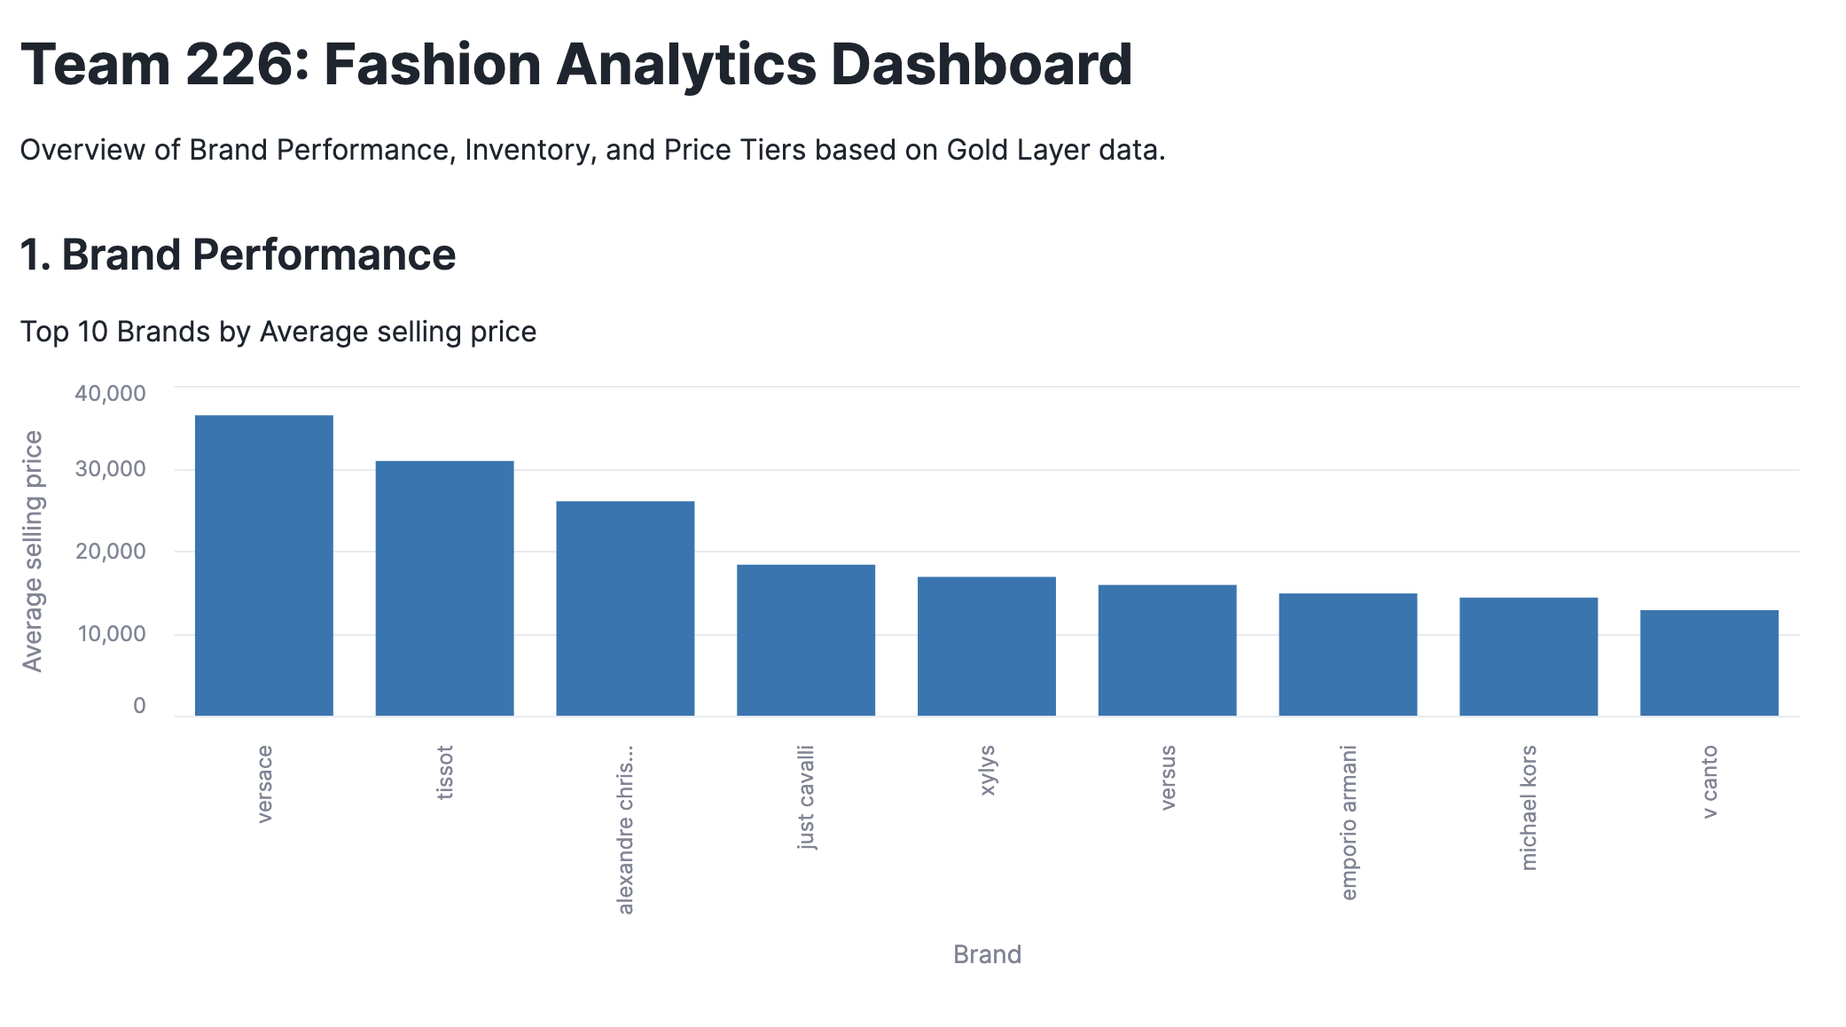
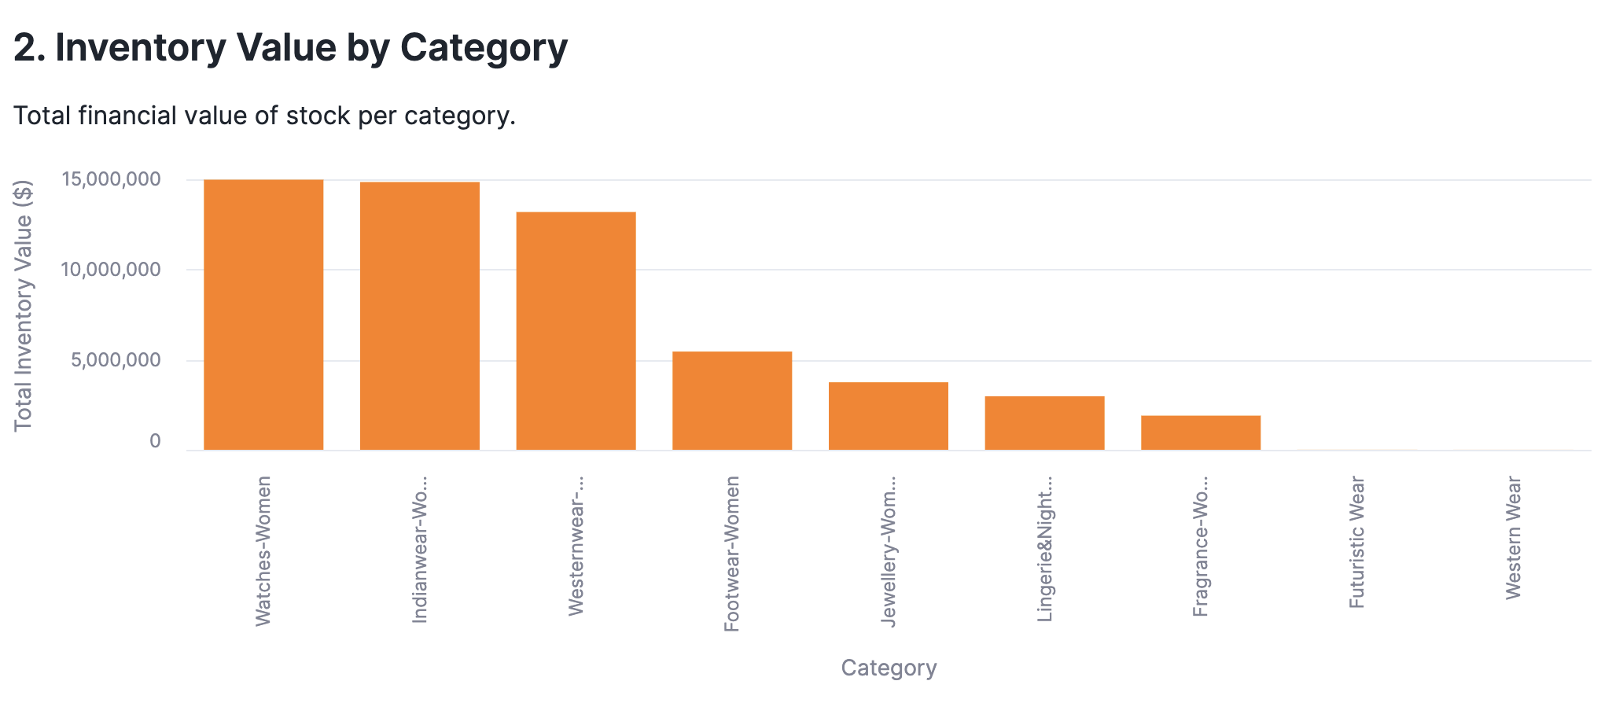
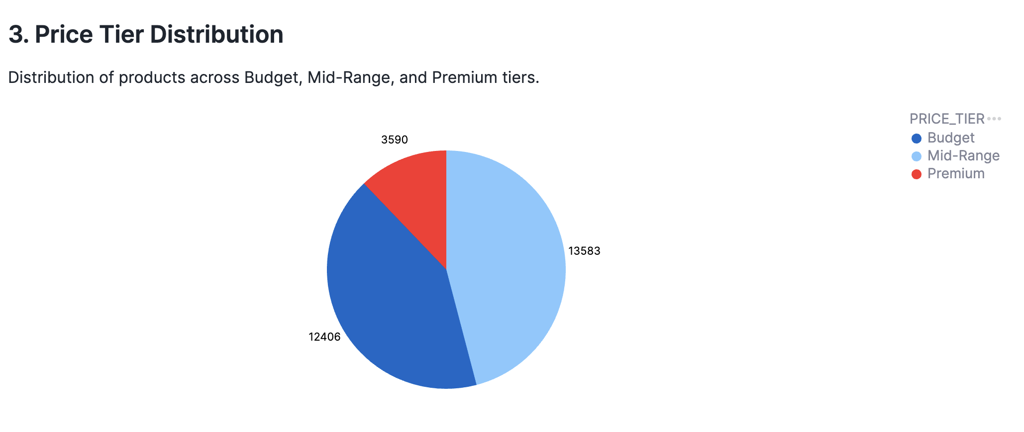
Gold Layer Dashboard using streamlit: Core Business Insights
Interactive visualization of the three core Gold Layer business intelligence reports: Brand Performance, Category Inventory, and Price Tier Analysis.

Slide 11

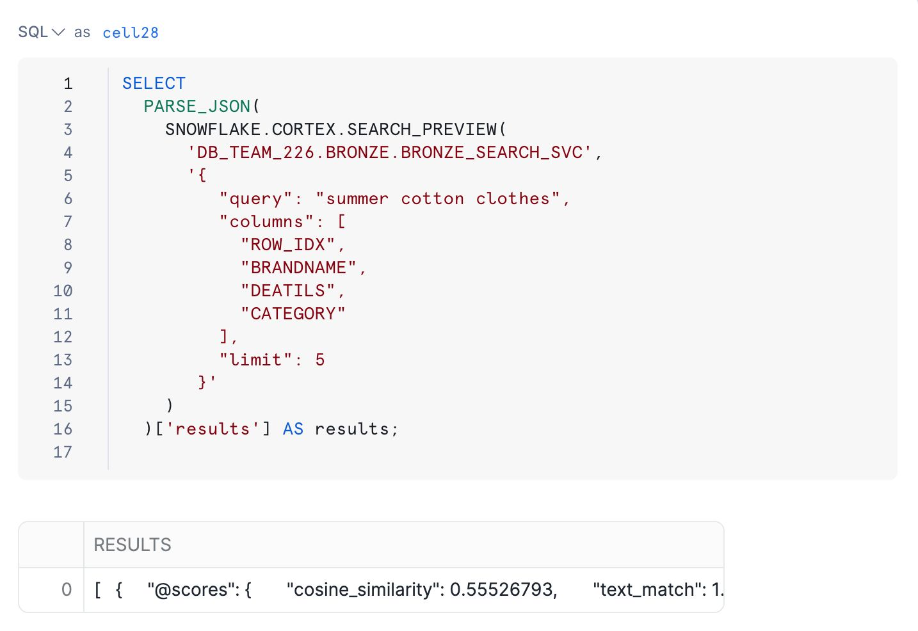
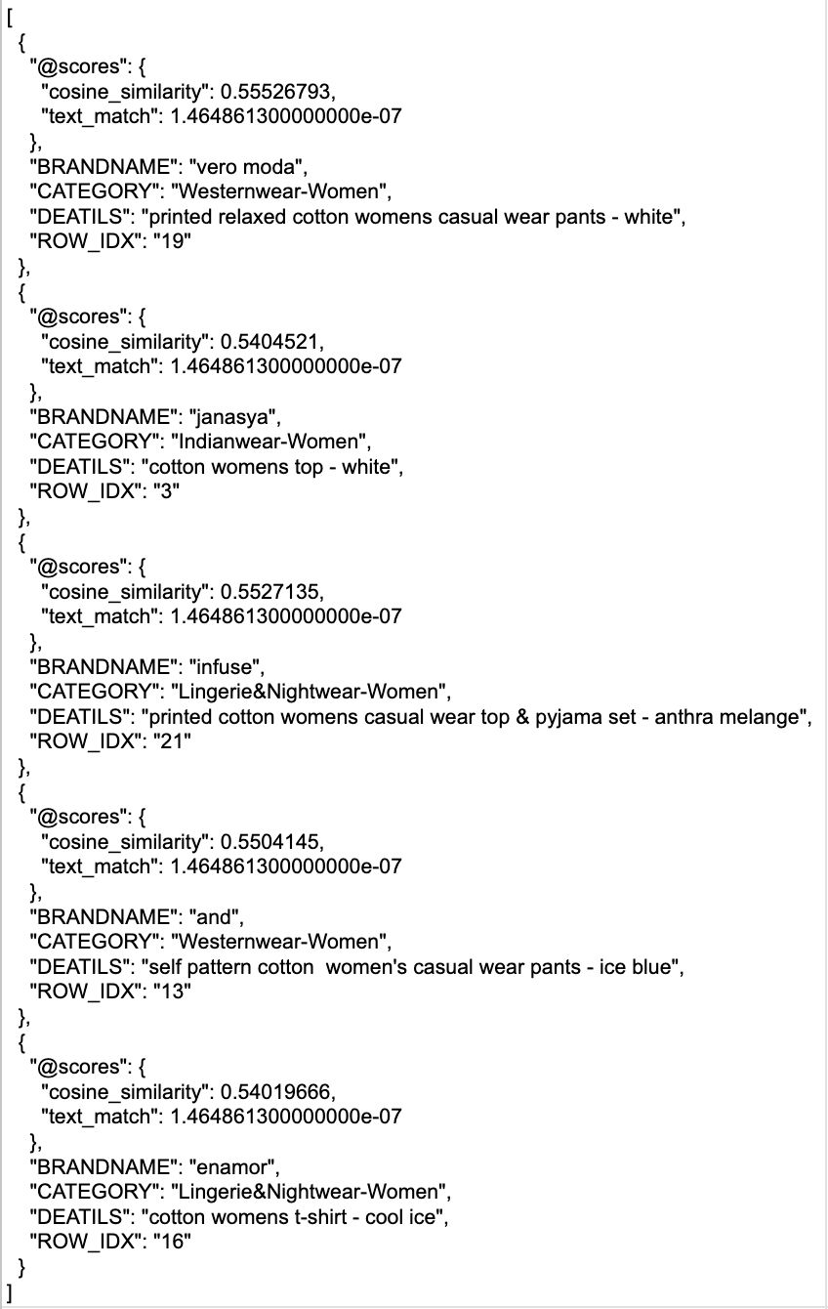
Cortex Search: Natural Language Product Discovery
Cortex Search leverages AI to enable natural language querying directly against the raw product descriptions in the Bronze layer. This allows business users to find products and patterns without writing complex SQL.
Key Capabilities
▪
Conversational Search:
Users can ask questions like "Show me all red dresses with floral patterns."
▪
No SQL Required:
Democratizes data access by removing the technical barrier of entry.
▪
Fast Discovery:
Provides near-instantaneous results by searching the enriched data attributes.
▪
Enriched Attributes:
Utilizes the clean, standardized attributes from the Silver layer for precise filtering.

Slide 12
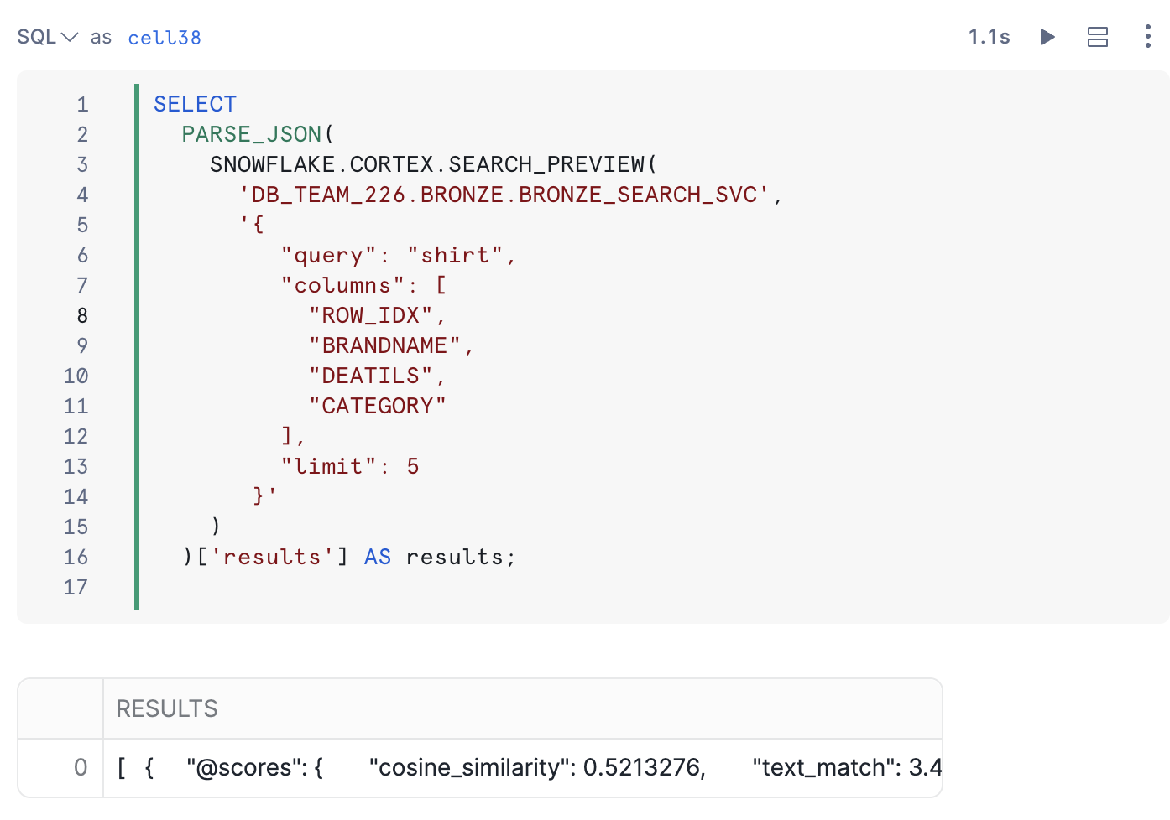
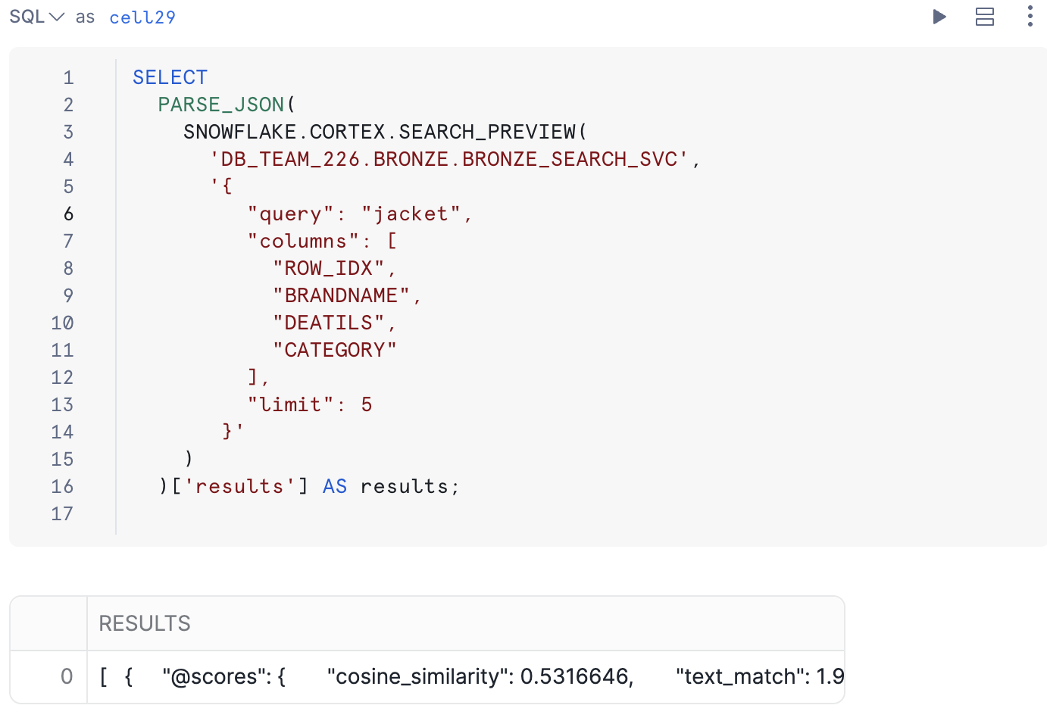
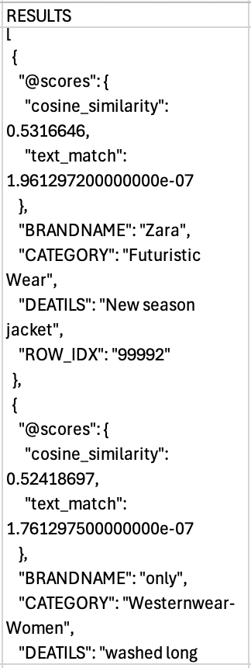
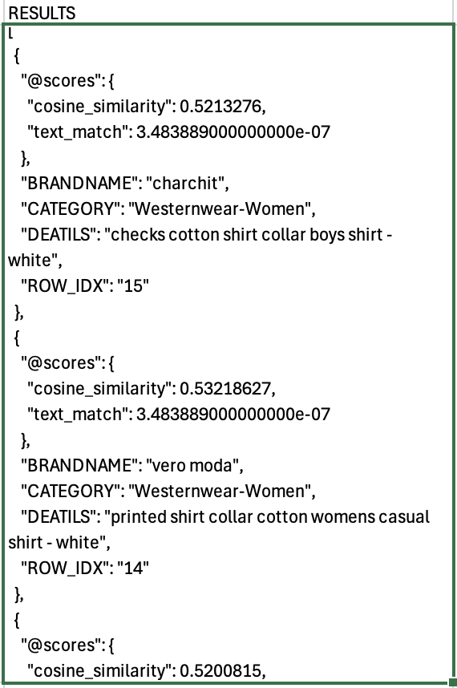
▪
▪
▪
▪

Slide 13

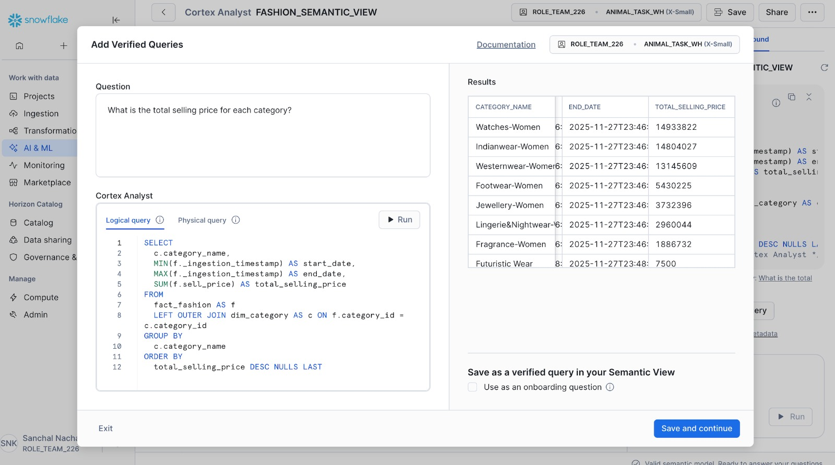
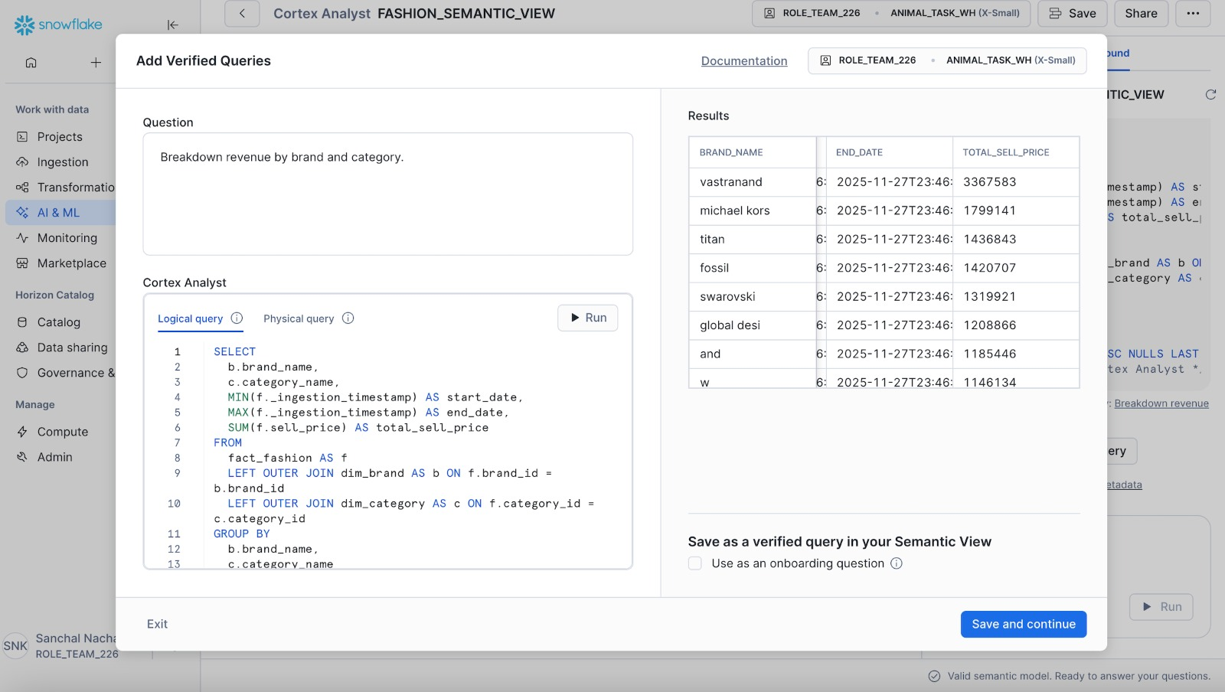
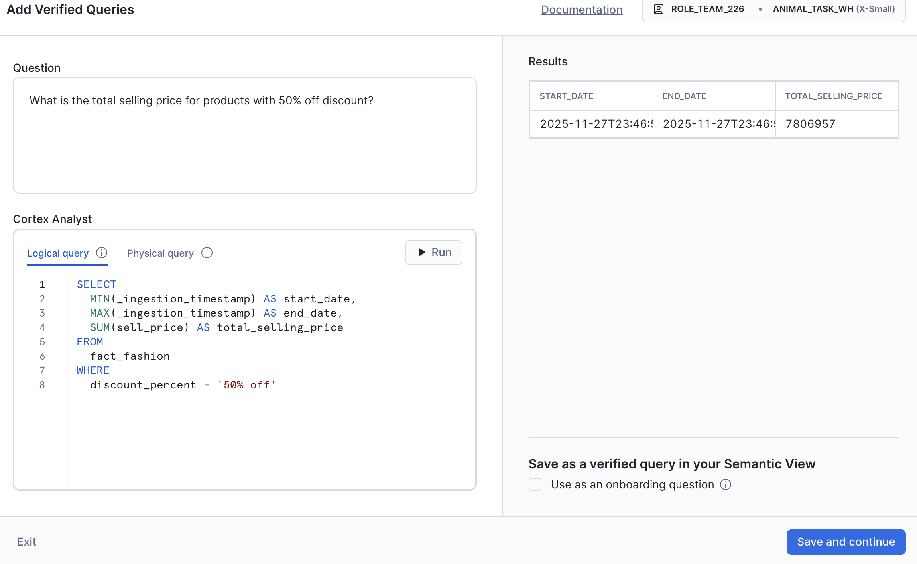
Cortex Analyst: AI-Powered Data Analysis
Cortex Analyst allows business users to query the clean, structured data in the Silver layer using natural language questions. The AI automatically translates the request into SQL, runs the query, and presents the results.
Key Capabilities
▪
Natural Language Questions:
Ask complex analytical questions without knowing the underlying schema or SQL syntax.
▪
Automatic SQL Generation:
AI engine translates natural language into optimized SQL queries for the Snowflake DWH.
▪
Query Curated Data:
Focuses analysis on the high-quality, standardized data in the Silver layer.
▪
Instant Insights:
Reduces time-to-insight by providing immediate answers to ad-hoc business questions.

Slide 14
Project Summary and Conclusion
A successful implementation of the Fashion Data Warehouse on Snowflake, delivering governance, quality, and business value.
Key Achievements
Data Governance
Data Quality
Established a clear, auditable 3-layer Medallion Architecture (Bronze, Silver, Gold) ensuring data quality and consistency at each stage.
Implemented Star Schema design in Silver layer with Fact and Dimension tables, enforcing referential integrity and data consistency.
Business Value
Future-Proofing
Created three high-value Gold layer reports (Brand Performance, Category Inventory, Price Tier Analysis) directly supporting business decisions.
Demonstrated incremental data loading capabilities and laid the foundation for advanced AI/Cortex services integration.
"A successful data warehouse transforms raw data into strategic assets, enabling organizations to make informed decisions with confidence
and agility."
— Team 226 | Fashion Data Warehouse Project

