Slide 1
Mininet & Relational Database
Project 1: Introduction

Slide 2
Goals
Emulate a simple network using Mininet
Run simple Postgres queries: rules and views

Slide 3
Mininet

Slide 4
Before you start
Download VirtualBox: https://www.virtualbox.org/wiki/Downloads
Download Mininet: http://mininet.org/download/
Or refer to following for more Installation instructions:
https://github.com/mininet/mininet/blob/master/INSTALL
https://mininet.org/vm-setup-notes/

Slide 5
Why Mininet
In networking, we often need to build, modify, and experiment with working systems.
Platform | Advantages | Disadvantages
Hardware Testbed | fast, accurate, ground truth | expensive, hard to reconfigure
Simulator | inexpensive, flexible, virtual | detail != accuracy
Emulator | inexpensive, flexible, reasonably accurate | slower than hardware experiments, some inaccuracy

Slide 6
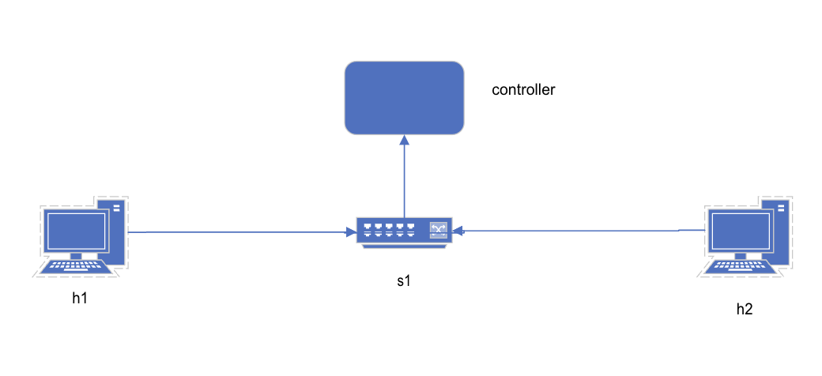
What is Mininet?
A network emulator
Creates a virtual network by setting up switches, connect components, and ping, etc.
Minimum topology on Mininet

Slide 7
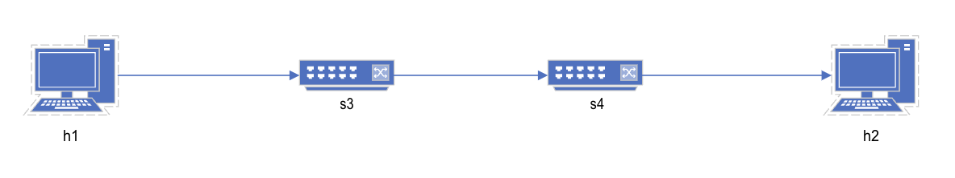
Objectives
topo-2sw-2host.py
Play around and modify the provided sample topology
Use Mininet to build a test network topology with different network components
Modify the available properties of the above topology
Use the basic debug tools built into Mininet to test connectivity between virtual hosts and get the state of the openflow switches in their topology

Slide 8
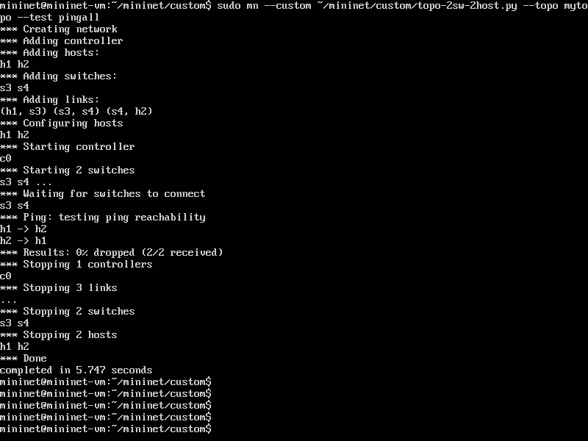
Running the sample.py

Slide 9
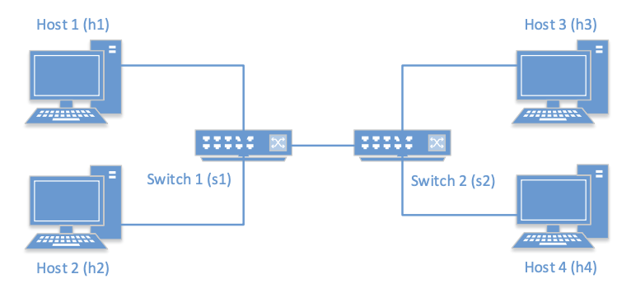
Part 1: Build a Simple Network
Your task is to modify the template python code or create a new code to represent the following network topology:
After creating the above architecture, you submission should include the following items:
(30 Points) Your source code
(20 points) Screenshots of the iperf h1 h4, dump, and pingall commands (from within the mininet cli in your running VM) in pdf format. Put your screenshots in a screenshots directory.
* Tip: You can try to automate collecting these by adding logs in your Python code. *

Slide 10
PostgreSQL

Slide 11
Before You Start
Download and Install PostgreSQL: https://www.postgresql.org/download/
Go through the documentation: https://www.postgresql.org/docs/current/index.html

Slide 12
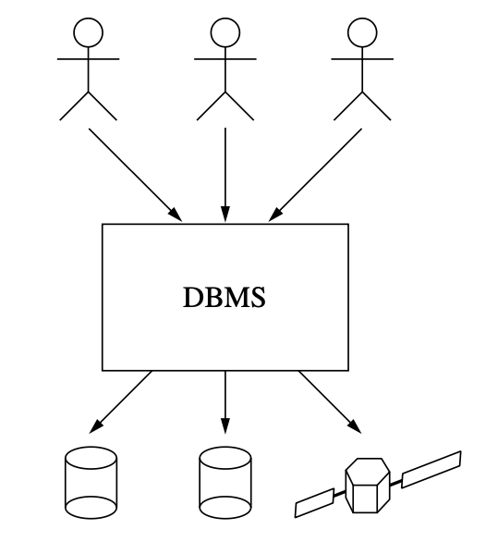
Relational Database Theory
Database systems can be viewed as mediators between human beings who want to use data and physical devices that hold it
We mostly concentrate on four tasks:
Extracting data
Changing data
Inserting data
Deleting data
PostgreSQL is a relational database management system (RDBMS)
A system for managing data stored in relations

Slide 13
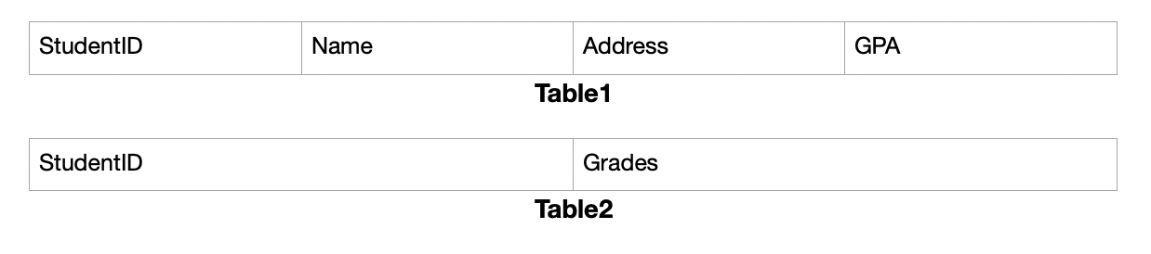
Part 2: PostgreSQL Views & Rules
(10 points) Successful installation and setup of PostgreSQL on your system
(10 points) Create a database, two tables with the following columns and plug in appropriate data

Slide 14
Part 2: PostgreSQL Views & Rules (Contd.)
(15 points) Create views for:
Students with GPA above 3.5
Students whose names start with ‘S’ (You might need to use regex here)
(15 points) Create rules where:
If a student has grades A, their GPA is changed to 4
If a student has GPA 4.0, their grades are changed to A
Upload all the queries and their outputs.
For rules, upload table values before and after the rule was executed.

