Slide 1


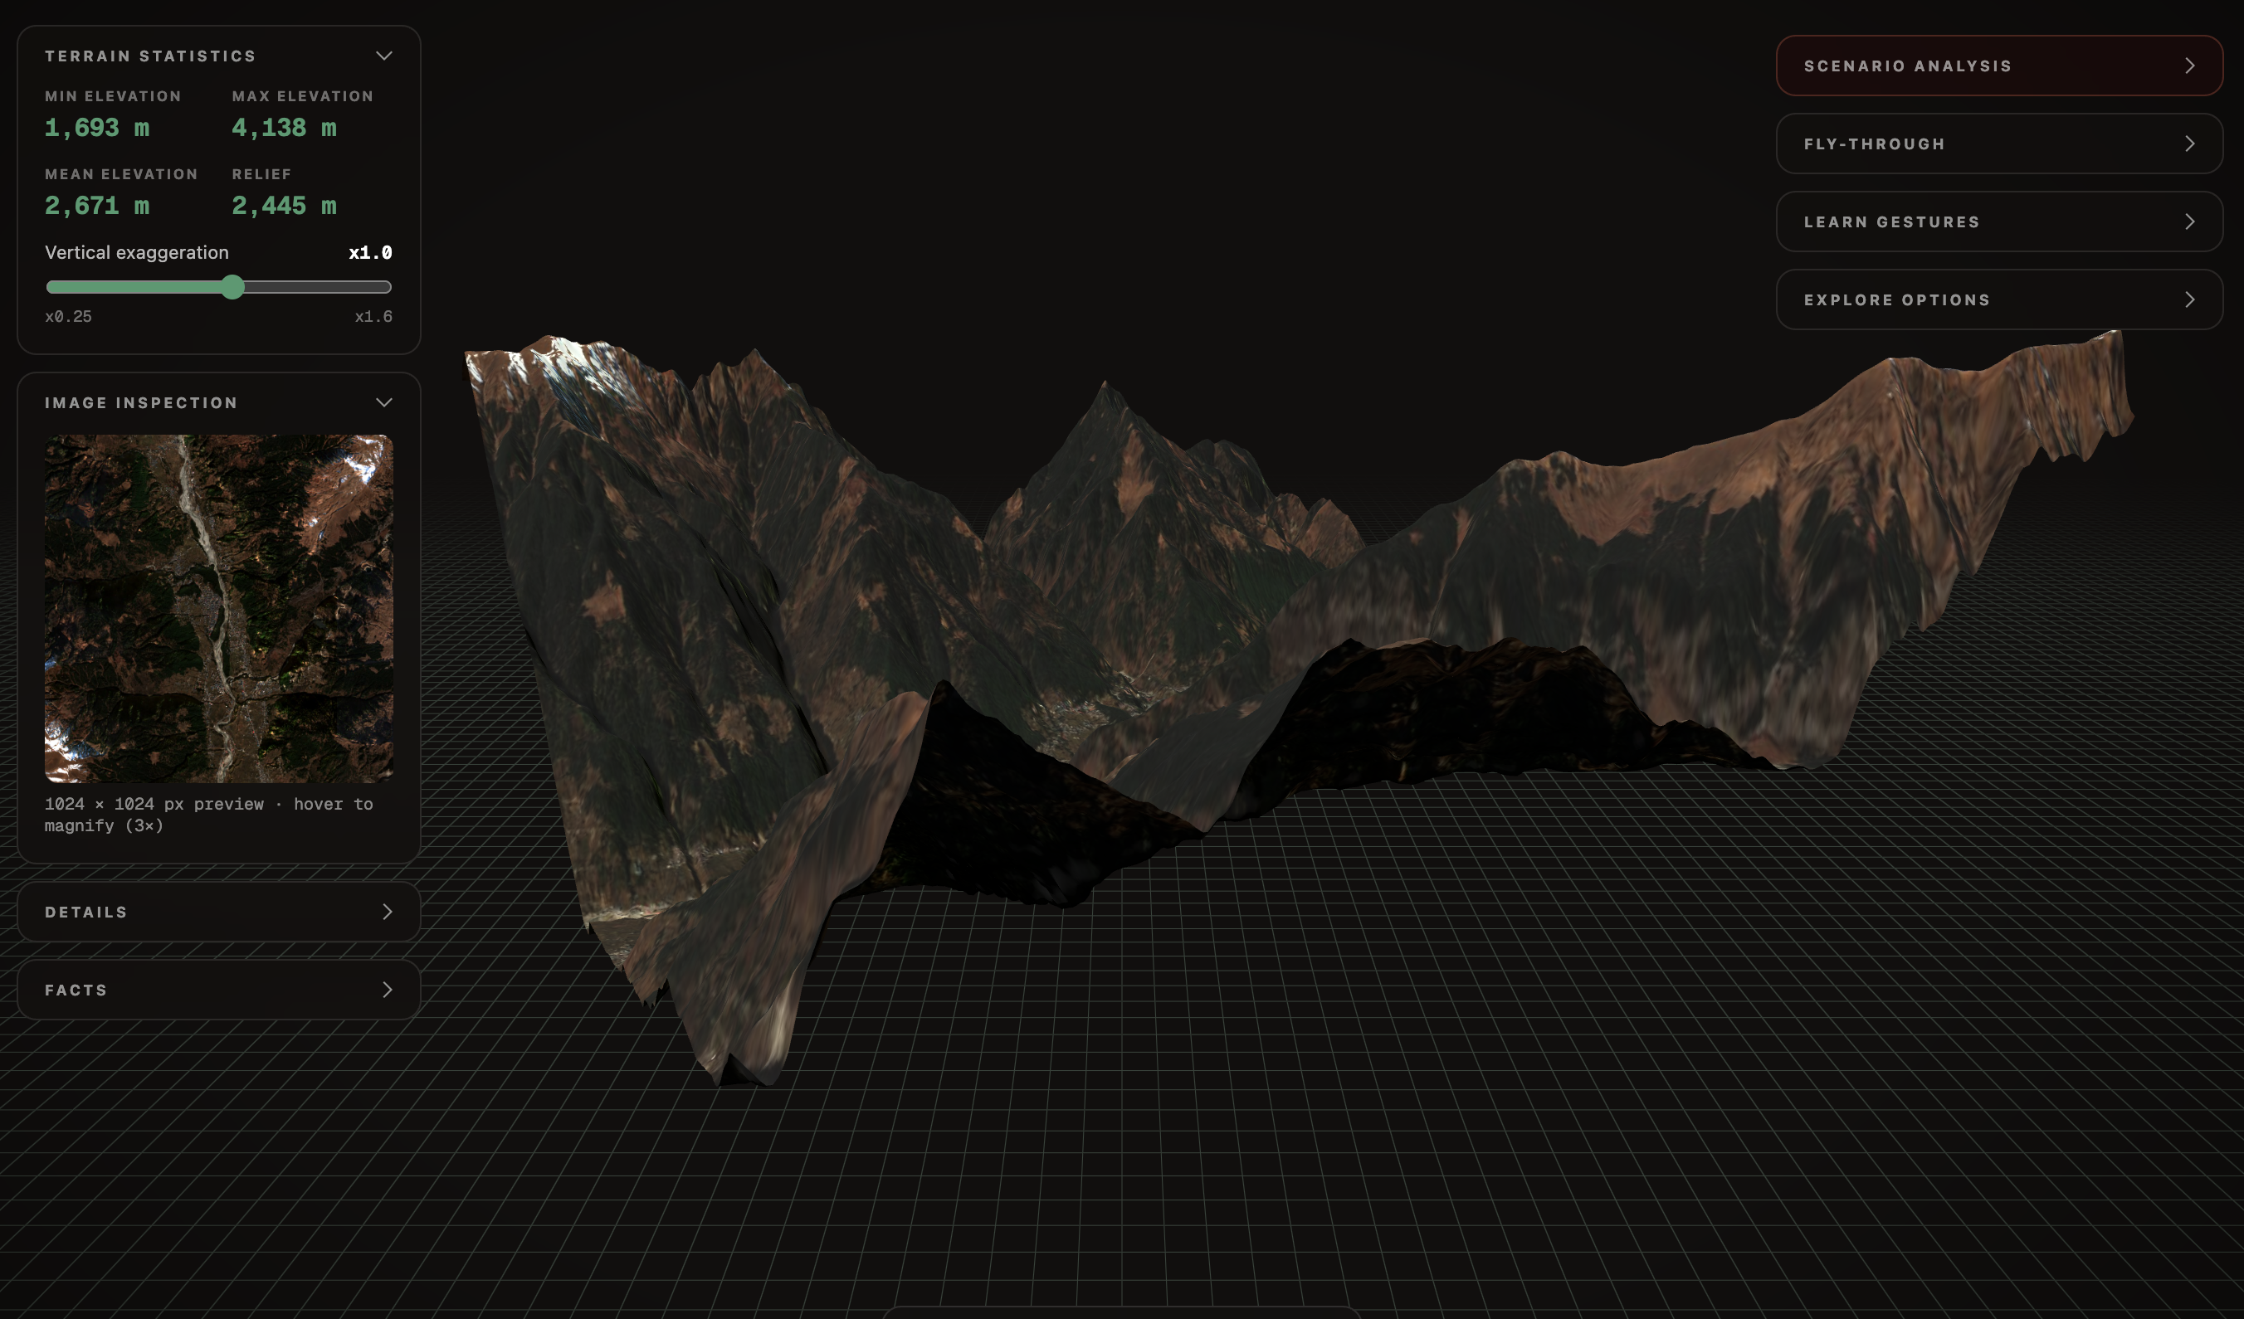



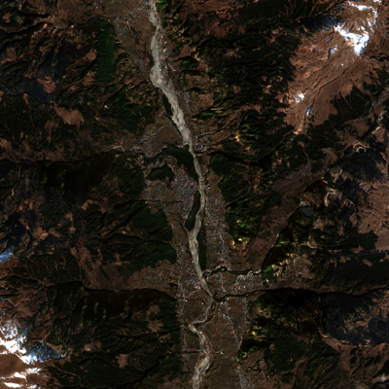

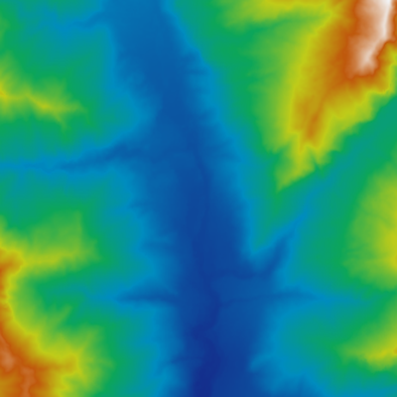
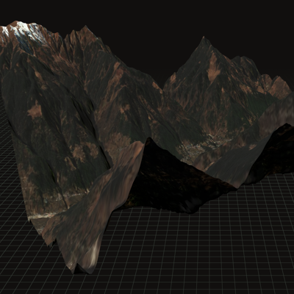


DEPTH WIZARD 2.0
Proof, not
promises.
Measured on our
own runs.
FEASIBILITY & VIABILITY
Pseudome
Built, measured and running today, on free infrastructure
FEASIBILITY
PROOF IT RUNS
VIABILITY
TECHNICAL
Depth Wizard Studio · Manali, HP · Sentinel-2 · Tier 1
RESOLUTION-AWARE BY DESIGN
Fine-tuned Depth Anything V2-Small (twin μ/σ head) beats the
per-tile oracle on all 4 metrics, on 47–49 of 50 tiles.
TIER 2 · learned height (Method 6)
≤ 5 m: synthetic only
DFC2019 · MAE 1.98 m · RMSE 3.49 m · r 0.745
TIER 1 · calibrated DEM · any resolution, anywhere on Earth
0.3 m
1 m
2 m
5 m
10 m
30 m
OPERATIONAL
▲ DFC2019 · Maxar VHR: proven
Sentinel-2: locked to Tier 1 ▲
One codebase ships as a web app and a Tauri desktop suite.
CPU-only ONNX inference: no GPU, no training for users.
LEAN, SHIPPABLE INSTALLER
PyTorch build
854.5 MB
≈0.3 s depth inference on CPU (measured)
ONNX build
352.1 MB
−58.8%
ECONOMIC
Output parity Pearson 1.000 · today’s full build 455.2 MB incl. a 100 MB offline tile library
₹0 infrastructure with no card on file anywhere: Hugging Face
Hub + ZeroGPU, GitHub Releases.
SCALES WITHOUT RETRAINING
▸ Tier 1 covers any Sentinel-2 footprint on Earth, no per-region model
585 free GPU calls/day ≈ 30–60 full demos
● LIVE · generated in our app, not a mock-up
▸ Library grows on demand (≈2 MB tiles) + Tauri in-app updater
DATA
SAME RUN, END TO END
MARKET & GOVT. FIT
Mordor Intelligence 2026 · MHA/PIB · NDMA · NRSC
Free, open inputs: Sentinel-2, Maxar Open Data, Copernicus
GLO-30, FABDEM, ICESat-2 + the DFC2019 LiDAR benchmark.
≈0.3 s
$1.81 B
$3.55B
₹13,693 cr
Disaster Mitigation Fund
(NDMF, 15th FC), 2021–26
depth on CPU (ONNX)
India geospatial analytics market, 2026
$1.58B
$1.81B
₹1,000 cr
Landslide mitigation (NLRMP)
15 states · approved Nov 2024
88 curated tiles ready in-app
2,445 m
14.43% CAGR
₹150 cr
Glacial-lake flood mitigation
Sikkim, HP, UK, Arunachal
Sentinel-2 RGB
DAv2 rel. depth
DEM elevation
3D terrain
relief rendered in 3D
2025
2026
2031F
NDEM
ISRO-NRSC disaster geo-portal
built under NDMA guidance
CHALLENGES → HOW WE SOLVED THEM
Depth models carry almost no height signal at 10 m
(within-crop ρ ≈ 0.11–0.13).
Desktop installer was 854.5 MB, mostly the PyTorch
CPU runtime.
Free hosting hit paid walls: R2 needs a card, HF
Spaces needs PRO.
A vertical-datum mismatch (EGM2008 vs WGS84)
inflated calibration error.
Two-tier routing: Sentinel-2 is locked to calibrated
DEM; the height model runs only on VHR.
Swapped to ONNX Runtime after a parity check
(Pearson 1.000): 352.1 MB.
Found a no-card path on HF ZeroGPU, verified with 585
real calls in a day.
Root-caused from the bias ≈ RMSE pattern and fixed:
DEM calibration now holds on all 4 terrain types.
4

