Slide 1





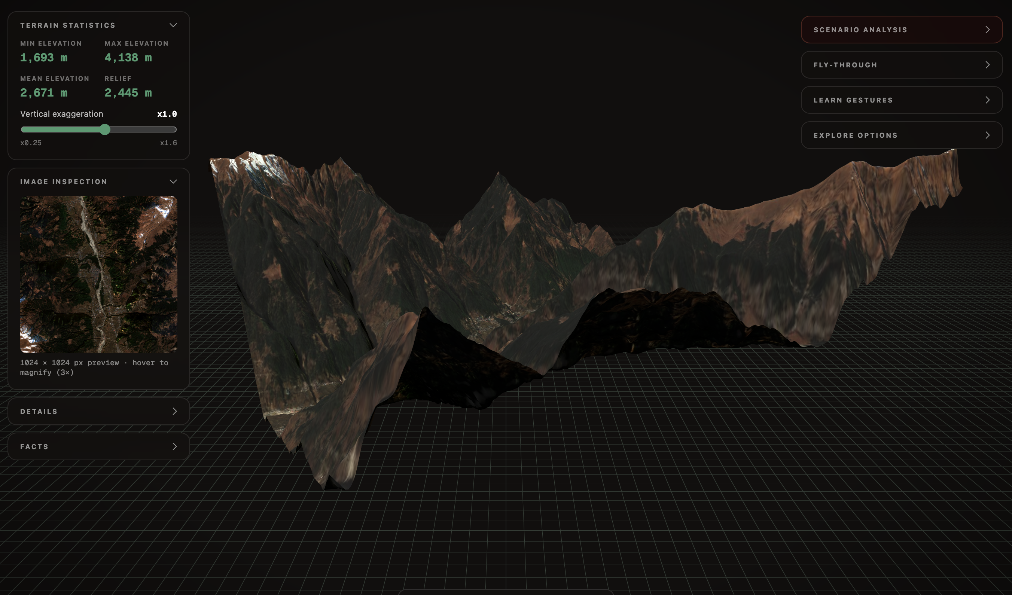
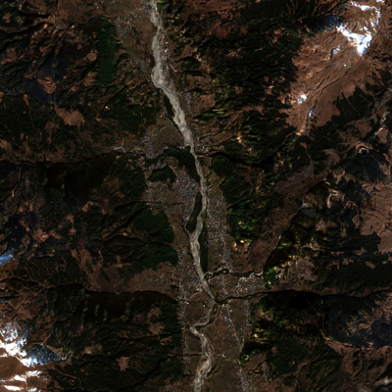

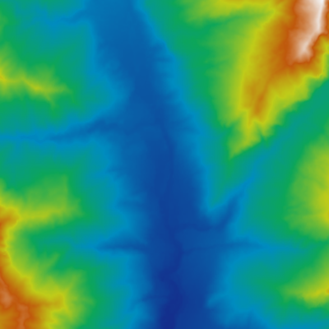
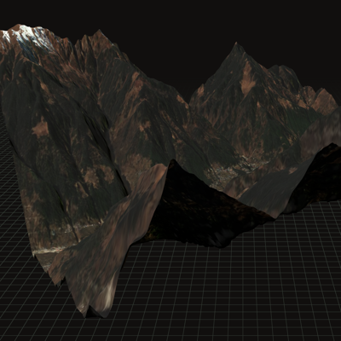


MARKET & GOVT. FIT
Mordor Intelligence 2026 · MHA/PIB · NDMA · NRSC
$1.81 B
$3.55B
₹13,693 cr
Disaster Mitigation Fund
(NDMF, 15th FC), 2021–26
India geospatial analytics market, 2026
$1.58B
$1.81B
₹1,000 cr
Landslide mitigation (NLRMP)
15 states · approved Nov 2024
14.43% CAGR
₹150 cr
Glacial-lake flood mitigation
Sikkim, HP, UK, Arunachal
2025
2026
2031F
NDEM
ISRO-NRSC disaster geo-portal
built under NDMA guidance

