Slide 1
Data Analysis Portfolio
Presented by : Sanchayan Ghosh
Employee ID: EMP20251210-169
Python Developer Intern
THE DEVELOPERS ARENA

Slide 2
Overview
Collection of analytics & ML projects
Python
• Visualization
• Insights

Slide 3
Project Domains
Business Analytics
Healthcare Analysis
Sports Analytics
Financial Markets
E-commerce

Slide 4
Key Skills
Data Cleaning & Preprocessing
Exploratory Data Analysis
Predictive Modeling
Visualization

Slide 5
Tools & Technologies
Python
Pandas / NumPy
Matplotlib / Seaborn
Scikit-learn
Django

Slide 6
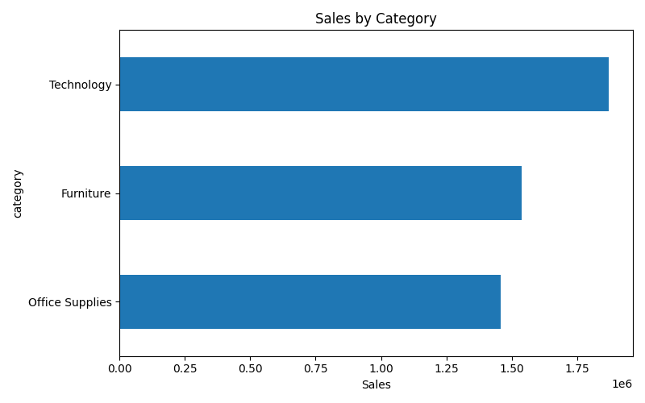
Visualizations

Slide 7
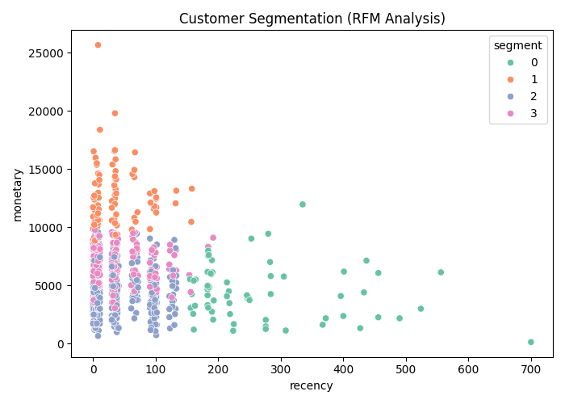
Visualizations(contd.)

Slide 8
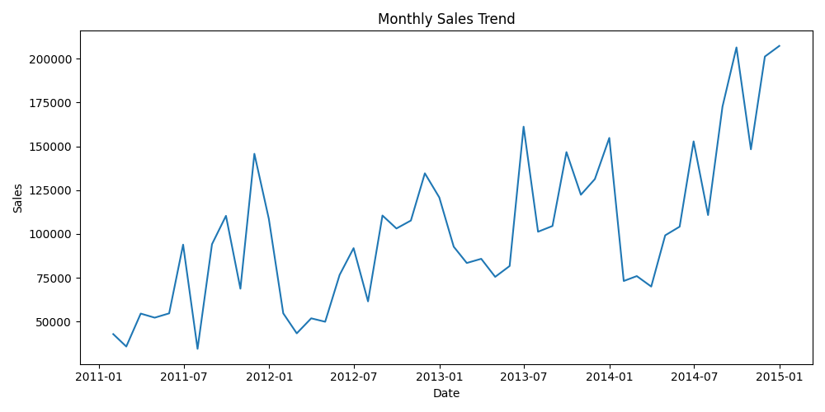
Visualizations(contd.)

Slide 9
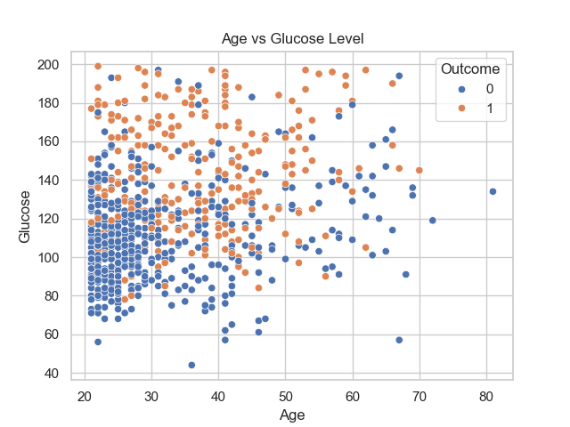
Visualizations(contd.)

Slide 10
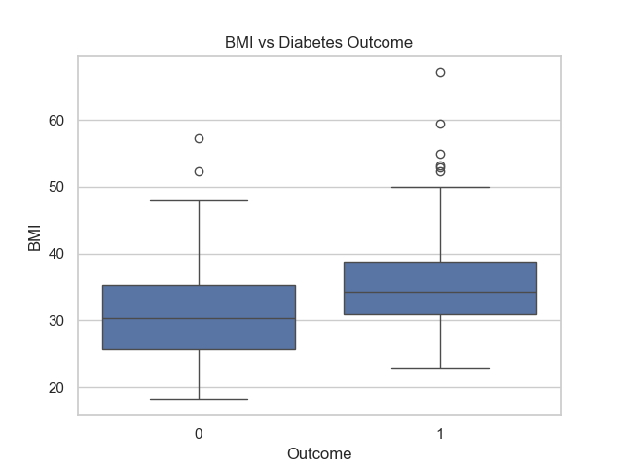
Visualizations(contd.)

Slide 11
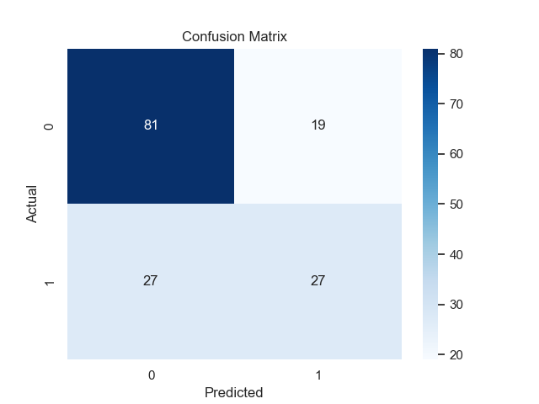
Visualizations(contd.)

Slide 12
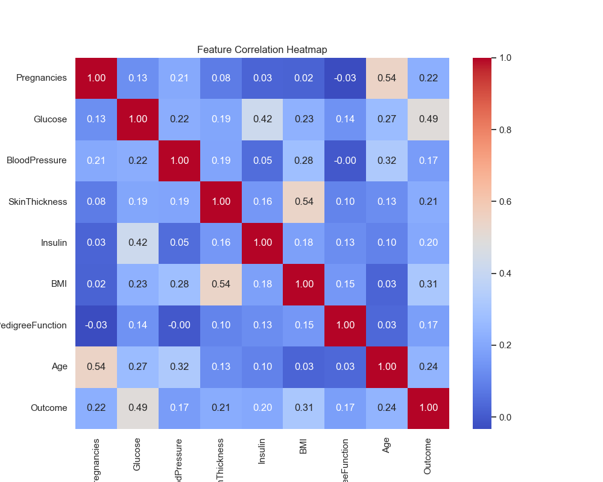
Visualizations(contd.)

Slide 13
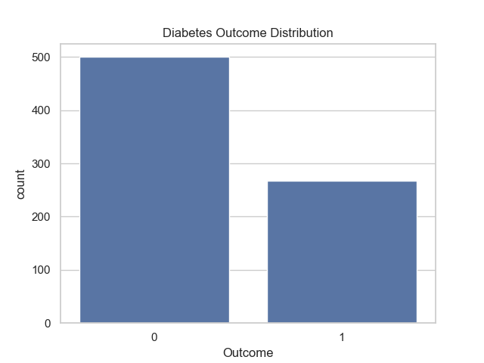
Visualizations(contd.)

Slide 14
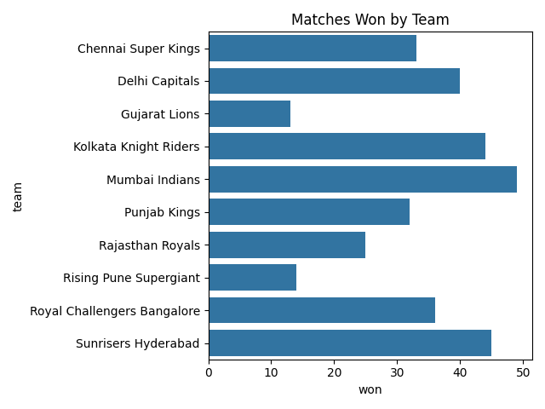
Visualizations(contd.)

Slide 15
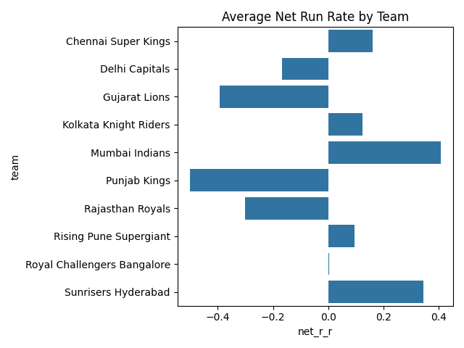
Visualizations(contd.)

Slide 16
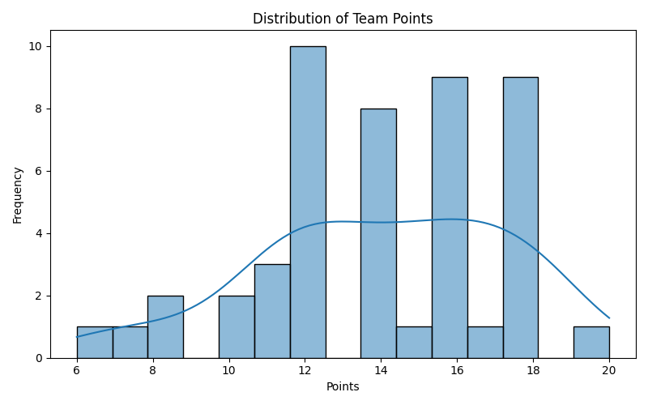
Visualizations(contd.)

Slide 17
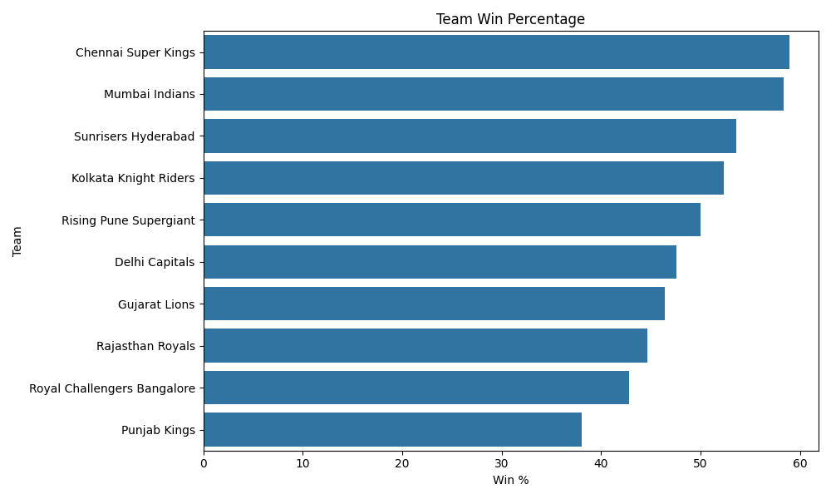
Visualizations(contd.)

Slide 18
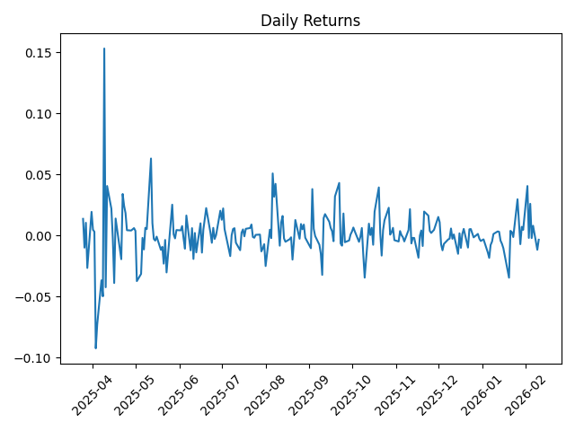
Visualizations(contd.)

Slide 19
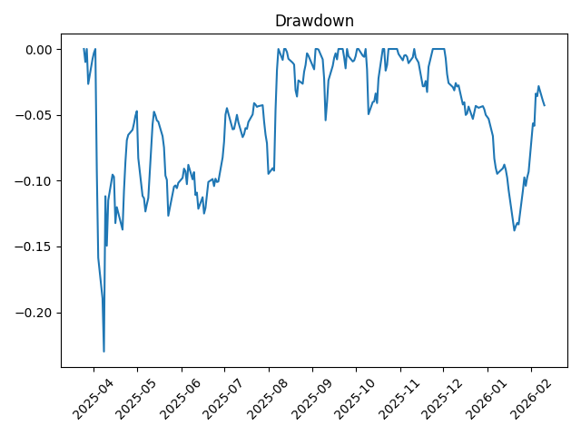
Visualizations(contd.)

Slide 20
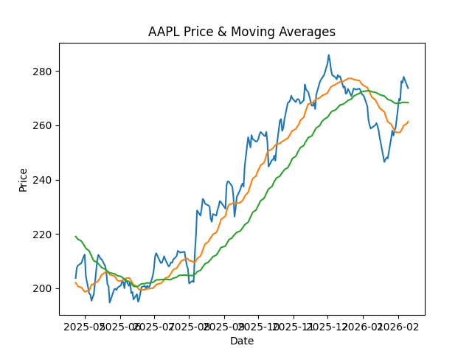
Visualizations(contd.)

Slide 21
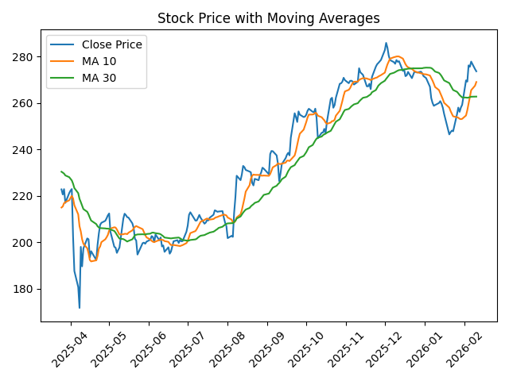
Visualizations(contd.)

Slide 22
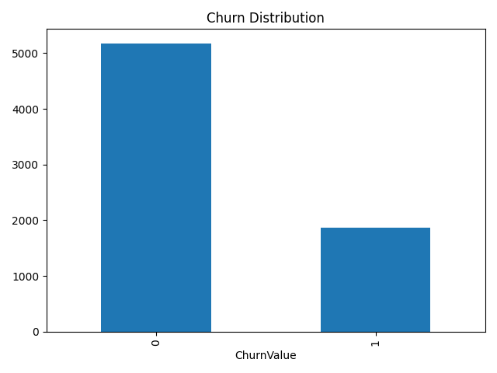
Visualizations(contd.)

Slide 23
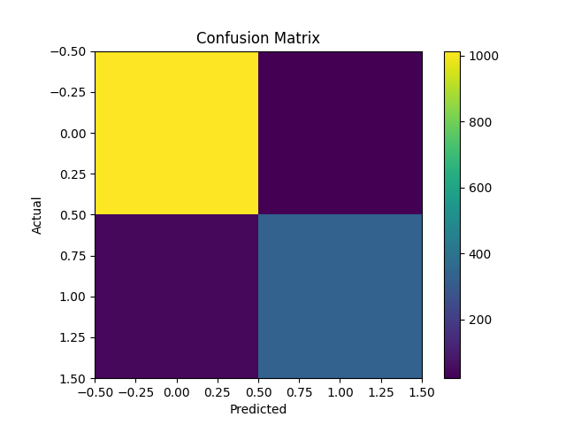
Visualizations(contd.)

Slide 24
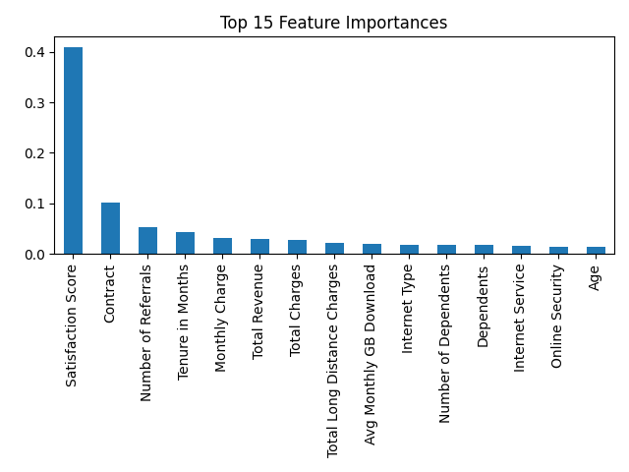
Visualizations(contd.)

Slide 25
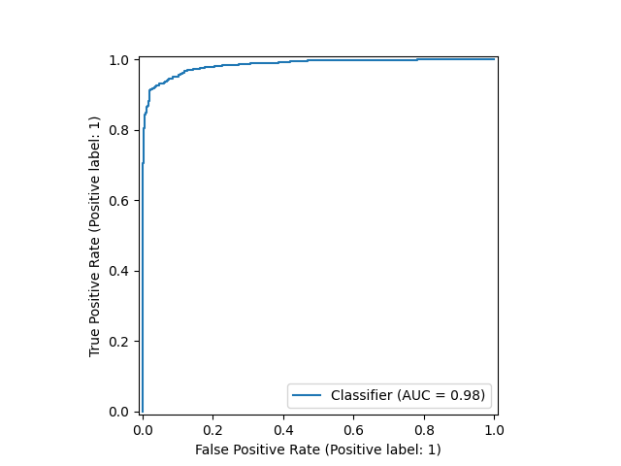
Visualizations(contd.)

Slide 26
Conclusion
Demonstrates practical analytical thinking
and end-to-end project execution

