Slide 1

WEB APPLICATION
Sanchayan Arudchelvam

Slide 2
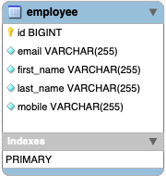

Introduction
To create an OOP-based web application, with utilisation of supporting tools, methodologies, and technologies, that encapsulates all fundamental and practical modules covered during training.
HR Web Application
Notes:
I had free reigns on what application I could build if it met the MVP specification. I wanted apply what I learnt in training to a project that could have real world use. So I based my web application on a HR application that can keep track of employees and their contact details.
Use what I have learnt on a real world use case.

Slide 3
Minimum Viable product
CRUD functionality in both the API and front-end.
Functional front-end
Local Database in MySQL
Testing coverage above 80%

Slide 4







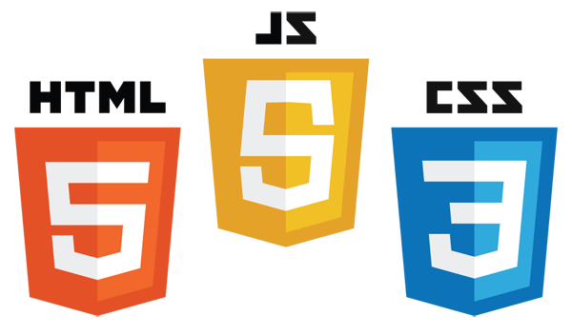


Technology Constraints
Version Control System: Git
Source Code Management: GitHub
Kanban Board: Jira
Database Management System: MySQL Server (Local)
Back-End Programming Language: Java
API Development Platform: Spring Boot
Front-End Web Technologies: HTML, CSS, JavaScript
Build Tool: Maven
Unit Testing: JUnit, Mockito
Notes:
These are the technologies learnt for the project.

Slide 5
Sprint Plan
Sprint 1 Monday | Sprint 2 Tuesday - Wednesday | Sprint 3 Thursday - Friday
Planning Risk Assessment ERD & UML Jira Git & GitHub | Create API Connect to Database Front-end creation | Front-end functionality Unit testing Integration testing Build application Presentation

Slide 6
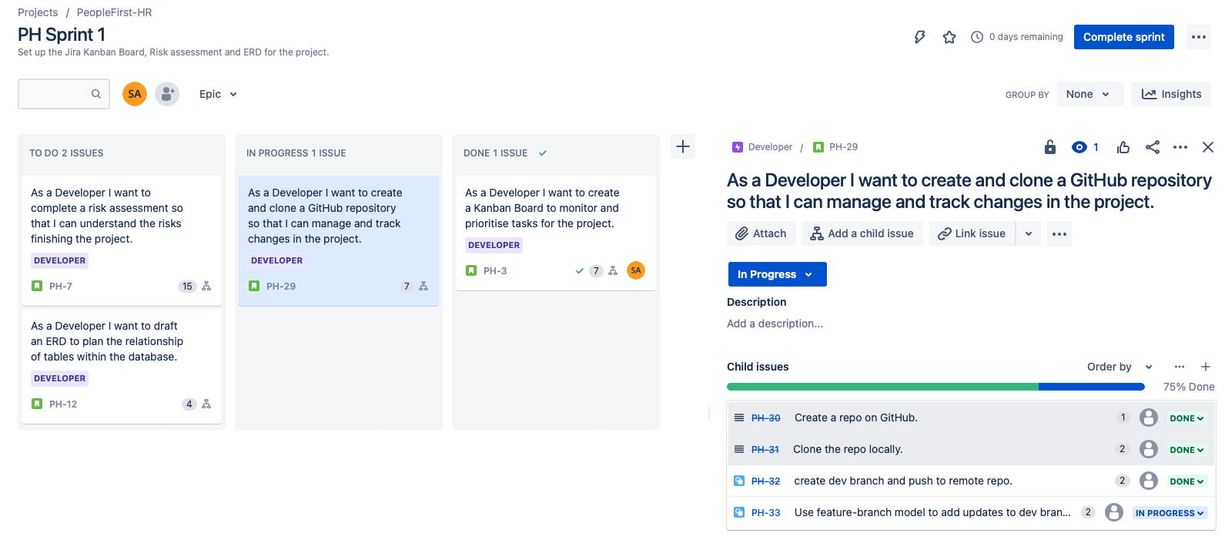
Sprint 1

Slide 7
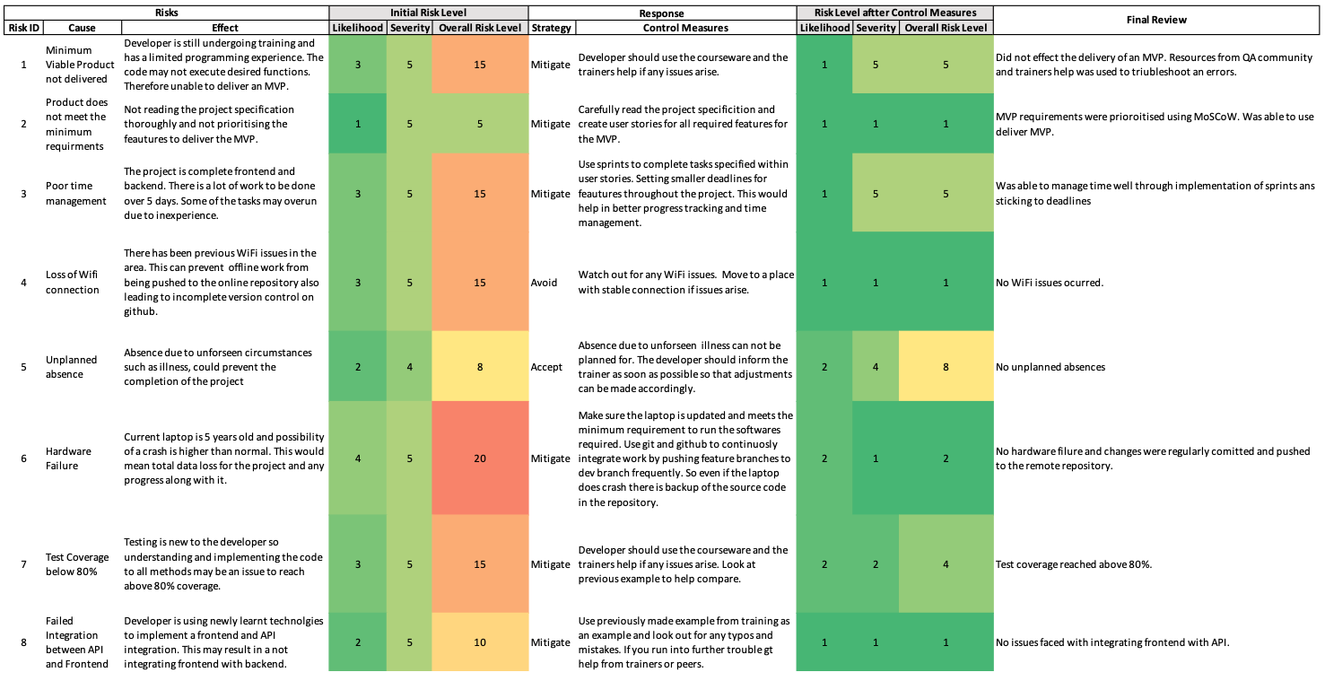
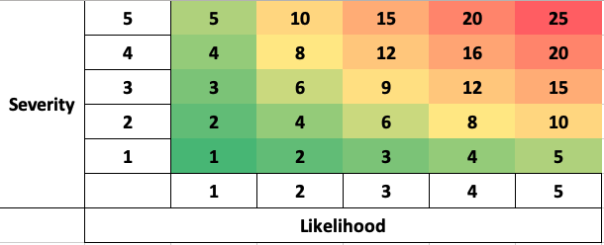
Risk Assessment

Slide 8
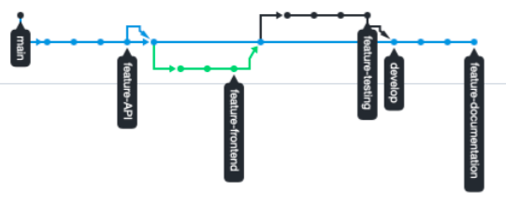
Feature Branch Model

Slide 9
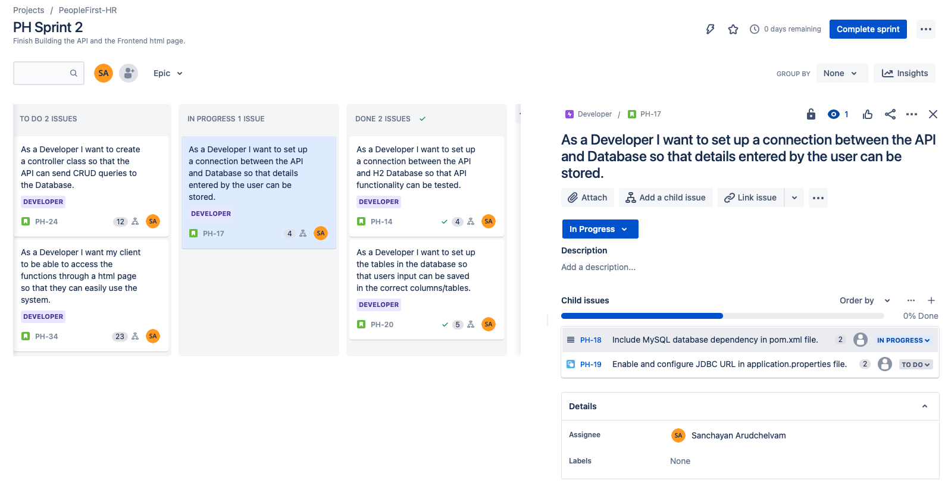
Sprint 2

Slide 10
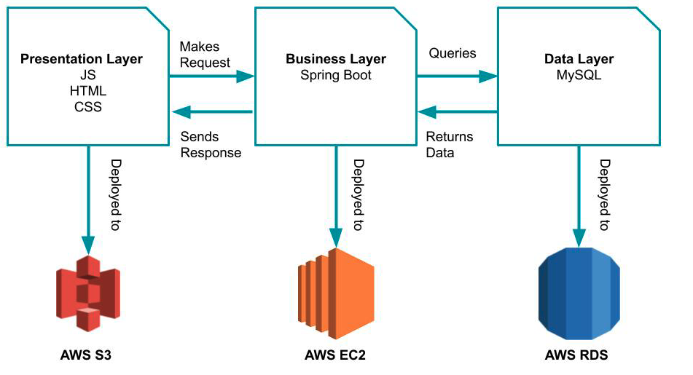
Three-tier Architecture
Notes:
Splits up major components of the web application into three layers
Front-end
API
Database

Slide 11
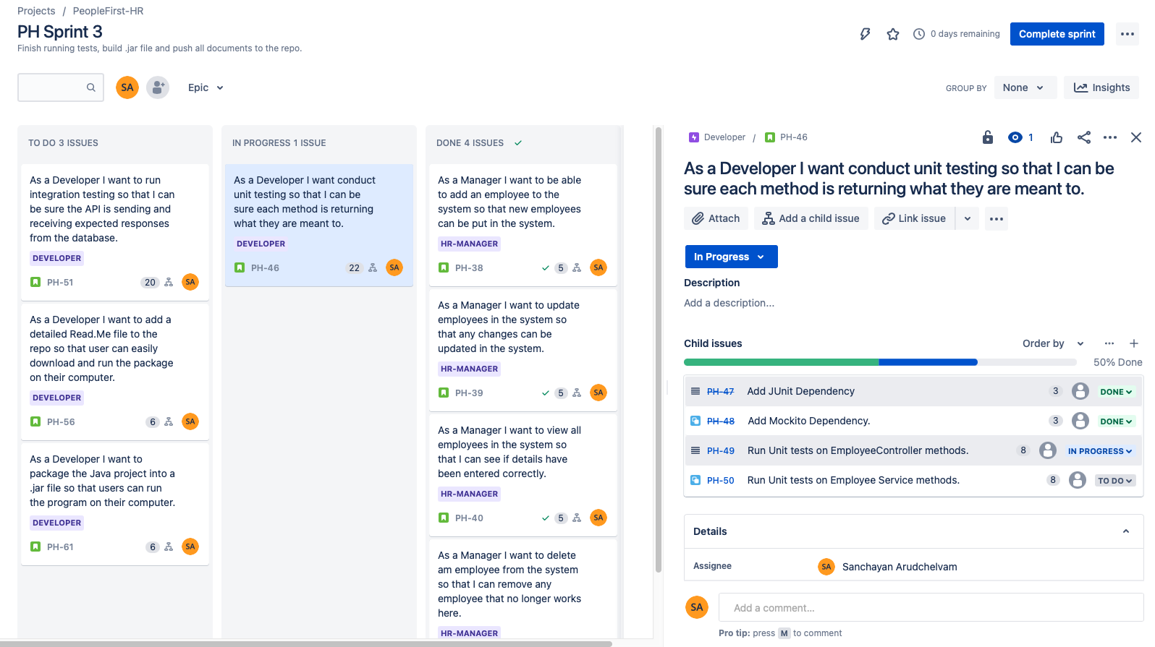
Sprint 3

Slide 12
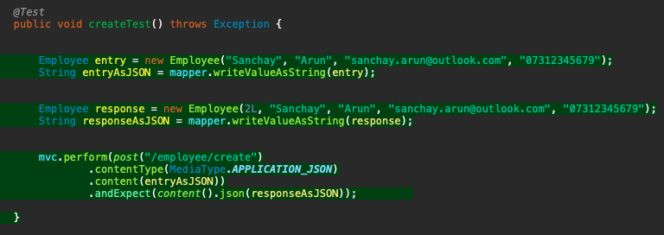
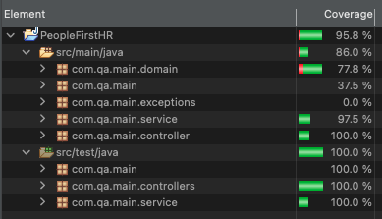
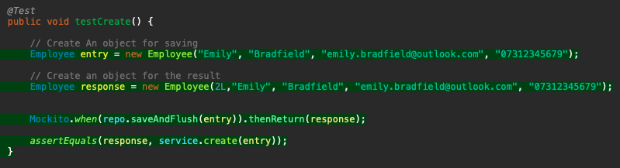
Testing
Integration Test
Unit Test
Notes:
Testing issues with EmployeeController unit testing, had to look at coverage and red highlighted code to see errors in testing
Integration tests on Controller and response from the DB
Unit testing on the methods within the service and controller

Slide 13
DEMO

Slide 14
Sprint Retrospective
What went well:
Was able to deliver an MVP
Test coverage above 80%
Front-end and backend functional
Project management
Improvements:
Styling of HTML page
Adding further entities
Edit button
Search by name function
Table view of stored data

Slide 15
Thank you for listening
Sanchayan Arudchelvam
https://github.com/sanchayarun

