Slide 1

IMS Project
Sanchayan Arudchelvam

Slide 2
Objective
To create an application with utilisation of supporting tools, methodologies and technologies that encapsulate all fundamental modules covered during training.

Slide 3
Minimum Viable product
Add a customer to the system
View all customers in the system
Update a customer in the system
Delete a customer in the system.
Add an item to the system
View all items in the system
Update an item in the system
Delete an item in the system
Create an order in the system.
View all orders in the system.
Delete an order in the system
Add an item to an order.
Calculate a cost for an order.
Delete an item in an order

Slide 4





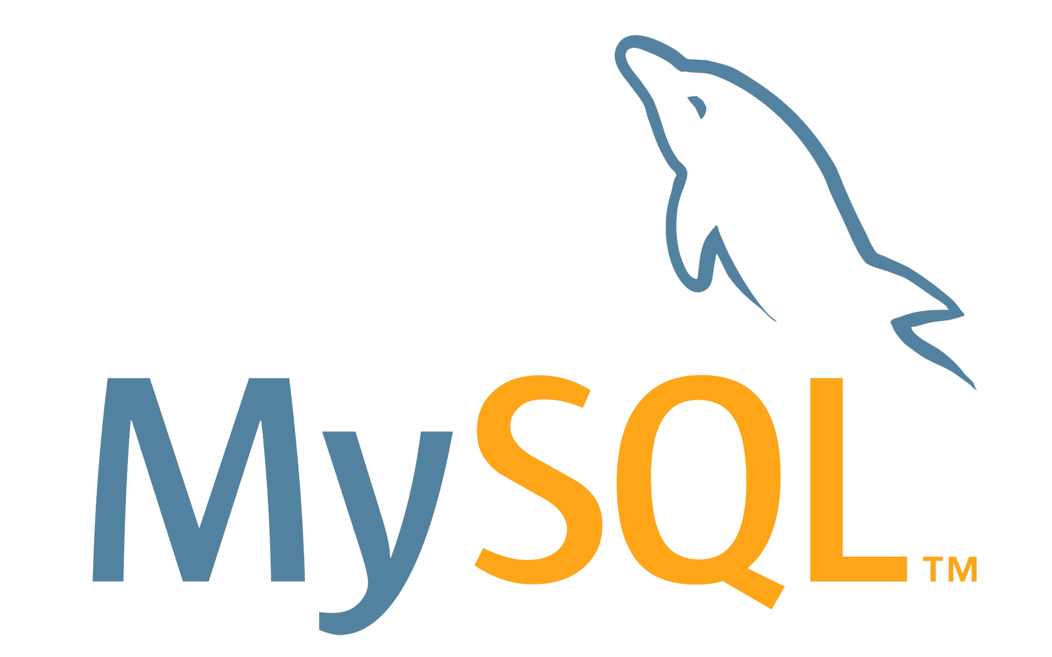
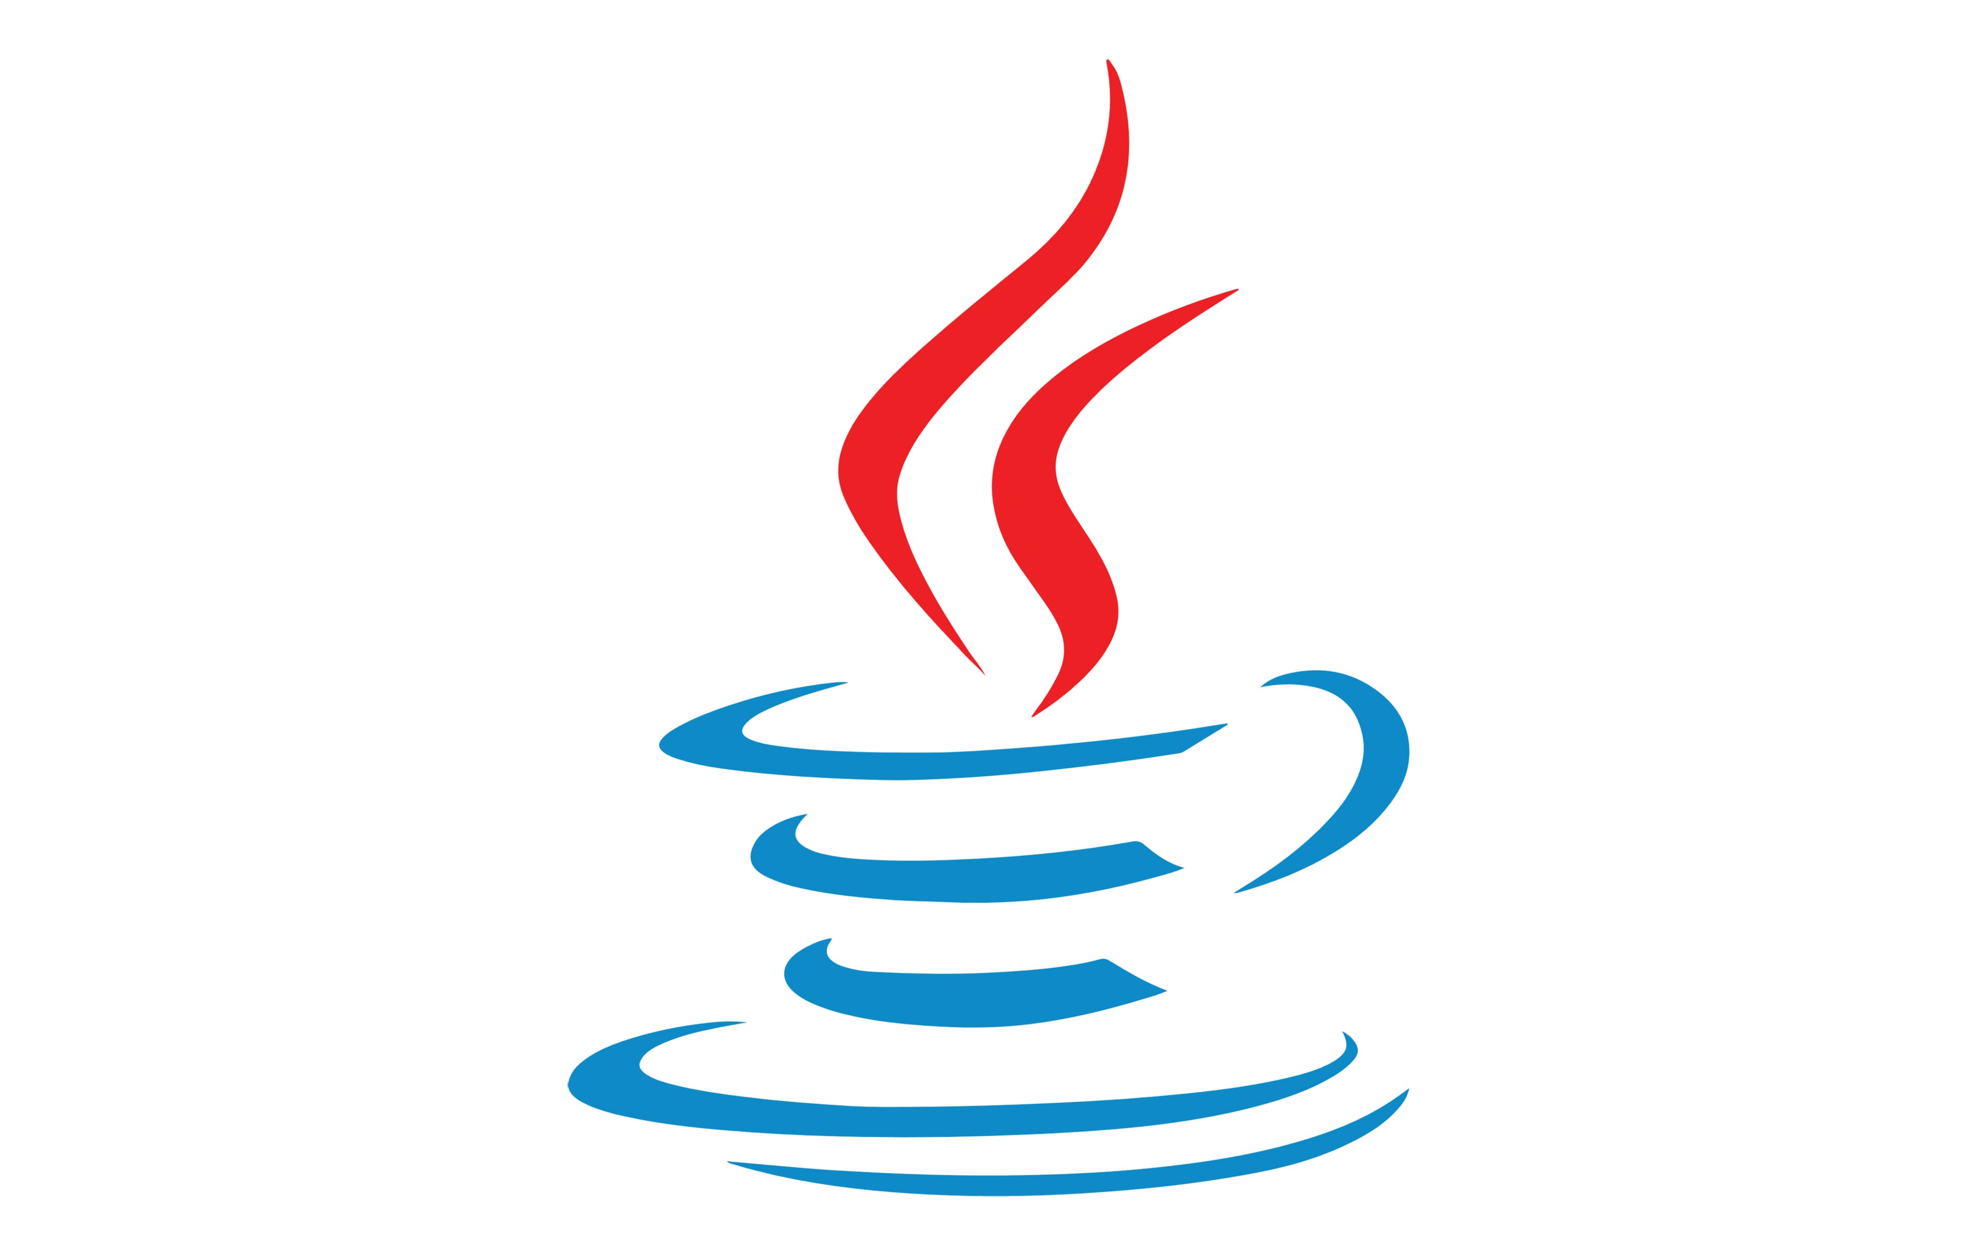
CONSTRAINTS
Version Control System - Git
Source Code Management - GitHub
Kanban Board - Jira
Database - MySQL Server 5.7+ (local or cloud hosted)
Back-end Programming Language - Java
Build Tool - Maven
Unit Testing - JUnit

Slide 5
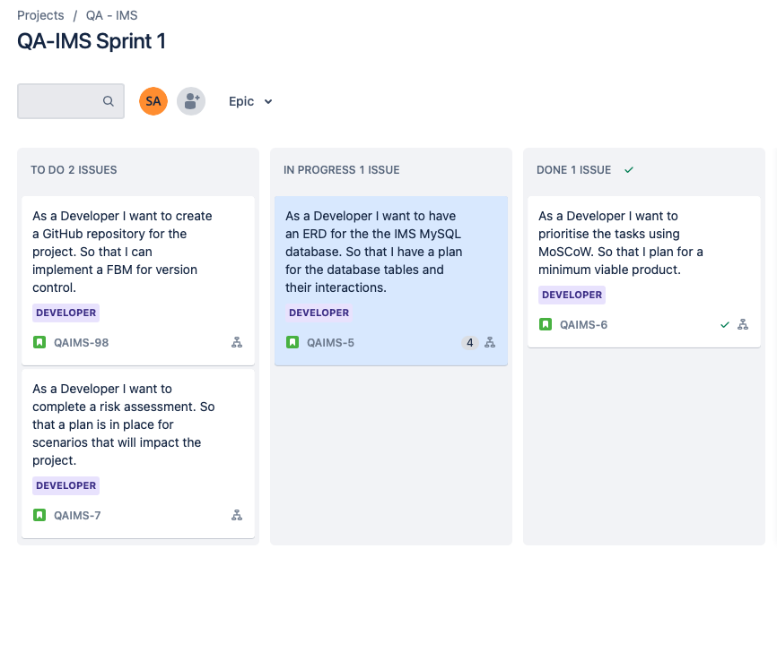
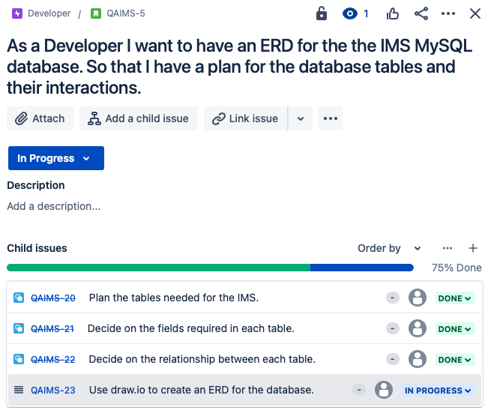
Sprint 1

Slide 6
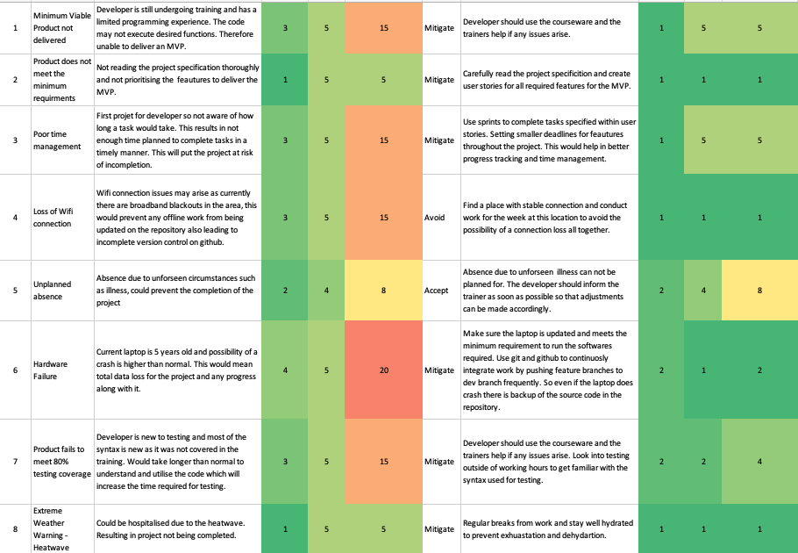
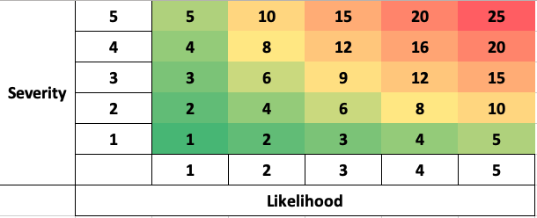
Risk Assessment

Slide 7
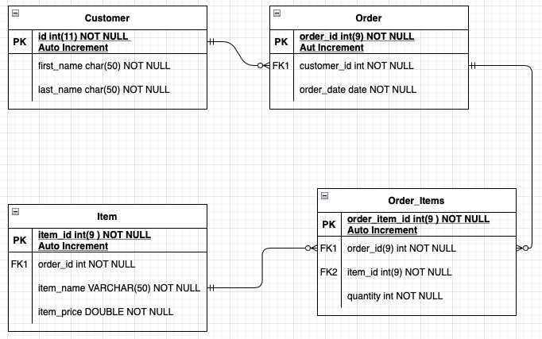
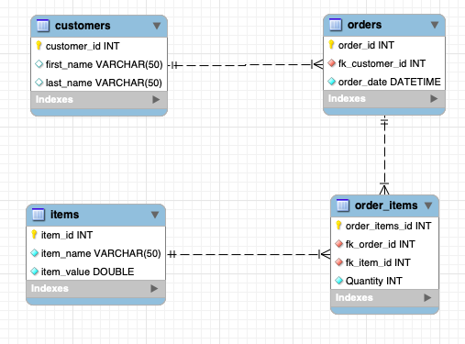
ERD
Notes:
Many-to-many relationships are disallowed in a relational database because of the problems they create.
These include: Data redundancy. Data insertion, deletion, and updating difficulties.

Slide 8
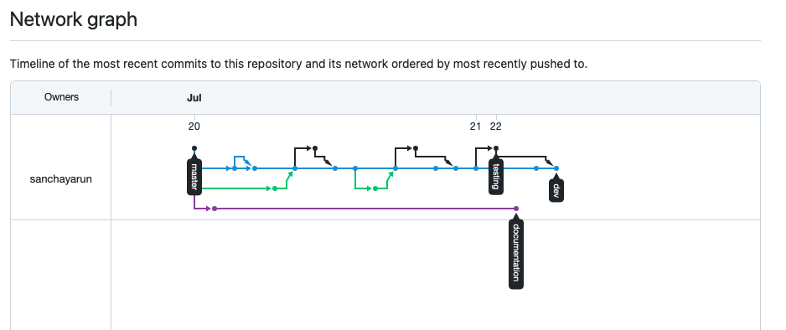
Feature Branch Model
Notes:
Clone the repository
Create and push a dev branch
Start creating feature branches off dev and merge them when you’re done

Slide 9
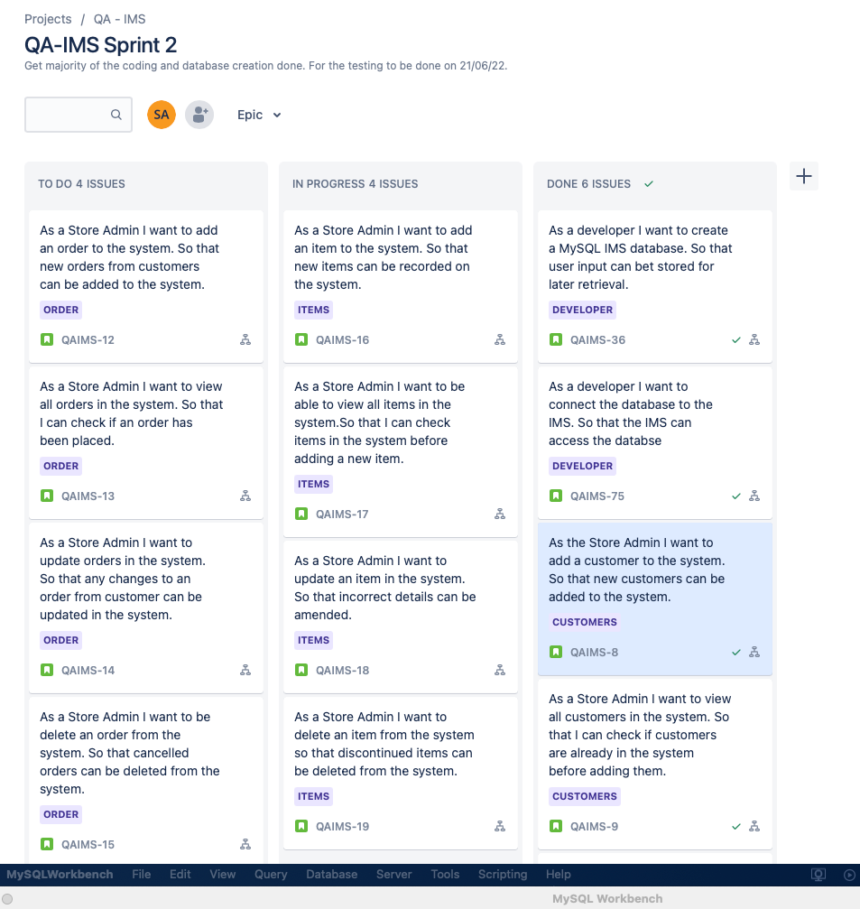
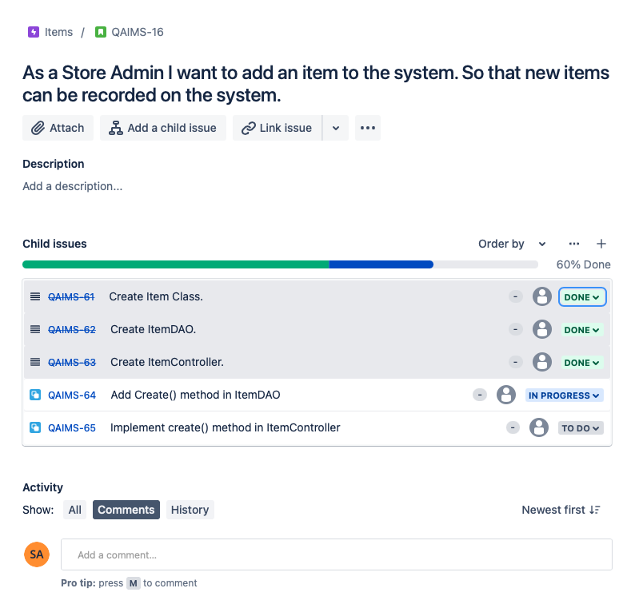
Sprint 2

Slide 10
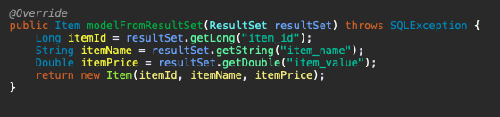
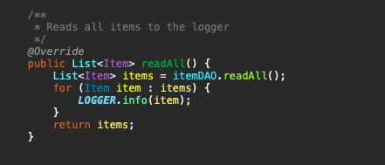
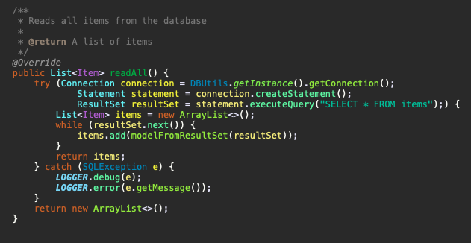
CRUD Controller & DAO
Notes:
Controller creates list named items containing Item objects using the readAll() function from dao
readall() function prepares a query to be sent to MySQL DB in this case “SELECT * FROM items;”
Stores the return of the query into items list using the modelFromResultset as a template for List object creation
For loop in controller makes sure all objects stored in the list are iterated over and printed to the console

Slide 11
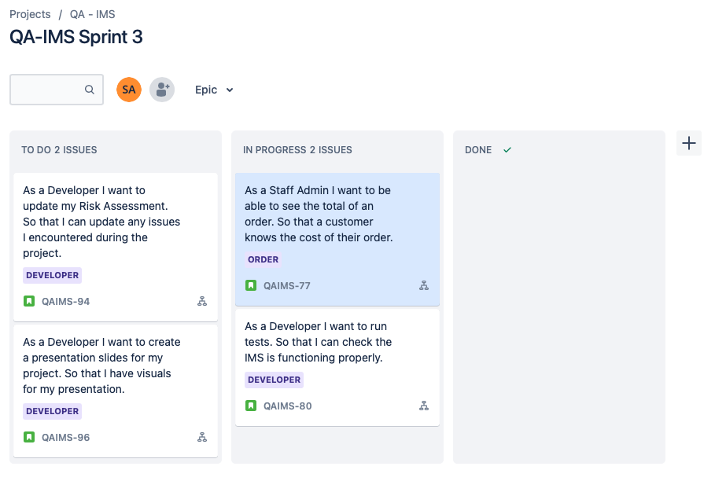
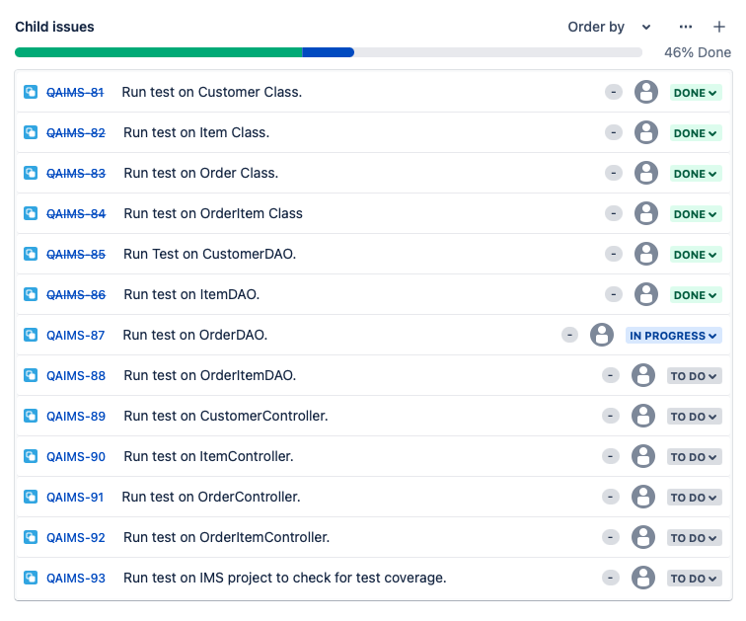
Sprint 3

Slide 12
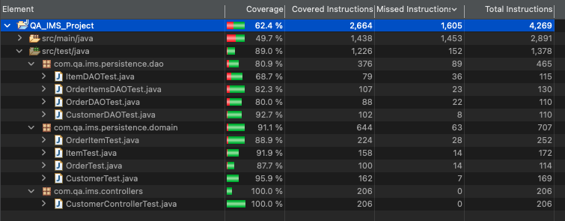
Testing

Slide 13
Issues
Couldn’t implement a method to calculate order total.
Couldn’t add items to order using OrderDAO
Testing coverage 64.4%

Slide 14
DEMO

