Slide 1

Live Gold & Silver Price Prediction using Machine Learning
A Mini Project in Machine Learning
Submitted by
Sanchay Bhardwaj (2300650100104)
Project Guide: Mrs. Ashna Thakur
B.S.A. College of Engineering & Technology, Mathura
Dept. of Computer Science & Engineering | Session 2026-27

Slide 2
Introduction
Gold & Silver Predictor
• Gold and silver are the two most tracked precious metals, priced in US dollars per troy ounce.
• Their prices move with demand, inflation, the dollar and global market sentiment.
• This project fetches the LIVE price of both metals and converts it into Indian Rupees per gram.
• A Machine Learning model then forecasts the price for the next 12 months.
• Everything is shown on one web dashboard, so the numbers can be read without any training.
Developed by Sanchay Bhardwaj (2300650100104) | B.S.A. College of Engineering & Technology, Mathura
Slide 2

Slide 3
Problem Statement
Gold & Silver Predictor
• Given the historical monthly price of gold and silver, predict their price for the coming months.
• This is a supervised regression problem: past behaviour is the input, future price is the output.
• Several models are trained, scored on data they have never seen, and the best one is kept.
• The winning model is connected to a live price feed and presented on a dashboard in rupees.
Developed by Sanchay Bhardwaj (2300650100104) | B.S.A. College of Engineering & Technology, Mathura
Slide 3

Slide 4
Objectives
Gold & Silver Predictor
• Build a clean monthly price dataset for gold and silver from the year 2000 up to today.
• Read the live price of both metals and the US dollar to rupee rate from public APIs.
• Engineer features that capture short-term momentum instead of raw price levels.
• Compare Random Forest, Linear Regression and Ridge against a naive baseline.
• Deliver an attractive dashboard showing present and future prices in Indian Rupees.
Developed by Sanchay Bhardwaj (2300650100104) | B.S.A. College of Engineering & Technology, Mathura
Slide 4

Slide 5
Live Data Sources
Gold & Silver Predictor
• api.gold-api.com/price/XAU - live gold price in US dollars per troy ounce.
• api.gold-api.com/price/XAG - live silver price in US dollars per troy ounce.
• open.er-api.com - today's US dollar to Indian rupee exchange rate.
• All three are free public feeds, so no key or login is needed.
• Conversion: Rs per gram = US$ per ounce x USD-INR rate / 31.1035 (one troy ounce = 31.1035 g).
Developed by Sanchay Bhardwaj (2300650100104) | B.S.A. College of Engineering & Technology, Mathura
Slide 5

Slide 6
Dataset
Gold & Silver Predictor
• Two files: gold_prices.csv and silver_prices.csv - one row per month since January 2000.
• Columns: Date, Year, Month and Price (US dollars per troy ounce).
• Yearly anchors are approximate LBMA annual averages, interpolated month to month with momentum.
• Model features: the last 3 monthly returns, plus the month and the year.
• The live API price is appended as the latest point, so the forecast always starts from today.
Developed by Sanchay Bhardwaj (2300650100104) | B.S.A. College of Engineering & Technology, Mathura
Slide 6

Slide 7
Methodology
Gold & Silver Predictor
• The model predicts the month-to-month RETURN, never the raw price.
• Why: a tree model cannot guess a price higher than anything it saw, so a 25 year rising trend breaks it.
• Price is rebuilt as next price = last price x (1 + predicted return).
• Forecasting rolls forward one month at a time, feeding each answer back as the next input.
• The split is chronological - the last 60 months are held out and never used for fitting.
Developed by Sanchay Bhardwaj (2300650100104) | B.S.A. College of Engineering & Technology, Mathura
Slide 7

Slide 8
Technology Used
Gold & Silver Predictor
• Language: Python.
• Data handling: pandas and NumPy.
• Models: scikit-learn - Random Forest, Linear Regression, Ridge.
• Backend: Flask, serving one JSON summary to the page.
• Frontend: Chart.js on a dark dashboard. Model save / load: Joblib.
Developed by Sanchay Bhardwaj (2300650100104) | B.S.A. College of Engineering & Technology, Mathura
Slide 8

Slide 9
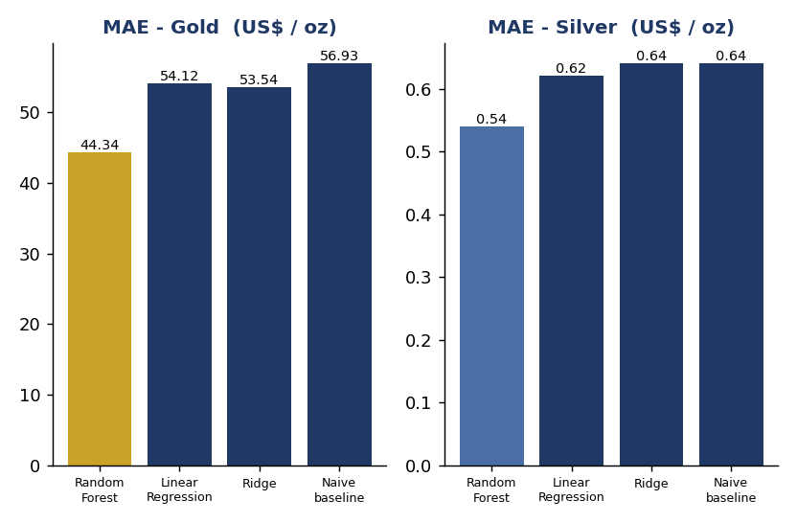
Results
Gold & Silver Predictor
Model | Gold MAE (US$/oz) | Gold R-sq | Silver MAE (US$/oz) | Silver R-sq
Random Forest | 44.34 | 0.9910 | 0.54 | 0.9942
Linear Regression | 54.12 | 0.9889 | 0.62 | 0.9909
Ridge | 53.54 | 0.9889 | 0.64 | 0.9903
Naive baseline | 56.93 | 0.9875 | 0.64 | 0.9897
Random Forest wins on both metals and beats the naive baseline. Test window: last 60 months, from Oct 2021. Lower MAE and higher R-squared are better.
Developed by Sanchay Bhardwaj (2300650100104) | B.S.A. College of Engineering & Technology, Mathura
Slide 9

Slide 10
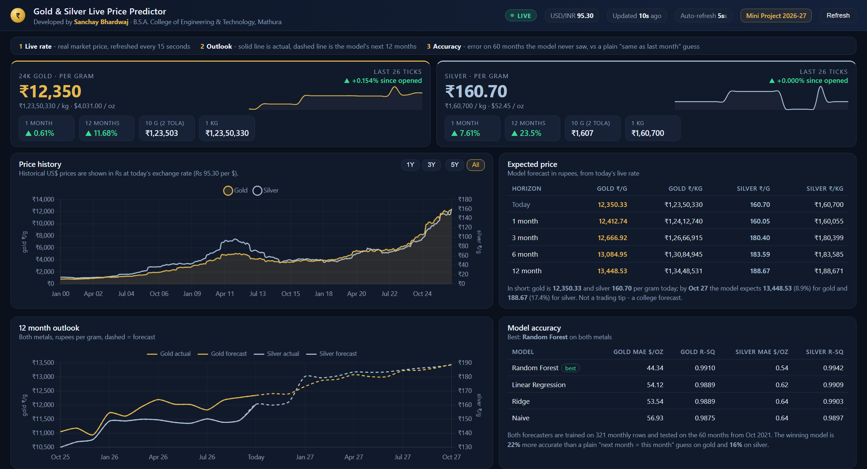
Application - Live Dashboard
Gold & Silver Predictor
The complete app on one screen: today's live gold and silver rate in rupees per gram, per 10 gram and per kg, the history since 2000, the 12 month outlook and the accuracy table.
Developed by Sanchay Bhardwaj (2300650100104) | B.S.A. College of Engineering & Technology, Mathura
Slide 10

Slide 11
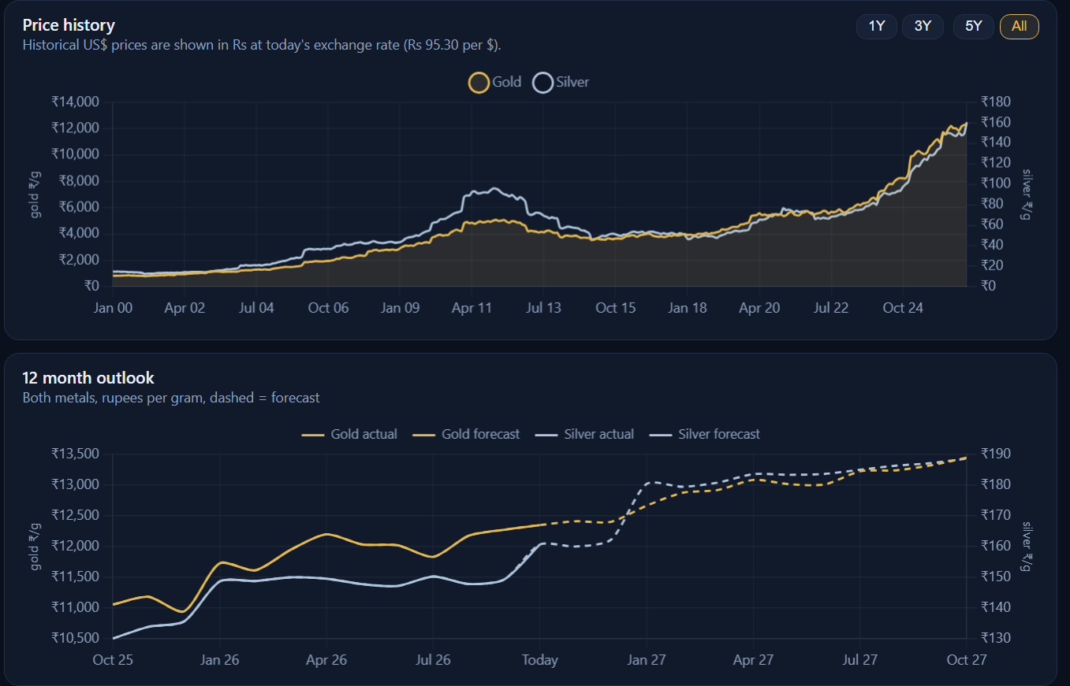
Application - History and Forecast
Gold & Silver Predictor
Top: monthly price history of both metals since 2000. Bottom: solid line is the actual price, dashed line is what the model expects for the next 12 months.
Developed by Sanchay Bhardwaj (2300650100104) | B.S.A. College of Engineering & Technology, Mathura
Slide 11

Slide 12
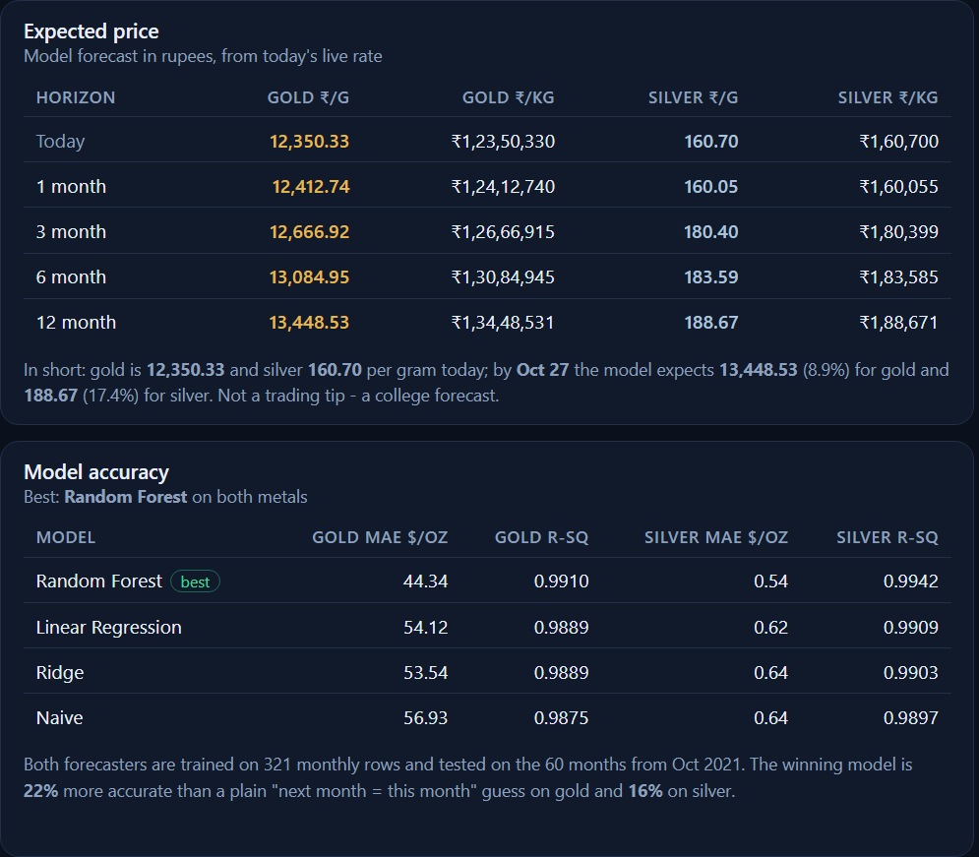
Application - Expected Price and Accuracy
Gold & Silver Predictor
Top: expected gold and silver price after 1, 3, 6 and 12 months in rupees. Bottom: error of every model on 60 unseen months against the naive baseline.
Developed by Sanchay Bhardwaj (2300650100104) | B.S.A. College of Engineering & Technology, Mathura
Slide 12

Slide 13
Conclusion
Gold & Silver Predictor
• Random Forest gave the lowest error on both metals and beat the naive baseline.
• Predicting returns instead of raw prices made the models reliable on a strongly trending series.
• Live prices, rupee conversion and the forecast are combined in one self-explanatory dashboard.
• The project demonstrates a complete Machine Learning pipeline - data, model, API, interface.
Developed by Sanchay Bhardwaj (2300650100104) | B.S.A. College of Engineering & Technology, Mathura
Slide 13

Slide 14
Future Scope
Gold & Silver Predictor
• Add real economic features such as inflation, the dollar index and interest rates.
• Try deep-learning time-series models like LSTM for longer horizons.
• Show a confidence range around the forecast instead of a single number.
• Extend to other metals and to jewelers' rate cards used in the local market.
• Publish the dashboard online with a scheduled daily data refresh.
Developed by Sanchay Bhardwaj (2300650100104) | B.S.A. College of Engineering & Technology, Mathura
Slide 14

Slide 15
Thank You
Questions & suggestions are welcome
Sanchay Bhardwaj (2300650100104)
Guide: Mrs. Ashna Thakur
B.S.A. College of Engineering & Technology, Mathura

