Slide 1
WEEK 10 FINAL DELIVERABLE PRESENTATION
CareerPilot AI
AI-Assisted Job Application Tracker & Placement Prep Platform
Intern Name: Sanchi Sisodia Intern ID: TBI-26100454 University: Graphic Era University (GEU) Live App: https://careerpilot-ai.vercel.app

Slide 2
WEEK 10 SUBMISSION
What Problem Are We Solving?
Problem Statement & Challenges Faced by Freshers:
• Application Disorganization: Students apply across multiple job portals (LinkedIn, Unstop) with no centralized tracking system.
• Spreadsheet Friction: Manual Excel sheets are slow, hard to maintain on mobile, and offer no real-time metrics.
• Generic Interview Preparation: Applicants face interviews unprepared due to lack of company and role-tailored questions.
• The Solution (CareerPilot AI): A centralized Kanban dashboard with real-time analytics and instant AI prep generation powered by Google Gemini.
CareerPilot AI | Intern ID: TBI-26100454 | Sanchi Sisodia | Graphic Era University (GEU)

Slide 3
WEEK 10 SUBMISSION
Selected Tech Stack & Technical Rationale
• Frontend: React 19 + Vite + Tailwind CSS: Fast component rendering, Vite HMR, and responsive dark/light mode UI components.
• Backend: Node.js + Express.js: Asynchronous non-blocking I/O ideal for RESTful JSON APIs and middleware integration.
• Database: MongoDB Atlas (Mongoose ODM): Flexible document model handling optional fields (notes, scores) seamlessly with cloud reliability.
• AI Feature: Google Gemini 1.5 Flash: High throughput, structured JSON schema prompting for rapid interview question generation.
• Auth & Security: JWT + GitHub OAuth: Stateless session authentication with 1-click developer login integration.
CareerPilot AI | Intern ID: TBI-26100454 | Sanchi Sisodia | Graphic Era University (GEU)

Slide 4
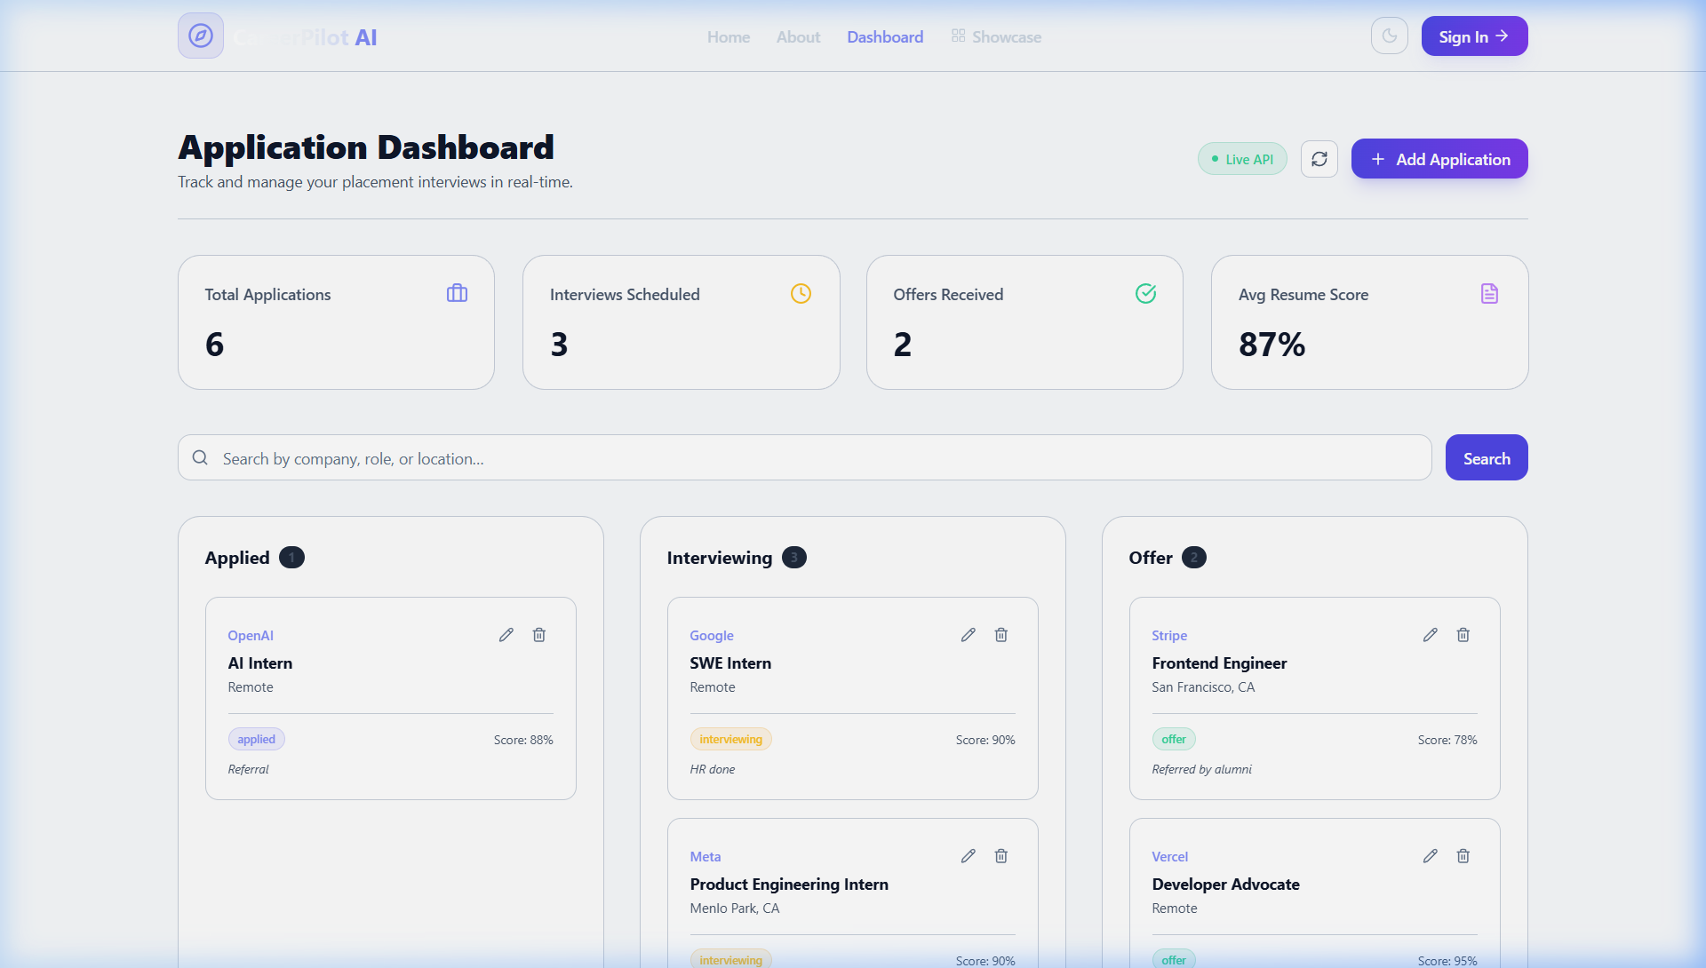
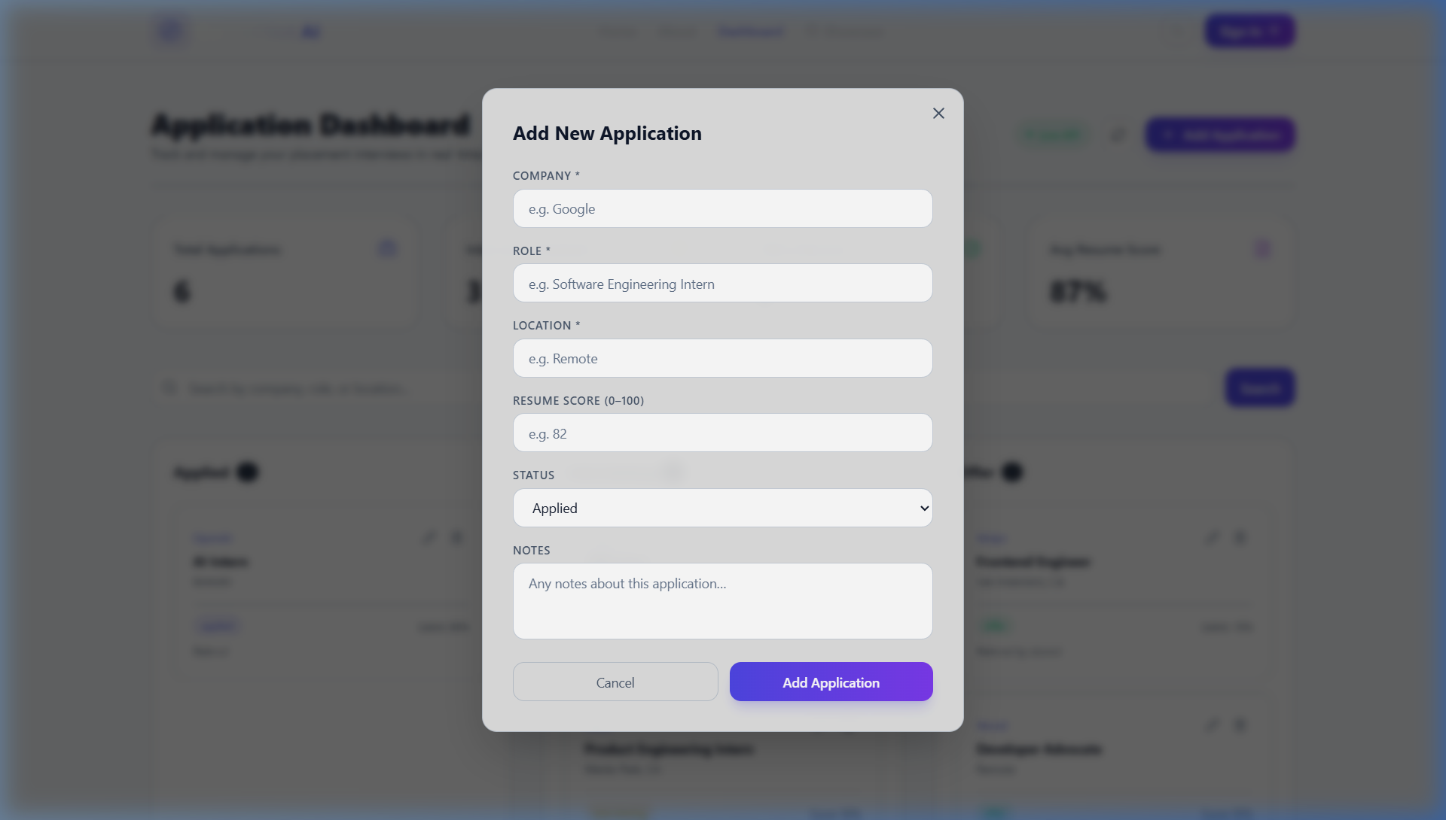
WEEK 10 SUBMISSION
Frontend Interface & Live Demonstration
Live App URL: https://careerpilot-ai.vercel.app
CareerPilot AI | Intern ID: TBI-26100454 | Sanchi Sisodia | Graphic Era University (GEU)

Slide 5
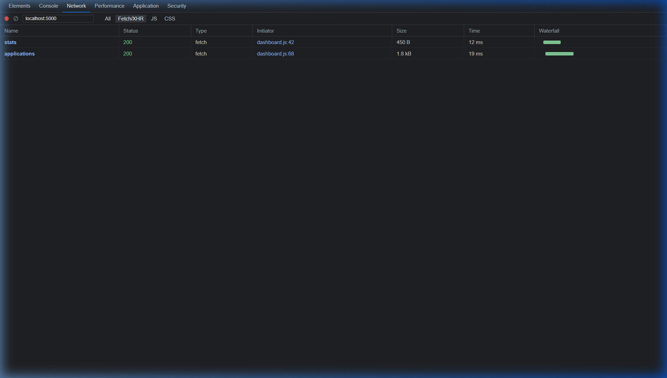
WEEK 10 SUBMISSION
Backend Architecture: Top 2 APIs
• 1. GET /api/applications/stats (Dashboard Analytics): Calculates real-time application metrics including total count, interviews scheduled, offers received, and average resume match score.
• 2. POST /api/ai/prep (AI Interview Prep Generator): Accepts company and role details, sends structured prompts to Gemini 1.5 Flash, and returns 3 tailored interview questions + 1 strategy tip in JSON format.
CareerPilot AI | Intern ID: TBI-26100454 | Sanchi Sisodia | Graphic Era University (GEU)

Slide 6
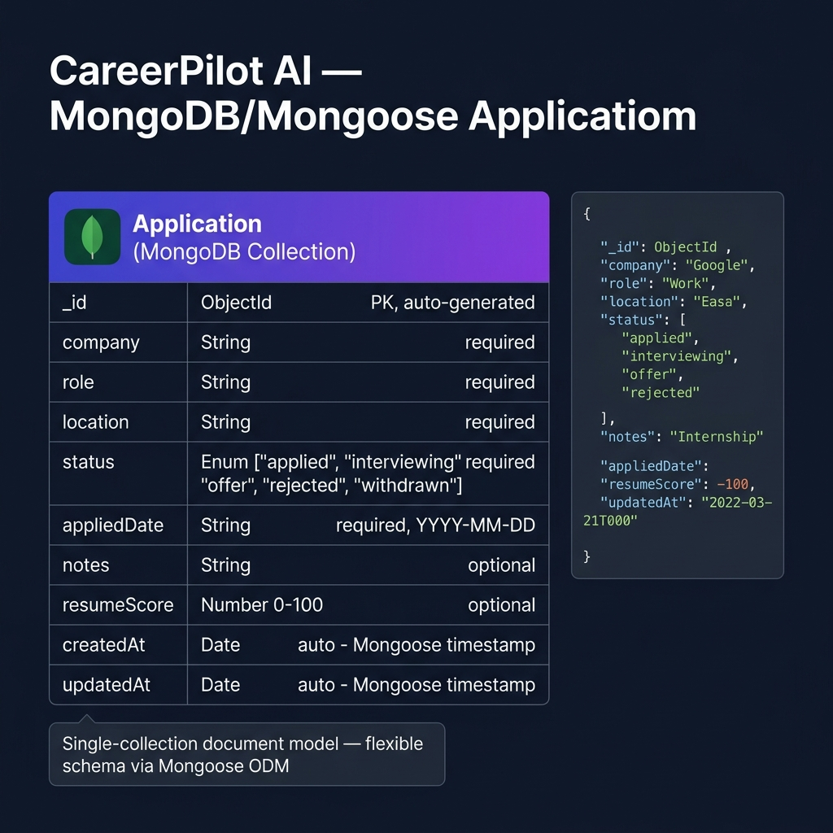
WEEK 10 SUBMISSION
Database Selected & Schema Design
• Database Choice: MongoDB Atlas (M0 Free Tier) with Mongoose ODM.
• Selection Reasons: Document flexibility for optional fields (notes, scores), JSON-native data flow, and cloud accessibility.
• Primary Collection: Application Schema storing company, role, location, status, appliedDate, notes, resumeScore, and timestamps.
CareerPilot AI | Intern ID: TBI-26100454 | Sanchi Sisodia | Graphic Era University (GEU)

Slide 7
WEEK 10 SUBMISSION
AI Feature & LLM Implementation
• LLM Model Used: Google Gemini 1.5 Flash (via @google/generative-ai SDK).
• Use Case: Automated candidate interview preparation and personalized placement coaching.
• Prompting Strategy: Instructs Gemini to return strict JSON schema containing exactly 3 role-specific interview questions and 1 actionable standing-out tip.
• Frontend Integration: Rendered dynamically inside the application detail views for seamless user experience.
CareerPilot AI | Intern ID: TBI-26100454 | Sanchi Sisodia | Graphic Era University (GEU)

Slide 8
WEEK 10 SUBMISSION
Hosting & Cloud Deployment Services
• Frontend Hosting (Vercel): Automated CI/CD git integration, global CDN distribution, edge environment variable management.
• Backend Hosting (Render): Node.js Express application host with HTTPS SSL termination and CORS security policy management.
• Database Hosting (MongoDB Atlas): Cloud-hosted M0 cluster with IP access controls and automated indexing.
CareerPilot AI | Intern ID: TBI-26100454 | Sanchi Sisodia | Graphic Era University (GEU)

Slide 9
WEEK 10 SUBMISSION
All Live Public URLs
• Live Frontend Web App: https://careerpilot-ai.vercel.app
• Live Backend REST API: https://careerpilot-ai-api.onrender.com
• GitHub Source Code Repository: https://github.com/sanchi1905/careerpilot-ai
CareerPilot AI | Intern ID: TBI-26100454 | Sanchi Sisodia | Graphic Era University (GEU)

Slide 10
WEEK 10 SUBMISSION
Internship Reflection & Key Learnings
• Key Learnings: Mastered full-stack engineering with React and Express, integrated production AI LLM APIs with structured output parsing, and gained hands-on cloud deployment experience.
• Experience: The weekly structured curriculum provided practical end-to-end development exposure, bridging academic concepts with production-ready software engineering standards.
CareerPilot AI | Intern ID: TBI-26100454 | Sanchi Sisodia | Graphic Era University (GEU)

