Slide 1
WEEK 9 SUBMISSION DELIVERABLE
CareerPilot AI
Week 9 — App Deployment & Go-Live
Intern Name: Sanchi Sisodia Intern ID: TBI-26100454 University: Graphic Era University (GEU) Live Frontend: https://careerpilot-ai.vercel.app Live Backend: https://careerpilot-ai-api.onrender.com

Slide 2
WEEK 9 DEPLOYMENT DELIVERABLE
Production Cloud Hosting Architecture
• Frontend Deployment (Vercel): Deployed from GitHub root. Configured environment variables (VITE_API_URL) for production backend connection.
• Backend Deployment (Render): Node.js Express web service running npm start. Configured environment secrets: MONGO_URI, JWT_SECRET, FRONTEND_ORIGIN.
• Database Hosting (MongoDB Atlas): Cloud-hosted M0 Free Cluster with Mongoose ODM and whitelisted IP network access (0.0.0.0/0).
• Security & Auth: Stateless JWT authentication tokens and rate-limited endpoints.
CareerPilot AI | Week 9 — App Deployment & Go-Live | Intern ID: TBI-26100454 | Sanchi Sisodia

Slide 3
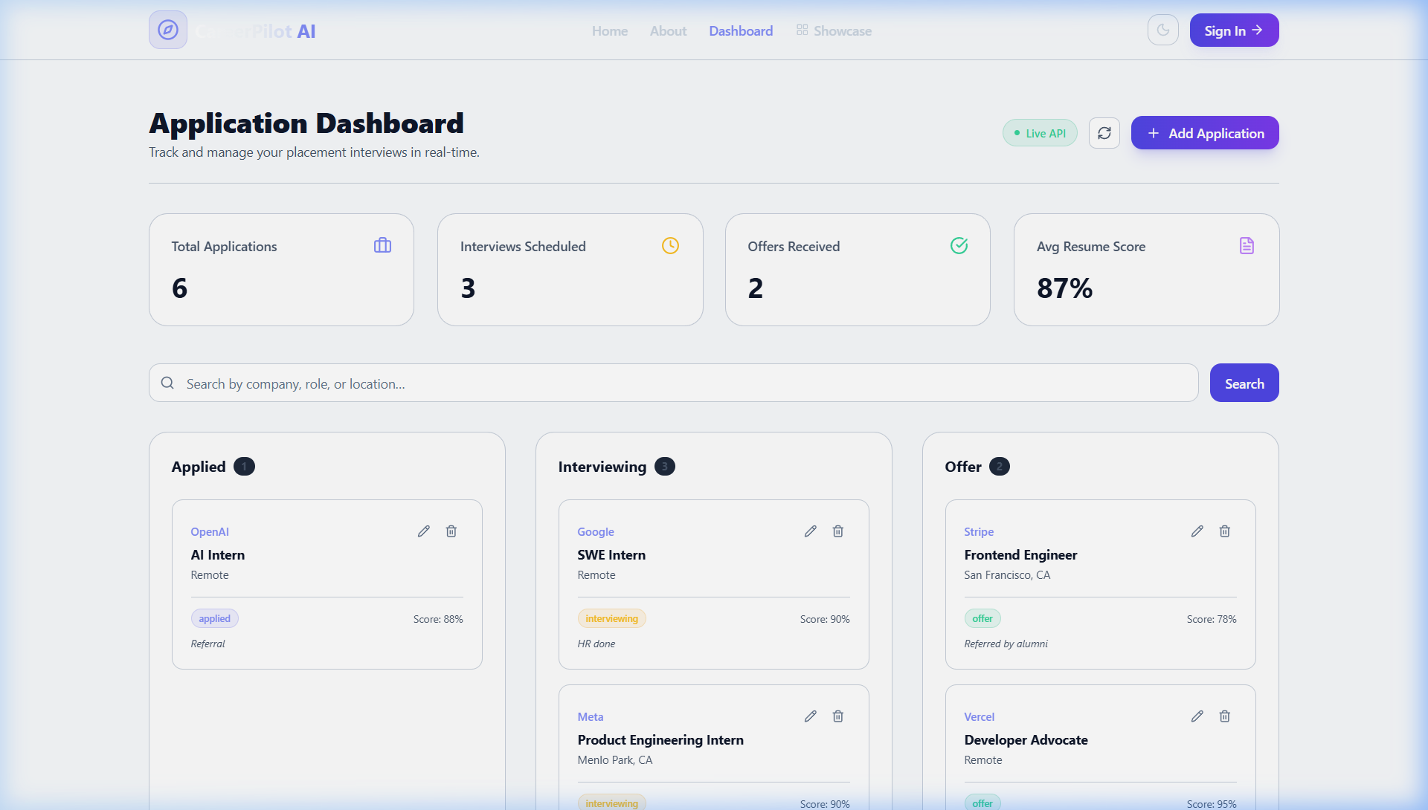
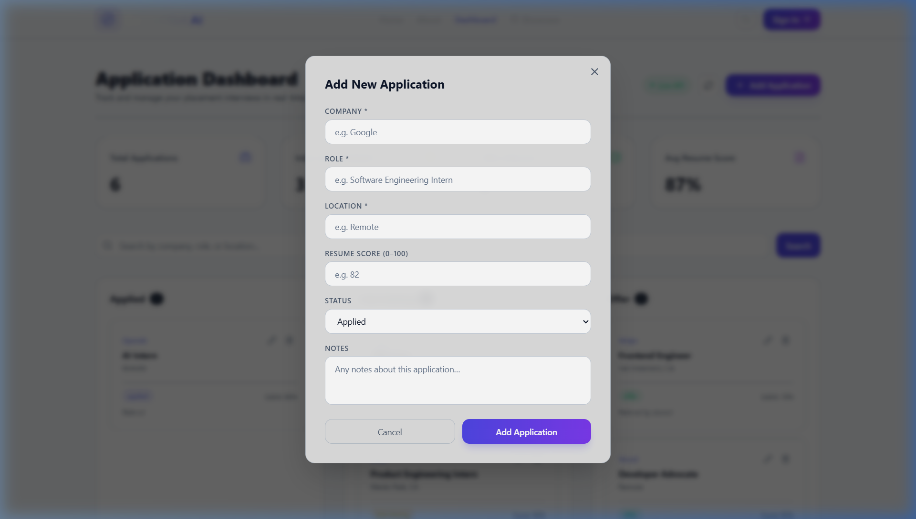
WEEK 9 DEPLOYMENT DELIVERABLE
Live Production Verification & Screenshots
CareerPilot AI | Week 9 — App Deployment & Go-Live | Intern ID: TBI-26100454 | Sanchi Sisodia

Slide 4
WEEK 9 DEPLOYMENT DELIVERABLE
Deployment Debugging & Free Tier Limitations
• CORS Resolution: Updated Express backend CORS policy to dynamically match Vercel production origin.
• Localhost URL Removal: Replaced hardcoded localhost URLs across AuthContext, Dashboard, and Login components.
• Render Idle Spin-Down: Render free tier spins down after 15 mins of inactivity. First request takes 30-50 seconds to warm up.
• MongoDB Atlas Whitelisting: Whitelisted 0.0.0.0/0 in Atlas Network Access for Render cloud IPs.
CareerPilot AI | Week 9 — App Deployment & Go-Live | Intern ID: TBI-26100454 | Sanchi Sisodia

