Slide 1


Project 4
Independent Data Analysis
Sanchi Gupta
College of Professional Studies
ALY6000: Introduction to Analytics
Professor Kayal Chandrasekaran
October 15, 2023

Slide 2


Content
01
Introduction
02
Data cleaning
03
Visualisations
04
Conclusion
05
Work Cited

Slide 3
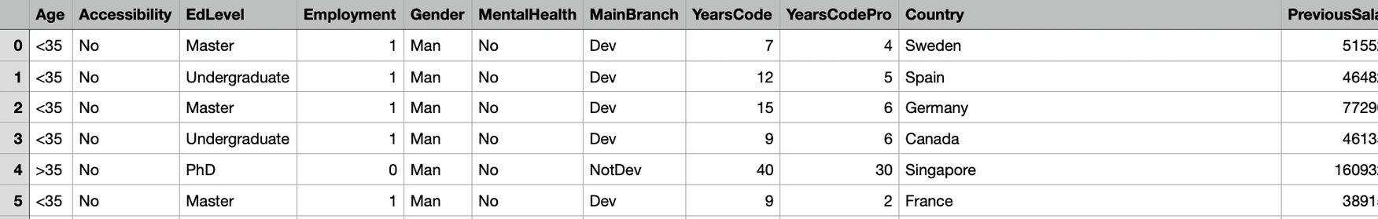
Introduction
I have chosen a dataset about JOB APPLICATIONS. During this project I was able to create many visualisations which can assist the companies in doing further analysis.
DATASET:
Age: age of the applicant, >35 years old or <35 years old
EdLevel: education level of the applicant (Undergraduate, Master, PhD)
Gender: gender of the applicant- Man, Woman, or NonBinary
YearsCode: how long the applicant has been coding
Country: country the applicant belongs to
YearsCodePro: how long the applicant has been coding in a professional context
PreviousSalary: the applicant's previous job salary
Employed: number of years applicant has worked before
ATTRIBUTES:

Slide 4
Data Cleaning
Data cleaning is the most important step to prepare the data in order to analyse it correctly. Below are the steps I have used for data cleaning & exploring-
clean_names() : Used to clean column names
subset() : To create a subset of the dataset with selected columns which are relevant
str() : To check the data type and structure of the resulting dataset
summary() : Used to obtain descriptive statistics
na.omit() : To remove rows with missing values (NA values)

Slide 5
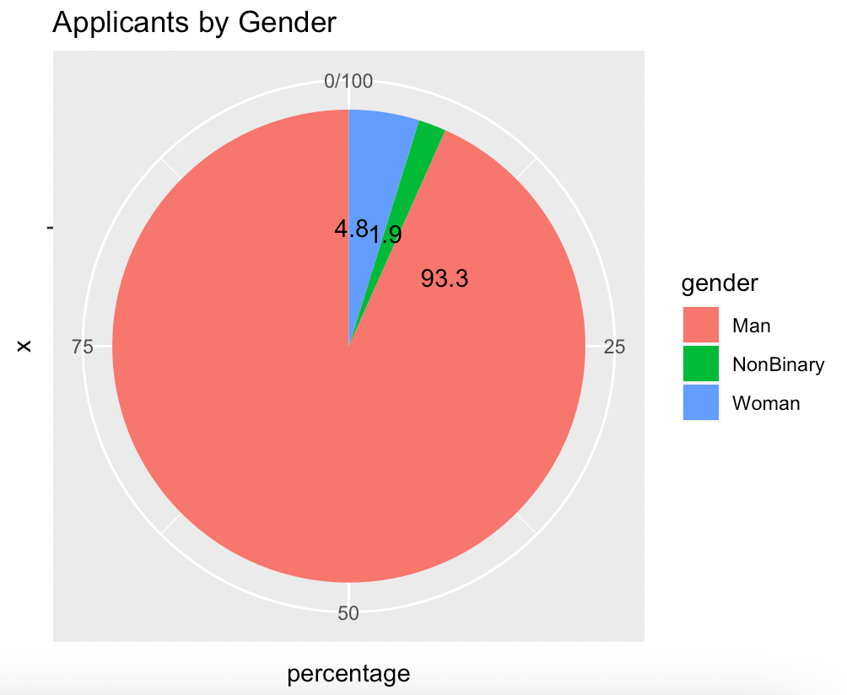
Visualisations
VISUALISATION #1
This tells us that the most applicants received for is 'Man' gender followed by 'Woman'. 'Man' applicants comprises of 93.3% and 'Woman' comprises of 4.8% of the total applicants.
Notes:
To summarise the dataset, summary() function along group_by() function is used.
Then using ggplot(), a pie chart is created to display the total number of applicants by gender and their percentage.

Slide 6
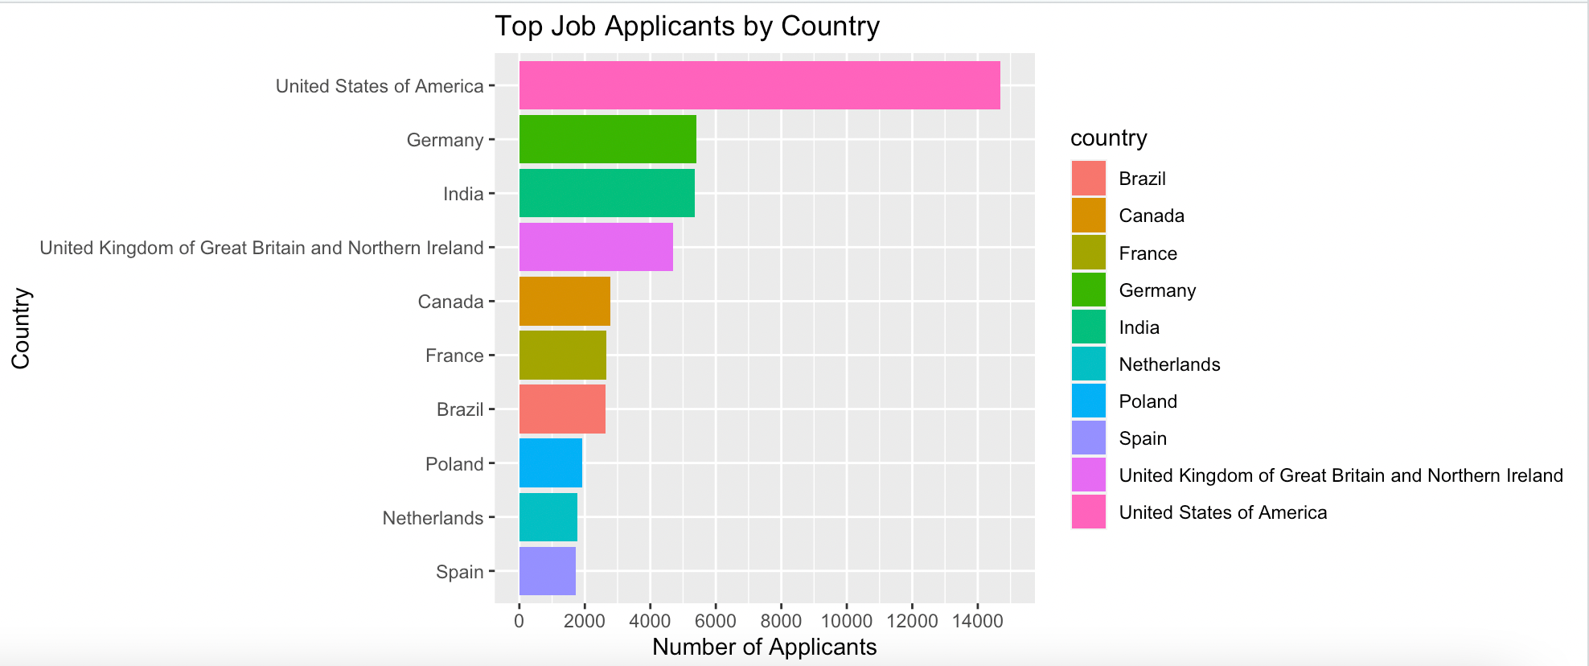
Visualisations
Question #1 : Which country has the highest job applicants?
From the above horizontal graph we can conclude that Unites States has the highest number of applicants followed by Germany and India. Unites States have 14,696 applicants in total.
Notes:
Steps:
I have summarize the dataset by country to count the number of job applicants using summary() function.
Then have renamed the 'gender' column to 'applicants'.
Arranging the countries in descending order by the number of applicants and selecting the top 10 countries has helped to visual data easily and find out the top country that has highest applicants.
Using ggplot(), a horizontal bar graph is plotted to visualize the top job applicants.

Slide 7
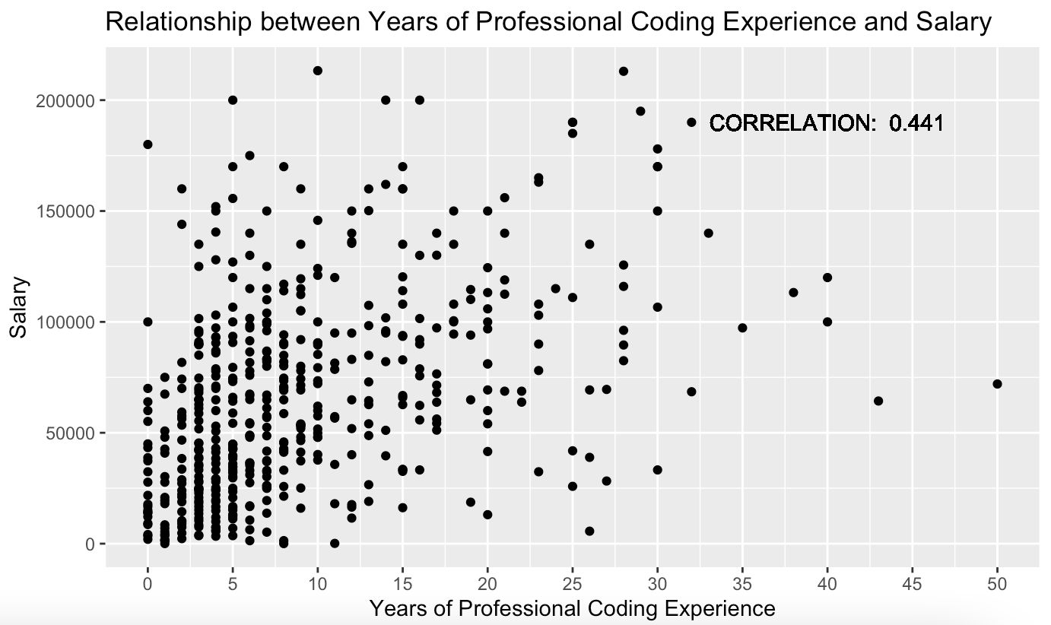
Visualisations
Question #2: Is there a correlation between years of professional coding experience and salary?
This chart shows us the relation between years of professional coding and salary. X axis denotes the years of professional experience and y axis denotes the salary range. This scatterplot is concentrated in the start which indicates that applicants that have less than 5 years of experience, their salary lies in the range of 0-50,000.
Notes:
Because of high number of observations, I created a sample dataset with 500 observations using sample_n().
Then calculated the correlation between 'years_code_pro' and 'previous_salary' which came equal to 0.441.
Plotted a scatterplot with the correlation coefficient using ggplot().

Slide 8
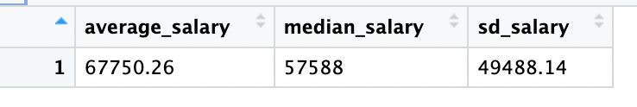
Visualisations
Question #3: What is the average and median salary of individuals in the dataset?
This table includes summary of the average, median, and standard deviation of previous salaries of all the applicants.
Average salary is different from median salary due tom outliers in the dataset. Outliers means applicants with extremely high salary that cause the average to move in their favour.
These statistical functions are required to determine the center of data.
Notes:
Summary() functions is used to calculate the average salary, median salary, and standard deviation of the salary and store that in a separate table called salary_summary.
To calculate the above statistical functions are used such as mean(), median(), and sd().

Slide 9
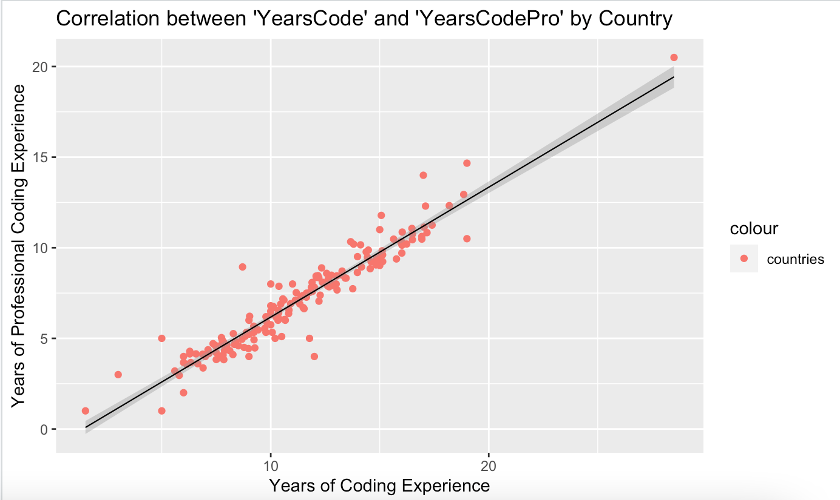
Visualisations
Question #4: Is there a correlation between ‘YearsCode’ and ‘YearsCodePro’ for each country?
Above graph shows correlation between ‘years coded’ and ‘years coded professionally’ for each country. Most of the countries are concentrated near the linear line of regression which denotes that there is less disparity between the experience and professional experience.
Notes:
Summarized the dataset by each country for 'years_code' and 'Years_code_pro' using group_by().
Using ggplot(), created a scatterplot for each country. Then added a linear graph to visualize the correlation between the two.

Slide 10
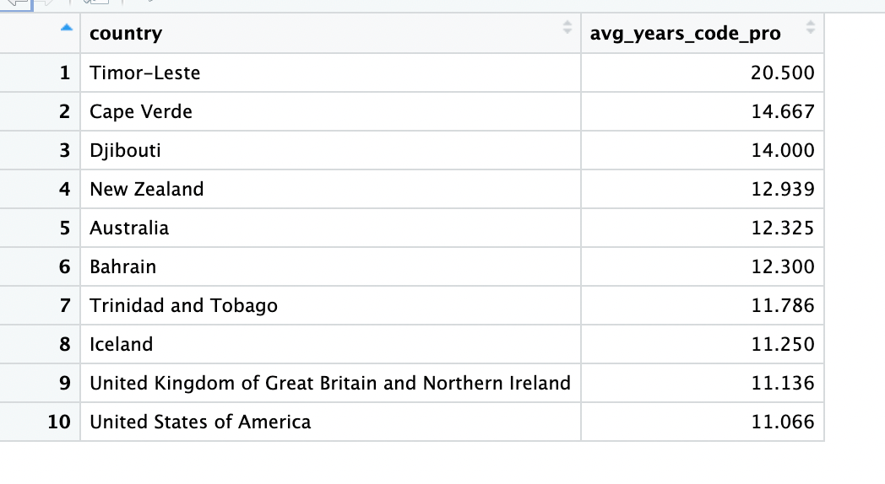
Visualisations
Follow-up question : Which countries have the most experienced coders?
The above table shows the countries with the most seasoned coders based on the average years of professional coding experience.
Timor-Leaste has the most experienced coders followed by Cape Verde.
Notes:
To obtain this result first I arranged the dataset in descending order using arrange() function. After arranging it , I sliced the dataset using slice() function and created a subset with subset() function.

Slide 11
Work Cited
AyushTankha. (2023, July). 70k+ Job Applicants Data (Human Resource). Kaggle. https://www.kaggle.com/datasets/ayushtankha/70k-job-applicants-data-human-resource
mishrapratikshya12. (2021, July). Sorting DataFrame in R using Dplyr. Geeks for Geeks. https://www.geeksforgeeks.org/sorting-dataframe-in-r-using-dplyr/?ref=ml_lbp
Antoine Soetewey. (2020, January). Descriptive statistics in R. Stats and R. https://statsandr.com/blog/descriptive-statistics-in-r/#introduction
Pie Charts. https://www.statmethods.net/graphs/pie.html

