Slide 1
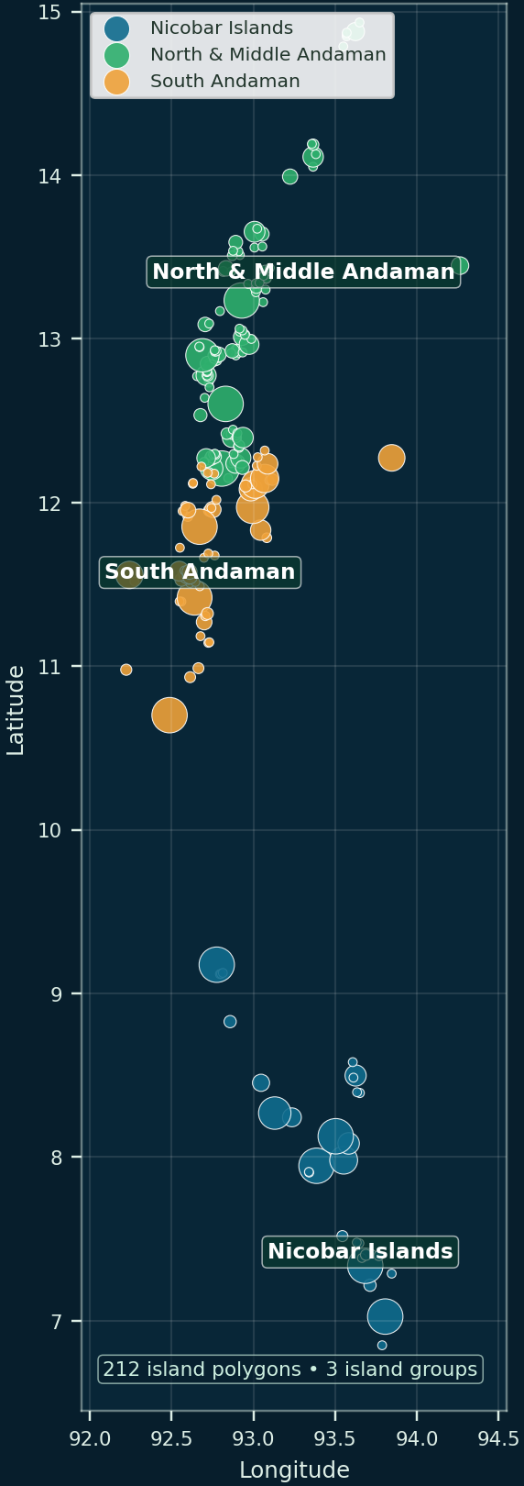
Forest Fragmentation Dynamics in the
Andaman and Nicobar Islands
Remote sensing and landscape metrics approach • 2000–2023
Submitted by
Sanchit Kumar — 2024201042
Priyanshu Jha — 2024201062
Professor: Ramachandra Prasad
Interactive presentation aligned with the project report
Launch dashboard
View GitHub code
Click the buttons and footer navigation during slideshow mode.
Map visual: processed island centroids, grouped by island region
1/20
Notes:
Open with the project title, candidate details and a meaningful map of the processed island centroids instead of a cropped dashboard screenshot. Use the buttons to open the dashboard and repository.

Slide 2
Interactive deck map
clickable navigation
Use this page as the home screen. Each section label is clickable, and the footer navigation remains available on every slide.
1
2
3
4
5
6
Introduction
Study area
Data
Methods
Results
Dashboard & close
Interactivity built in: agenda jump links, persistent footer navigation, and live external links to the production dashboard and GitHub repository.
Home
Intro
Study
Data
Methods
Results
Dashboard
Close
Dashboard
GitHub
2/20
Notes:
Explain that the presentation is not simply linear; the examiner can jump directly to sections or open the live dashboard.

Slide 3
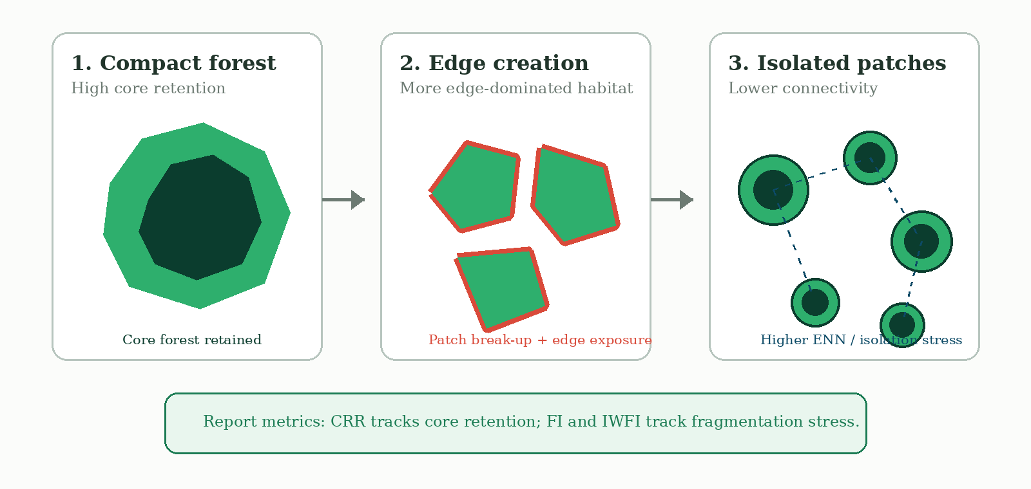
Why forest fragmentation matters in island ecosystems
1. Introduction
Project motivation
Island forests can retain high total forest area while losing interior habitat, gaining edge exposure and becoming less connected.
Main message: forest-area loss is not enough; spatial configuration, core retention and isolation must be analysed together.
Report basis: fragmentation theory from Fahrig (2003), Haddad et al. (2015), FRAGSTATS / PyLandStats metric families.
Home
Intro
Study
Data
Methods
Results
Dashboard
Close
Dashboard
GitHub
3/20
Notes:
Use the schematic to show the conceptual difference between intact forest, edge creation and isolated forest patches.

Slide 4
Literature survey: what the project builds on
1.1 Literature survey
Global forest monitoring
Fragmentation metrics
Andaman–Nicobar studies
Hansen et al. (2013) provide 30 m Landsat-based tree-cover loss through annual loss-year layers. ESA WorldCover 2021 provides a 10 m land-cover snapshot for interpretation.
Fahrig (2003), Haddad et al. (2015), FRAGSTATS and PyLandStats support patch density, edge density, core area and nearest-neighbour metrics.
Bahuguna et al. (2008), Tiwari et al. (2016) and Veettil et al. (2020) show the value of satellite data for coastal ecosystems, forest encroachment and mangrove dynamics in the islands.
Gap addressed by this work: annual 2000–2023 forest masks + island-wise landscape metrics + interactive dashboard for the full archipelago.
Key references: Hansen et al. 2013; Zanaga et al. 2022; Fahrig 2003; Haddad et al. 2015; Bahuguna et al. 2008; Tiwari et al. 2016; Veettil et al. 2020.
Home
Intro
Study
Data
Methods
Results
Dashboard
Close
Dashboard
GitHub
4/20
Notes:
Summarize the literature categories and position the project as a synthesis of remote sensing, landscape ecology and regional Andaman/Nicobar studies.

Slide 5
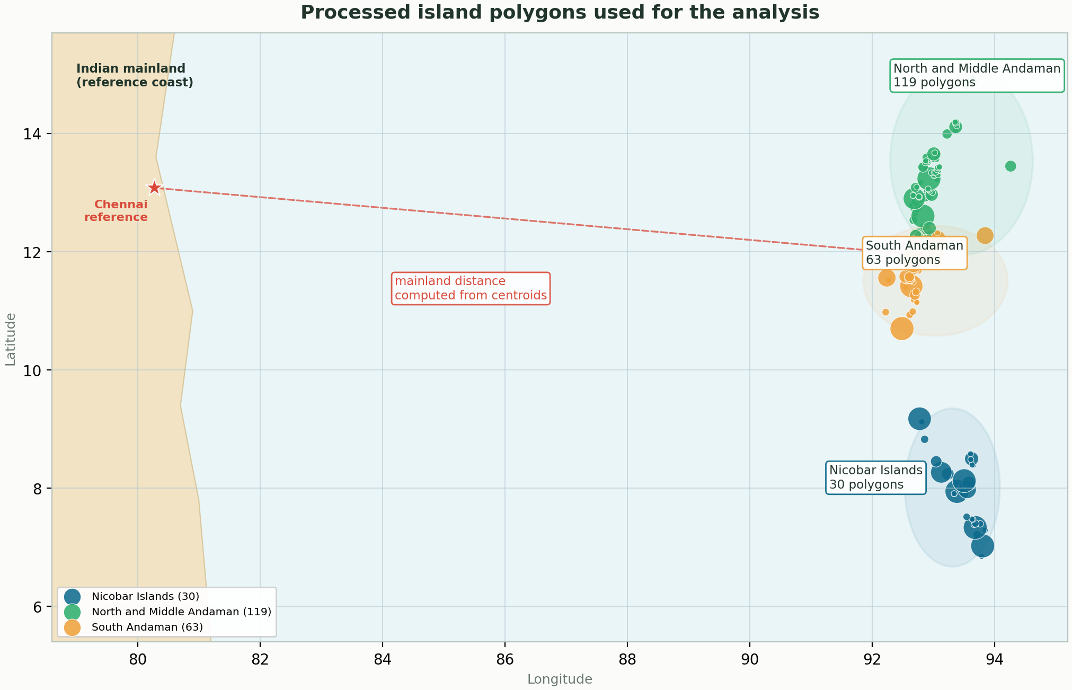
Study area: Andaman and Nicobar archipelago
1.3 Study area
212
≈7,610.9 km²
processed island polygons
processed total area
2000–2023
3
analysis years
major groups
Island group
Polygons
Area (km²)
Nicobar Islands
30
1,726.8
North & Middle Andaman
119
3,406.5
South Andaman
63
2,477.5
The map uses project centroids and highlights the Chennai coast reference used for mainland-distance calculations.
Home
Intro
Study
Data
Methods
Results
Dashboard
Close
Dashboard
GitHub
5/20
Notes:
Introduce the spatial units, the three island groups and the mainland-distance reference used in the analysis.

Slide 6
Objectives and research questions
1.2 Objectives
Research questions
Operational objectives
1) Do smaller islands lose core forest faster than total forest area?
2) Do forest-loss levels approach fragmentation or percolation thresholds?
3) Is fragmentation better explained by mainland distance or by intra-archipelago connectivity?
• Generate annual forest/non-forest masks from Hansen tree cover and loss-year layers.
• Compute PLAND, PD, ED, TCA, ENN_MN and patch counts for every island.
• Derive CRR, FI, IWFI, EII and cumulative loss indicators.
• Compare patterns by group, size class, isolation and trajectory.
• Deploy a reproducible Streamlit/Folium dashboard.
Analytical focus: move from forest area to forest configuration.
Dashboard and code are linked throughout this deck for live verification and reproducibility.
Home
Intro
Study
Data
Methods
Results
Dashboard
Close
Dashboard
GitHub
6/20
Notes:
Use this slide to connect the questions to the metrics that appear later: CRR, FI, IWFI and EII.

Slide 7
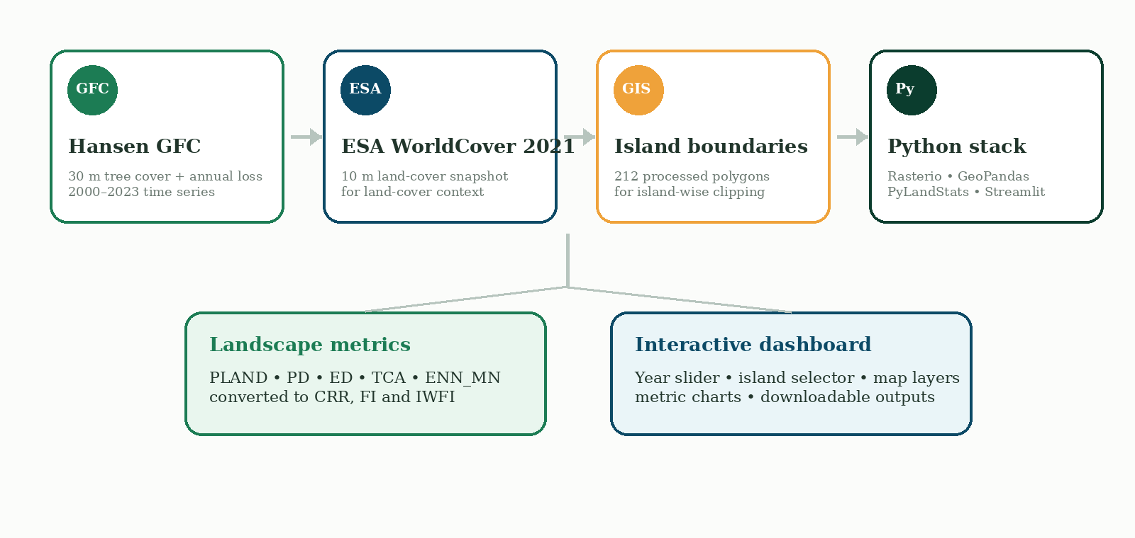
Materials: satellite data, boundaries and software stack
2.1 Data used
Important dashboard note: ESA WorldCover is a 2021 classification snapshot and does not respond to the year slider.
Data sources follow the report: Hansen Global Forest Change; ESA WorldCover 2021; GADM/vector island boundaries; open-source Python geospatial ecosystem.
Home
Intro
Study
Data
Methods
Results
Dashboard
Close
Dashboard
GitHub
7/20
Notes:
Highlight how the data stack connects directly to the metrics and final dashboard deliverable.

Slide 8
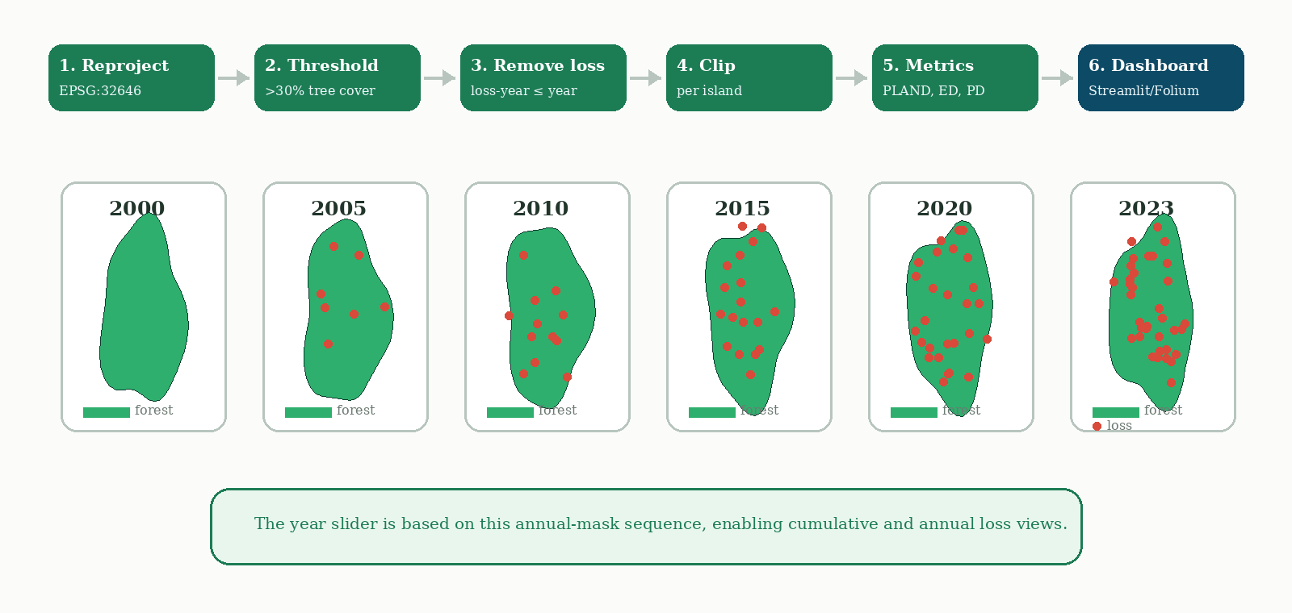
Processing workflow: from rasters to dashboard
2.2 Data processing
Forest baseline: year-2000 tree cover >30%; loss-year pixels up to the selected year are removed before island-wise metric calculation.
Home
Intro
Study
Data
Methods
Results
Dashboard
Close
Dashboard
GitHub
8/20
Notes:
Walk through the processing storyboard: reproject, threshold, remove loss, clip by island, compute metrics and visualise in the dashboard.

Slide 9
Core landscape metrics used in the analysis
2.3 Metrics
Metric
Meaning
Interpretive use
Why this matters: a forest can retain area but lose interior/core habitat if patches become narrower, more fragmented or more edge-exposed.
PLAND
Percentage of landscape occupied by forest
Area-based forest proportion
PD
Patch density
How many forest patches occur per area
The report follows standard landscape-ecology logic: area, edge, patch and isolation metrics are interpreted together rather than independently.
ED
Edge density
How exposed and irregular forest boundaries are
TCA
Total core area
Interior forest area after edge buffering
ENN_MN
Mean Euclidean nearest-neighbour distance
Patch isolation within an island
Metric family
n_patches
Number of forest patches
Patch break-up indicator
PyLandStats implements comparable workflows in Python, extending the FRAGSTATS class-level metric tradition.
Home
Intro
Study
Data
Methods
Results
Dashboard
Close
Dashboard
GitHub
9/20
Notes:
Define each metric clearly before moving to composite indicators.

Slide 10
Composite indicators: translating metrics into ecological meaning
2.3 Metrics
CRR = TCA / TA
Core Retention Ratio
Higher CRR means more forest remains as interior/core habitat.
FI = (ED × PD) / PLAND
Fragmentation Index
Higher FI means more edge and patch break-up relative to forest proportion.
IWFI = FI × ln(ENN_MN + 1) × ln(distance + 1)
Isolation-Weighted Fragmentation Index
Adds patch isolation and mainland distance to the fragmentation signal.
EII
Effective Isolation Index
Represents intra-archipelago isolation used to compare connectivity effects.
Interpretation rule: use CRR together with FI/IWFI — not a single metric — to avoid over-reading area-only changes.
Home
Intro
Study
Data
Methods
Results
Dashboard
Close
Dashboard
GitHub
10/20
Notes:
Connect formulas to interpretation: CRR is protective; FI and IWFI are stress indicators.

Slide 11
Statistical analysis: exploratory modelling and transparent caveats
2.4 Statistical analysis
Models / analyses used
Output
Reported value
Interpretation
• K-means clustering of CRR trajectories into Stable, Linear Degradation and Rapid Collapse labels.
• OLS model for 2023 IWFI drivers using log area, log mainland distance and effective isolation.
• Correlation comparison between IWFI and mainland distance / effective isolation.
• Piecewise regression to identify island-size threshold where CRR stabilises.
OLS observations
n = 3 aggregate groups
Screening only; not causal
Breakpoint
3196.95 km²
CRR stabilises above this size
Mainland distance vs IWFI
r = -0.987, p = 0.1043
High correlation; not significant
Effective isolation vs IWFI
r = -0.989, p = 0.0959
High correlation; not significant
Caution: high R² values from a three-group model are descriptive, not statistical proof. Use them as screening evidence.
Regression summary file: OLS rank exceeds observations; p-values are not significant at 0.05; condition number indicates numerical concerns.
Home
Intro
Study
Data
Methods
Results
Dashboard
Close
Dashboard
GitHub
11/20
Notes:
Emphasize the project is transparent about limitations of the aggregate regression.

Slide 12
Result 1 — Forest-area loss is low, but core retention differs
3.1 Aggregate results
Group
Forest 2023
CRR
Loss %
IWFI
Nicobar Islands
172,122 ha
0.598
1.812
205.7
North & Middle Andaman
338,579 ha
0.570
1.042
229.6
South Andaman
246,358 ha
0.292
0.546
175.9
• Aggregate forest-area loss remains low in all three groups.
• South Andaman has the lowest aggregate CRR in 2023, indicating higher edge-dominated forest.
• North & Middle Andaman shows high IWFI in the 2023 summary because fragmentation and isolation components combine.
Core retention is the stronger story than total area loss.
Home
Intro
Study
Data
Methods
Results
Dashboard
Close
Dashboard
GitHub
12/20
Notes:
Use the chart and table to highlight South Andaman CRR and the need to interpret configuration metrics.

Slide 13
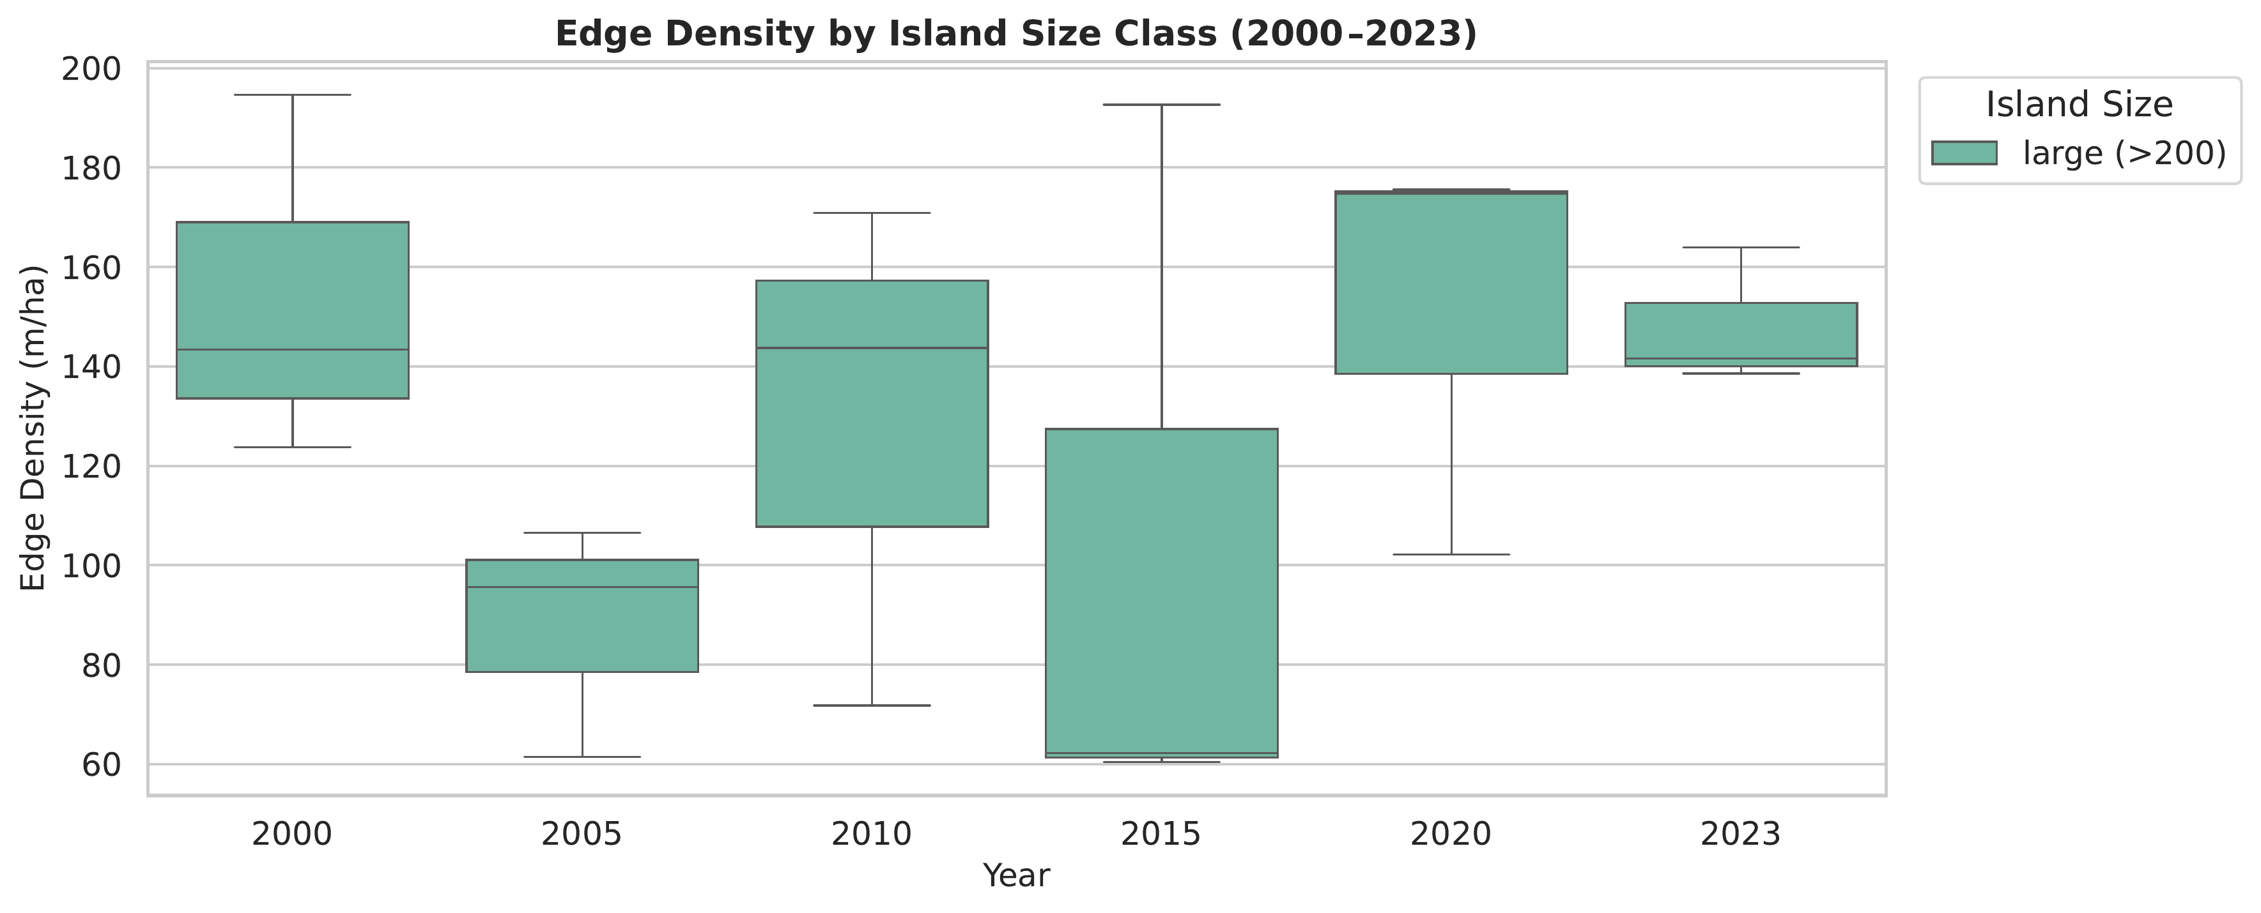
Result 2 — Tiny islands amplify fragmentation signals
3.2 Edge density by size class
2023 size-class snapshot
Class
Polygons
Mean FI
Mean IWFI
tiny (<10)
176
6.296
254.3
small (10–50)
19
2.741
108.8
medium (50–200)
11
2.205
89.5
large (>200)
6
3.089
130.3
The boxplot shows year-to-year variability in edge density. Small and tiny islands can show large metric swings because a few changed pixels strongly affect patch and edge ratios.
Interpret carefully: tiny polygons are ecologically important, but their ratios can be numerically unstable.
Home
Intro
Study
Data
Methods
Results
Dashboard
Close
Dashboard
GitHub
13/20
Notes:
Explain that size class effects support island-biogeography expectations, but with caution for very small polygons.

Slide 14
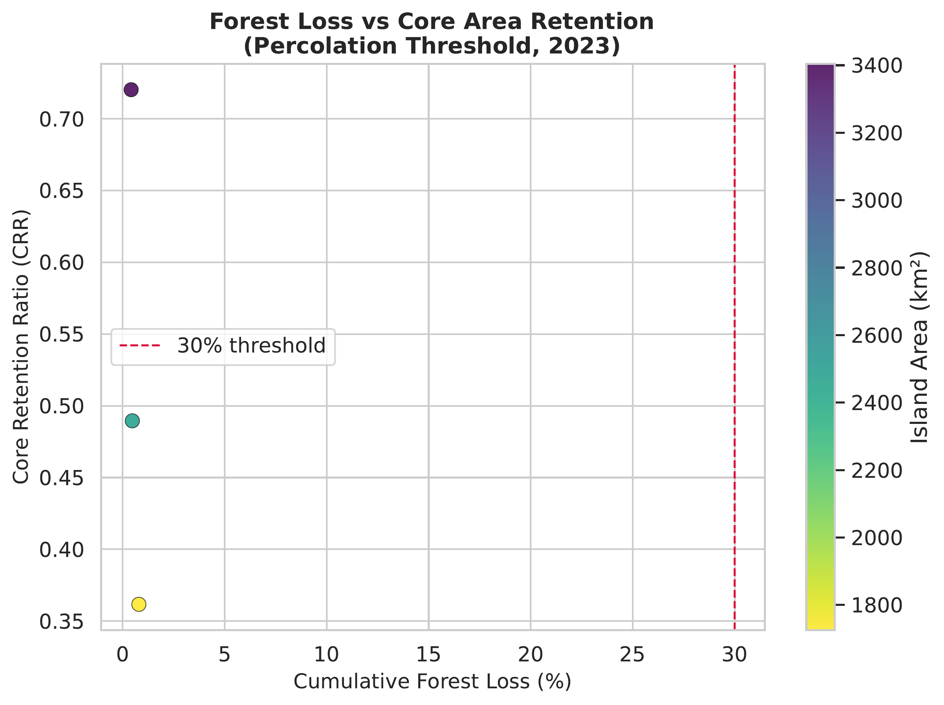
Result 3 — Low forest loss can still hide core-habitat stress
3.3 Forest loss and CRR
• The 30% loss line is a reference from fragmentation/percolation theory, not an observed transition proven here.
• Most aggregate points remain far below that threshold in the processed 2000–2023 data.
• Core retention still differs substantially, so area-based loss alone is insufficient.
Core-area metrics reveal stress that cumulative-loss percentage may miss.
Report interpretation: forest configuration and interior/core habitat should be evaluated alongside total forest-area change.
Home
Intro
Study
Data
Methods
Results
Dashboard
Close
Dashboard
GitHub
14/20
Notes:
The plot makes the central point that low loss does not necessarily mean high ecological resilience.

Slide 15
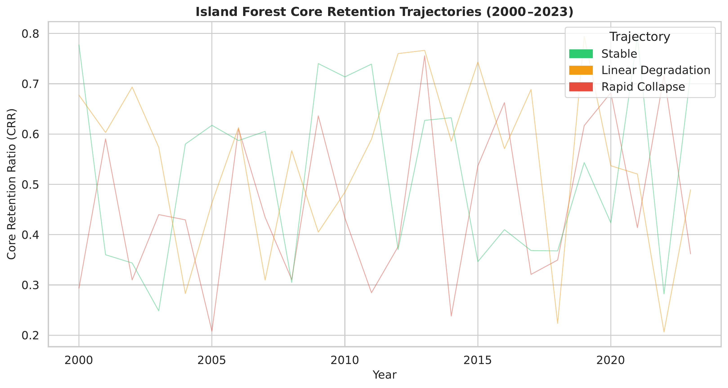
Result 4 — Core-retention trajectories and cluster labels
3.4 Temporal trajectories
Cluster labels
Island group
Trajectory label
Nicobar Islands
Rapid Collapse
North & Middle Andaman
Stable
South Andaman
Linear Degradation
The labels are descriptive trajectory classes. Because only three aggregate groups are used in the clustering summary, they should not be treated as statistically robust ecological categories.
Use the clusters as communication labels, not definitive classification.
Home
Intro
Study
Data
Methods
Results
Dashboard
Close
Dashboard
GitHub
15/20
Notes:
Clarify the usefulness and limitation of trajectory labels.

Slide 16
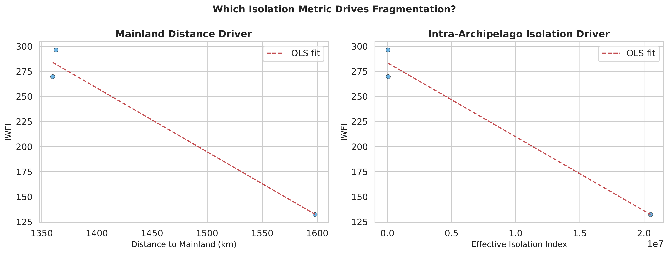
Result 5 — Isolation drivers are relevant but exploratory
3.5 Isolation drivers
r=-0.987
p=0.1043
r=-0.989
p=0.0959
mainland distance vs IWFI
effective isolation vs IWFI
Regression caveat: n=3 aggregate groups; results are hypothesis-generating rather than causal.
The piecewise model reported a CRR stabilization threshold above 3196.95 km², suggesting larger islands may retain core forest more consistently.
Interpretation: isolation matters, but field validation and more detailed connectivity modelling are needed.
Home
Intro
Study
Data
Methods
Results
Dashboard
Close
Dashboard
GitHub
16/20
Notes:
Use this slide to show the relationship plots while being honest about statistical limitations.

Slide 17
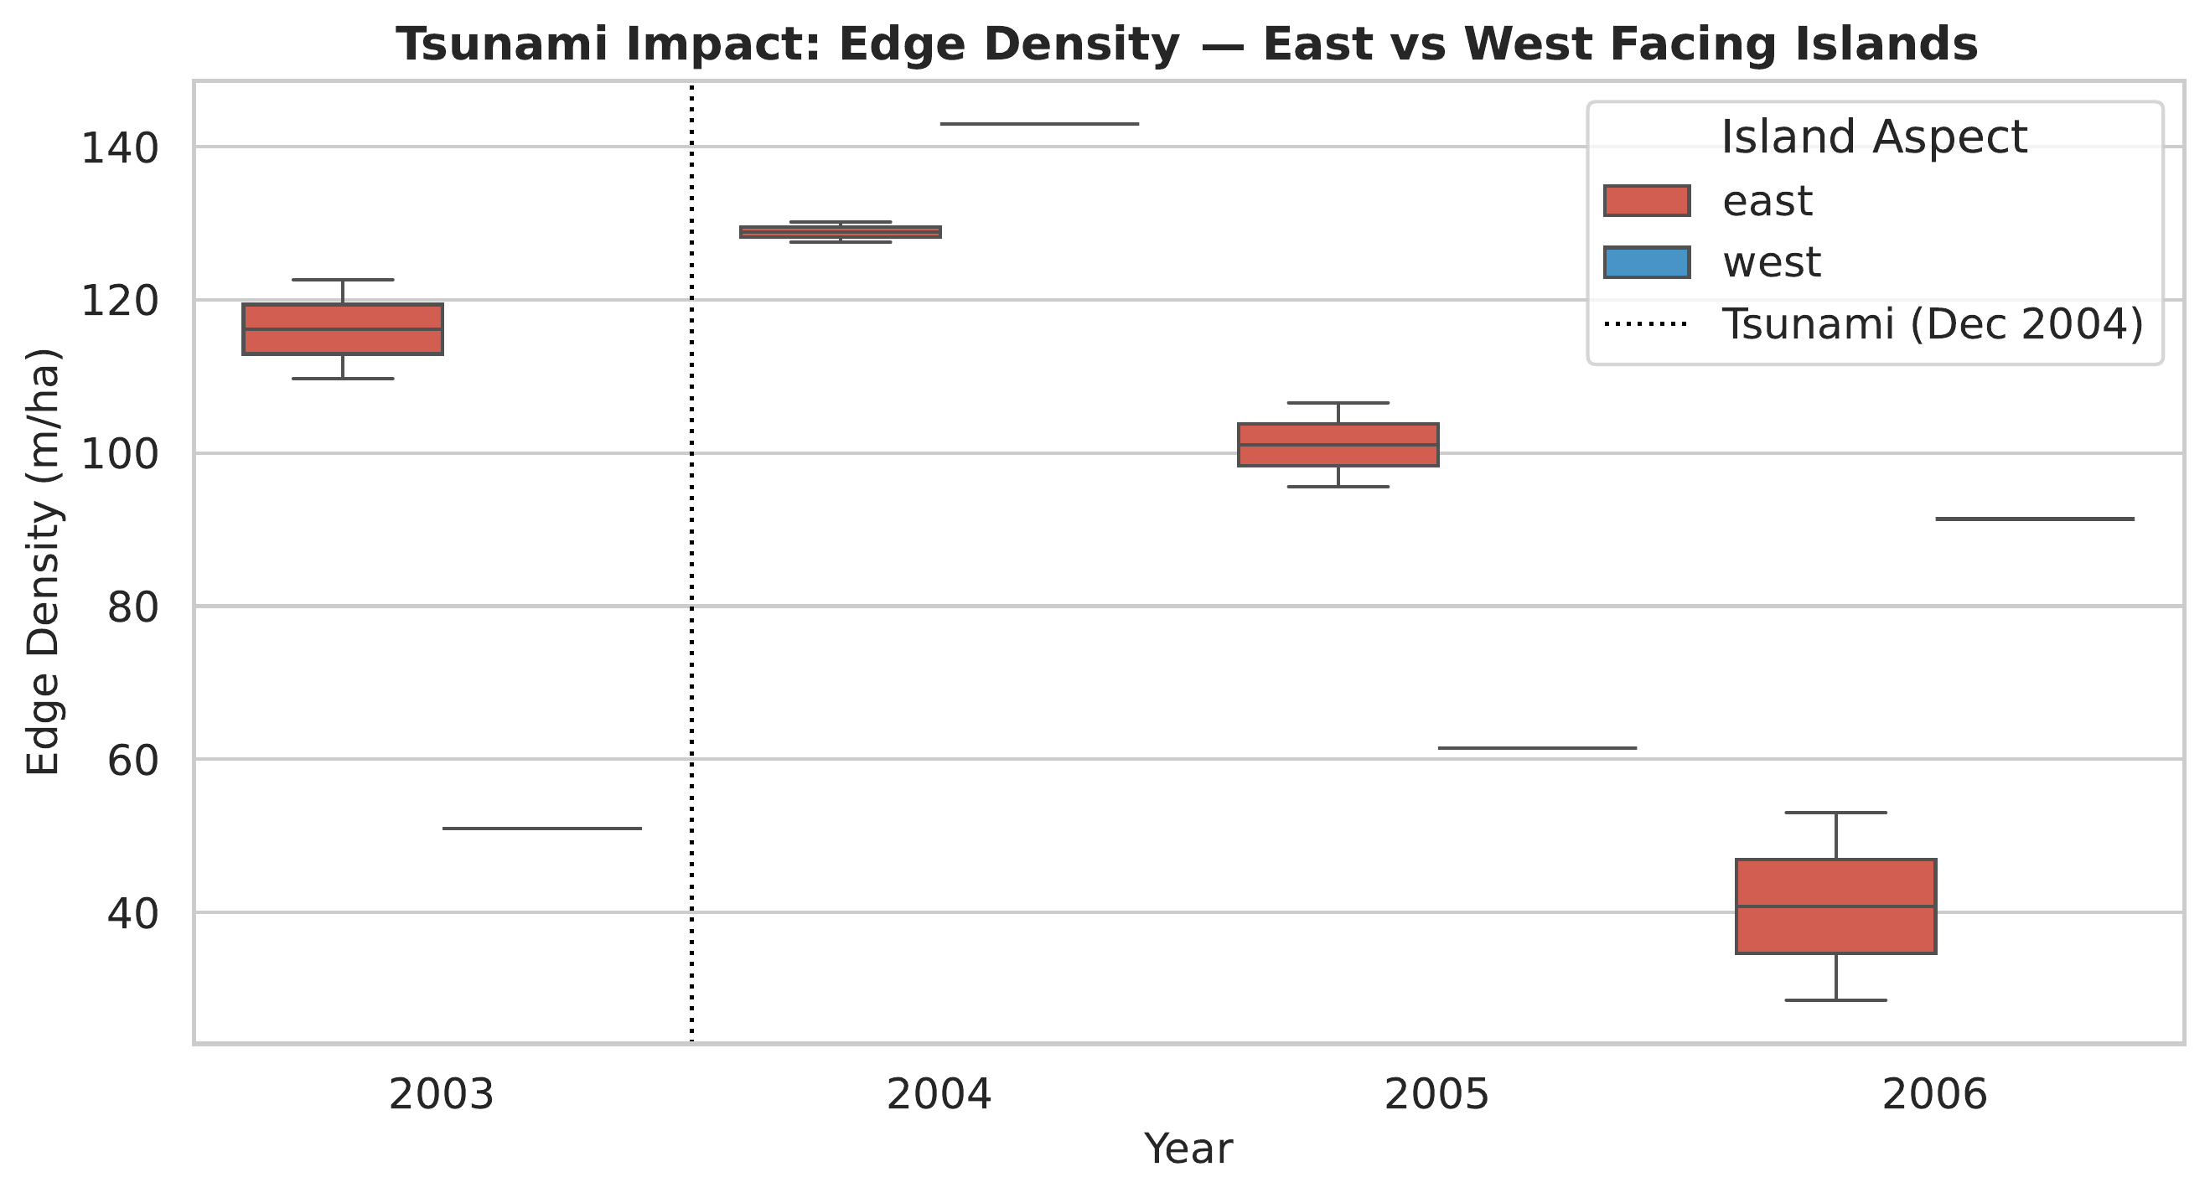
Result 6 — Tsunami-period edge-density signal
3.6 Tsunami signal
• The 2003–2006 comparison was included because the 26 December 2004 earthquake and tsunami affected the region.
• The figure separates east- and west-facing island polygons using an aspect proxy.
• The result is indicative, not conclusive, because the workflow does not directly map field-observed tsunami damage.
Use as a disturbance-screening signal, not direct attribution.
Contextual comparison: Bahuguna et al. (2008) directly documented coastal ecosystem impacts from the 2004 tsunami using RESOURCESAT AWiFS data.
Home
Intro
Study
Data
Methods
Results
Dashboard
Close
Dashboard
GitHub
17/20
Notes:
Explain that the project is cautious about tsunami interpretation.

Slide 18
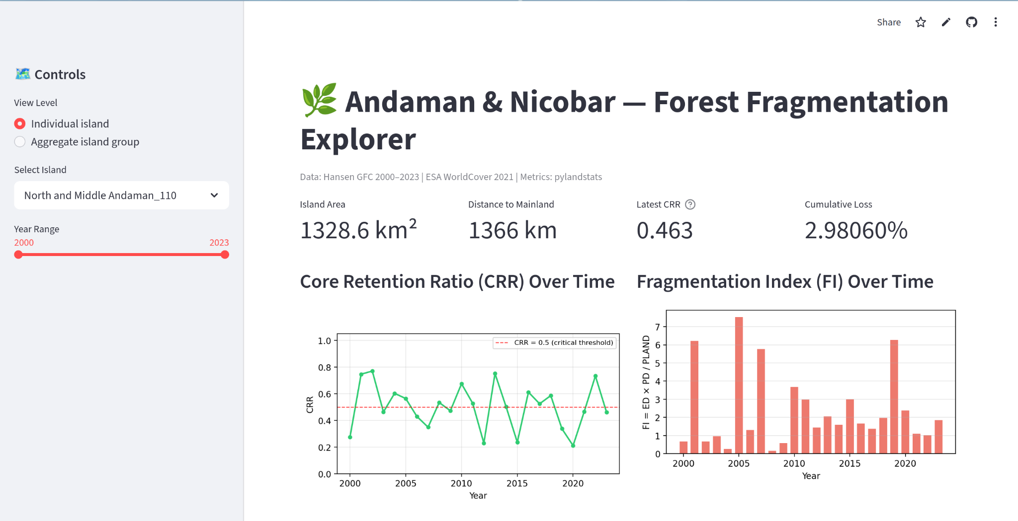
Interactive dashboard: controls, metrics and charts
3.8 Dashboard
Visible dashboard features
• View level toggle: Individual island or aggregate island group.
• Island/group dropdown and year slider from 2000 to 2023.
• Summary metrics: island area, mainland distance, latest CRR and cumulative loss.
• Time-series charts for CRR, FI and IWFI.
• Data sources and metric methodology are stated inside the portal.
Launch live dashboard
Screenshot and button are clickable in slideshow mode.
Home
Intro
Study
Data
Methods
Results
Dashboard
Close
Dashboard
GitHub
18/20
Notes:
The dashboard is a final deliverable that lets users reproduce the exploration interactively.

Slide 19
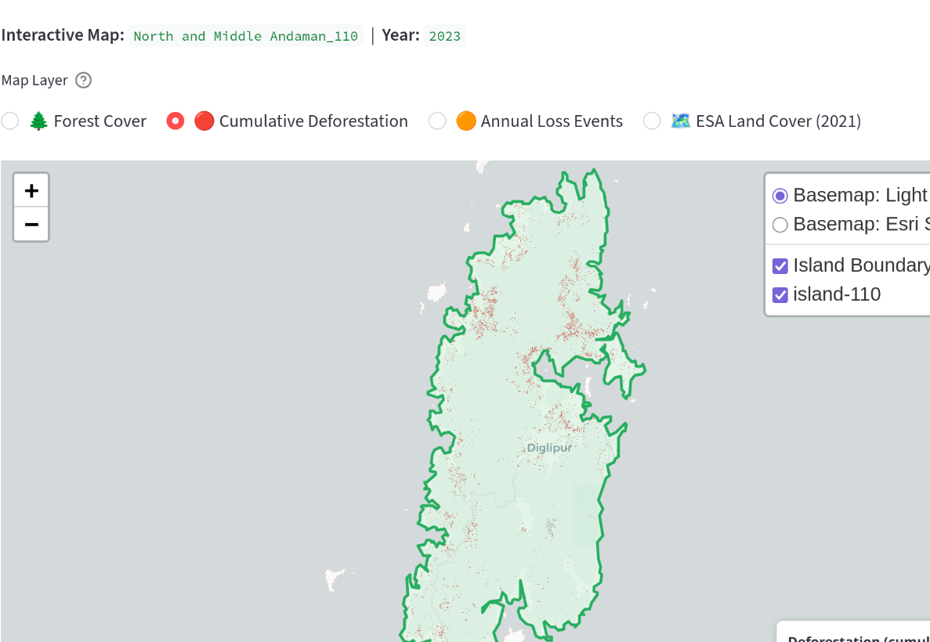
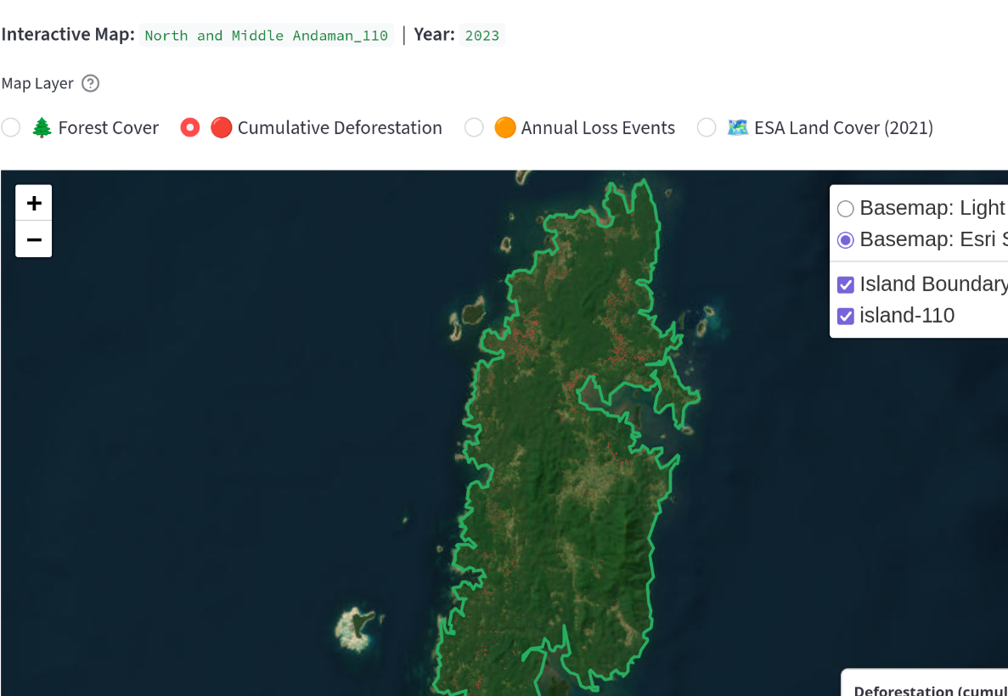
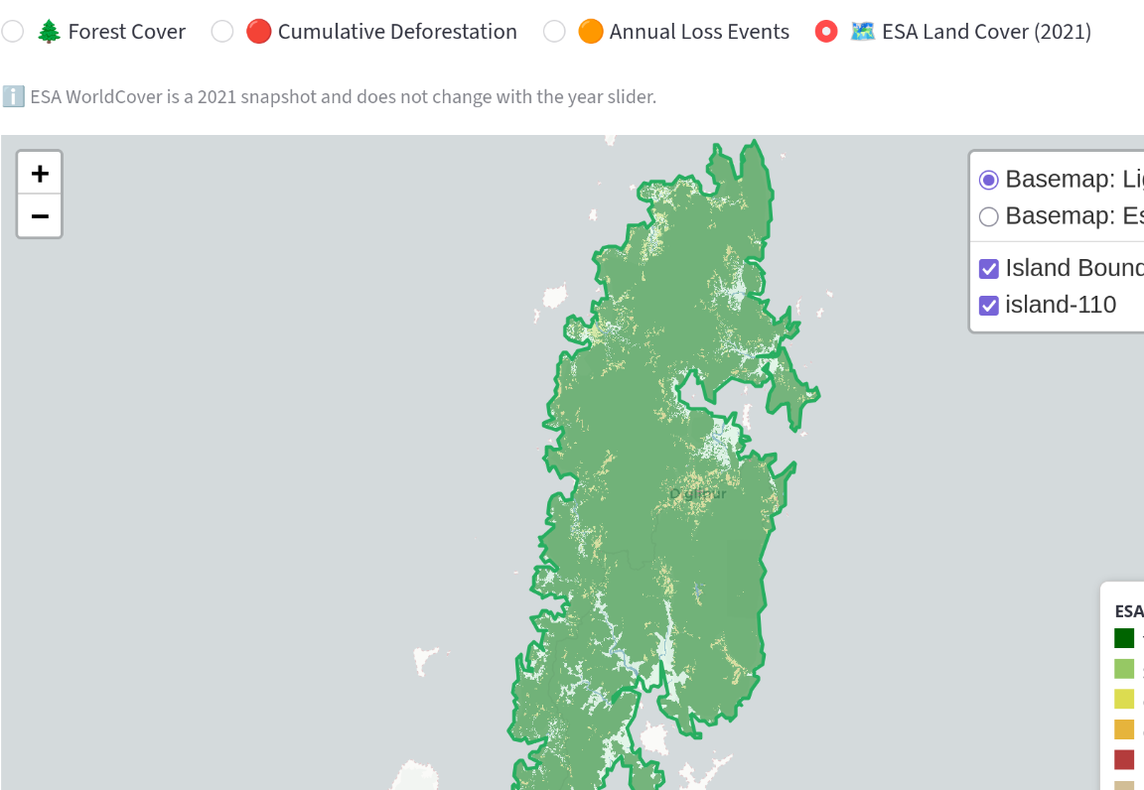
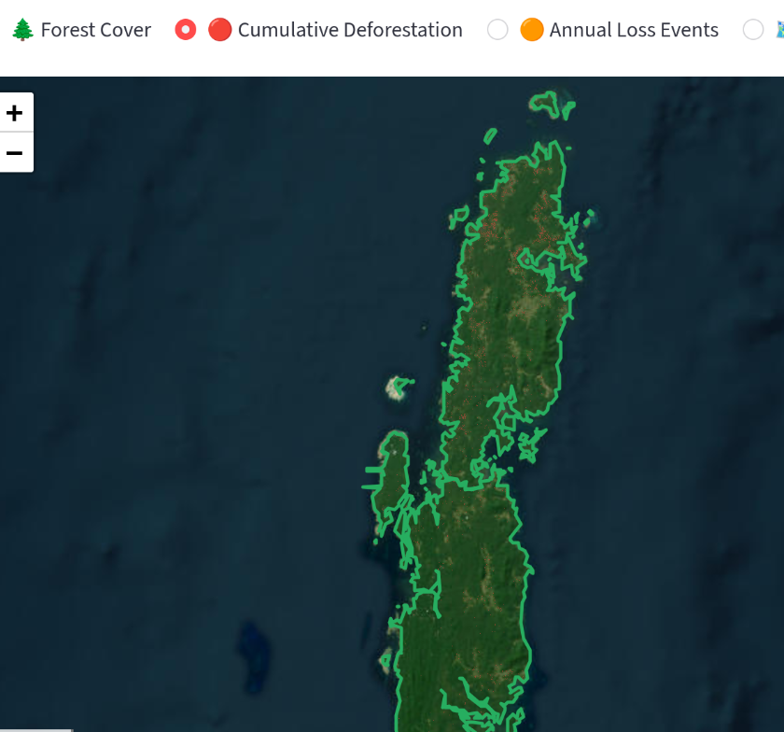
Interactive dashboard: map layers and interpretation
3.8 Dashboard
Cumulative loss: older-to-newer deforestation colours
Satellite basemap: terrain and coastline context
ESA WorldCover 2021: static land-cover snapshot
Aggregate view: multiple island boundaries
Map layer controls
Interpretive use
• Forest Cover: displays forested pixels for the selected island and year.
• Cumulative Deforestation: shows loss accumulated up to the selected year.
• Annual Loss Events: isolates year-specific loss events.
• ESA Land Cover: tree cover, shrubland, grassland, cropland, built-up, bare/sparse and water bodies.
The layer switcher allows the same island to be interpreted through clean basemaps, satellite context, deforestation timing and 2021 land-cover classes. This makes the dashboard useful for screening, visual communication and report-ready screenshots.
Home
Intro
Study
Data
Methods
Results
Dashboard
Close
Dashboard
GitHub
19/20
Notes:
Explain each dashboard layer and how it supports the interpretation in Section 3.8 of the report.

Slide 20
Conclusions, limitations and deliverables
4–5 Close
Key conclusions
Limitations
• Aggregate forest-area loss is low, but forest configuration shows measurable fragmentation stress.
• South Andaman has the lowest aggregate 2023 CRR, indicating stronger edge-dominated forest.
• Tiny islands show the highest mean FI and IWFI in 2023, though ratios require careful interpretation.
• The dashboard turns the analysis into an interactive screening and communication tool.
• Hansen GFC identifies tree-cover loss but does not directly separate natural disturbance, plantation rotation or human clearing.
• Very small islands can produce unstable edge and patch ratios.
• Aggregate statistical models are exploratory because the regression/cluster summary has only three island groups.
• Field validation and species-level habitat requirements are needed for site-level planning.
Acknowledgements
Deliverables
Hansen Global Forest Change team, ESA WorldCover consortium, GADM/vector boundary providers, Python geospatial ecosystem, Streamlit/Folium, and Professor Ramachandra Prasad.
Open dashboard
GitHub repository
Selected references: Hansen et al. (2013); Zanaga et al. (2022); Fahrig (2003); Haddad et al. (2015); Bahuguna et al. (2008); Tiwari et al. (2016); Veettil et al. (2020); Bosch (2019); McGarigal & Marks (1995).
Home
Intro
Study
Data
Methods
Results
Dashboard
Close
Dashboard
GitHub
20/20
Notes:
Close with conclusions, limitations, acknowledgements and the reproducible links.

