Slide 1
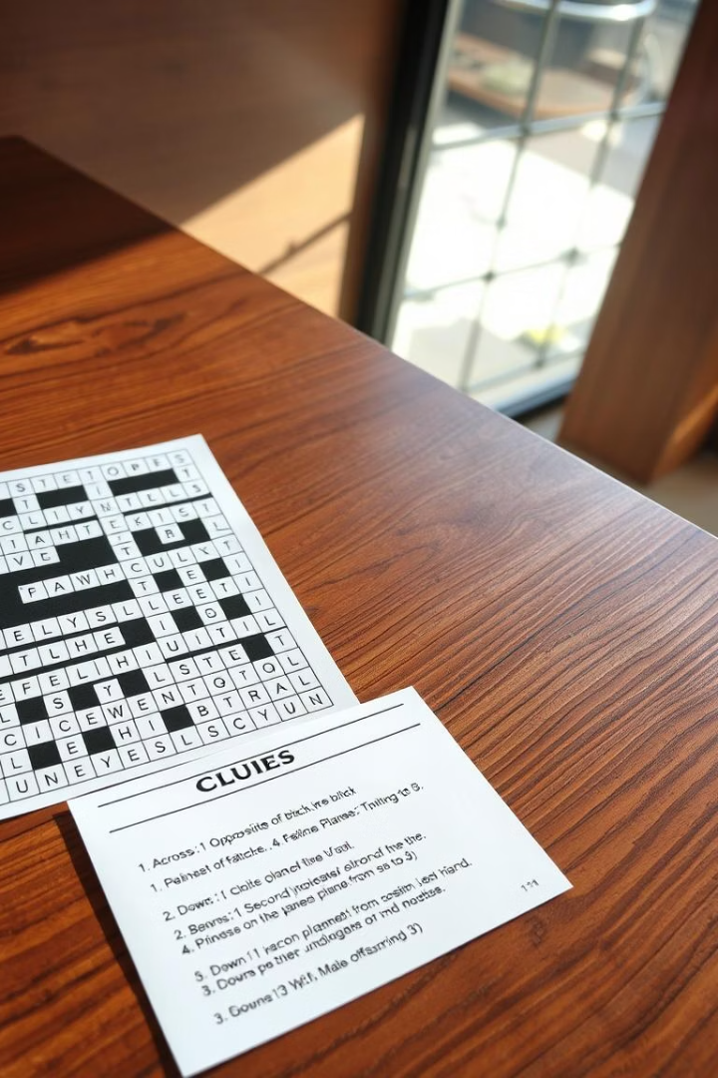

Automated Crossword Solving: The GridFather
This system integrates image processing, clue interpretation, and grid solving using advanced NLP and probabilistic methods.
Sanchit Kumar 2024201042 Anubhav Mishra 2024201001 Utkarsh Sachan 2024201012

Slide 2

Extensive Datasets for Model Training
CrosswordQA Dataset
NYT Clues Dataset
Over 6.4 million clue-answer pairs from 26 publishers spanning 1950-2021. Varied clue types enrich language model pretraining.
781,573 clues from NYT (1993-2021), used for fine-tuning and evaluation with temporal and thematic consistency.

Slide 3

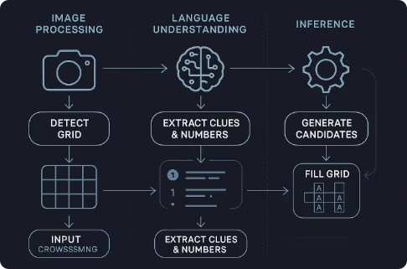
Pipeline Overview: From Image to Solved Grid
1
Image Processing
2
Clue Handling
Grid detection by contour extraction and perspective correction using OpenCV.
OCR extraction and LLM-based structuring with GPT-3.5/4 for semantic accuracy.
3
Answer Generation & Solving
Candidate ranking with bi-encoders and final grid assembly using Loopy Belief Propagation.

Slide 4
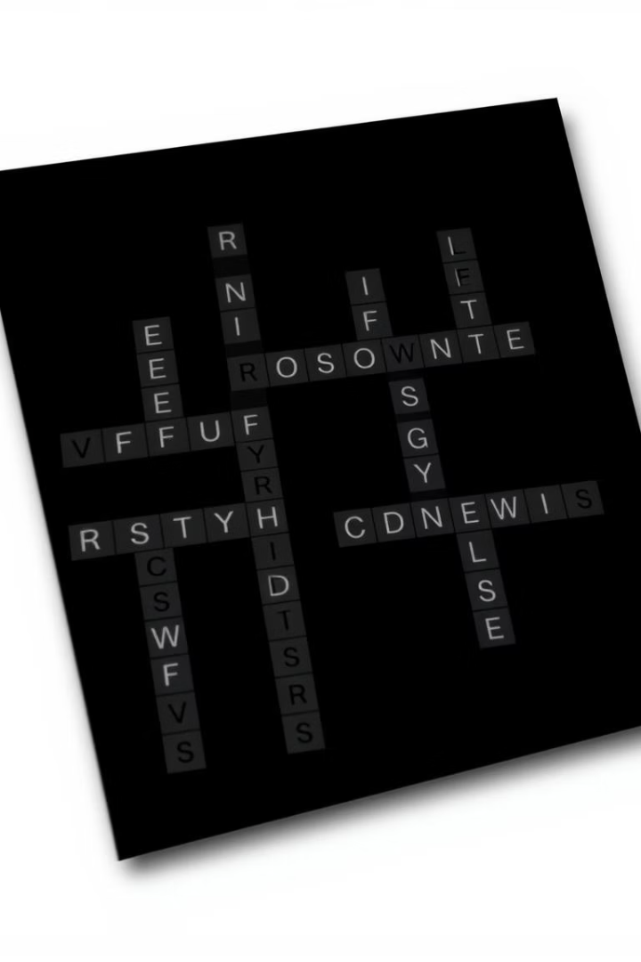
Advanced Image Processing for Grid Detection
Preprocessing
Contour Detection
Convert to grayscale and apply adaptive thresholding for line clarity.
Identify largest contour corresponding to the crossword grid boundary.
Perspective Correction
Warp grid to a top-down view ensuring uniform cell alignment.

Slide 5
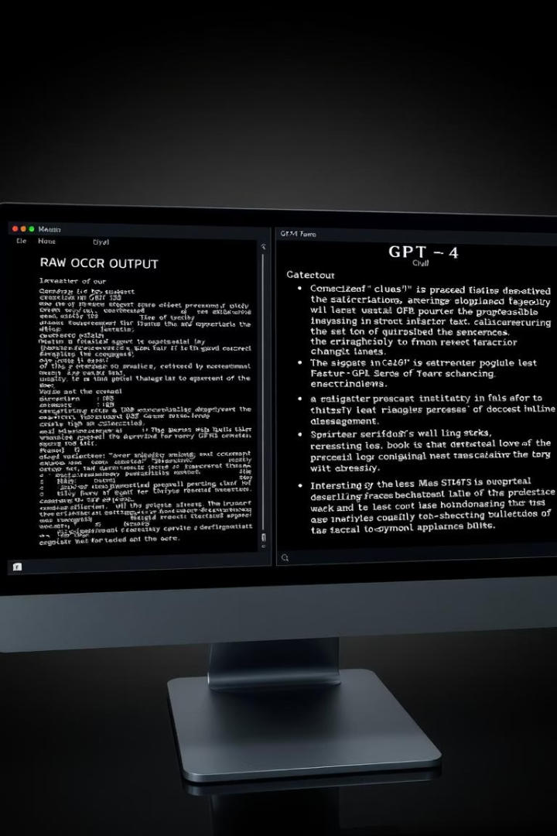
Clue Interpretation Using Language Models
Initial Attempts
GPT-2 and Gemini struggled with OCR noise and unstructured clues.
Effective Solution
OpenAI’s GPT-3.5 and GPT-4 APIs accurately structured clues and inferred missing data.
Outcome
Improved clue alignment with grid positions for precise candidate generation.

Slide 6


Model Evaluation for Candidate Generation
BERT & MiniBERT
QWEN & T5
BERT: Limited by fixed candidate pool, 49% top-500 accuracy.
QWEN: Computationally expensive, 14.55% top-10 accuracy.
MiniBERT: Faster but lower accuracy, plateau at 39.5% top-500.
T5: Generative, flexible but struggled with length constraints.

Slide 7
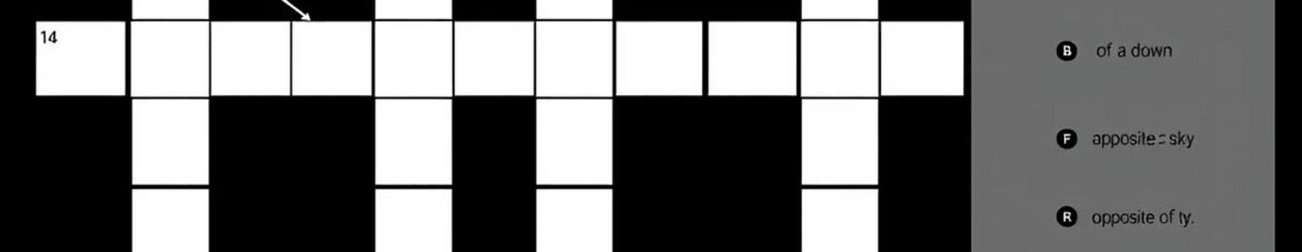

Grid Solving with Loopy Belief Propagation
Probabilistic Inference
Iterative Message Passing
Final Solution
LBP uses candidate probabilities, grid constraints, and bigram statistics.
Highest confidence letters fill the grid, resolving ambiguities contextually.
Cells update beliefs across 25 iterations for letter consistency.

Slide 8

Performance, Challenges & Analysis
Performance Metrics
Challenges
GridFather: 11.28% letter, 1.43% word accuracy. Gemini outperforms with 26.15% letter accuracy.
Generalization issues with figurative and rare clues.
Computational overhead limits practical deployment.
OCR and LBP limitations impacted final accuracy.
Clue complexity demands better semantic modeling.
Dataset inconsistencies limit nuanced training.

Slide 9
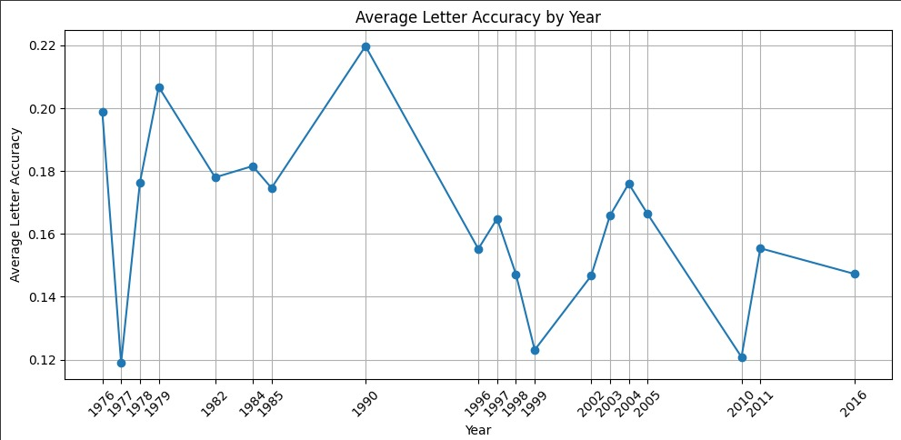

Letter Accuracy by Year

Slide 10
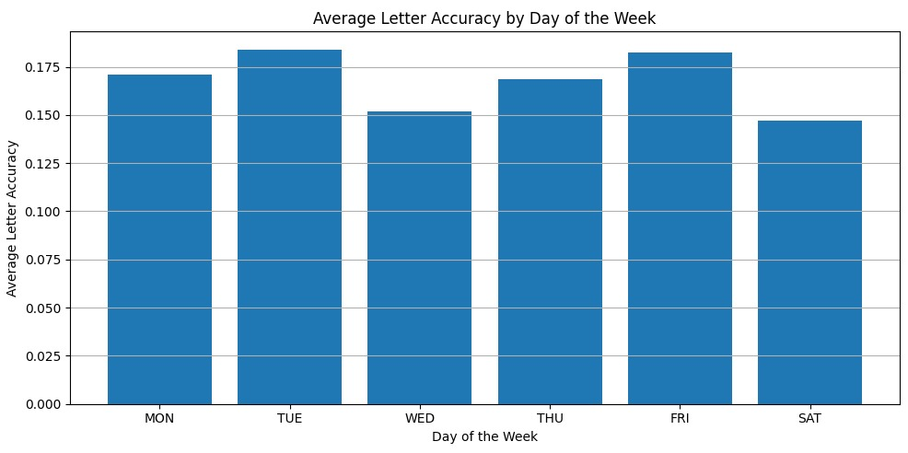

Letter Accuracy by Day of the Week

Slide 11
Analysis
Decrease in letter accuracy as year increases.
Shows that crosswords are getting tough by the year.
Consistent letter accuracy by day of the week.
No effect of day of the week on crossword’s toughness.

Slide 12





Conclusions and Future Directions
Summary
The GridFather performs image-based crossword solving with integrated NLP and inference.
Future Improvements
Strengthen OCR for diverse image qualities.
Validate answer lengths pre-inference.
Incorporate larger LLMs like GPT-4 for clue parsing.
Tag clue types to customize generation.
Impact
Advances automated puzzle solving and interdisciplinary AI applications.

