Slide 1
Mining Relationships between US Petroleum Production and Oil/ Gas Price
Sanchit Singhal
Milind Siddhanti

Slide 2
Problem Definition / Motivation
Volatile industry
Growing US dominance in global oil markets
Draw inferences between drilling performance per region and global oil and natural gas prices
Help to :
Regulate petroleum firms by government
Direct investment by corporations
Develop economic relationships between states

Slide 3
Datasets
Source: US Energy Information Administration (EIA)
Files = 4 csvs (oil prices per day, gas prices per month, DPR, DUC)
Available Features
Date/Month (Jan 07 - Jan 18)
Rig Count
Production per rig (oil/natural gas)
Total Production (oil/natural gas)
Prices (oil/natural gas)
Region
Completed and Uncompleted rig rate
Petroleum Imports
Petroleum Exports

Slide 4
Data Preprocessing
Split Datasets into Oil and Natural gas sets
Removed missing values
Merged Region information as a feature
Added Price information
Selected last day price of month as bin value
Discrete numerical values
Oil Price into 5 bins
Natural Gas into 4 bins

Slide 5
Data Exploration of Price Fluctuations

Slide 6
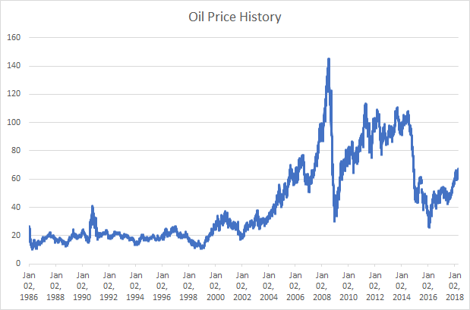

Slide 7
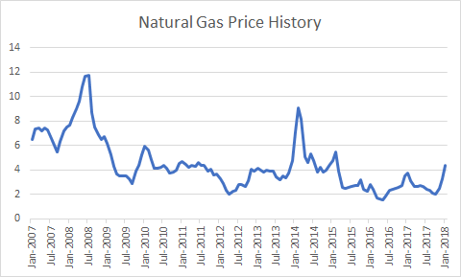

Slide 8
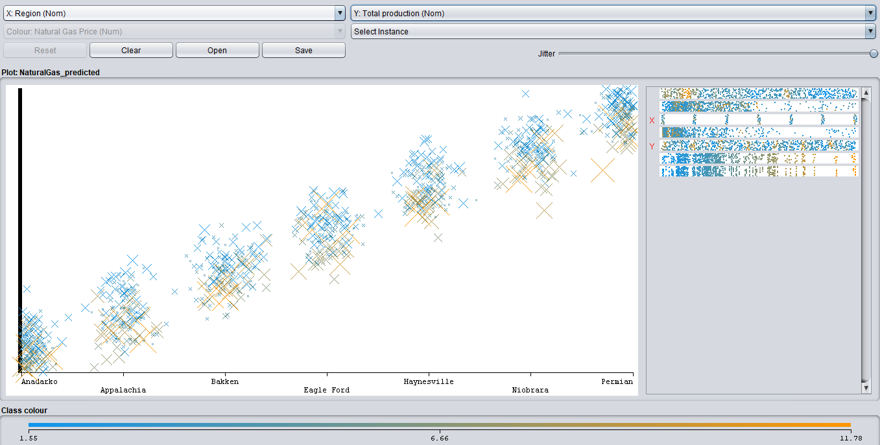

Slide 9
Data Modeling to Understand
Natural Gas Production in the US

Slide 10
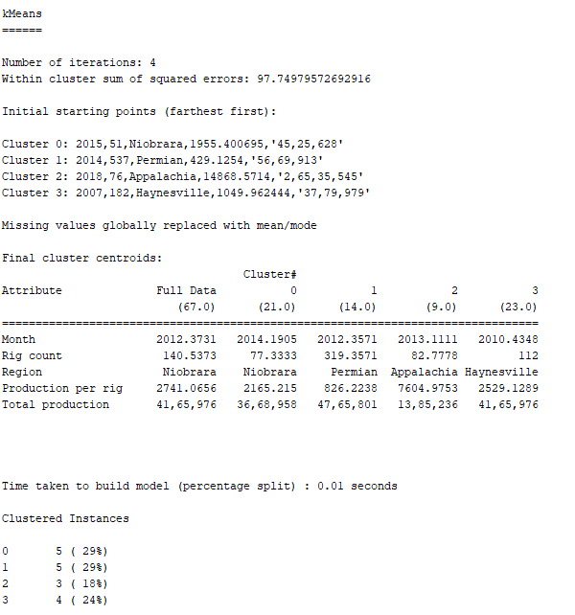
Simple K Means on Natural Gas
Features: Month, Rig count, Production per rig, Total production, Region
Model: Simple K Means(Clustering)
Properties: Euclidean distance
Max iterations = 200
No of clusters = 4
Initialization method = Farthest first
Percentage split = 80

Slide 11
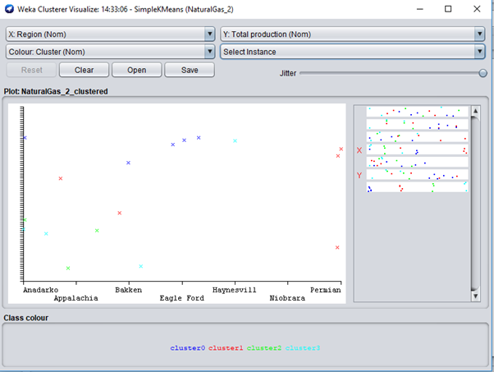
Evaluation of Model
Classifier Visualization

Slide 12
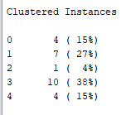
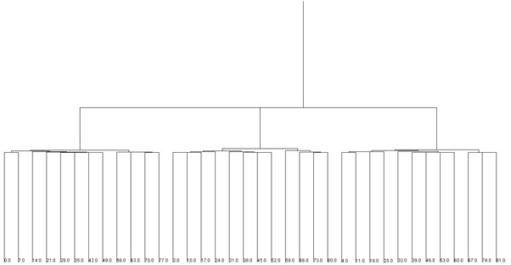
Hierarchical Clustering on Natural Gas
Features: Month, Rig count, Production per rig, Total production, Region
Model: Hierarchical (Clustering)
Properties:
Euclidean Distance
No of clusters = 5

Slide 13
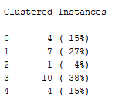
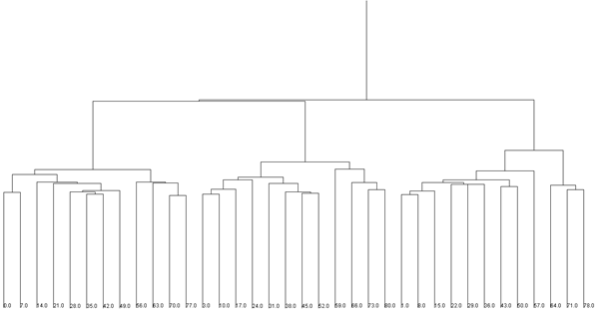
Hierarchical Clustering on Natural Gas
Features: Month, Rig count, Production per rig, Total production, Region
Model: Hierarchical (Clustering)
Properties:
Manhattan Distance
No of clusters = 5

Slide 14
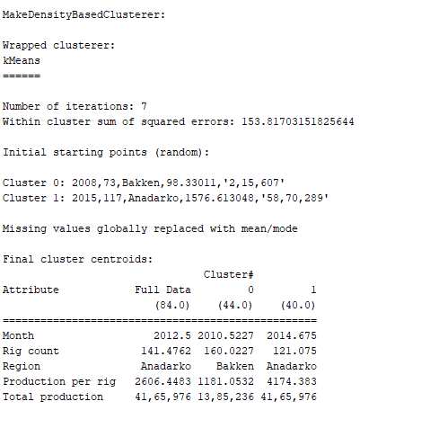
Density-Based Clusters on Natural Gas
Features: Month, Rig count, Production per rig, Total productio, Region
Model: Density Based (Clustering)
Properties
No of clusters = 2
Percentage split = 70

Slide 15
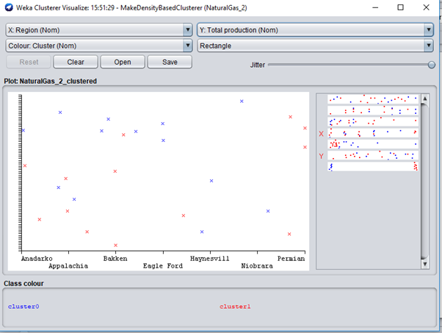
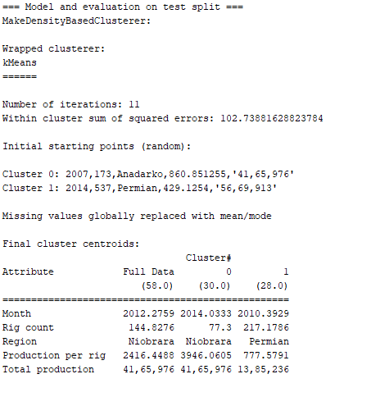
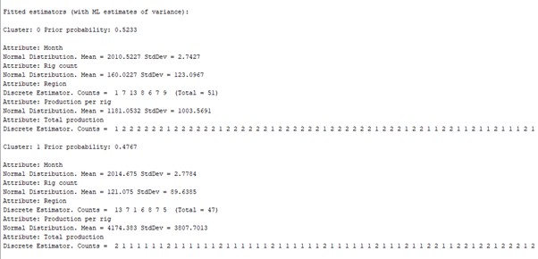
Evaluation of Model

Slide 16
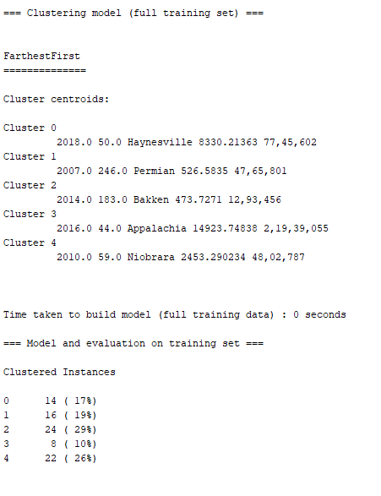
Farthest First Clusters on Natural Gas
Features: Month, Rig count, Production per rig, Total production, Region
Model: Density Based (Clustering)
Properties
No of clusters = 5
Percentage split = 70

Slide 17
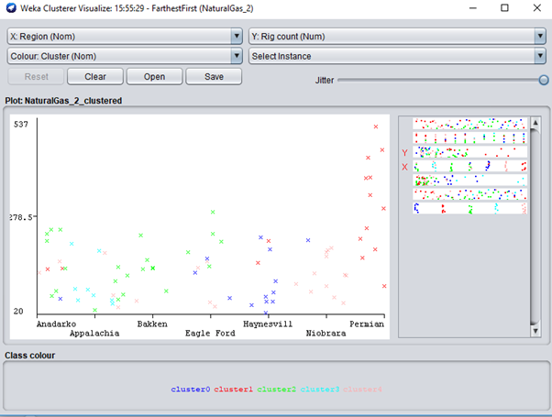
Evaluation of Model
Classifier Visualization

Slide 18
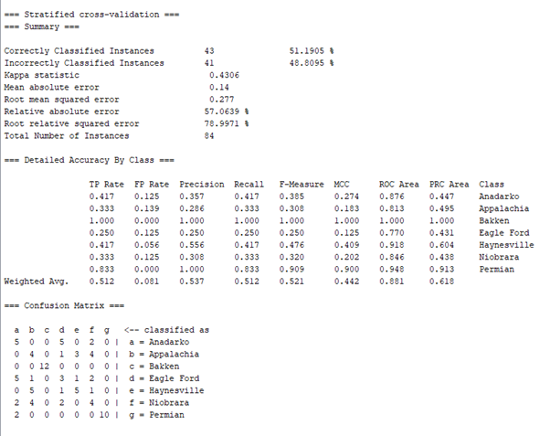
Logistic Regression on Natural Gas
Features: Month, Rig count, Production per rig, Total production
Response: Region
Model: Logistic Regression (Classification)
10-fold cross-validation

Slide 19
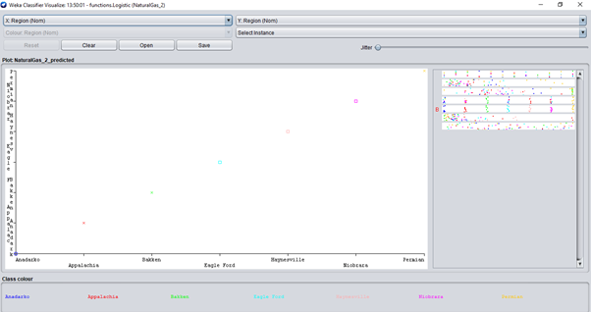
Evaluation of Model
Classifier Visualization

Slide 20
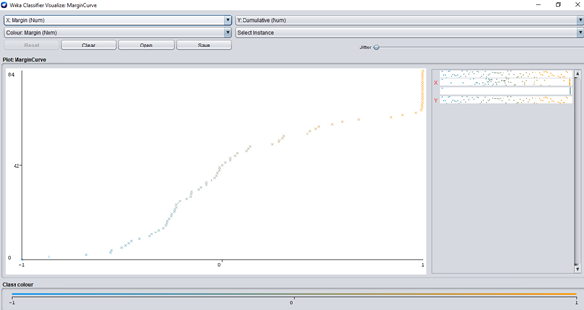
Evaluation of Model
Margin Curve

Slide 21
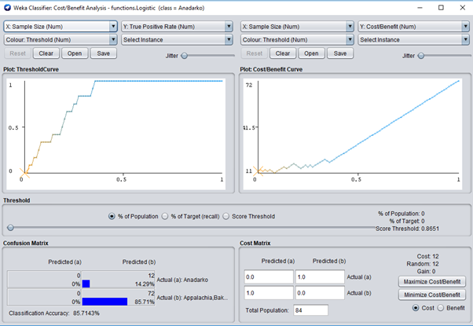
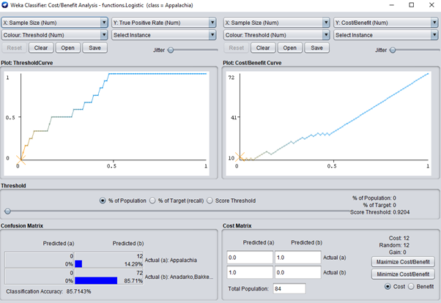
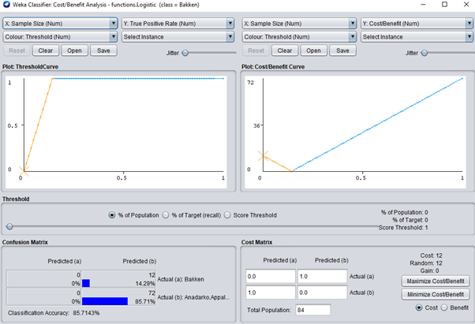
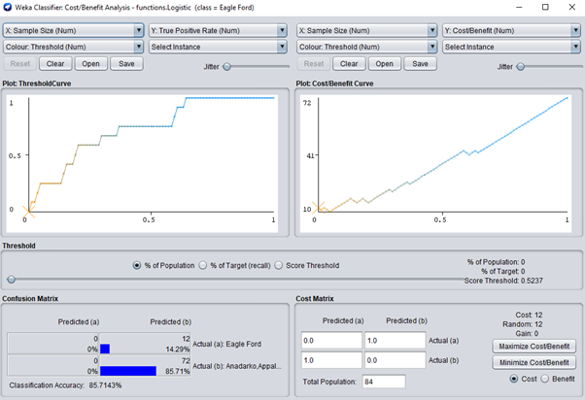
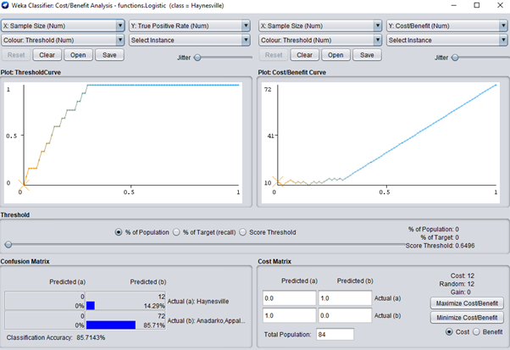

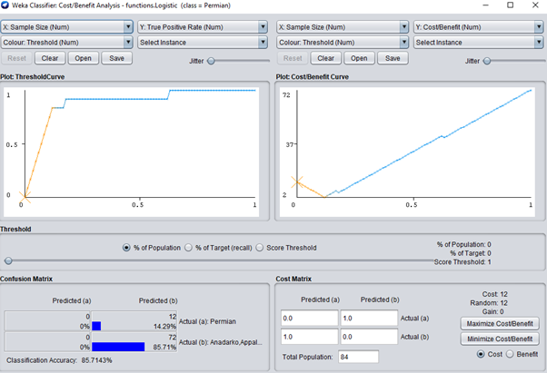
Region-wise Threshold Curve and Cost-Benefit Analysis
Anadarko
Appalachia
Bakken
Eagle Ford
Haynesville
Niobrara
Permian

Slide 22
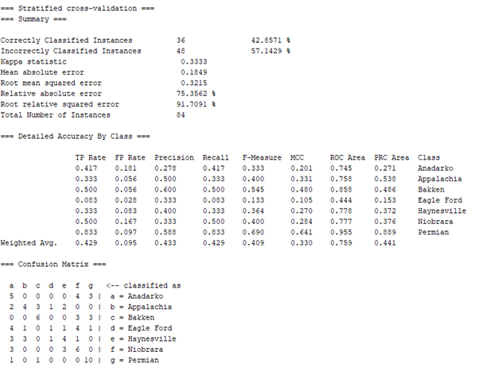
Naïve Bayes on Natural Gas
Features: Month, Rig count, Production per rig, Total production
Response: Region
Model: Naive Bayes(Classification)
10-fold cross-validation

Slide 23
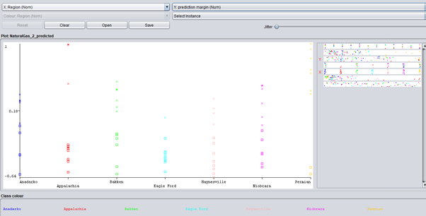
Evaluation of Model
Classifier Visualization

Slide 24
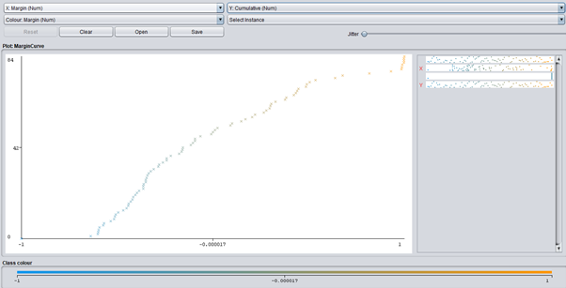
Evaluation of Model
Margin Curve

Slide 25
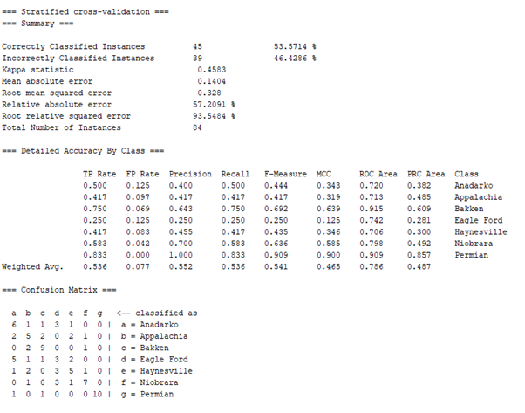
Decision Tree on Natural Gas
Features: Month, Rig count, Production per rig, Total production
Response: Region
Model: Decision Tree (Classification)
Filter: J48
Properties:
confidenceFactor = 0.25
numFolds = 3
unpruned = false

Slide 26
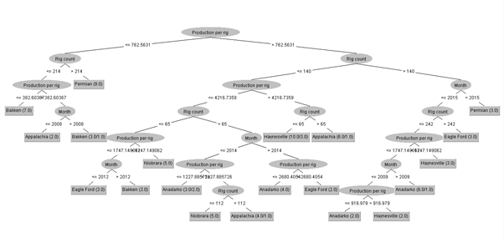

Slide 27
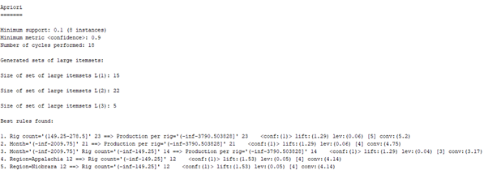
Apriori Rule Association on Natural Gas
Features: Month, Rig count, Production per rig, Total production, Region
Model: Density Based (Clustering)
Properties
No of Rules = 5
Min Metric = 0.9

Slide 28
Modeling Relationship between Natural Gas Prices and US Petroleum Production

Slide 29
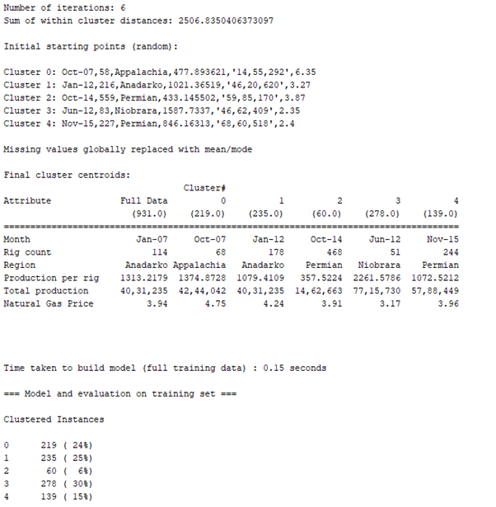
Simple K Means on Natural Gas vs. Price
Features: Month, Rig count, Production per rig, Total production, Region, Natural Gas Price
Model: Simple K Means(Clustering)
Properties: Manhattan distance
Max iterations = 200
No of clusters = 5

Slide 30
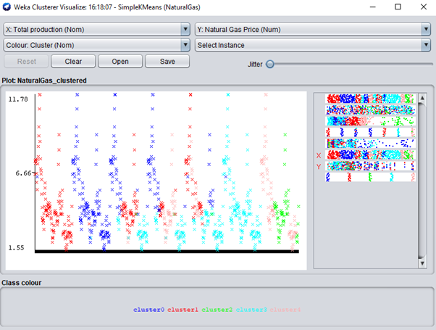
Evaluation of Model
Classifier Visualization

Slide 31
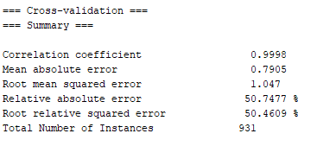
Linear Regression on Natural Gas vs. Price
Features: Month, Rig count, Production per rig, Total production, Region
Response: Natural Gas Price
Model: Linear Regression(Classification)
Properties: Selection Process = M5 method

Slide 32
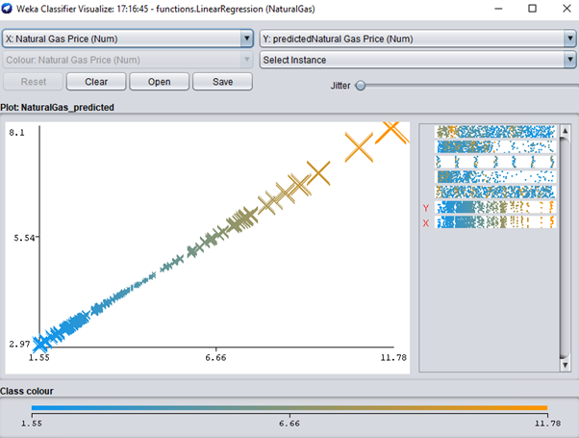
Evaluation of Model
Classifier Visualization

Slide 33
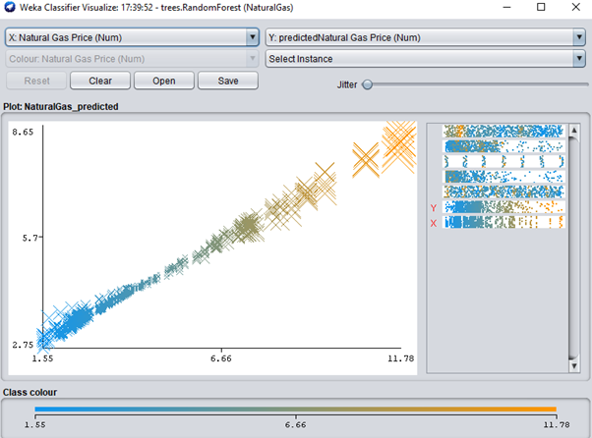
Random Forest on Natural Gas vs. Price
Features: Month, Rig count, Production per rig, Total production, Region
Response: Natural Gas Price
Model: Random Forest (Classification)
Properties: Attribute importance is true
Batch and bagging size = 100

Slide 34
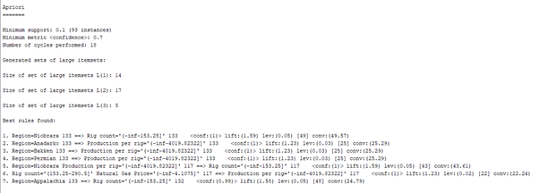
Apriori Rule Association on Natural Gas vs. Price
Features: Month, Rig count, Production per rig, Total production, Region, Natural Gas Price
Model: Apriori(Association)
Properties: No of Rules = 7
Metric Type = confidence
Min metric = 0.7

Slide 35
Modeling Relationship between Oil Prices and US Petroleum Production

Slide 36
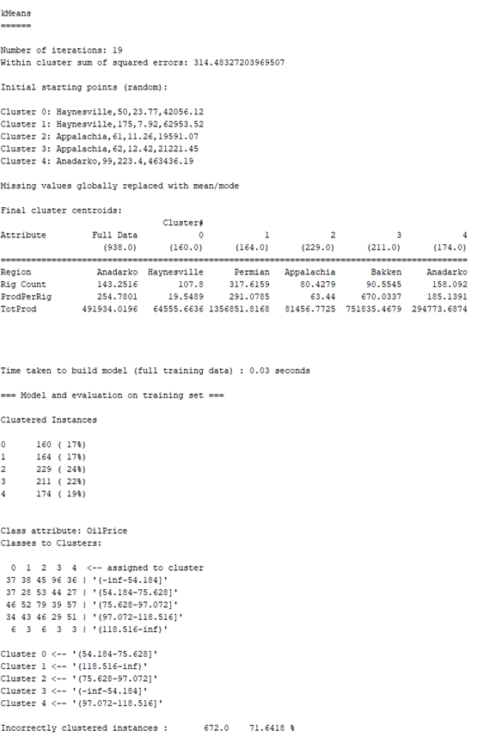
Simple K Means on Oil vs. Price
Features: Month, Rig count, Production per rig, Total production, Region, Oil Price
Model: Simple K Means(Clustering)
Properties: Manhattan distance
Max iterations = 200
No of clusters = 5

Slide 37
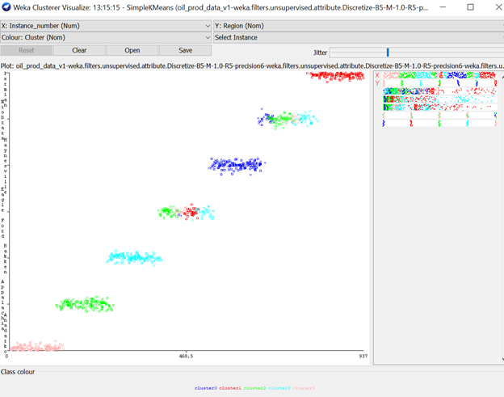
Evaluation of Model
Classifier Visualization

Slide 38
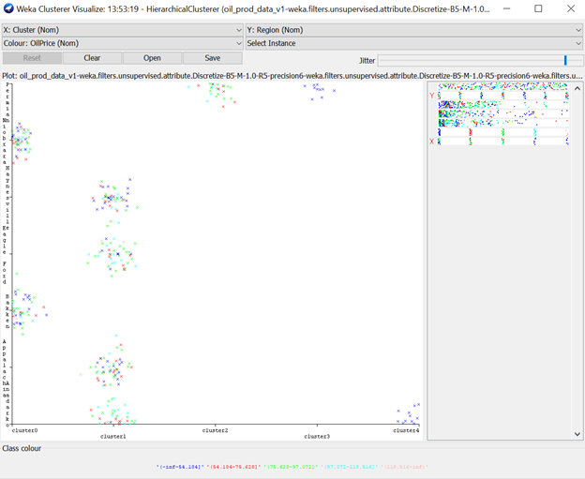
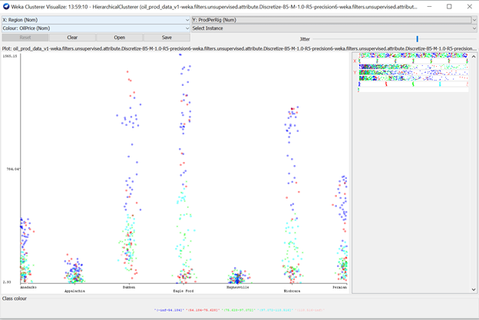
Hierarchical Clustering on Oil vs Price

Slide 39
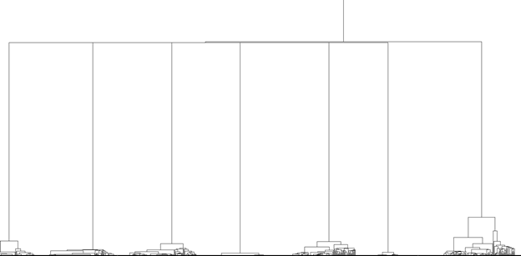
Hierarchical Clustering on Oil vs Price

Slide 40
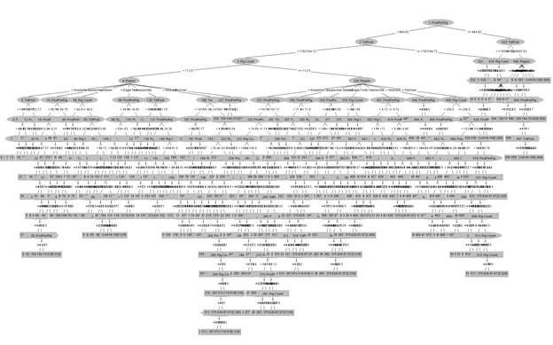
Decision Tree on Oil vs Price
Un-pruned tree

Slide 41
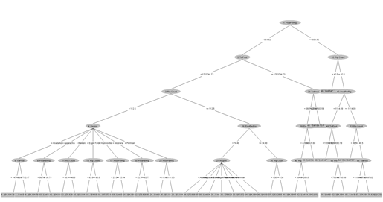
Decision Tree on Oil vs Price
Pruned tree (max depth=5)

Slide 42
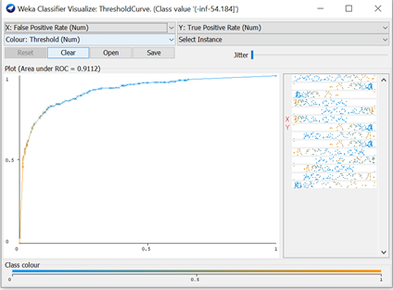
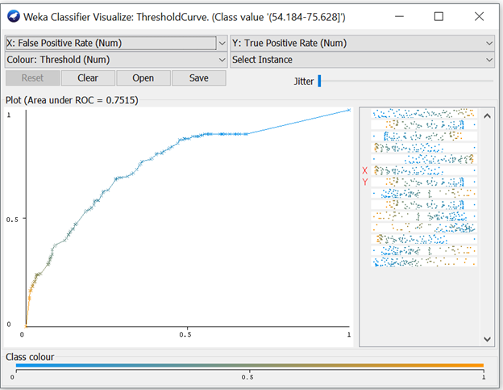
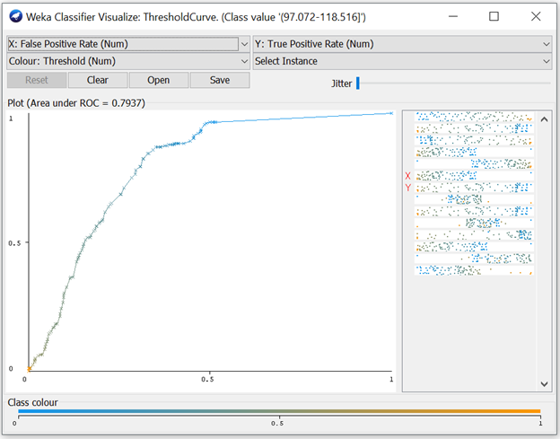
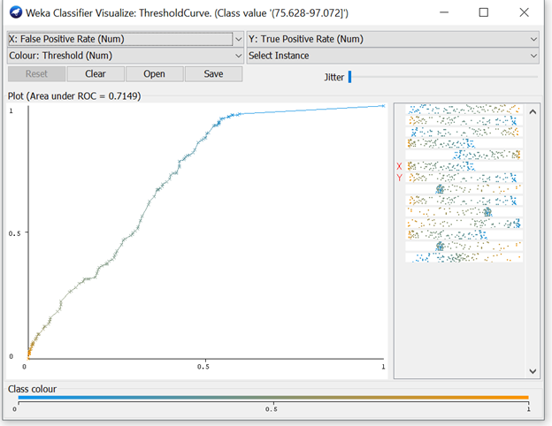
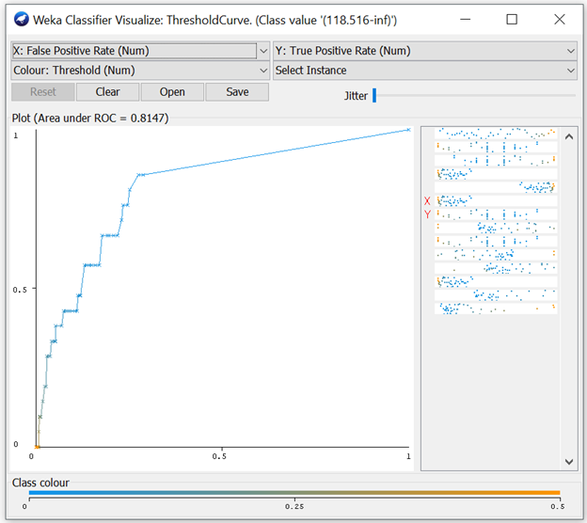
Evaluation of Model

Slide 43
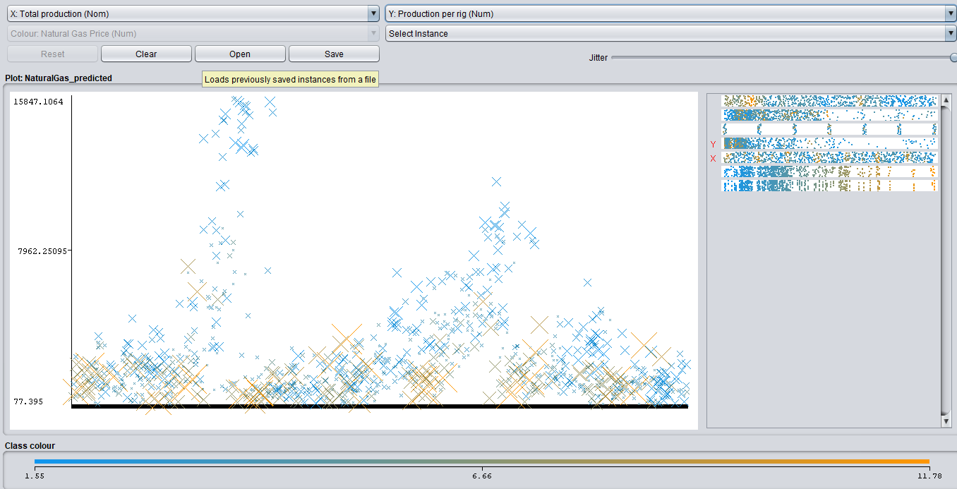
Results

Slide 44
Key Findings
Rig counts are highly correlated with region
Obvious, but data talks!
Rig counts + Natural Gas Price is a good predictor of production per rig
Although not our objective, interesting association
Low Oil Prices = easier to classifying (model performance)
Potentially because of number of data points
Regions are so different : Should analyse individually
Production per rig is the best predictor of oil price
Model building takeaway: pruning is extremely helpful!
Model building takeaway: limiting features can drive more insights

Slide 45
Further Research Topics
Impact of Oil Quality on Production
Global Natural Gas Production vs Prices
Petroleum Production vs Energy Consumption

Slide 46
Q & A

