Slide 1
Impact of image content in crowdfunding projects success
GoFundMe
Gaurav Lalwani
Sonakshi Garg
Shweta Mane
Milind Siddhanti
Sanchit Singhal
Pedro Seguel

Slide 2
Why it matters?
The presence of images is known to affect positively fundraising in crowdfunding projects.
“Adding compelling fundraising images to your fundraiser page is one of the best ways to become a crowdfunding success story; fundraisers with at least five photos raise more than those with one. Photos can tell your story, spark compassion, and inspire action. (GoFundMe)”
But, what about image content?
What is the impact of image content on the success projects?

Slide 3
Goals
Goal: Prototype system that optimizes image to the success (money raised) of crowdsourcing campaigns on GoFundMe.
Use an automated strategy to analyze content and process in scale that facilitate more successful campaigns for users on the site
Analyze impact of image content on domain specific projects (i.e. Business or Charity)
What type of images are related to highest levels of success in projects?

Slide 4
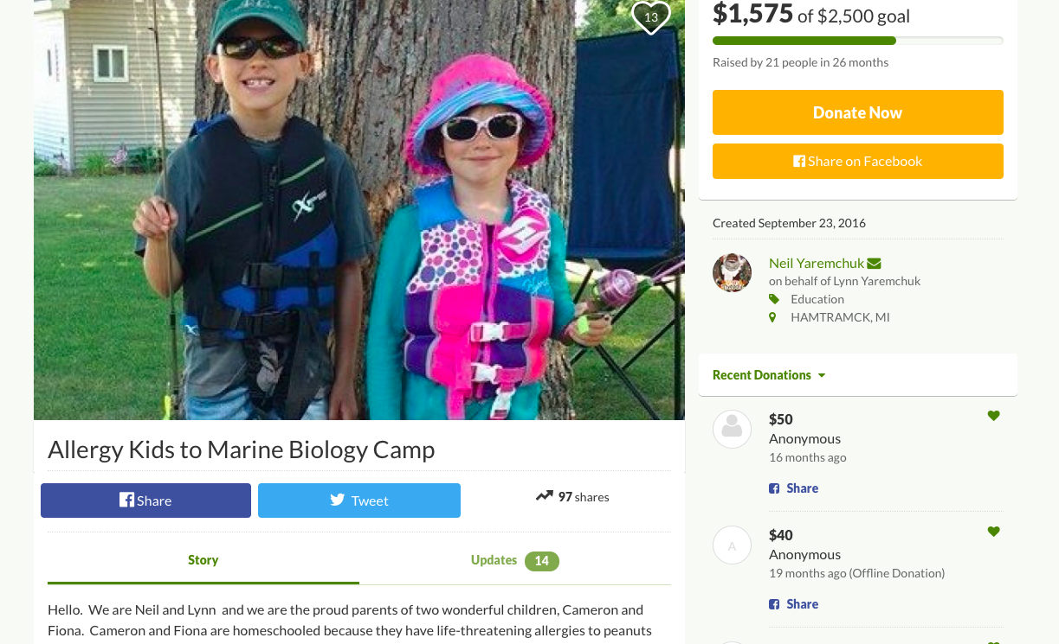
Methods
GoFundMe project site
Business projects: 928
Charity projects: 999
Display Image
Project metadata
Money (Raised and Goal)
Date of creation
Shares
Updates

Slide 5
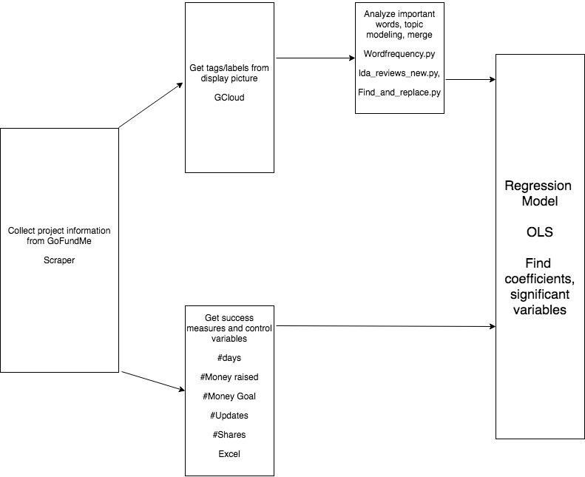
Workflow
Get tags from display picture
GCloud
Analyze important words, topic modeling, merge
Wordfrequency.py
lda_reviews_new.py,
Find_and_replace.py
Get success measures and control variables
#days
#Money raised
#Money Goal
#Updates
#Shares
Excel
Notes:
Collection:
We selected project quieried by “Charity”.
Percentage of raised and goal achieved
How fast was the money raised
2) GCloud
We used Google Vision to get image tags from image URL scraped from each project website. We just focused on the Display image.
3) Excel
Goal: Get only the number from the text
Remove “of” and the “coin sign” before the number
Remove “goal” after the number
b) Raised: Get only he number form the text
c)

Slide 6
Results: OLS regression
 | Business | Charity | Business | Charity
goal | 2167 *** | 2355.86 *** | 1867 *** | 2440.72 ***
days | 0.81 | 5.14 | -0.89 | 2.2
shares | 10.7 *** | -3.69 | 9.6 *** | -4.53
human aspect (topic score) |  |  | 385.5 | -636.42
People (presence) | -551.2 | -565.844
Notes:
We are looking at one topic from topic modelling (human aspect). Narrowed it from multiple topics
People_1 (computer vision label, to see presence of people in labels) - check values for both charity and business
Human aspect model - check values for both charity and business

Slide 7
Insights/recommendations
To GoFundMe
The simple suggestion of changing the content of a image can have an impact in campaign success.
This consider difference in domain specific projects.
Replicate this analysis with images inside of the project description.
The whole process can be automated on scale to benefit the platform ecosystem:
+ projects getting money leading to more successful campaigns for users
+ higher engagement on the site leading to a more active community
Notes:
We analyzed the content of the images to understand the impact of presence of certain features ( eg: people, ambience, etc) on the amount of money raised. However from our findings we can conclude that the dominating factors driving the money raised for charity and business domain projects are the Goal of the project and number of shares i.e how popular is the project on the platform.
Recommendations:
Have an active community engaging with the projects
Marketing efforts to reach a larger audience

