Slide 1

Final-Hackathon Spam Filter
Joy Wyckoff
Sanchit Singhal
Sonakshi Garg

Slide 2

THE PROBLEM
Spam Data contains:
Spam Train : 350
Non-Spam Train: 350
Spam Test : 130
Non-Spam Test: 130
Create a spam filter and assess its classification performance

Slide 3
SOLUTION/APPROACH TO THE PROBLEM
Used a supervised learning algorithm since we had an output variable ‘Y’
Used TFIDF and Count Vectorizer to create features
Created Classifiers - multinomial Naïve Bayes and Support Vector Machine

Slide 4

RESULTS/OUTPUTS

Slide 5
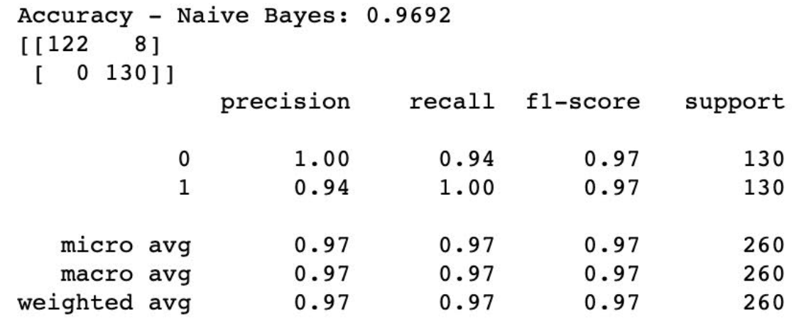
Classification Model 1 : Naïve Bayes

Slide 6
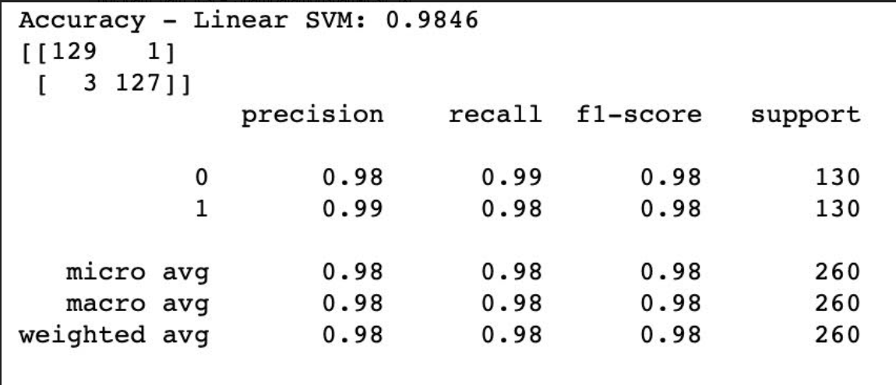
Classification Model 2 : Linear SVM

Slide 7
THANK YOU

