Slide 1

Submitted By:
Team PySpyder
Captain: Abdul Mugeesh
Mentor: Dr. Akash Punhani
Team members:
Akshat Singhal
Harish Tiwari
Himanshu Tyagi
Sanchit Singhal

Slide 2
Problem Scenario :
Our client, ElectricCo, is a major utility company providing gas and electricity to corporate, SME and residential customers. In recent years, post-liberalization of the energy market in Europe, ElectricCo has had a growing problem with increasing customer defections above industry average. They would like to identify the drivers of this problem and to devise and implement a strategy to counter it. The churn issue is most acute in the SME division and thus they want it to be the first priority. The head of the SME division has asked whether it is possible to predict the customers which are most likely to churn so that they can trial a range of pre-emptive actions.
Todo task :
The client also would like to answer the following questions:
What are the most explicative variables indicating churn?
Is there a correlation between subscribed power and consumption?
Is there a link between sales channel and churn?
Build a machine learning model that can predict the customers with high probability of churn.

Slide 3
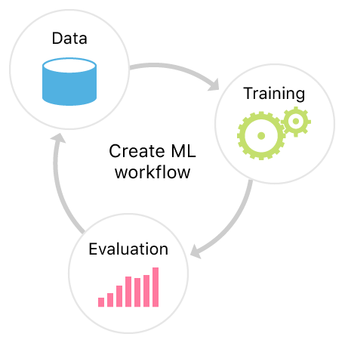
Start
Data Pre-processing
Lasso Regression
To find weightage of each variable in churn prediction
Model Training
With explicative variables
WORK FLOW
Churn Prediction
Churn Probability
Cross Validation of Model
End

Slide 4
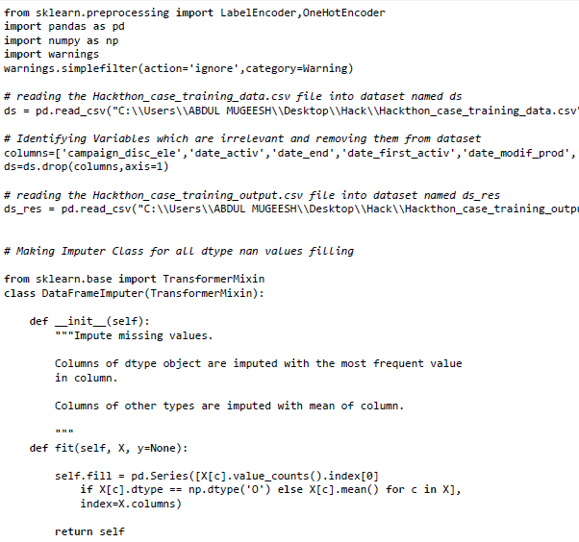
Data Pre-processing :

Slide 5
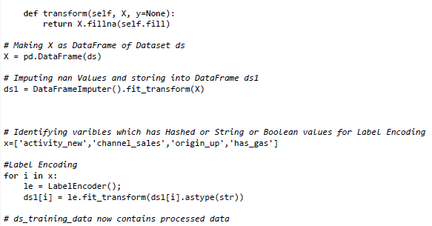
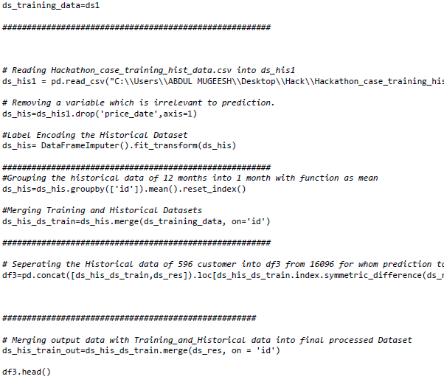
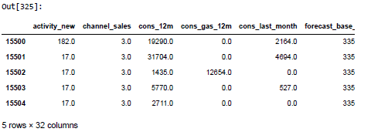
df3.head()

Slide 6
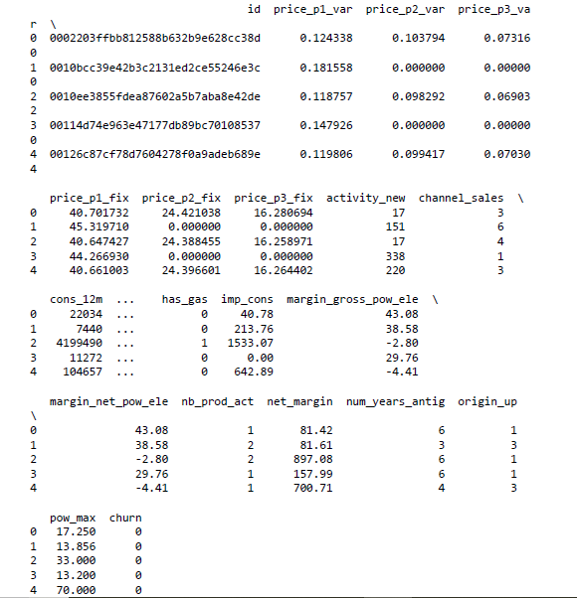
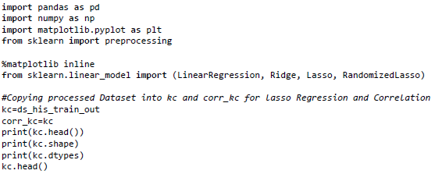

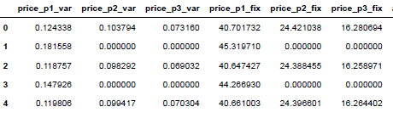
Lasso Regression:
To find weightage of each variable in churn prediction
kc.head()

Slide 7

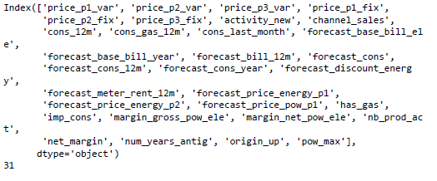

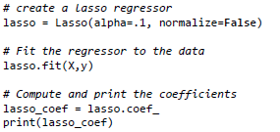
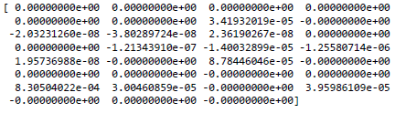
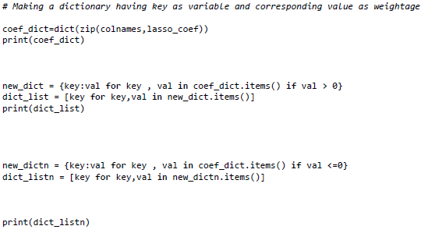
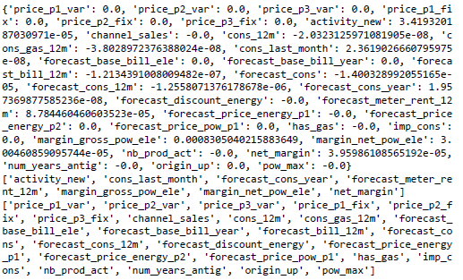
most explicative variables

Slide 8



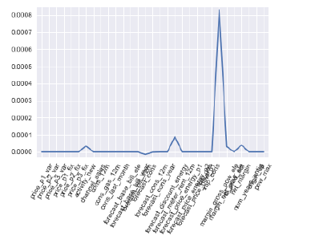

Slide 9
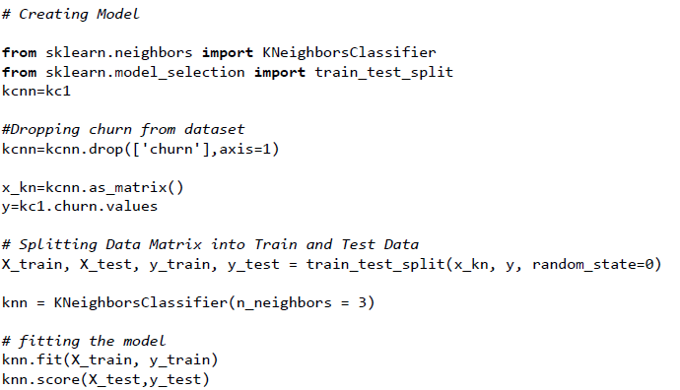

Model Training:
score

Slide 10
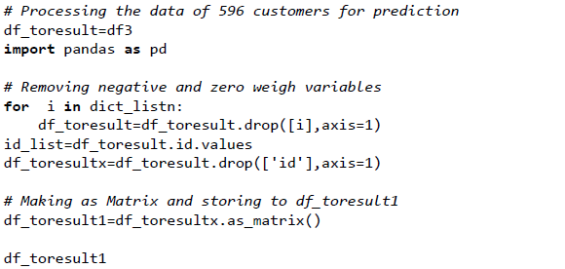
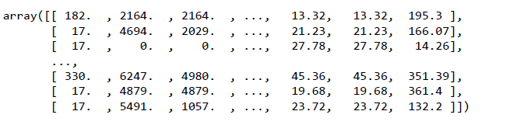
Churn Prediction :

Slide 11

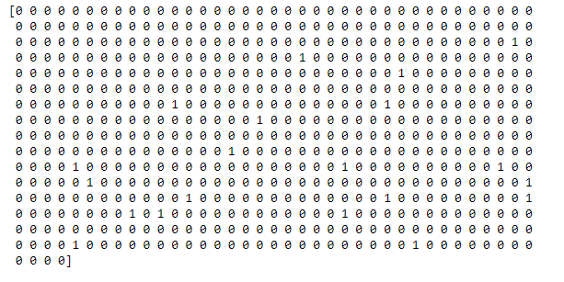
Finding the churn values for 596 customers

Slide 12
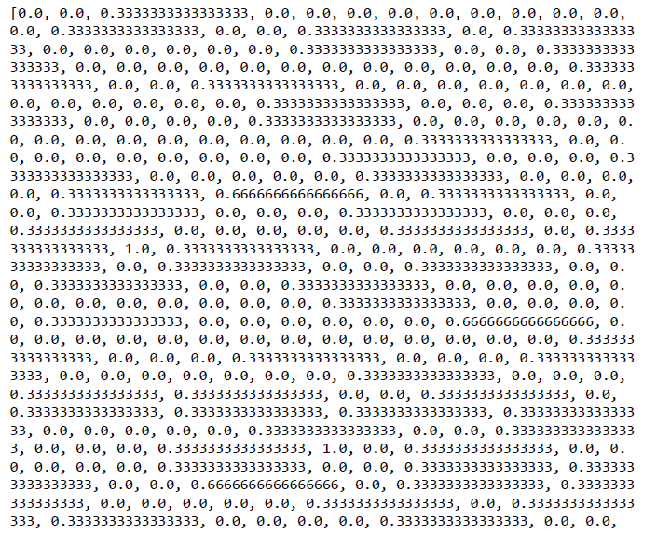
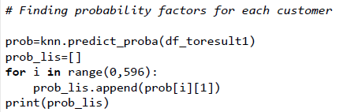
Churn Probability factor :

Slide 13
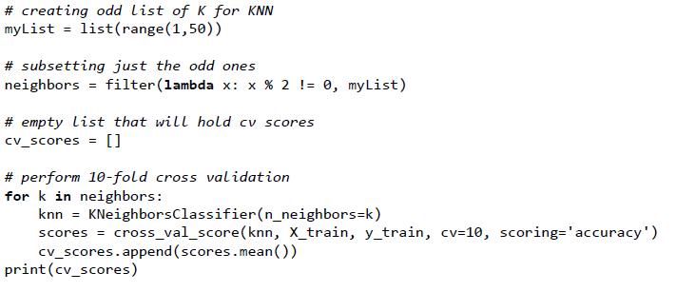
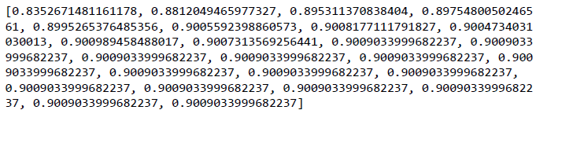
Cross Validation of Model :
Apply the cross validation for the accuracy of the model

Slide 14
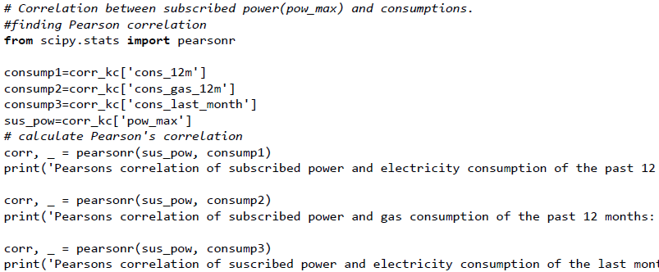
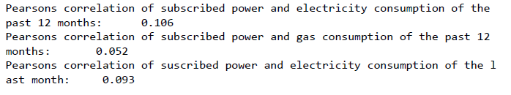
Correlation between subscribed power and consumptions :
Correlation

Slide 15
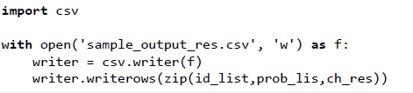
Output: PySpyder_sample_output.csv

Slide 16
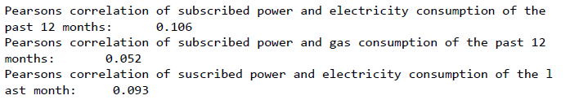
Task Solutions:
What are the most explicative variables indicating churn?
Solution:
After applying the Lasso Regression these are the most explicative variables indicating churn.
2. Is there a correlation between subscribed power and consumption?
Solution:
After applying Pearson correlation these are the outputs shows correlation between subscribe power and consumptions.

Slide 17
3. Is there a link between sales channel and churn?
Solution:
After applying the Lasso Regression we find that the sales channel didn’t indicating the churn. Therefore, there is no link between the sales channel and churn.
4. Build a machine learning model that can predict the customers with high probability of churn.
Solution:
You can have look over the Model we had submitted in (.ipynb file) which can help predicting the customers with high probability of churn.

Slide 18
Thank you so much..
From : Team PySpyder

