Slide 1
Playing Atari with Deep reinforcement learning
Volodymyr Mnih, Koray Kavukcuoglu, David Silver, Alex Graves, Ioannis Antonoglou, Daan Wierstra, Martin Riedmiller
Sanchit Tanwar
UID. 119167717
Under the guidance of Dr. Waseem Malik

Slide 2
Paper’s Idea
The paper adds the idea of deep neural networks with traditional reinforcement learning algorithm of Q-learning.
Q-learning’s performance on high dimensional data like visual world depends on the feature extraction techniques and using convolutional neural network can help in improving the performance out of the box.
Deep Q learning algorithm was introduced in the paper which uses convolutional neural network with learnable action value function.
The model was trained on atari games with experience replay.
Reached a performance better than human level on 3 atari games and state of the art in comparison to other algorithms on 3 atari games.

Slide 3
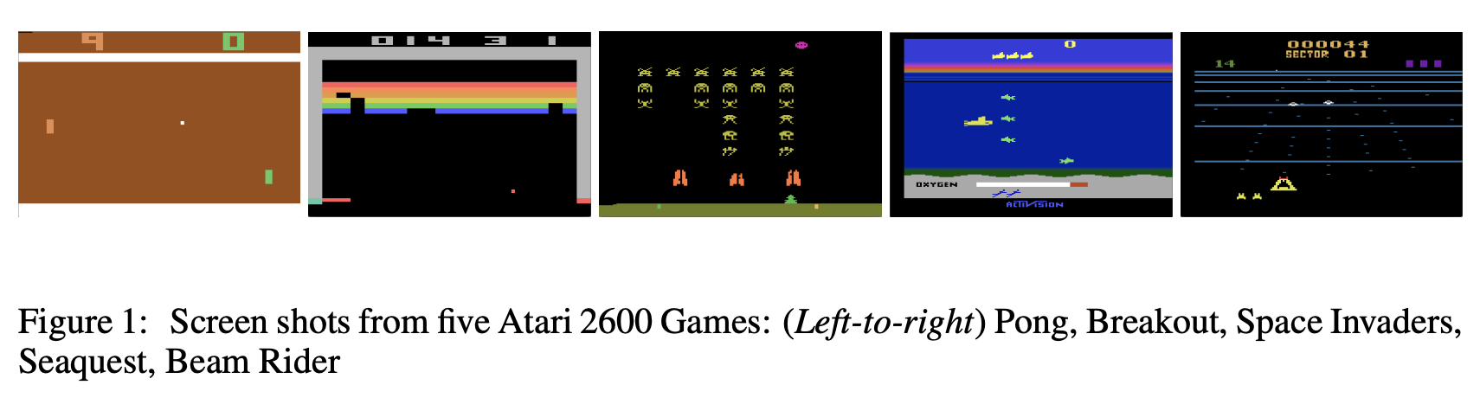
Atari Games Used in paper

Slide 4
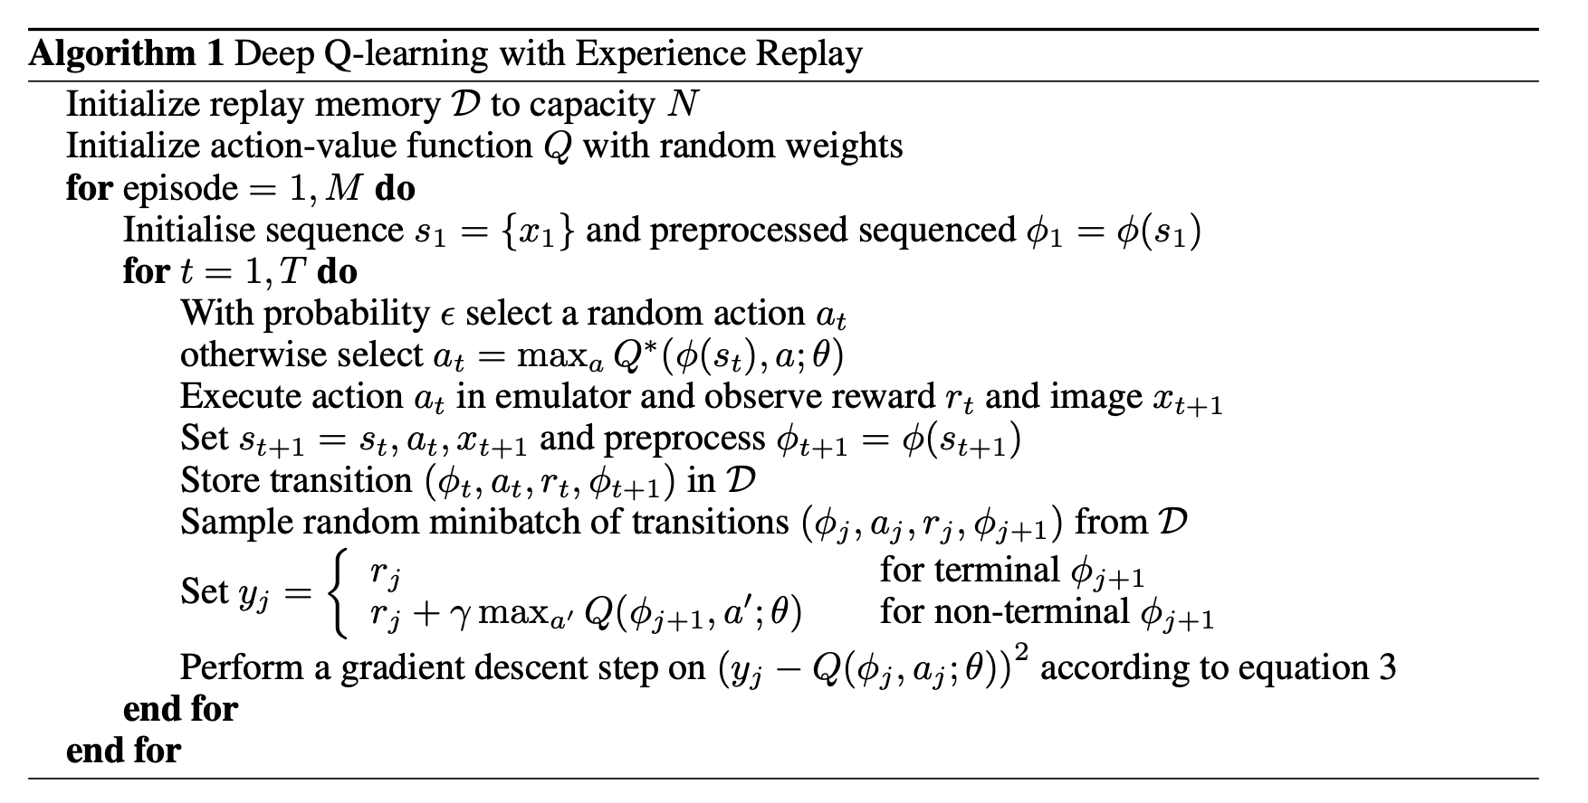
Deep Q-learning algorithm

Slide 5
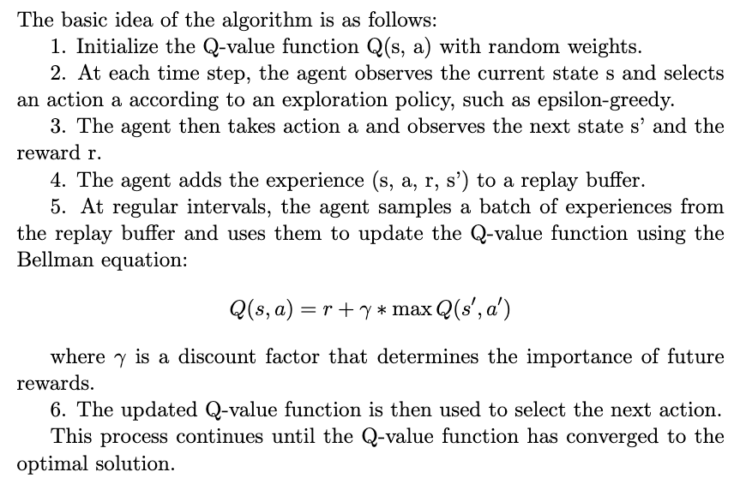

Slide 6
Conclusion
This same algorithm can be extended to a lot of real world applications, some of the examples include controller for red lights with cameras to optimize traffic flow, controller for air conditioner in office spaces with temperature sensor to optimize the cost saving while still maintaining the optimal temperature.
The reinforcement learning algorithms are already used for training large language models to give a sense of human in the loop learning. Deepmind created reinforcement learning agent which beats the best human player in some of the most complex games, and also applied them to real world problems like solving complicated mathematical problems and coding problems.

Slide 7
Links
Original Paper
GitHub repository
Link to simulation video

Slide 8
Thank you

