Slide 1
Lead Scoring Case Study
Submitted by :
Sandeep Santhosh
Sangeetha Manoharan
Sanchita Deb

Slide 2
Problem statement
Background: X Education, an online educational platform, actively markets its courses to industry professionals across various digital platforms, including search engines and websites.
Challenge: Despite generating a significant volume of leads daily through website interactions and referrals, the company's lead conversion rate remains low at approximately 30%. This means that for every 100 leads generated, only about 30 convert into paying customers.
Current Inefficiencies: The sales team expends substantial effort on leads with low conversion potential, which dilutes their focus and reduces overall efficiency.
Opportunity: There is a critical need to optimize the lead management process by identifying the most promising leads, referred to as 'Hot Leads'. By targeting these leads, X Education aims to increase its conversion rate, allowing the sales team to concentrate their efforts on those most likely to enroll.
Strategic Goal: Enhance the lead conversion process to boost the conversion rate to the target of 80%, thereby maximizing resource utilization and increasing return on investment.

Slide 3
Business Objective
Primary Objective: Develop a predictive model to assign a lead score ranging from 0 to 100 to each lead, based on their likelihood to convert into paying customers. The aim is to enhance the lead conversion rate significantly.
Target Lead Conversion Rate: Achieve a lead conversion rate of 80%, a substantial increase from the current rate of 30%, as specified by the CEO.
Hot Leads Identification: The model should enable X Education to identify 'Hot Leads'—those most likely to convert, allowing the sales team to focus their efforts more effectively and efficiently.
Adaptability for Future Needs: The model must be versatile enough to adapt to future changes in business strategies or market conditions. It should accommodate various scenarios, such as peak times, optimal manpower utilization, and strategic shifts after achieving initial conversion targets.
Long-Term Business Impact: By focusing on the most promising leads, the company expects not only to increase direct sales efficiency but also to optimize overall marketing and operational strategies, thereby maximizing ROI and sustaining business growth.

Slide 4
Problem approach
Source the data for analysis
Clean and prepare the data
Exploratory Data Analysis
Feature Scaling
Splitting the data into Test and Train dataset
Building a logistic Regression model and calculate Lead Score
Evaluating the model by using different metrics - Specificity and Sensitivity or Precision and Recall
Applying the best model in Test data based on the Sensitivity and Specificity Metrics

Slide 5
Methodology
Data Sourcing , Cleaning and Preparation
Read the Data from Source
Convert data into clean format suitable for analysis
Remove duplicate data
Outlier Treatment
Exploratory Data Analysis
Feature Standardization
Feature Scaling and Splitting Train and Test Sets
Feature Scaling of Numeric
data
Splitting data into train and test set
Model Building
Feature Selection using RFE
Determine the optimal model
using Logistic Regression
Calculate various metrics like accuracy, sensitivity, specificity, precision and recall and evaluate the model
Result
Determine the lead score and check if target final predictions amounts to 80% conversion rate
Evaluate the final prediction on the test set using cut off threshold from sensitivity and specificity metrics

Slide 6
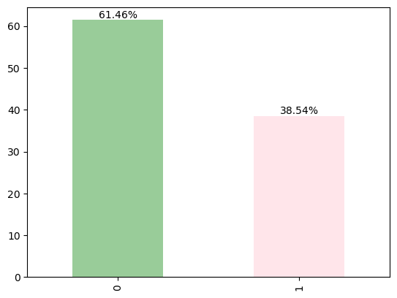
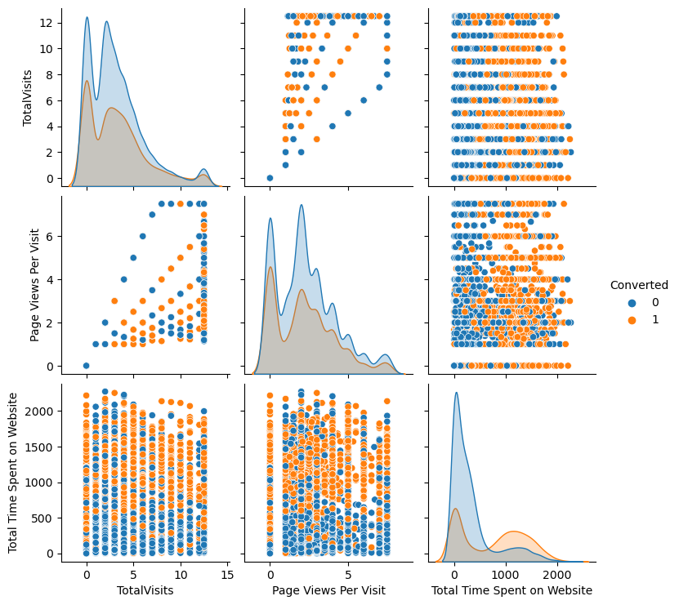
Exploratory Data Analysis
Conversion rate is 38.5% in total
The conversion rates were high for Total Visits, Total Time Spent on Website and Page Views Per Visit
.

Slide 7
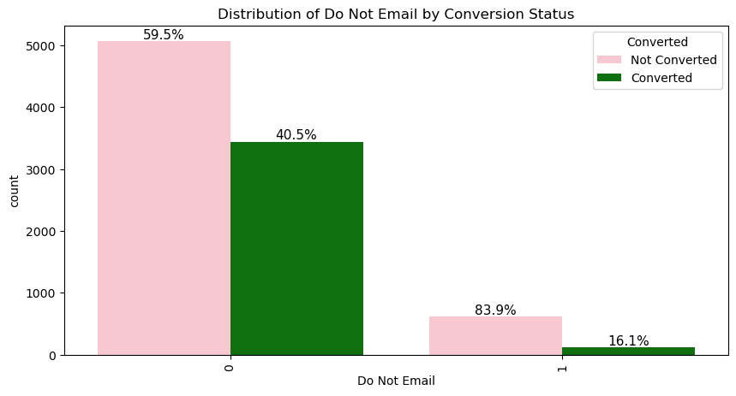
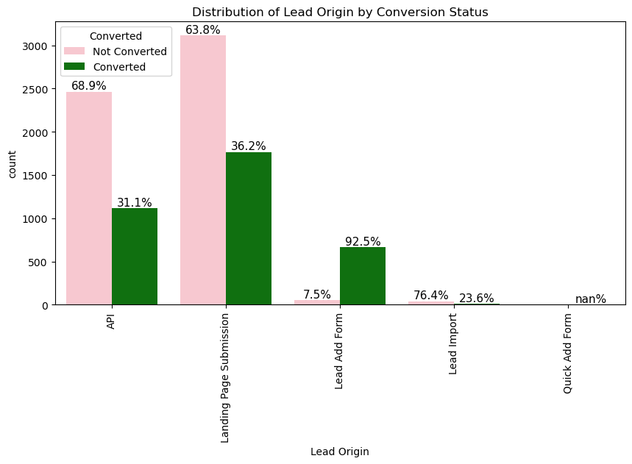
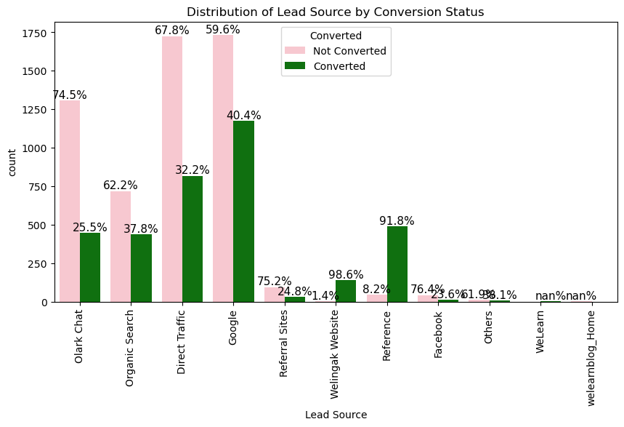
In Lead Origin, maximum conversion happened from Landing Page Submission
Major conversion has happened from Emails sent
Major conversion in the lead source is from Google

Slide 8
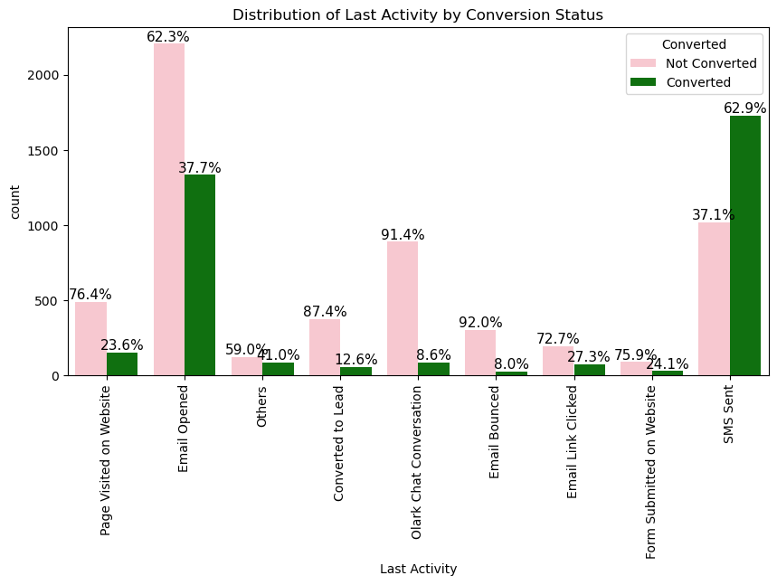
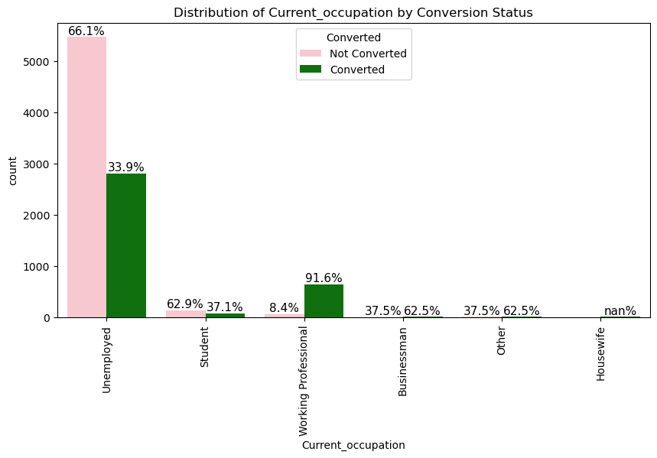
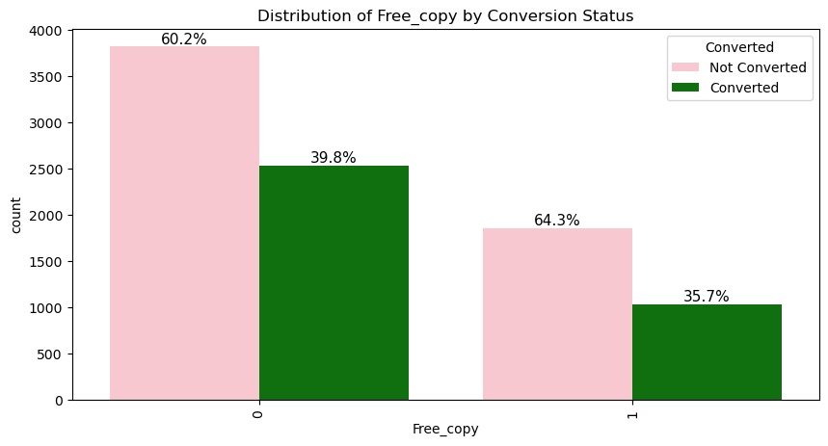
Last Activity value of SMS Sent' had more conversion.
More conversion happened with people who are unemployed
More conversion happened with free copy not distributed

Slide 9
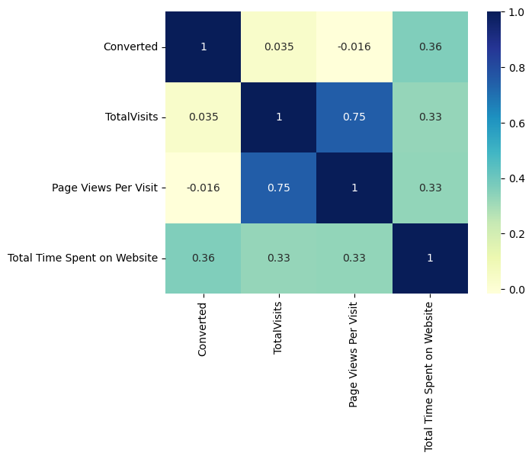
Correlation
Total visits and page views per visit have a strong positive correlation

Slide 10
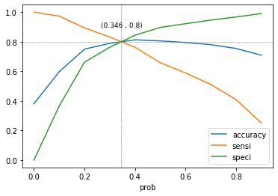
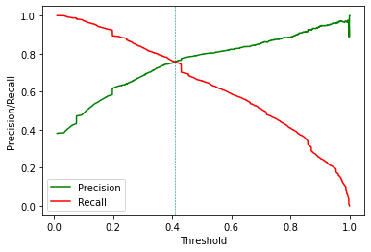
Model Evaluation
The graph depicts an optimal cut off of 0.346 based on Accuracy, Sensitivity and Specificity
The graph depicts an optimal cut off of 0.42 based on Precision and
Recall
3161 697
974 1965

Slide 11
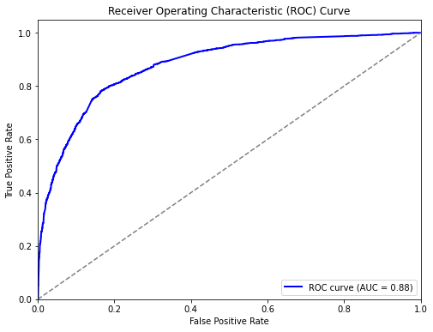
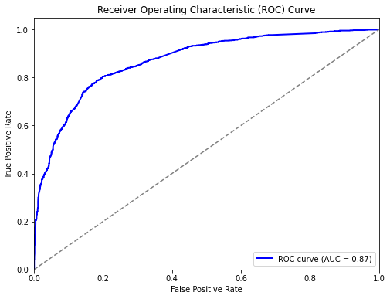
Model Evaluation
ROC for train data
ROC for test data
3161 697
974 1965
Confusion matrix – Train Dataset
Confusion Matrix- Test Dataset
3589 413
1351 326
844 1622
222 873

Slide 12
Observations
Test Data Set:
Accuracy: 80.23%
Sensitivity: 79.73% ≈ 80%
Specificity: 80.56%
Train Data Set:
Accuracy: 81.57%
Sensitivity: 75.75%
Specificity: 85.16%
Recommendations to increase our Lead Conversion Rates:
Focus on features with positive coefficients for targeted marketing strategies.
Develop strategies to attract high-quality leads from top-performing lead sources.
Engage working professionals with tailored messaging.
Optimize communication channels based on lead engagement impact.
More budget/spend can be done on Welingak Website in terms of advertising, etc.
Incentives/discounts for providing reference that convert to lead, encourage providing more references.
Working professionals to be aggressively targeted as they have high conversion rate and will have better financial situation to pay higher fees too.
To identify areas of improvement:
Analyze negative coefficients in specialization offerings.
Review landing page submission process for areas of improvement

Slide 13
Conclusion
The evaluation matrics are pretty close to each other so it indicates that the model is performing consistently across different evaluation metrics in both test and train dataset.
The model achieved a sensitivity of 81.57% in the train set and 79.73% in the test set, using a cut-off value of 0.345.
Sensitivity in this case indicates how many leads the model identify correctly out of all potential leads which are converting
The CEO of X Education had set a target sensitivity of around 80%.
The model also achieved an accuracy of 80.23%, which is in line with the study's objectives.
Hence overall this model seems to be good.

