Slide 1

Lending Club case study - Sanchita Gangopadhyay

Slide 2
Business Objective
A consumer finance company specializing in lending various types of loans to urban customers wants to analyze the risk of approving loan application based on past data. Two types of risks are associated with the bank’s decision:
If the applicant is likely to repay the loan, then not approving the loan results in a loss of business to the company
If the applicant is likely to default, then approving the loan may lead to a financial loss for the company
The aim is to :
Understand the driving factors (or driver variables) behind loan default
Identify patterns which indicate if a person is likely to default, for taking actions such as –
Denying the loan
Reducing the amount of loan
Lending (to risky applicants) at a higher interest rate

Slide 3
Loan data set & Approach
Loan status can be of the following two types:
Loan accepted: If the company approves the loan, there are 3 possible scenarios described below:
Fully paid – Paid back loan amount in full.
Current – Loan account is still active. Considered in analysis if >90% of term length has been paid.
Charged-off – Defaulted. These two terms have been used interchangeably throughout analysis.
Loan rejected: The company had rejected the loan, these records are not considered for analysis
Three factors For analyzing credit risk:
Character - length of employments, past bankruptcies, employer, verification status
Capacity - DTI, annual income, homeownership
Conditions – Funded amount, Interest rate, term length, Purpose

Slide 4
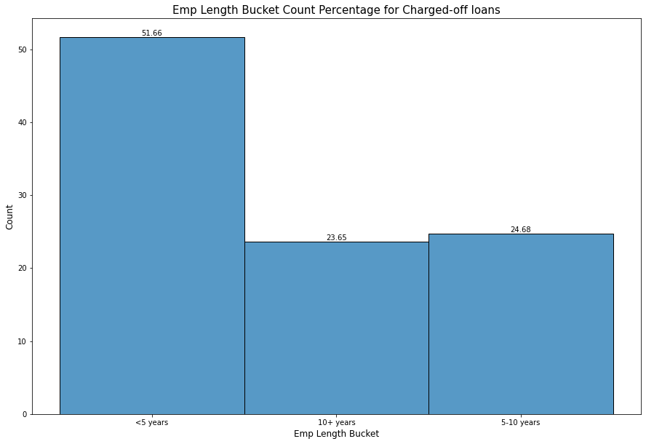
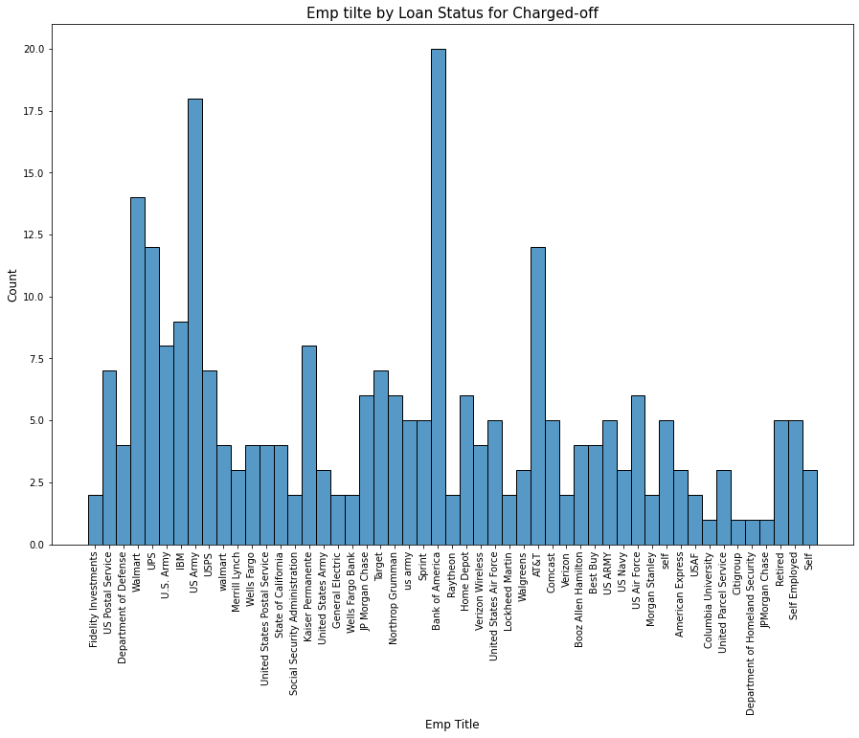
Analysis on Character
Around 52% of
charged-off loan customers have <5
years employment
length
Median of Funded
amount for Charged-off loans with 10+ years
of employment is
higher than others
Top 3 employers for defaulted loans are US Army, Bank of America and Walmart.

Slide 5
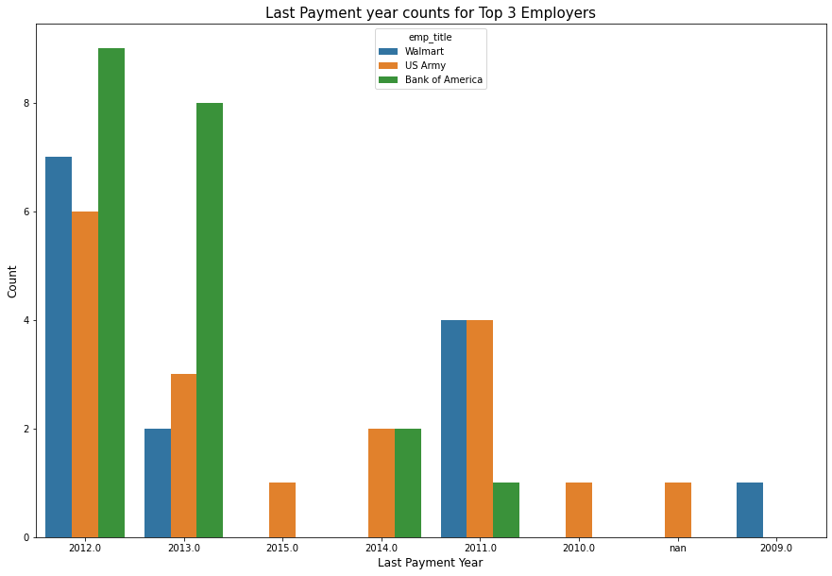
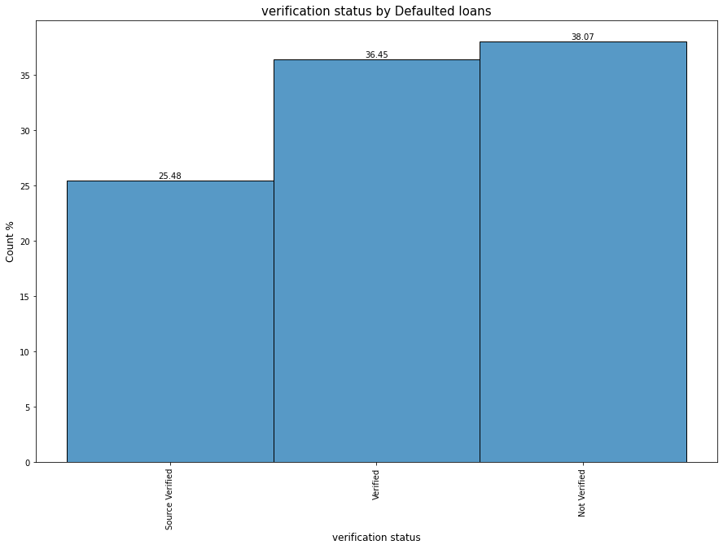
Analysis on Character – contd.
Most Bank of America customers stopped
paying in 2012 and
2013. BOA had major
job cuts during
2011-2013, which may have resulted in this
For 38% of defaulted customers, employment/source of income was not verified

Slide 6
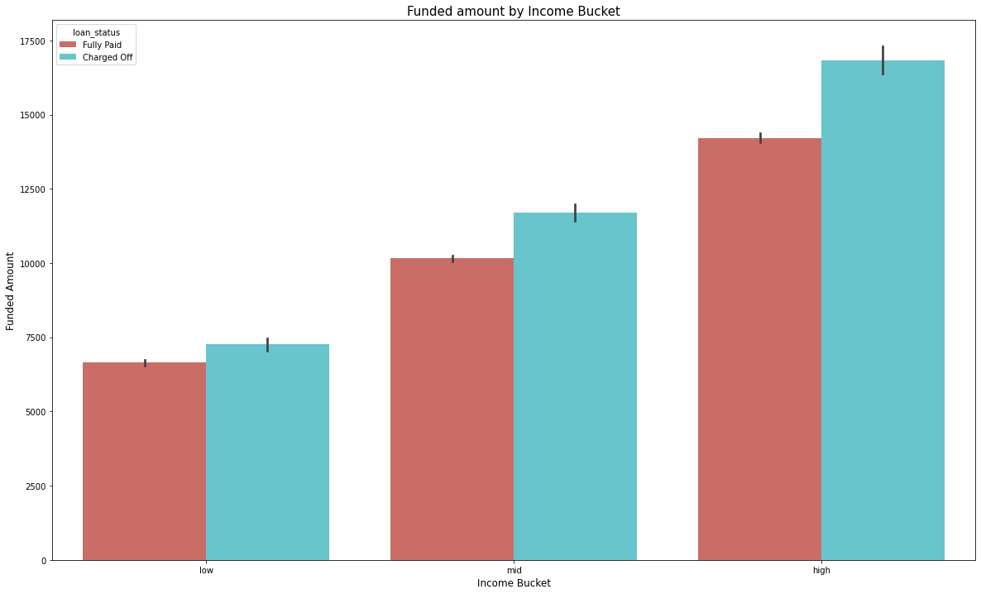
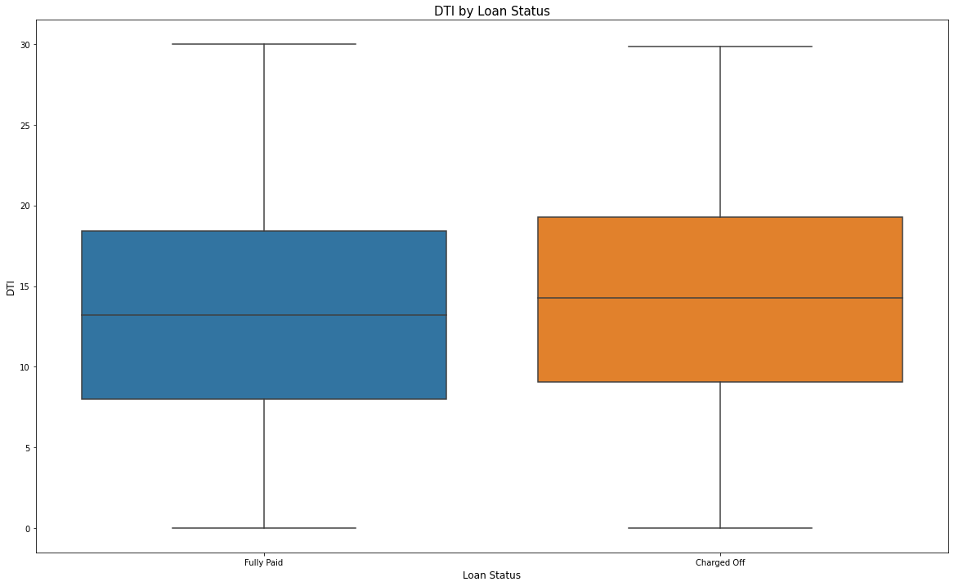
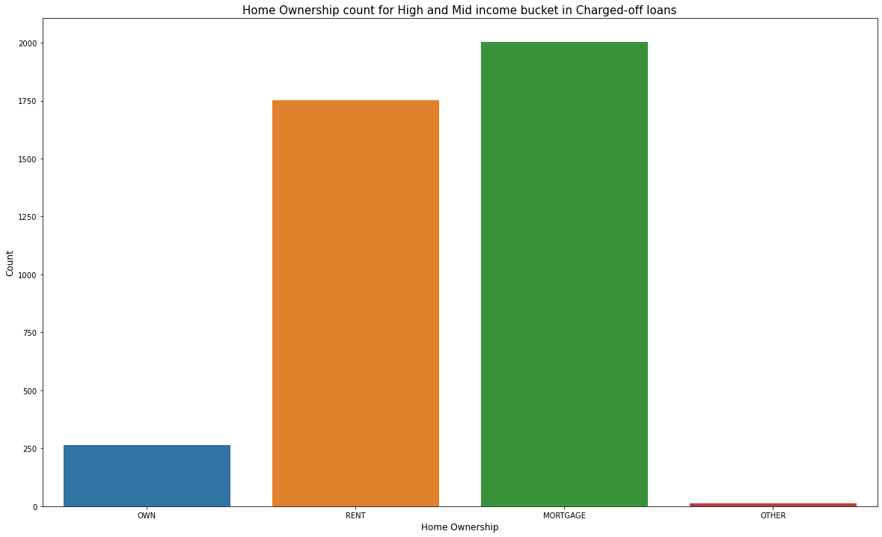
Analysis on capacity
Median DTI for Charged-off loans is around 8% higher than Fully-paid loans
For fully paid loans, highest median funded amount is around 13K, whereas it is around 18K for Charged off loans (both in high income bucket).
Funded amount for Charged-off loan is considerably higher than that of Fully paid loans across income groups , especially for High income group.
Majority of charged-off customers in high and mid income buckets had either mortgaged or rented home

Slide 7
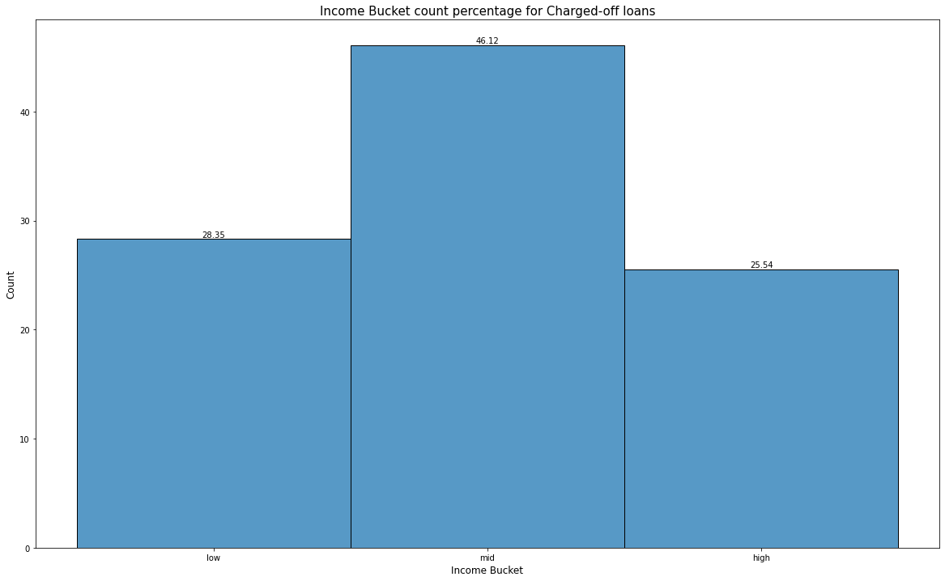
Analysis on capacity – Contd.
46% of defaulters were from Mid income bucket

Slide 8
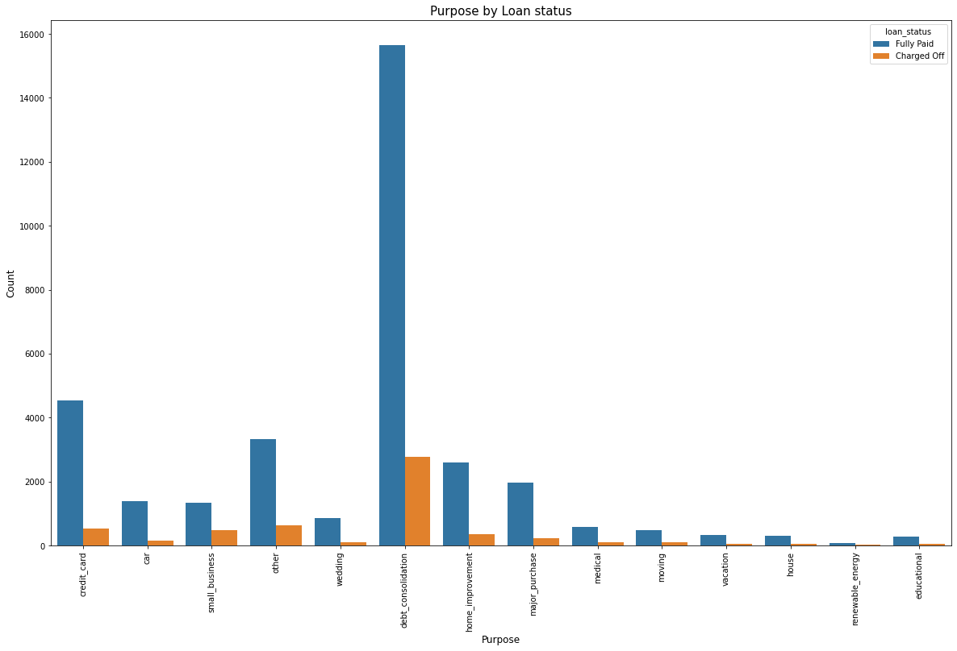
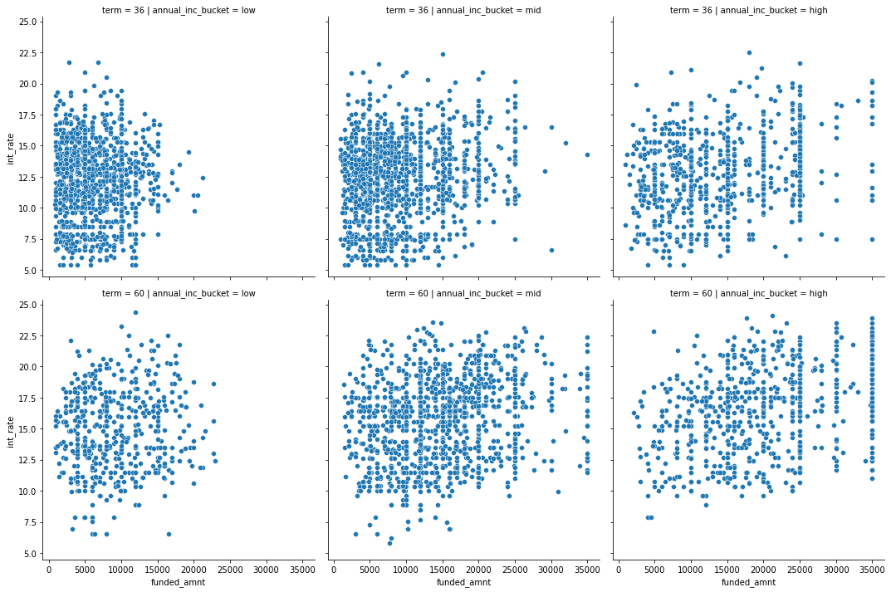
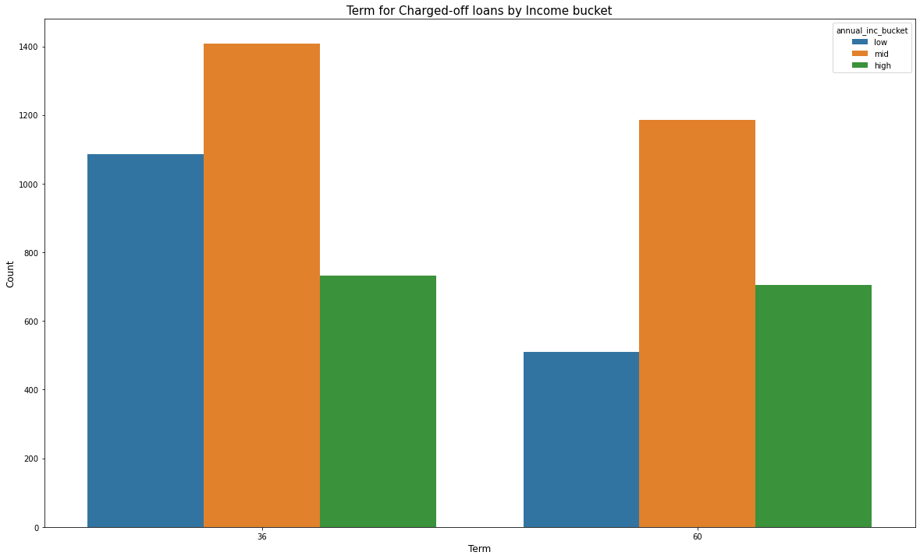
Analysis on conditions
Relation between Funded amount and Interest rate across Income buckets and Term lengths
Most common category of purpose is debt-consolidation across Charged-off and Fully-paid loans
Charged-off loans in low and mid income buckets have more customers with 36 months of term
Interest rate tend to be on the higher side for 60 months of term length in mid and high income group for Charged-off loans, but not for 36 months term, although majority defaulted customers have 36 months term

Slide 9
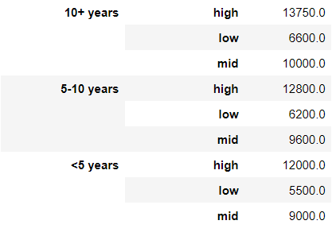
Analysis & Recommended Guidelines
Employment length
Income Bucket
Recommended Funded amount
Most important parameters to be considered for analysing default risk:
Length of employment
Annual income
Debt to income ratio
Employer reputation
Requested loan amount
Employment verification
Guidelines for loan approvals:
Exercise caution while approving loan application for customers with employment length less than five years
Refer to Table – 1 for recommended guideline on loan amount across employment length and income buckets
In case requested funding amount is considerably more than the recommended levels, consider it to be a risk
Rigorous verification of employment/source of income to be done for all loan applications
Consider raising interest rate by 5% for mid and high income group customers seeking 36 months of term
Employer reputation and job stability to be considered
Table - 1

Slide 10
Thank You

