Slide 1

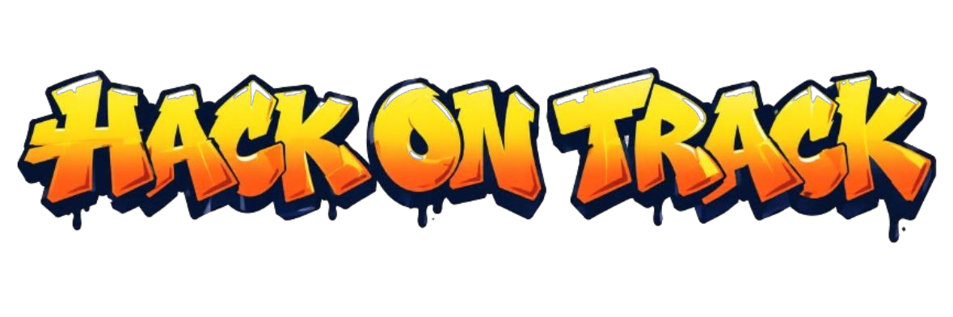





Team Name : KAIZEN
Abstract :
KAIZEN is an autonomous security-repair agent for GitHub repositories. On every push it scans the code (own rules + Bandit + Semgrep + CodeQL), lets an LLM trace each finding to its root cause, writes an exploit test that must fail on the original code, patches the bug, and accepts the fix only when the exploit is blocked and the repository's own test suite shows no new failures. Verified fixes ship as a pull request with a hashed evidence package.
Domain : Cyber Security
Problem Statement Title:
Given a vulnerable open-source repository, build an AI agent that locates the security bug, writes a patch, and proves the fix does not break the existing test suite.
Results at a glance :
4 / 4
13
≤ 60 s
200+
bugs fixed + verified in 11 s
CWE classes · Python, JS, TS
push → flagged on dashboard
automated tests on KAIZEN

Slide 2













PROBLEM:
OSS maintainers: drowning in unconfirmed scanner alerts
Open-source repositories ship known-vulnerable code (SQL / command injection, path traversal, XSS, unsafe deserialization). Scanners such as CodeQL, Bandit and Semgrep only flag candidates: a human still has to confirm each one, write a patch and check that nothing else broke.
Security / DevSecOps teams: triage and verify every fix by hand
Who Is
Affected?
Developers & students: don't know how to fix it securely
PAIN POINTS:
Research & Benchmarking of Existing Systems
✗ Alert fatigue: pattern scanners flag safe code. On one real student repo, 14 of 15 "critical" SQL alerts were parameterised queries.
✗ No proof: a patch that looks right may not block the exploit, or may silently break existing behaviour.
✗ Slow fix time: triage → patch → re-test → review takes days, while the vulnerable code stays deployed.
✗ Lost context: alerts arrive long after the commit that introduced the bug, and teach the author nothing.
EXISTING SYSTEM | WHAT THEY DON'T DO | WHAT KAIZEN DOES
Static scanners CodeQL · Semgrep · Bandit | ✗ Write a fix ✗ Prove exploitability | ✓ Uses them as inputs ✓ LLM root-cause triage
Dependency bots Dependabot · Snyk | ✗ Fix first-party code ✗ Exploit proof | ✓ Patches your own code ✓ Exploit test per fix
AI autofix GitHub Copilot Autofix | ✗ Exploit fail → pass gate ✗ Test-suite regression gate | ✓ Both gates mandatory ✓ Evidence pack per fix
Research agents SWE-agent · AutoCodeRover | ✗ Security / CWE focus ✗ Push-triggered fixing | ✓ 13 CWE classes ✓ Push → PR automatically
TODAY vs. KAIZEN
Today
Scanner alert
Manual triage
Hand-written patch
Re-test + review
Hope nothing broke
days
Research & practice
Jimenez et al., "SWE-bench: Can LMs Resolve Real-World GitHub Issues?", ICLR 2024 (LINK)
Zhang et al., "AutoCodeRover: Autonomous Program Improvement", ISSTA 2024 (LINK)
Pearce et al., "Examining Zero-Shot Vulnerability Repair with LLMs", IEEE S&P 2023 (LINK)
MITRE, "CWE Top 25 Most Dangerous Software Weaknesses", 2024 (LINK)
KAIZEN
Push detected
Agent triage
Exploit + patch
Proof gates
Verified PR
secs

Slide 3













PROPOSED SOLUTION
KAIZEN AGENT PIPELINE
KAIZEN: an AI security-repair agent that takes a GitHub repository (or a single push), locates exploitable bugs, writes a minimal patch and proves it: exploit blocked, existing test suite still green, before anything is committed.
1. INTAKE
2. BASELINE
3. DISCOVER
4. ROOT CAUSE
repo at a pinned commit,
disposable workspace
run existing suite
(pytest / npm test)
rules · Bandit · Semgrep
· CodeQL alerts
LLM + callers → exploit-
able or cleared
➢ Detect: own rules (Python, JS/TS) + Bandit + Semgrep + CodeQL alerts
➢ Triage: LLM reads the flagged code and its callers; safe findings are cleared with a reason
➢ Reproduce: generates an exploit test that must FAIL on the original code
➢ Patch: minimal edit (≤ 2 files, ≤ 40 lines), up to 4 findings in parallel
➢ Prove: exploit test now PASSES, existing tests show 0 new failures, code still parses
➢ Ship: pull request + evidence pack (diff, tests, every command with its SHA-256)
8. SHIP
7. VERIFY
6. PATCH
5. EXPLOIT TEST
branch + PR +
evidence pack
5 gates on the
patched copy
find/replace edits,
≤ 2 files · ≤ 40 lines
must fail on the
original code
↺ Retry loop: a failed gate is fed back to the model, and a fix is only kept when every gate passes
✓ Exploit: fail → pass
✓ Suite: 0 new failures
✓ Syntax: parses
✓ Scope: small patch
✓ Rule re-check
KAIZEN – From Push to Verified Pull Request
Real run on a 4-bug repository: root cause 4.5 s · exploits 1 s · verify 1.4 s → 4 / 4 verified in 11 s
Open-source maintainers: verified PRs instead of raw alerts
Security / DevSecOps teams: triage and proof done automatically
PUSH
DETECTED
SCAN
ROOT-CAUSE
TRIAGE
EXPLOIT
TEST
MINIMAL
PATCH
PROOF
GATES
VERIFIED
PR
TARGET
USERS
Students & developers: learn secure fixes from their own commits

Slide 4


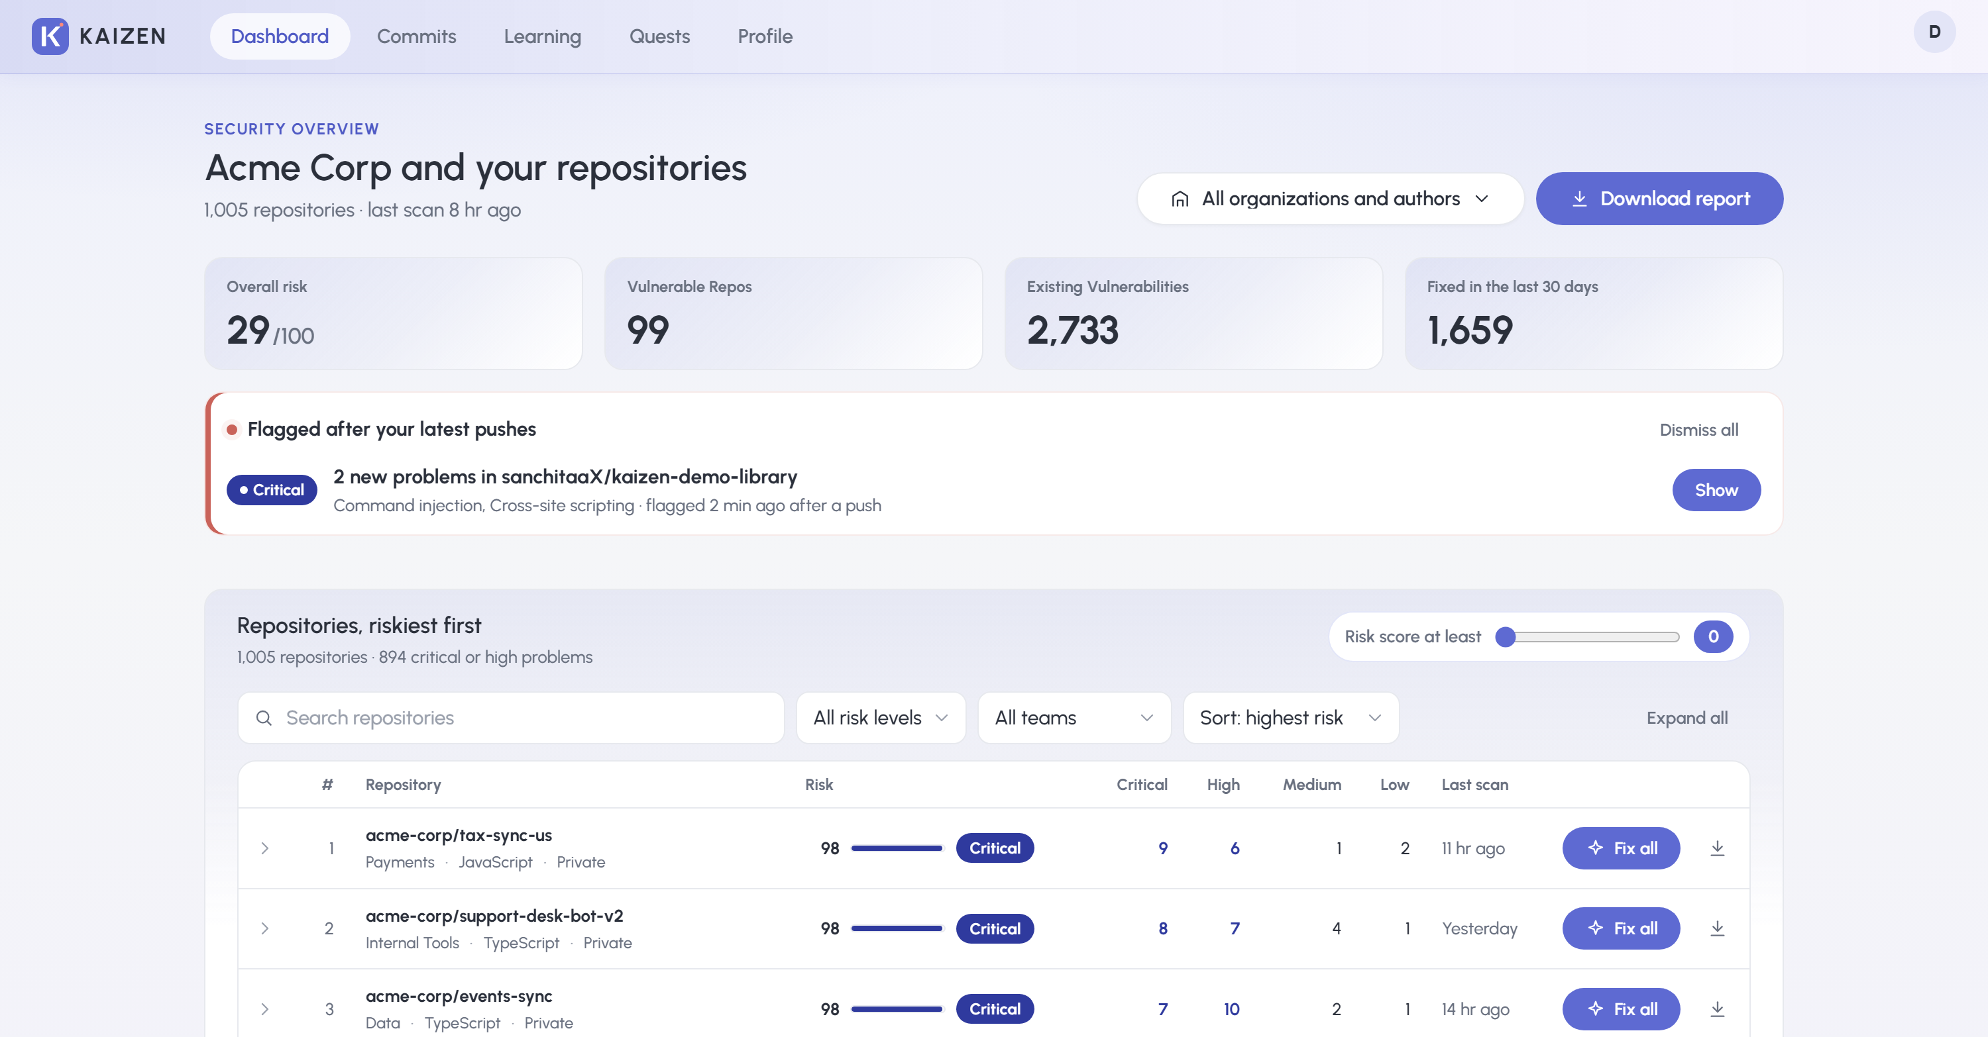

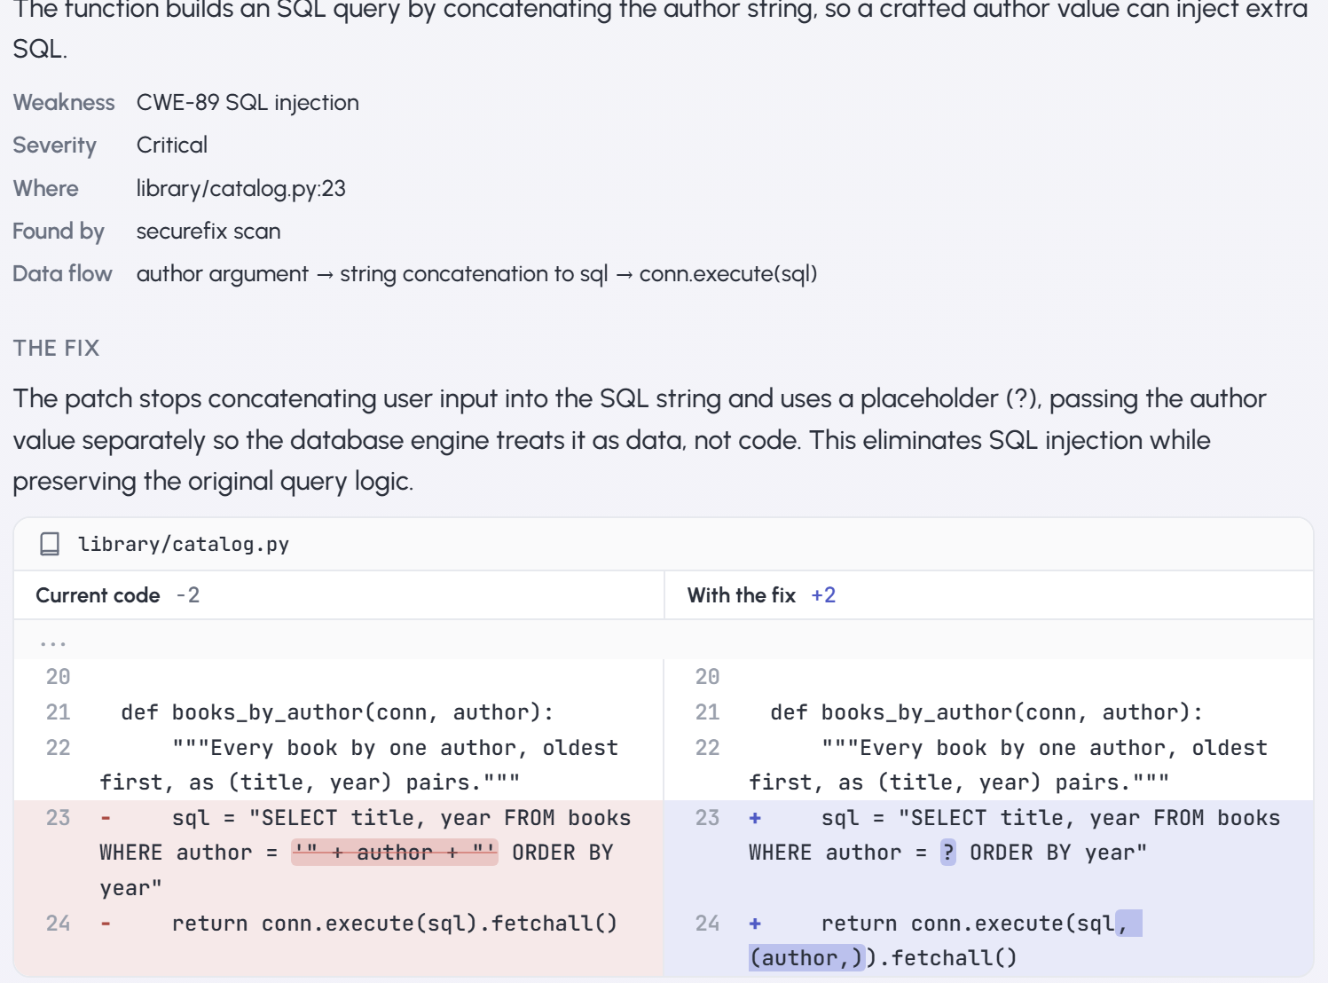
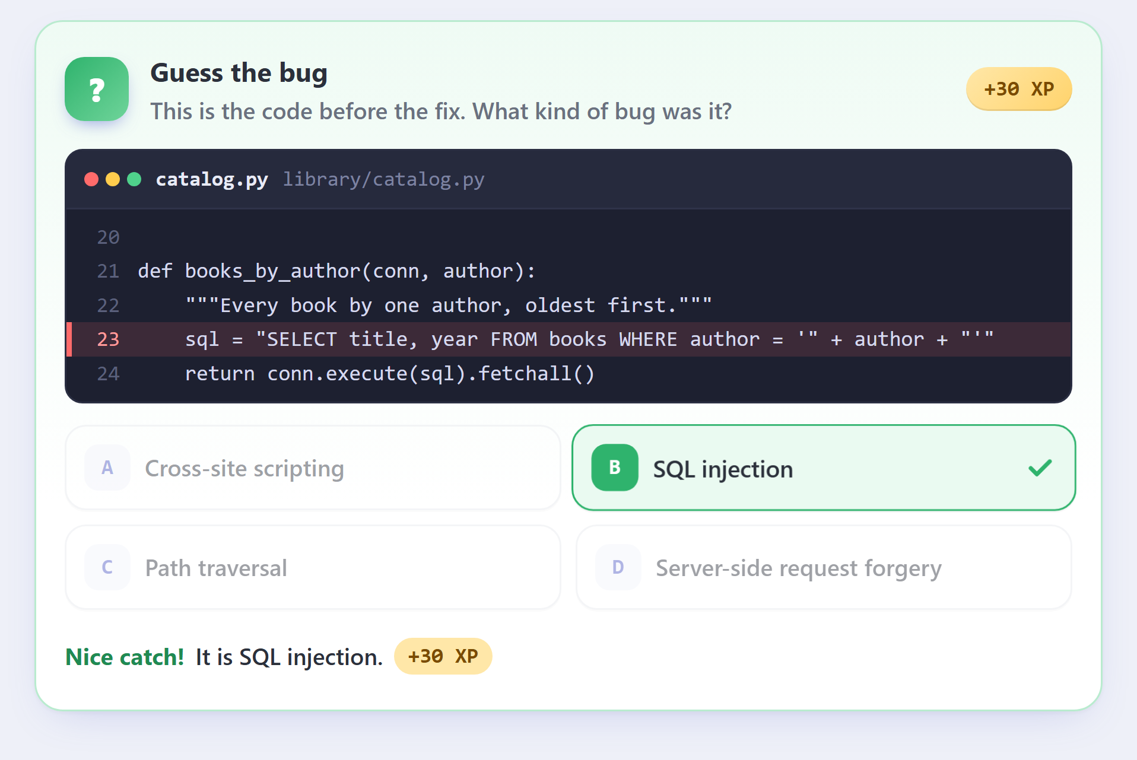
KEY FEATURES
✓ Proof-carrying patches: every fix ships with an exploit test (fails before, passes after) and a before/after run of the repo's own suite
✓ Auto push detection: GitHub webhook + 60 s watcher re-scan every pushed repo; new problems are flagged on the dashboard
✓ Commit-level fixing: check any single commit, see the finding and the fix, then commit or ignore it from the chat
✓ Multi-language: Python, JavaScript, TypeScript · pytest, jest, vitest, mocha, node:test
✓ Fix all: up to 4 findings patched in parallel (one model call each); 11–15 s on our test repos
✓ False-positive triage: findings the agent proves unreachable are marked "Not exploitable" with the reason
Push flagged automatically · Fix all per repository
INNOVATION & UNIQUENESS
✓ Chat interface: ask KAIZEN about any result; fixes are shown side by side (current code | with the fix)
✓ Learning mode: every fix links CWE, OWASP and PortSwigger material; a Learning page groups your own mistakes
✓ Guess-the-bug quiz: after you act on a fix, name the bug class from the vulnerable code (+XP)
✓ Quests & rewards: XP, 6 levels, quests and demo coupons; opt-in, off by default
Side-by-side fix in the chat
Guess-the-bug quiz (+XP)

Slide 5













SYSTEM ARCHITECTURE
TECHNOLOGY STACK
CLIENT LAYER
(Browser · JS)
BACKEND LAYER (FastAPI · Python 3.13)
EXTERNAL SERVICES
Backend: Python 3.13, FastAPI, Uvicorn, SQLite
Auth
Fleet API
Agent API
Chat API
Game API
GitHub
Dashboard
GitHub OAuth
sessions
repos · Fix all
events · PRs
runs · evidence
pull requests
commit checks
Q&A
XP · quests
quiz
AI: gpt-oss-120b via Groq (OpenAI-compatible API), fallback gpt-oss-20b
OAuth · REST
code scanning
PRs · webhooks
Chat
Push watcher (60 s) + webhook
Scan: rules · Bandit · CodeQL
PDF reports
Security: 13 CWE rule sets, Bandit, Semgrep, GitHub CodeQL
LLM
Test runners: pytest (JUnit XML), npm test (jest, vitest, mocha, node:test)
Commits
gpt-oss-120b (Groq)
fallback gpt-oss-20b
SECURITY REPAIR AGENT (app/agent)
Workspace
Discover
Analyze
Exploit test
Patcher
Test runner
Verify
Evidence
Frontend: Jinja2 templates, HTML, CSS, vanilla JS
Learning
Sandbox: temp folder at a pinned commit · stripped environment · time limits · SHA-256 of every command's output
Scanners
Integrations: GitHub OAuth, REST API, webhooks · ReportLab PDFs
Quests
Bandit · Semgrep
CodeQL alerts
DATABASE LAYER (SQLite): repositories · vulnerabilities · fixes · agent runs · push events · XP ledger
CURRENT IMPLEMENTATION STATUS
FINAL OUTPUT
✓ Done: push detection → scan → triage → fix → proof → PR
✓ Done: Fix all (4 parallel) + commit-level checks
✓ Done: chat, learning, quiz, quests & rewards
✓ Tested: 200+ automated tests passing
Verified patch
Exploit regression test
Pull request on GitHub
Evidence pack (PDF + JSON)
Evaluation repositories & knowledge sources
Benchmark repos: Corner Shop (3 CWEs) 3/3 verified in 15 s · Little Library (4 CWEs) 4/4 verified in 11 s · 2 real student repos for false-positive triage
Vulnerability knowledge: MITRE CWE · OWASP Top 10 & Cheat Sheets · PortSwigger Web Security Academy

Slide 6





FEASIBILITY:
BENEFITS OF THE SOLUTION
Technical: works end to end today on real GitHub repos (detect → exploit → patch → proof → PR); one model call per finding in fast mode.
Security
Speed
Quality
Learning
Trust
Operational: one FastAPI process + SQLite, runs on a laptop, no GPU; the LLM is any OpenAI-compatible endpoint, so it is swappable.
exploitable bugs closed with proof
unsafe fixes rejected
days of triage → seconds
4 fixes in parallel
0 new test failures required
small, reviewable diffs
CWE / OWASP links per fix
quiz + quests
hashed command log
evidence pack per run
Social: every verdict is explained in plain words with learning links, so developers learn secure coding from their own bugs.
IMPACT ON THE TARGET AUDIENCE
Economical: free-tier LLM + open-source scanners; cost is about one model call per finding.
Open-source maintainers
Get a verified pull request with an exploit test instead of an unconfirmed alert.
SCALABILITY ROADMAP: MVP TO PLATFORM
Security / DevSecOps teams
False positives are cleared with a reason; every fix carries a reviewable evidence pack.
1 · MVP
2 · PILOT
3 · CI
4 · SANDBOX
5 · SCALE
Students & developers
See their own bug, the fix side by side, and the CWE behind it, then practise with the quiz.
One laptop, demo + student repos
One GitHub org via webhooks
GitHub App: check on every PR
Docker, no network, more languages
Job queue + worker pool, org-wide
FUTURE SCOPE:
Container sandbox (Docker, no network) for running exploit tests
Java, Go and PHP support; SARIF import from any scanner
GitHub App check that blocks merging an unproven fix

