Slide 1
AI-Powered Fake News Detection
Machine Learning Pipeline
Text Classification

Slide 2
Dataset Statistics
Total Articles: 16604
Fake News Articles: 7661
Real News Articles: 8943
Average Words per Article: 307.26
Missing Text Rows Removed: 0

Slide 3
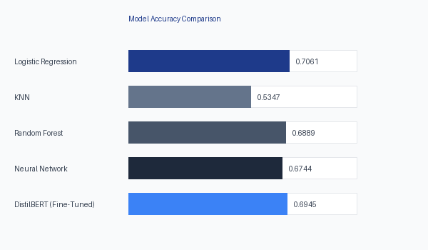
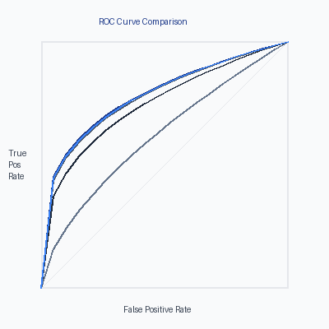
Results: Model Accuracy & ROC-AUC

Slide 4
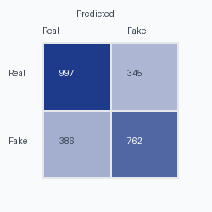
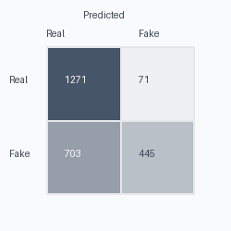
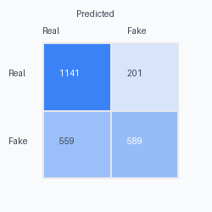
Confusion Matrices

